Slide 2


Unit 4
urbanization
LOOKING BACK

Slide 3
LESSON 8
LOOKING BACK
WARM-UP
Watch a video and answer the questions.
Pronunciation: Listen and underline
Vocabulary: Complete the text
Grammar: Choose the correct answer
LOOKING BACK
PROJECT
AN URBAN AREA
Wrap-up
Homework
CONSOLIDATION

Slide 4

Choose the correct information about the video
“Urban and Rural life” to get bonus
https://www.youtube.com/watch?v=n-4hL_4IBsM&t=2s

Slide 5
What motivates the speaker to leave their country cottage in the first place?
A love for the city
A desire to buy
Stilton cheese
A need to avoid ferocious felines
An invitation to a
show

Slide 6
What is the main advantage of cities mentioned in the conversation?
Lower crime rates
Higher wages
Shorter commute times
Access to specialized products

Slide 7
According to the conversation,
what is a disadvantage of country living?
Lack of cultural institutions
High housing prices
Limited job opportunities
Inability to order online

Slide 8
How does the speaker in favor of the city justify the higher housing prices?
Cities have better restaurants
Cities offer more job opportunities
Cities have lower crime rates
Housing prices increase
with metropolitan density

Slide 9
What is the speaker's opinion about commuting?
Commuting is more efficient in the city
Commuting is better in
the country
Commuting is a necessary evil
Commuting is enjoyable
with music

Slide 10
According to the conversation, what is a positive aspect of city life related to cultural institutions?
Endless novelty
Increased safety
Lower fixed costs
Higher wages

Slide 11
What is the city dweller's response to the concern about cities being dangerous?
Crime rates have increased since the 1980s
Safety depends on the neighborhood
Eyes on the street make the city safe
Cities have lower crime
rates than the country

Slide 12
What does the speaker mean by
"the chance of meeting someone new and exciting" concerning urban density?
Increased likelihood of encountering crime
More opportunities for
social interactions
Higher probability of finding a good job
Greater chance of
encountering rodents

Slide 13


Slide 14

LOOKING BACK
1
Listen and underline the unstressed words in the following sentences. Then practise saying the sentences in pairs.
1. There are more than fifty new skyscrapers in the city.
2. People can get around easily by the new metro instead of getting stuck in traffic jams.
3. Many young people go to big cities looking for better job opportunities and higher salaries.
4. There have been a lot of changes in my home town, and most of them have been welcomed by residents.

Slide 15
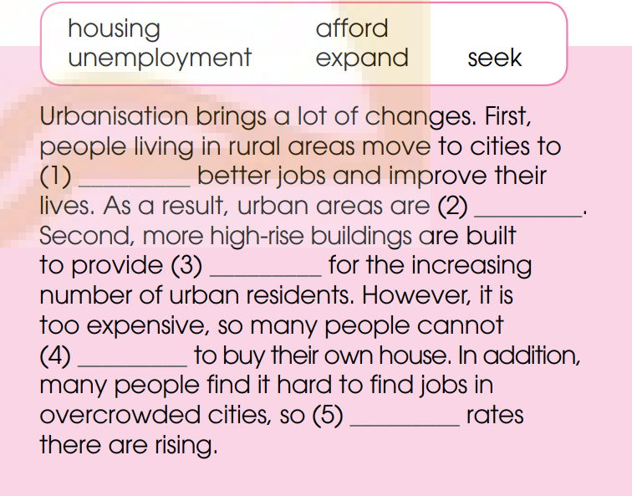
LOOKING BACK
2
Complete the text, using the correct forms of the words in the box.
seek
expanding
housing
afford
unemployment

Slide 16
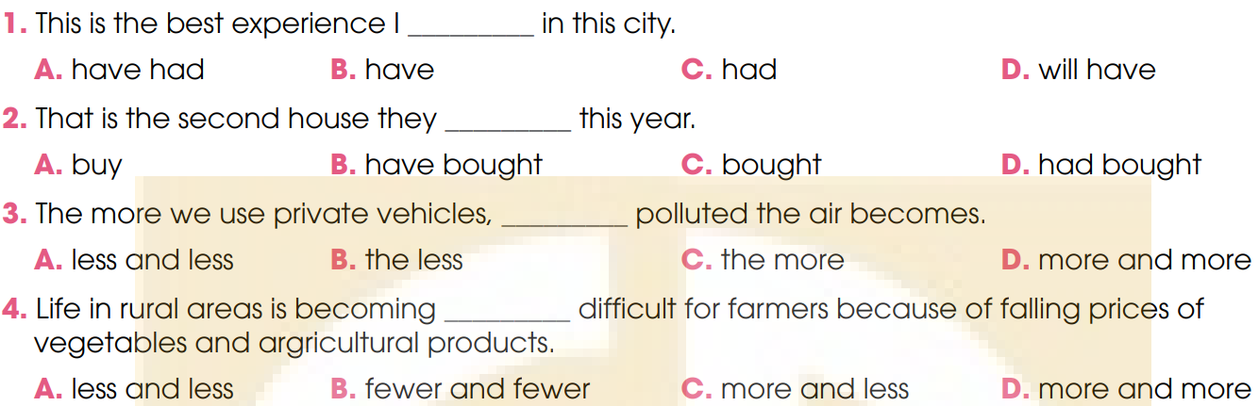
LOOKING BACK
2
Choose the correct answer a, B, C, or d.

Slide 17
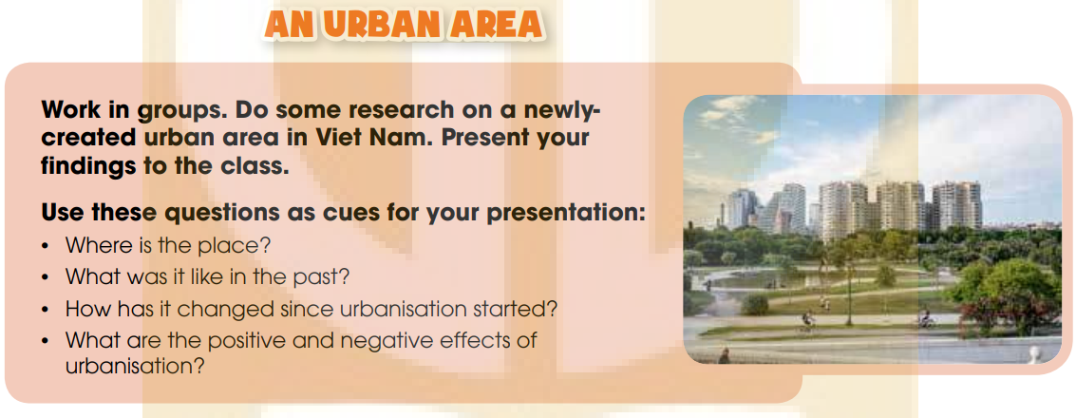
PROJECT

Slide 18
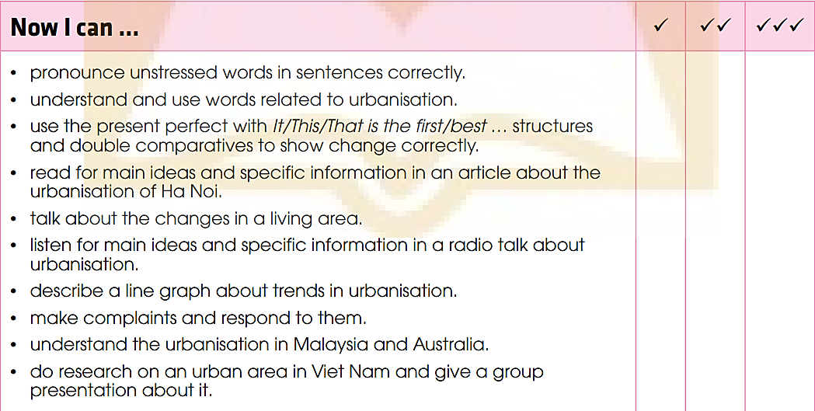
PROJECT

Slide 19
CONSOLIDATION
1
Wrap-up
What have you learnt today?
Review the vocabulary and grammar of Unit 4
Apply what you have learnt (vocabulary and grammar) into practice through a project.

Slide 20
CONSOLIDATION
2
Homework
Do exercises in the workbook.
Prepare for Unit 5.

Slide 21
Website: hoclieu.vn
Fanpage: facebook.com/www.tienganhglobalsuccess.vn

