Slide 1
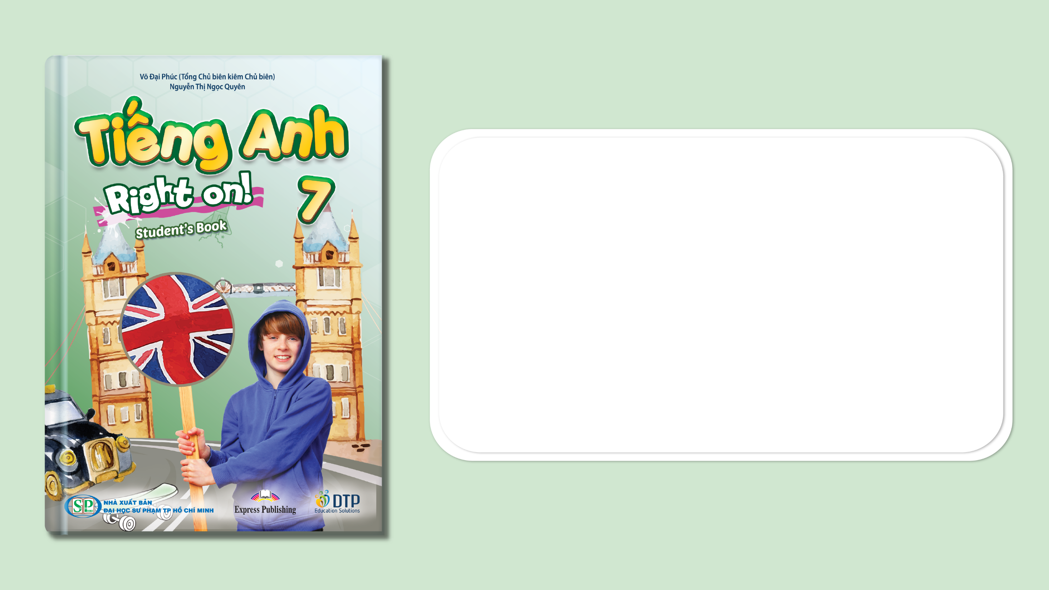
Unit 4: All things high-tech
Lesson 4c: Vocabulary
Page 68

Slide 2
Lesson Outline
Warm-up
Vocabulary
Listening
Consolidation
Wrap-up

Slide 3
Objectives
By the end of this lesson, students will be able to…
- learn vocabularies about computers: screen, tower, router, speakers, keyboard, USB ﬂash drive.
- listen for specific information.
- talk about computers.

Slide 4

WARM-UP

Slide 5
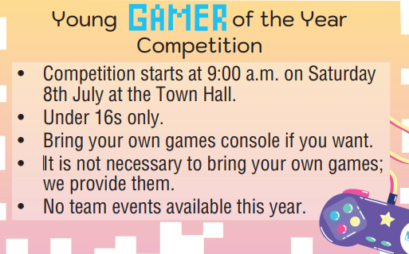
Read the advert and choose the correct option.
1. You must/can be at the Town Hall a little before 9:00 a.m.
2. You can/have to be under sixteen years old.
3. You can/must take your games console.
4. You shouldn’t/don’t have to take your own games.
5. You don’t have to/can’t play in a team.

Slide 6

It’s time to learn …

Slide 7
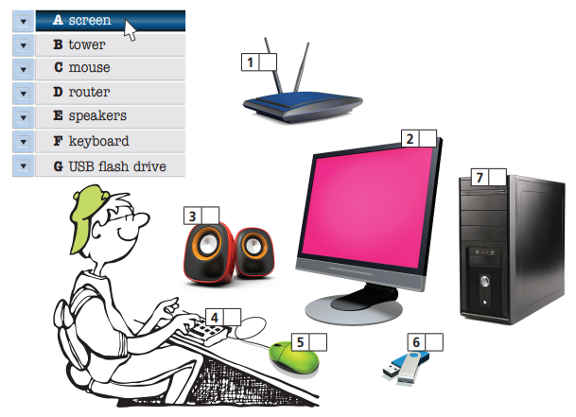
Match the pictures (1-7) to the words in the list (A-G).
D
A
B
E
F
C
G

Slide 8

Vocabulary
Listen and repeat. Click each phrase to hear the sound.
screen /skriːn/ (n) màn hình
router /ˈruːtər/ (n) bộ định tuyến
speakers /ˈspiːkərz/ (n) cặp loa
keyboard /ˈkiːbɔːd/ (n) bàn phím
USB ﬂash drive /ˌjuːesˈbiː flæʃ draɪv/ (n) ổ USB
tower /taʊər/ (n) thùng máy tính (bao gồm vỏ máy & các phần bên trong)

Slide 9
Look at the IPA and the meaning of each word to read out the word.
/skriːn/ (n) màn hình
/ˈruːtər/ (n) bộ định tuyến
/ˈspiːkərz/ (n) cặp loa
/ˈkiːbɔːd/ (n) bàn phím
/ˌjuːesˈbiː flæʃ draɪv/ (n) ổ USB
/taʊər/ (n) thùng máy tính (bao gồm vỏ máy & các phần bên trong)

Slide 10
2 Complete the sentences with the words you have learnt.
1. You need a ___________ to connect to the Internet.
2. To choose an item on the ___________, you must click on it
with your ___________ .
3. Most of the important parts of a computer are in a _______ .
4. Please copy the files to my ______________ .
5. I can’t listen to the song; my ___________ don’t work.
6. Use your ___________ to type in your homework.
router
screen
mouse
tower
USB flash drive
speakers
keyboard

Slide 11
Extra Practice
WB, page 34
Choose the correct option.
1. It helps you connect to the Internet.
router/tower
2. It is the working area on a monitor of a computer.
mouse/screen
3. It moves the cursor around a screen.
keyboard/mouse

Slide 12
Extra Practice
WB, page 34
Choose the correct option.
4. It holds most of the components of a computer.
USB ﬂash drive/tower
5. It allows you to input text into a computer.
keyboard/router
6. You can store files in it.
USB ﬂash drive/tower

Slide 13

Listening

Slide 14
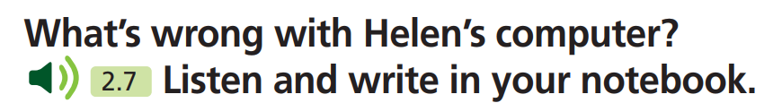
Pre - listening
What information do you have to find out?
Problem with Helen’s computer.
What are you going to do?
Listen and write in notebook.

Slide 15
While - listening
Now listen and choose the correct answer.  FIRST TIME
What’s wrong with Helen’s computer?
☞ YOUR ANSWER?
The computer isn’t working and there’s nothing on the screen. It looks like there is a problem with the tower.
☞ WHY?

Slide 16
While - listening
Now listen again and check.  SECOND TIME
While you are listening, focus on what Mike and Helen say.
Helen: My computer isn’t working. There’s nothing on the screen.
Helen: Oh, well, I don’t think it’s the keyboard or the mouse.
Mike: I agree. It looks like a problem with the tower.
The computer isn’t working and there’s nothing on the screen. It looks like there is a problem with the tower.
☞ THE ANSWER IS …

Slide 17
While- listening
Extra Practice
Listen and fill in the blanks.
Helen: Hi, Mike! Can you help me?
Mike: Sure, Helen. What’s (1) ______?
Helen: My computer isn’t working. There’s nothing on the (2) _________.
Mike: Well, the screen seems fine. Look – this light shows it’s on.
Helen: Oh, well, I don’t think it’s the (3) ________ or the mouse.
Mike: I agree. It looks like a (4) ________ with the tower.
Helen: The tower? Yes … Let me take a closer look.
wrong
screen
keyboard
problem

Slide 18
Audio Scripts
Helen: Hi, Mike! Can you help me?
Mike: Sure, Helen. What’s wrong?
Helen: My computer isn’t working. There’s nothing on the screen.
Mike: Well, the screen seems fine. Look – this light shows it’s on.
Helen: Oh, well, I don’t think it’s the keyboard or the mouse.
Mike: I agree. It looks like a problem with the tower.
Helen: The tower? Yes … Let me take a closer look.

Slide 19

Post- listening
4 Have you got a computer at home? Which of the parts above has it got? Tell your partner.

Slide 20
STUDENT A
STUDENT B
Hi, B. Have you got a computer at home?
Yes, I have.
Which of the parts above
has it got?
It has got a tower, screen, keyboard, mouse and speakers.
What else have you got?
I also have got a USB ﬂash drive and a router.

Slide 21

CONSOLIDATION

Slide 22

Work in pairs.
Practice the conversation.
Helen: Hi, Mike! Can you help me?
Mike: Sure, Helen. What’s wrong?
Helen: My computer isn’t working. There’s nothing on the screen.
Mike: Well, the screen seems fine. Look – this light shows it’s on.
Helen: Oh, well, I don’t think it’s the keyboard or the mouse.
Mike: I agree. It looks like a problem with the tower.
Helen: The tower? Yes … Let me take a closer look.

Slide 23

WRAP-UP

Slide 24
Lesson 3
Today’s lesson
Vocabularies
screen
tower
router
speakers
keyboard
USB ﬂash drive
Listening: listen for key information.
Speaking: talk about computers.

Slide 25
Lesson 3
Homework
Practise the vocabularies and make sentences using them.
Do the exercises in TA 7 Right on WB (page 34).
Do the exercises in Tiếng Anh 7 Right on Notebook (page 31).
Prepare the next lesson (page 69 SB).

Slide 26
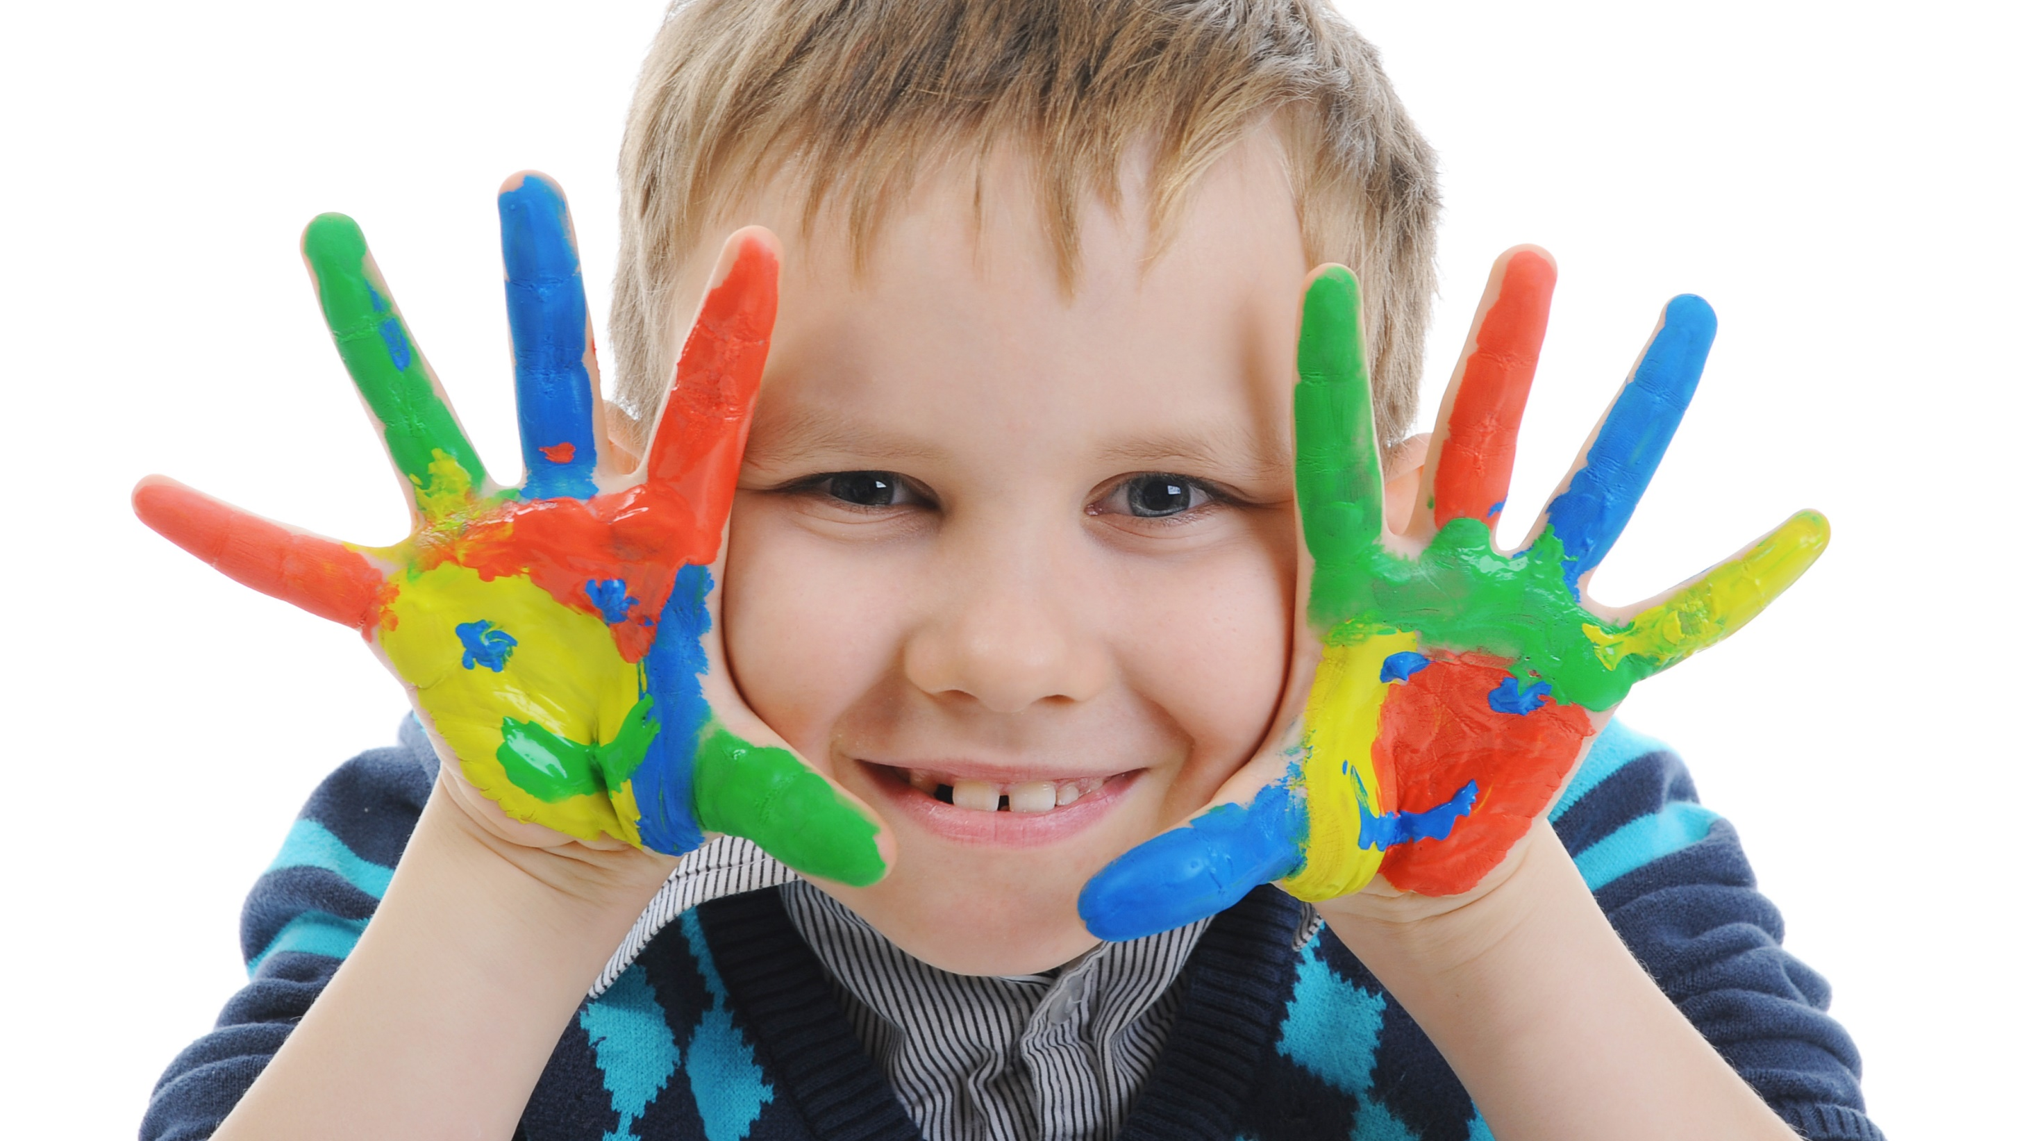
Enjoy your day!

