Slide 1


Slide 2



Unit
12
LIFE ON OTHER PLANETS
LESSON 5: SKILLS 1
1
Unit
READING
SPEAKING

Slide 3
LESSON 5: SKILLS 1
WARM-UP
Task 1: Work in pairs. Discuss the questions.
Task 2: Read the text and match the highlighted words in the text with their meanings.
Task 3: Read the text again and answer the following questions.
READING
Task 4: Tick the boxes to show what conditions a planet needs to support human life.
Task 5: Talk about the conditions you think are required for a planet to support human life.
SPEAKING
CONSOLIDATION
Wrap-up
Homework

Slide 4
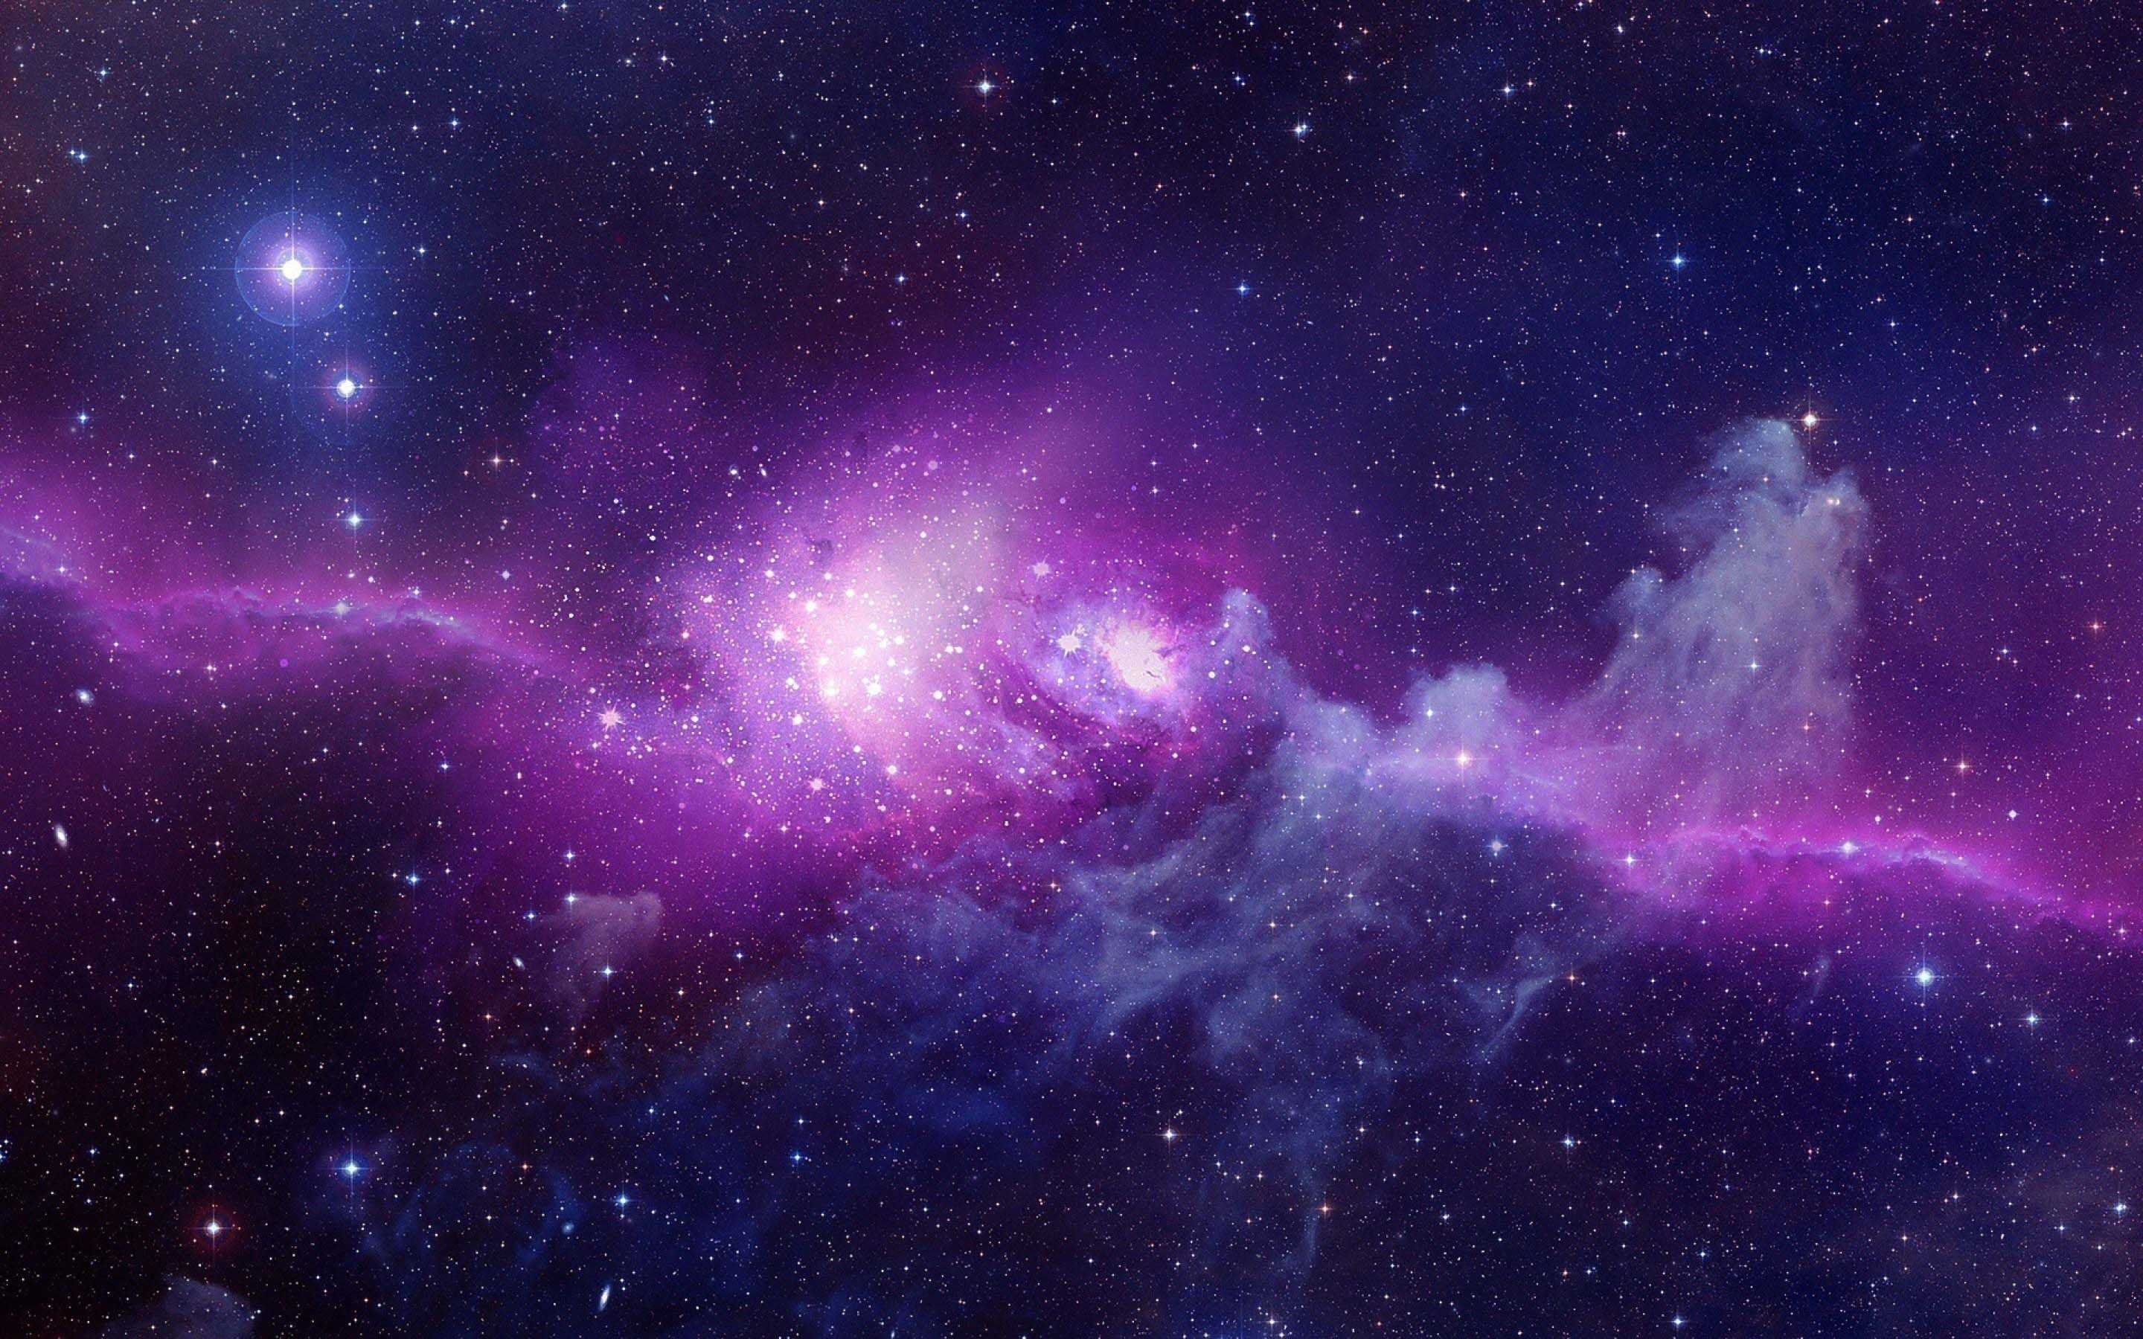
WARM-UP
1
Work in pairs. Discuss the following questions.
1. What do you know about other planets?
2. Would you like to live on another planet?
Why / Why not?

Slide 5
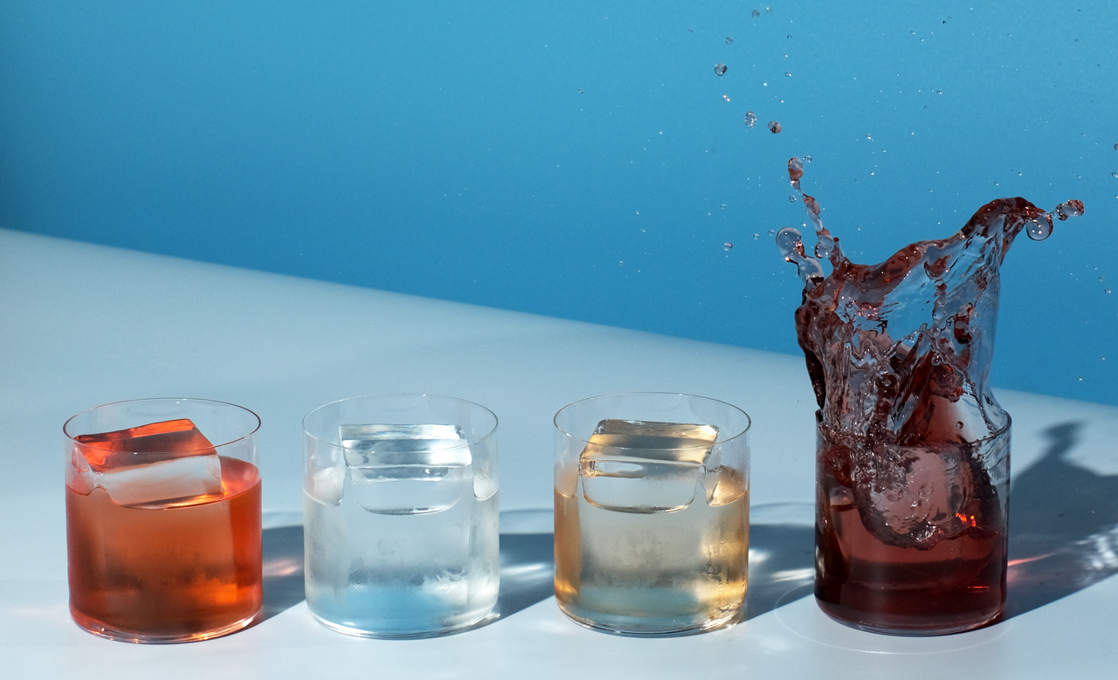

READING
liquid (n)
/ˈlɪkwɪd/
chất lỏng

Slide 6
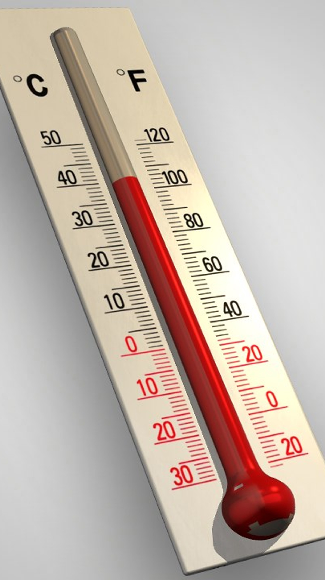
READING
temperature (n)
/ˈtemprətʃə/
nhiệt độ

Slide 7
READING
atmosphere (n)
The mixture of
gases around
the earth
/ˈætməsfɪə/
khí quyển

Slide 8

gravity (n)
/ˈɡrævəti/
trọng lực,
lực hút trái đất

Slide 9
READING
habitable (adj)
providing conditions that are good enough to live in or on
/ˈhæbɪtəbl/
có thể ở được, phù hợp để ở

Slide 10
READING
promising (adj)
signs that it is going to be successful or enjoyable
/ˈprɒmɪsɪŋ/
đầy hứa hẹn, triển vọng

Slide 11
READING
trace (n)
a sign that something has happened or existed
/treɪs/
dấu hiệu, dấu vết, vết tích

Slide 12
READING
New words | Pronunciation | Meaning
1. liquid (n) | /ˈlɪkwɪd/ | chất lỏng
2 temperature (n) | /ˈtemprətʃə/ | nhiệt độ
3. atmosphere (n) | /ˈætməsfɪə/ | không khí
4. gravity (n) | /ˈɡrævəti/ | trọng lực, lực hút trái đất
5. habitable (adj) | /ˈhæbɪtəbl/ | có thể ở được, phù hợp để ở
6. promising (adj) | /ˈprɒmɪsɪŋ/ | đầy hứa hẹn, triển vọng
7. trace (n) | /treɪs/ | dấu hiệu, dấu vết, vết tích

Slide 13
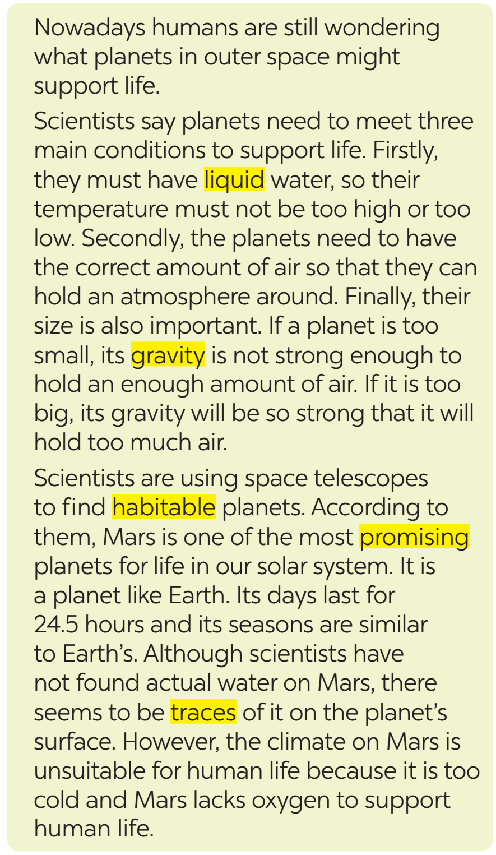
READING
2
Read the text and match the highlighted words in the text with their meanings.

Slide 14
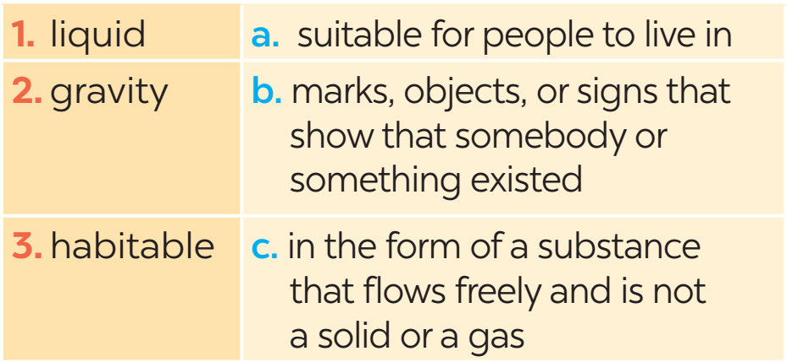
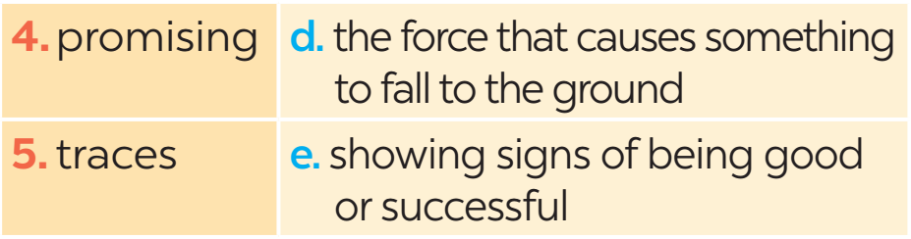
READING
2
Read the text and match the highlighted words in the text with their meanings.

Slide 15
READING
3
Read the text again and answer the following questions.
1. What are humans still wondering nowadays?
2. Why does a habitable planet need to have the correct amount of air?
Humans are still wondering what planets in outer space might support life.
It needs to have the correct amount of air to hold an atmosphere around it.

Slide 16
READING
3
Read the text again and answer the following questions.
3. What happens if a planet is too small?
4. How long does a day on Mars last?
5. Why can we not live on Mars?
Its gravity is not strong enough to hold an enough amount of air.
A day on Mars lasts for 24.5 hours.
Because it is too cold and lacks oxygen to support human life.

Slide 17
SPEAKING
4
Work in pairs.Tick the boxes to show what conditions a planet needs to support human life.
1. There must be enough liquid water on the planet.
2. The planet must have craters on its surface.
3. The planet must hold an atmosphere.
4. The planet must have at least two moons.
5. The planet must have enough oxygen in the air.

Slide 18
SPEAKING
4
Can you add other conditions for a habitable planet?
Suggested ideas:
– The planet must experience at least two seasons.
– The planet's temperature of the planet must be suitable for humans to live on it.
– There must be enough sources of energy on the planet.
– The planet must be a comfortable distance away from a star.
– The planet must rotate on its axis and revolve.
– The planet must hold an atmosphere.
– The stars around the planet must be stable.
– The planet must have carbon that is found in all living things.

Slide 19
SPEAKING
5
Work in groups. Take turns to talk about the conditions you think are required for a planet to support human life. Use the information in and your own ideas.
4
Example:
There are some conditions planets must have to support human life on them. First, the most important condition is that ...

Slide 20

CONSOLIDATION
1
Wrap-up
What have we learnt in this lesson?
Read about the possibility of life on other planets.
Talk about the conditions needed for planets to support human life.

Slide 21

CONSOLIDATION
2
Homework
Do the exercises in the workbook.

Slide 22

Website: hoclieu.vn
Fanpage: facebook.com/tienganhglobalsuccess.vn/

