Slide 1
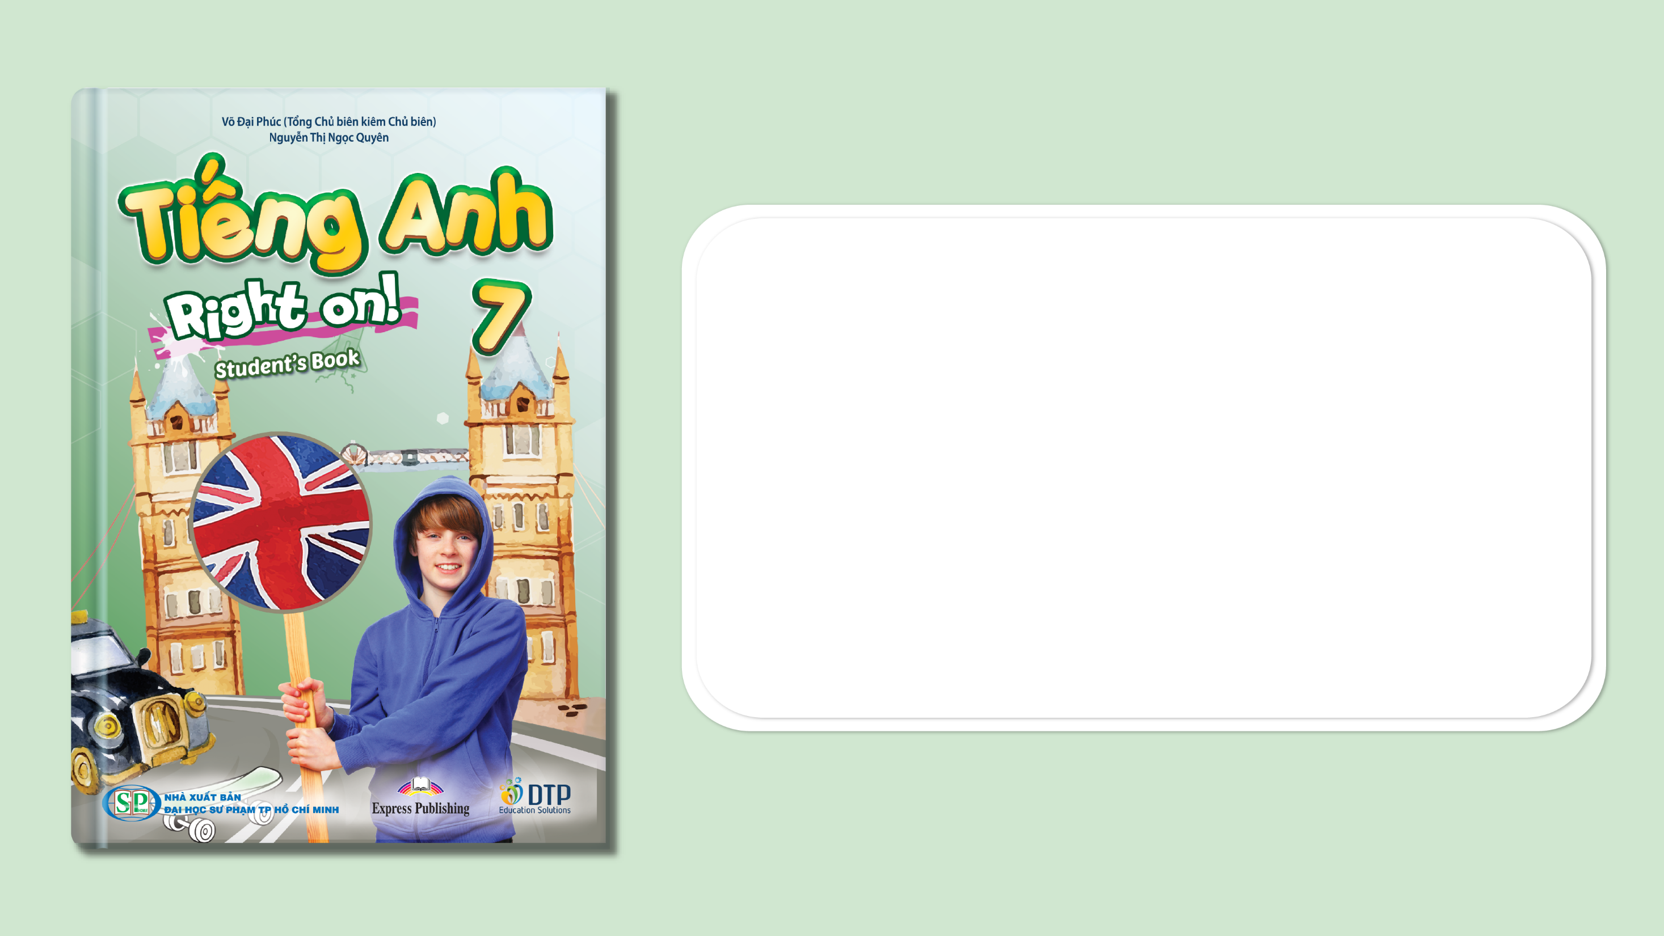
Unit 2: Fit for life
Lesson 2e: Grammar
Page 36

Slide 2
Lesson Outline
Warm-up
Grammar
Consolidation
Wrap-up

Slide 3
Objectives
By the end of this lesson, students will be able to…
- learn and use new grammar point: used to.
- talk about their activities they used to do when they were 6.

Slide 4

WARM-UP

Slide 5
Choose the word whose main stress is placed differently from that of the others. Practise saying them.
1. A. gymnastics B. taekwondo C. karate D. kickboxing
/dʒɪmˈnæstɪks/ /ˌtaɪˈkwɒndəʊ/ /kəˈrɑːti/ /ˈkɪkbɒksɪŋ/
2. A. polite B. quiet C. cosy D. easy
/pəˈlaɪt/ /ˈkwaɪət/ /ˈkəʊzi/ /ˈiːzi/
3. A. enjoy B. finish C. discuss D. relax
/ɪnˈdʒɔɪ/ /ˈfɪnɪʃ/ /dɪsˈkʌs/ /rɪˈlæks/

Slide 6
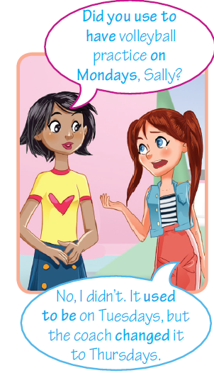
Look at the picture and answer the questions.
1. When do we use “used to”?
2. What is the form of the verb after “used to”?
Answers:
1. We use used to to talk about things that happened regularly in the past, but they don’t happen anymore.
2. bare infinitive.

Slide 7

It’s time to learn …

Slide 8

Presentation

Slide 9

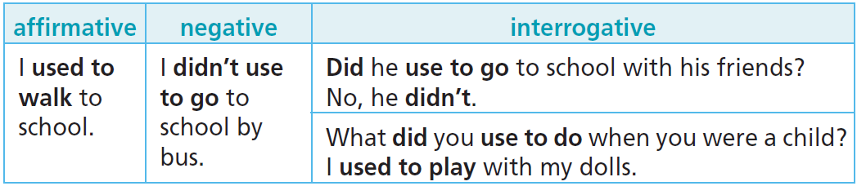
Structure
We use used to to talk about things that happened regularly in the past, but they don’t happen anymore.
We can use the Past Simple instead of used to with no difference in meaning to talk about past habits.
She used to eat meat more often when she was younger.
She ate meat more often when she was younger.

Slide 10

We don’t use used to for actions that happened at a stated time in the past.
e.g. I went to football practice yesterday.
(NOT: I used to go to football practice yesterday.)

Slide 11
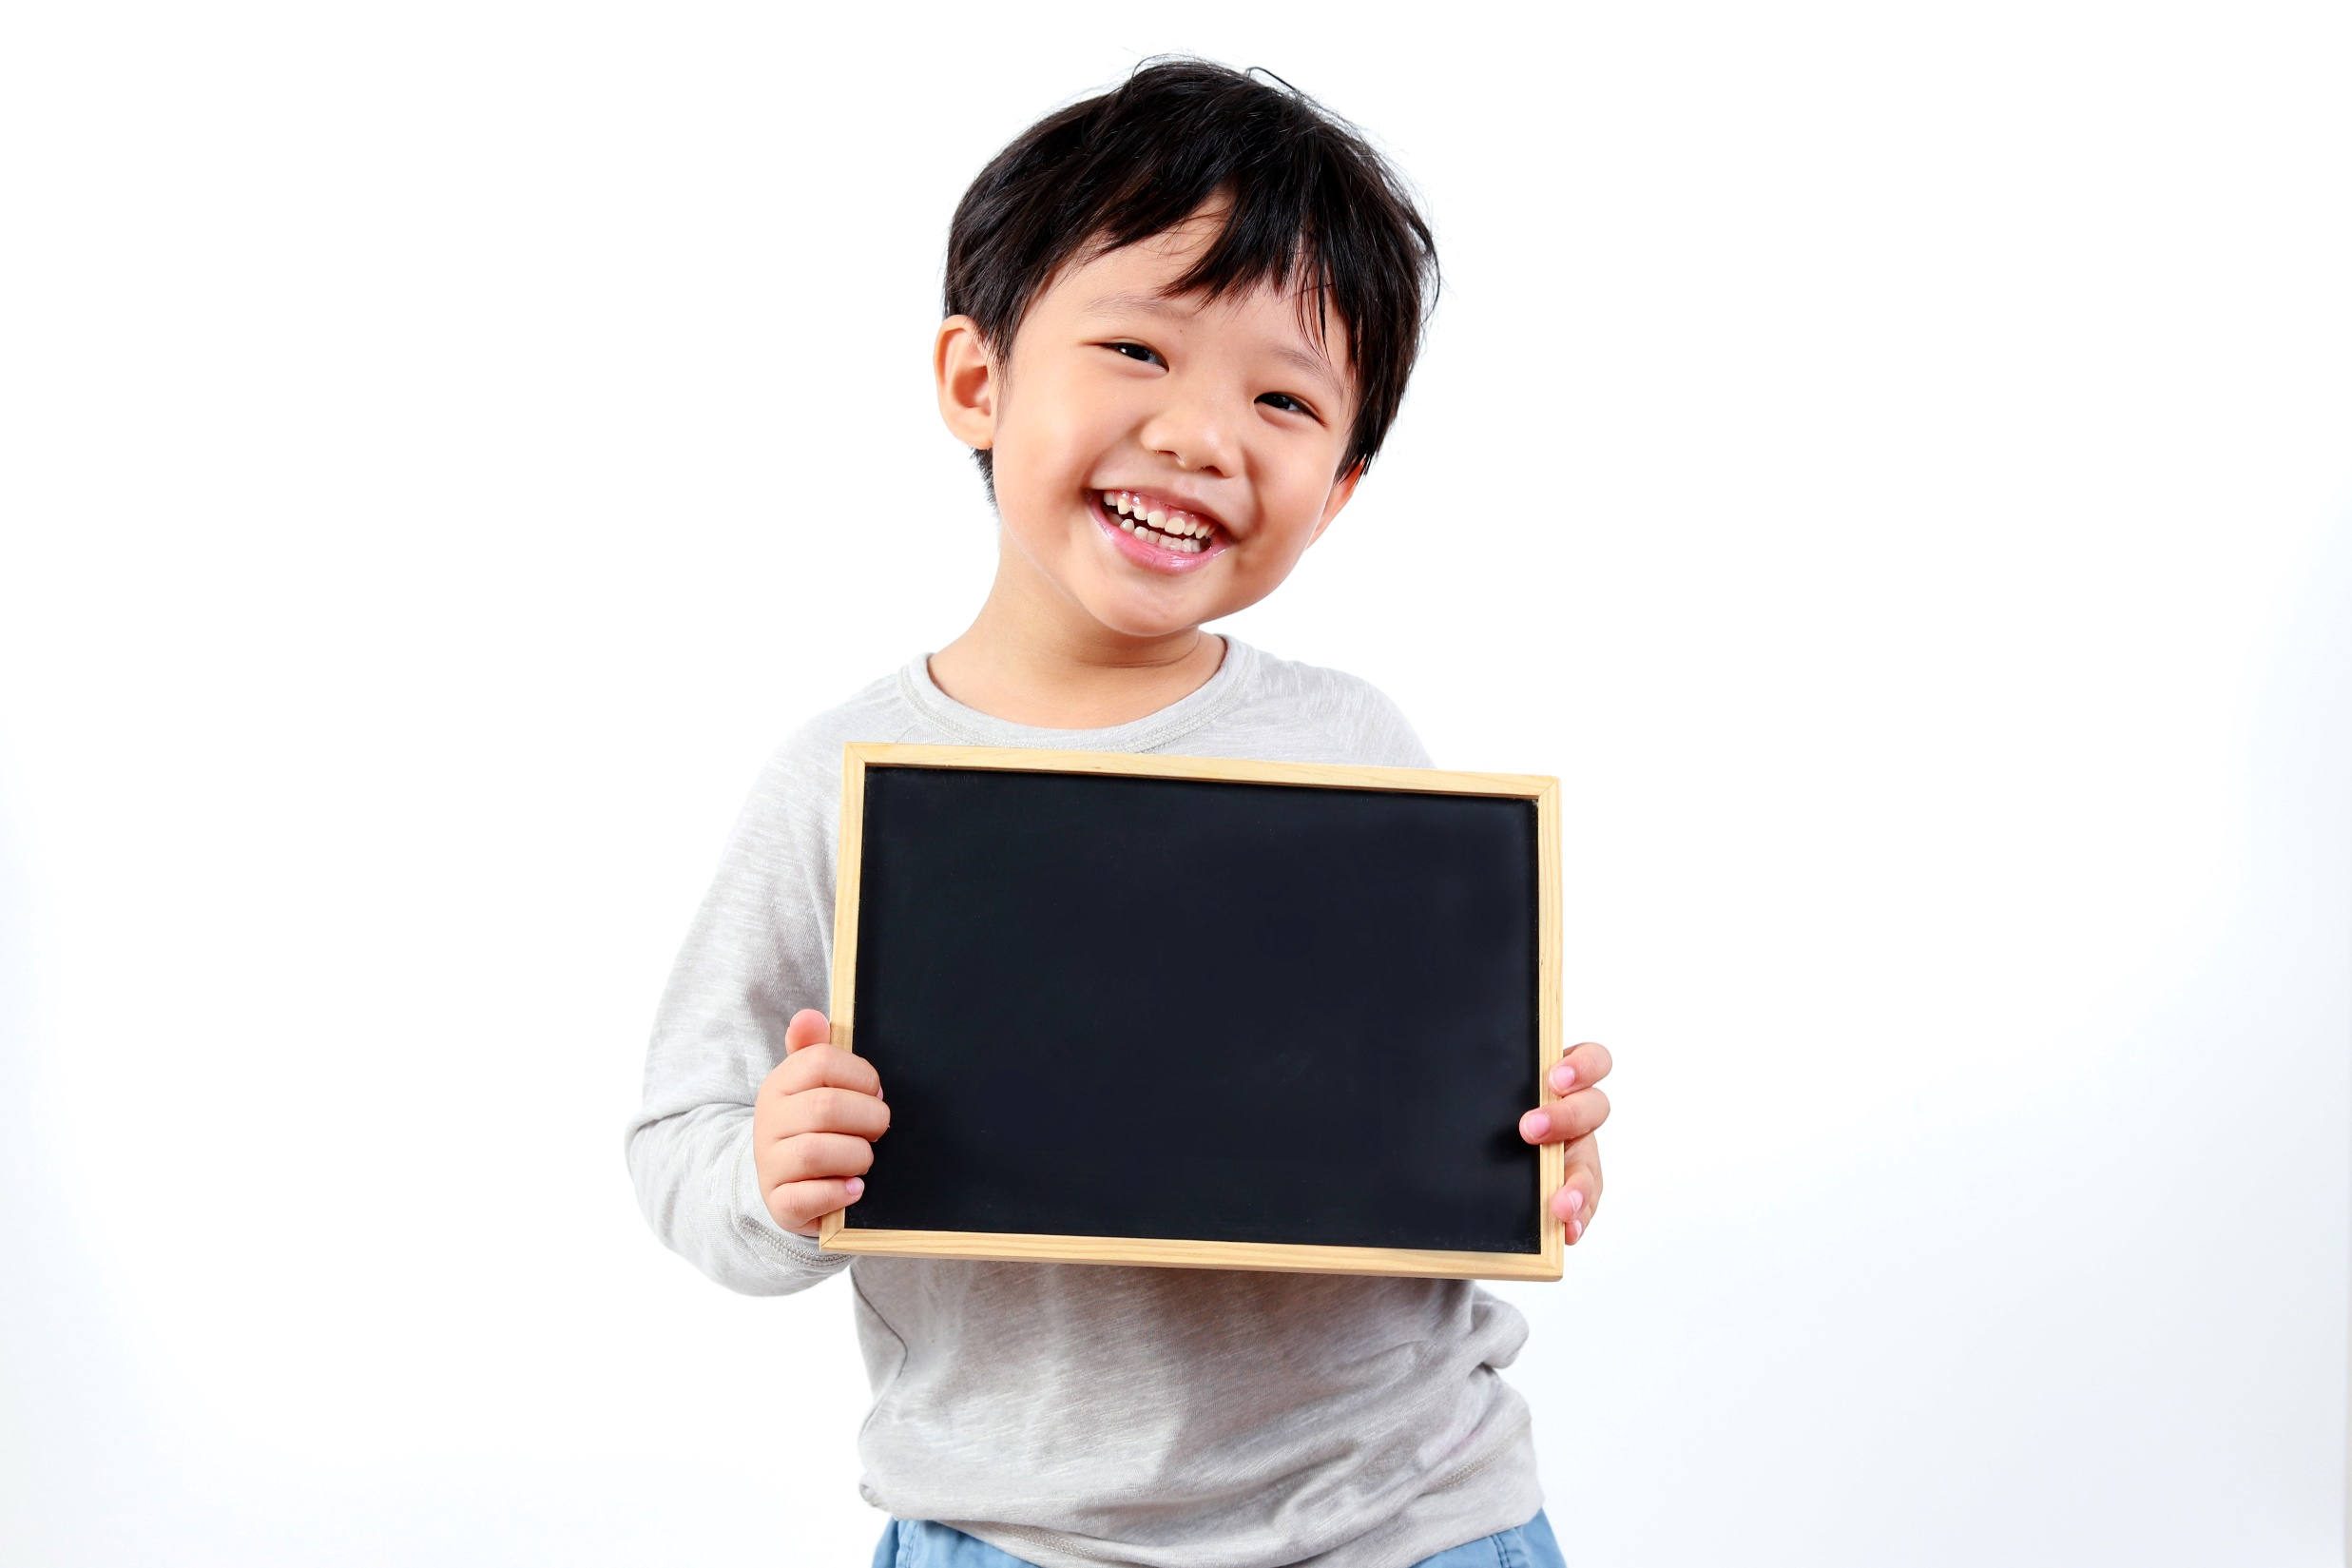
Practice

Slide 12
1. Choose the correct option. Sometimes, both options are correct.
1 Marko used to go/went snorkelling every summer but now he’s too busy.
2 Mary didn’t use/used to play tennis when she was at college.
3 Jane left/used to leave for the gym an hour ago.
4 Every summer, we used to go/went swimming.
5 Did Jenny use/used to play basketball when she was a kid?
6 The sports centre used to move/moved to a new location.
7 I didn’t use/used to go jogging when I was a kid.
8 My parents used to buy/bought me a new racquet last week.

Slide 13
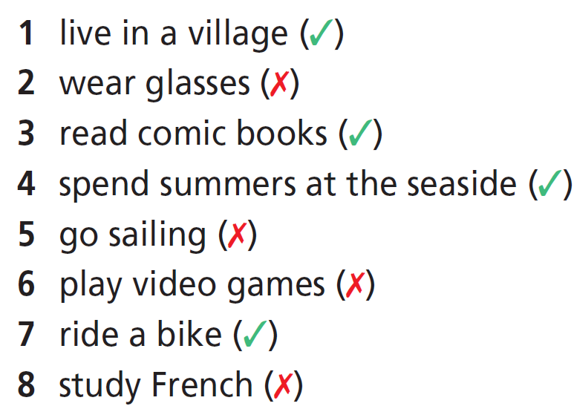
2. Write what James used to/didn’t use to do when he was six.
James used to live in a village.
James didn’t use to wear glasses.
James used to read comic books.
James used to spend summers at the seaside.
James didn’t use to go sailing.
James didn’t use to play video games.
James used to ride a bike.
James didn’t use to study French.

Slide 14
Extra Practice
GB, page 67
30 ★ Choose the correct option.
1 Susan didn’t use/used to go to the gym so often.
2 I used/use to like eating fast food, but not anymore.
3 Peter used to/didn’t use to swim. He was afraid of water.
4 My parents used to have/had a motorbike.
5 We didn’t use/didn’t used to live in the city.
6 I used to/didn’t use to have got long hair, but now my hair is short.
7 Sally used to/didn’t use to be a shy girl, but now she talks a lot.
8 I used to/didn’t use to play with dolls. I had no dolls.

Slide 15
Extra Practice
WB, page 67
31 ★ Choose the correct option.
1 A: Did you use to play in the park?
B: No, I didn’t/used to.
2 A: Did Amy used/use to come here with her friends?
B: No, she didn’t.
3 A: I didn’t used/use to like English lessons.
B: I know, but now you want to live in the UK!
4 A: Did she use/used to ride her bike to school?
B: Yes, she did.
5 A: Did your grandma use to work/worked in the bank?
B: No, she didn’t.

Slide 16
Extra Practice
WB, page 20
3 ★★★ Complete the sentences with the correct form of used to and the verbs in brackets.
1 I __________________ (ride) my bike to school, but now I walk.
2 __________________ (you/do) taekwondo?
3 We __________________ (not/have) a swimming pool in our town.
4 My cousins __________________ (play) badminton every weekend.
5 _____________________ (your dad/run) marathons?
6 Emma __________________ (not/like) computer games, but now she plays them all the time!
used to ride
Did you use to do
didn’t use to have
used to play
Did your dad use to run
didn’t use to like

Slide 17

Production

Slide 18

3. What did your partner use to do when he/she was six? Ask to find out, then tell the class.
A: Did you use to go to the cinema?
B: No, I didn’t. I used to watch cartoons on TV.
Suggested Answers:
A: Did you use to play with toy cars?
B: No, I didn’t. I used to watch TV.
A: Did you use to go to ballet lessons?
B: No, I didn’t. I used to play sports.

Slide 19

CONSOLIDATION

Slide 20
Make five sentences about the activities you often did when you were 6 but now you don’t.

Slide 21

WRAP-UP

Slide 22
Today’s lesson
Structures/ Sentence patterns
used to + bare infinitive

Slide 23
Homework
Practise used to and make sentences using them.
Do the exercises in TA 7 Right on WB (page 20).
Complete the grammar notes in TA 7 Right On notebook (page 16).
Prepare the next lesson (page 37 SB).

Slide 24
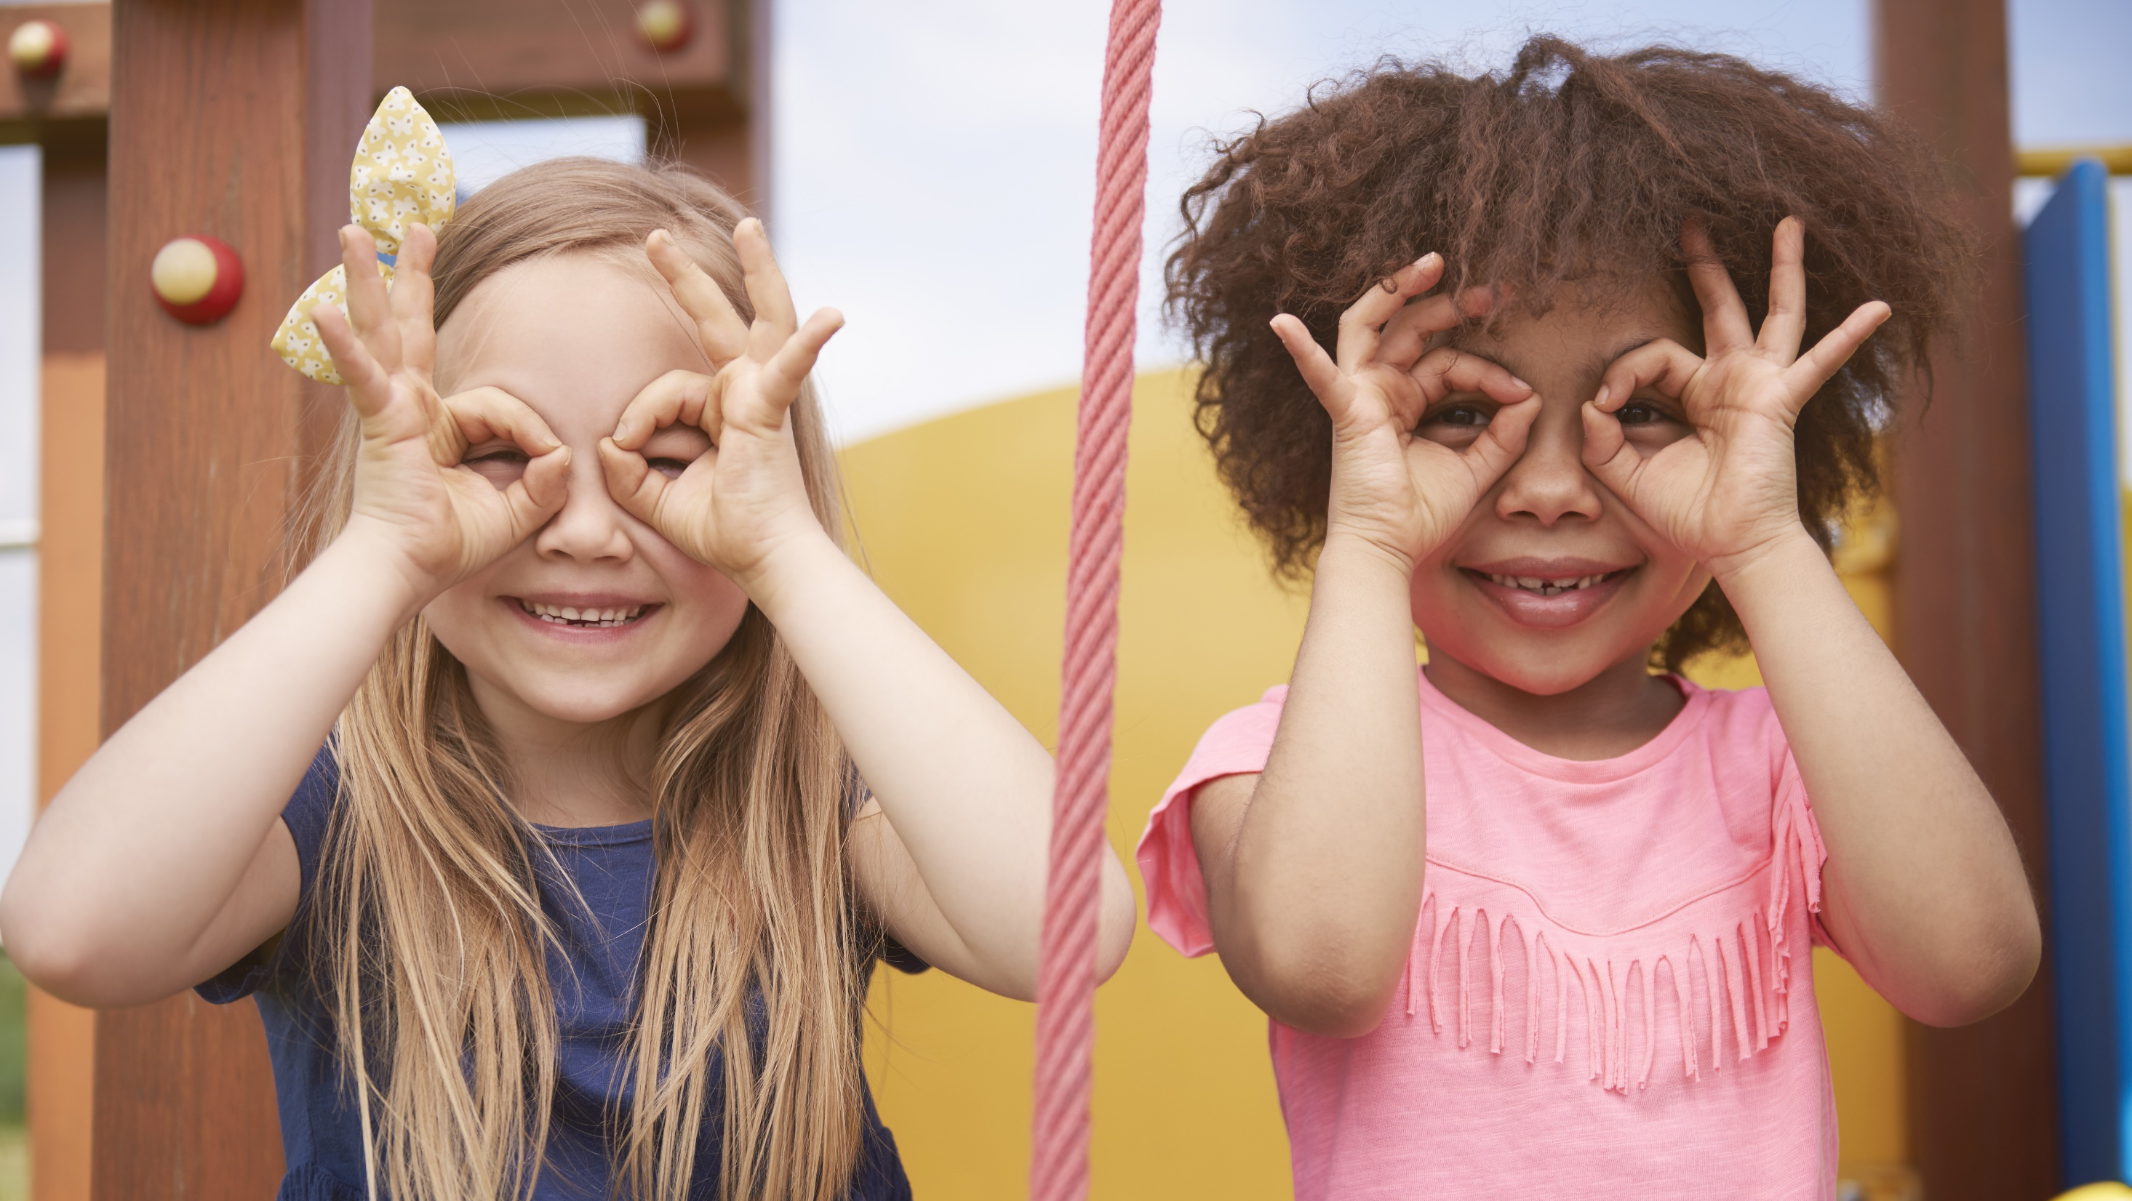
Enjoy your day!

