Slide 1


Slide 2

Unit
5
1
Unit
FAMILY LIFE
INVENTIONS
COMMUNICATION AND CULTURE/ CLIL
LESSON 7
Artificial intelligence

Slide 3

Unit
1
1
FAMILY LIFE
Family Life
Unit
OBJECTIVES
Revise how to make and respond to requests.
Know more information about computer hardware.

Slide 4
LESSON 7
COMMUNICATION AND CULTURE/ CLIL
Unit
WARM-UP
Card game
Everyday English
Activity 1: Listen and complete a conversation at a computer store with the expressions in the box. Then practise it in pairs.
PRESENTATION
Activity 2: Work in pairs. Role-play similar conversations about other devices you want to buy. Use the example in 1 and the expressions below to help you.
PRACTICE
Culture
Activity 1: Read the text below. Match the highlighted words and phrase with their meanings.
PRODUCTION
Activity 2: Look at the advertisements. Decide which one is most suitable for each person below.
CONSOLIDATION
Wrap-up
Homework

Slide 5

LESSON 7
COMMUNICATION AND CULTURE/ CLIL
Unit
WARM-UP
Card game
Select word cards about Computer
Stick the cards on sheets of A1 paper.
Stick the sheets of A1 paper on the walls/ board.

Slide 6

LESSON 7
COMMUNICATION AND CULTURE/ CLIL
Unit
WARM-UP
Card game
Laptop Screen
Hardware Software
Speed Document
Display Battery
Light Weight
Size Brand
Program Memory
data

Slide 7
LESSON 7
COMMUNICATION AND CULTURE/ CLIL
Unit
WARM-UP
Card game
Everyday English
Activity 1: Listen and complete a conversation at a computer store with the expressions in the box. Then practise it in pairs.
PRESENTATION

Slide 8

PRESENTATION_ EVERYDAY ENGLISH
1
Listen and complete a conversation at a computer store with the expressions in the box. Then practise it in pairs. (p. 58).
A. Can you let me know about
B. Can you please recommend
C. Certainly
D. Feel free to ask me if you need further information
E. Sure
Tim: Hello. I’m looking for a laptop. (1) ________ a good one to me?
Shop assistant: (2) ________, but (3) ______ your needs first?
Tim: (4) ________. I’m a student, so I’d like a cheap and light laptop.
Shop assistant: Then I think this laptop is the best one for you. You can take a look at it. (5) ________.
B
C
A
E
D

Slide 9
LESSON 7
COMMUNICATION AND CULTURE/ CLIL
Unit
WARM-UP
Card game
Everyday English
Activity 1: Listen and complete a conversation at a computer store with the expressions in the box. Then practise it in pairs.
PRESENTATION
Activity 2: Work in pairs. Role-play similar conversations about other devices you want to buy. Use the example in 1 and the expressions below to help you.
PRACTICE
Culture
Activity 1: Read the text below. Match the highlighted words and phrase with their meanings.

Slide 10
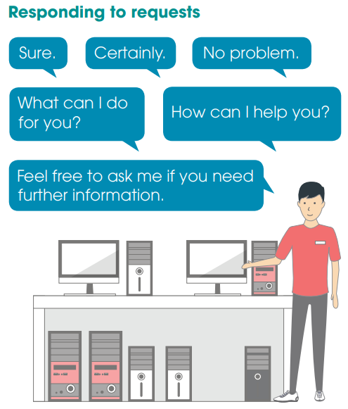
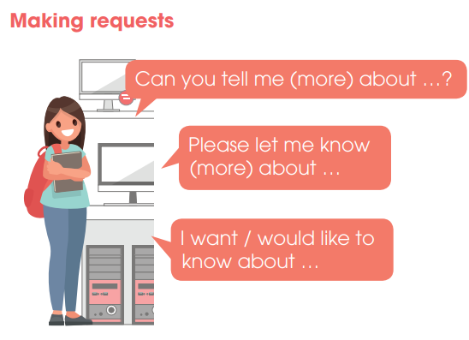
PRACTICE
2
Work in pairs. Role-play similar conversations about other devices you want to buy. Use the example in 1 and the expressions below to help you. (p. 59.)

Slide 11
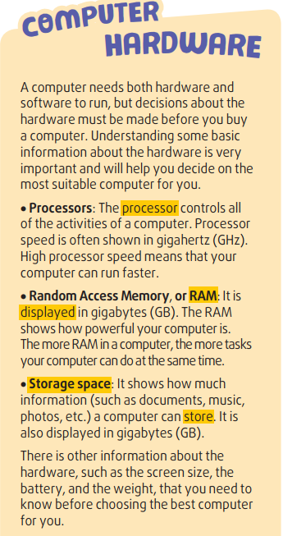
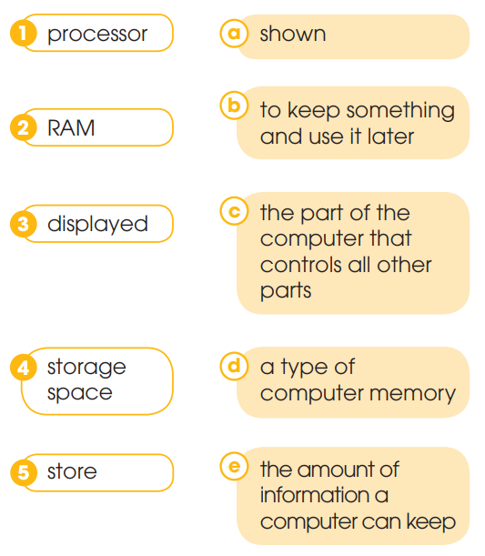
PRACTICE_CULTURE
1
Read the text below. Match the highlighted words and phrase with their meanings. (p. 59-60).

Slide 12
PRACTICE_CULTURE
1
Read the text below. Match the highlighted words and phrase with their meanings. (p. 59-60).

Slide 13
LESSON 7
COMMUNICATION AND CULTURE/ CLIL
Unit
WARM-UP
Card game
Everyday English
Activity 1: Listen and complete a conversation at a computer store with the expressions in the box. Then practise it in pairs.
PRESENTATION
Activity 2: Work in pairs. Role-play similar conversations about other devices you want to buy. Use the example in 1 and the expressions below to help you.
PRACTICE
Culture
Activity 1: Read the text below. Match the highlighted words and phrase with their meanings.
PRODUCTION
Activity 2: Look at the advertisements. Decide which one is most suitable for each person below.

Slide 14
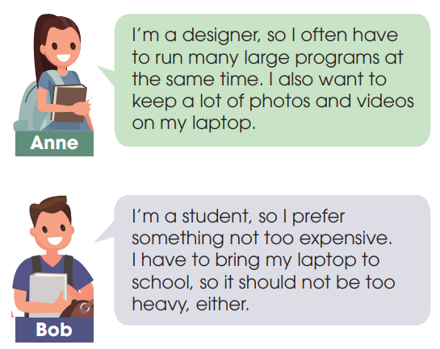
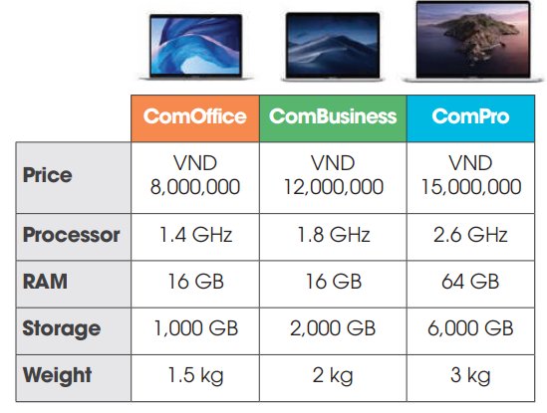
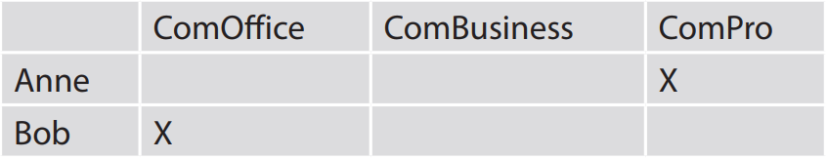
PRODUCTION
2
Look at the advertisements. Decide which one is most suitable for each person below. (p.60).

Slide 15
LESSON 7
COMMUNICATION AND CULTURE/ CLIL
Unit
Who remembers more?
WARM-UP
Everyday English
Task 1: Listen and complete the conversation with the words from the box. Then practise it in pairs.
PRESENTATION
Task 2: Work in pairs. Take on a role and act out a conversation like the one in 1.
PRACTICE
Culture
Task 1: Read the text below and complete the diagram about Save the Children.
PRODUCTION
Task 2: Work in groups. Use the diagram to talk about Save the Children.
CONSOLIDATION
Wrap-up
Homework

Slide 16
CONSOLIDATION
1
Wrap-up
Revise how to make and respond to requests.
Know more information about computer hardware.

Slide 17
CONSOLIDATION
2
Homework
1. Prepare for the next lesson: Unit 5_Looking back and project
2. Do exercises in the workbook

Slide 18


