Slide 1

UNIT 6: COMMUNITY LIFE
Lesson 3.1 – Vocabulary & Listening
Page 54

Slide 2




LESSON OUTLINE
Consolidation

Slide 3

By the end of this lesson,
students will be able to …
- practice listening and reading for specific information.
- talk about how to improve community.

Slide 4



Slide 5

Work in pairs.
How would you spend a million dollars improving your community? Why do you want to make these changes?

Slide 6



Slide 7
Pre-Listening
a. Listen to a radio show about Youth Lead the Change. How often does the competition happen in Hartmouth?
Underline the key words/phrases.
1. every year 2. every two years

Slide 8
Underline the key words/phrases.
1. The winning project was announced by the government. _______
2. The amount to spend was two million dollars. _______
3. Over five thousand people voted for Plant the City. _______
4. Hartmouth Shelters came in second place. _______
5. Heat for Success will help students study better. _______

Slide 9


While-Listening
Listen once and choose.
1. Every year
Listen twice and answer.
1. The winning project was announced by the government. _______
2. The amount to spend was two million dollars. _______
3. Over five thousand people voted for Plant the City. _______
4. Hartmouth Shelters came in second place. _______
5. Heat for Success will help students study better. _______
True
False
True
True
True

Slide 10

Scripts
M: You're listening to Hartmouth Radio. In today's news, Hartmouth City government has just announced the winning projects in this year's Youth Lead the Change competition. And this is how Hartmouth's young people voted on ways to spend one million dollars of the city's budget.
The winning project is Plant the City. 5,480 people voted to spend the money on planting more trees and plants around the city. This will help fight climate change and make Hartmouth more beautiful.

Slide 11
The second project with 5,476 votes is Hartmouth Shelters. The money is going to buy new furniture, facilities, and equipment to give some help to people who are sadly experiencing homelessness.
The last project with 4,100 votes is Heat for Success. The money is going to update or replace school heating systems. This will help students study better in winter. If you are interested in joining next year's Youth Lead the Change competition, choose from the list of projects on their website, then write to them saying why you think it's the best way to help improve Hartmouth. Next up, weather with Nick.

Slide 12
Extra Practice
WB, page 36
Pre-Listening
Underline the key words/phrases.
a. Listen to a talk about a charity for young people. Who is the speaker talking to?
1. a soccer team 2. a group of students

Slide 13
b. Now, listen and circle the correct answers.
1. What sport did he see teenagers playing in India?
a. basketball b. badminton c. soccer
2. What were they not wearing?
a. shirts b. shoes c. gloves
3. What is the name of the charity?
a. Sports for Kids b. Kids Play Project c. Shirts and Shoes
4. How many countries have they raised money in?
a. 20 b. 10 c. 40
5. What can people do on the website?
a. donate money b. sign up c. play sports

Slide 14

While-Listening
Listen once and circle
→ 2. a group of students

Slide 15
b. Now, listen and circle the correct answers.
Listen twice and circle
1. What sport did he see teenagers playing in India?
a. basketball b. badminton c. soccer
2. What were they not wearing?
a. shirts b. shoes c. gloves
3. What is the name of the charity?
a. Sports for Kids b. Kids Play Project c. Shirts and Shoes
4. How many countries have they raised money in?
a. 20 b. 10 c. 40
5. What can people do on the website?
a. donate money b. sign up c. play sports

Slide 16
Scripts
M: Hello, everyone. Today, I'm going to talk about a project that helps young people play sports. On a trip to India six years ago, I saw some teenagers playing soccer with a tin can. They didn't have any shoes to wear, or a ball to play with. I wanted to do something for them, so I started the Kids Play Project to raise money to buy equipment and shoes. Now, we provide soccer balls and shoes to poor teenagers all over the world. Every year, we organize sports competitions and soccer games with famous athletes helping and taking part. They not only train our
teenagers but they also compete in friendly games with them.

Slide 17
It's a lot of fun and the kids love it, plus it raises money. Last year, we raised over seven hundred thousand dollars to buy sports equipment in twenty countries.
We've recently completed building a new sports center in Mumbai, India. Young people can play soccer, and other sports like cricket and badminton. We want to do the same in Indonesia and Mexico. That's where you can help. We need young people to organize fundraising projects. If you’re interested, please sign up on our website.

Slide 18

Post-Listening
Work in pairs.
Do you think her project is successful?
Give some good things from this project.

Slide 19
Pre-Reading
Underline the key words/phrases.
a. Lisa wrote to the Youth Lead the Change project. Is her project for...
1. young people and children? 2. everyone?

Slide 20


Dear Sir/Madam,
My name is Lisa Bolton and I think the project Green Spaces for All will help improve Hartmouth.
Many people live in apartments or small houses without any yards. There are not enough green spaces for them to use. I think we should use the money from the city budget to build more parks around the city. They can be a safe place for all people to enjoy, and they will make our city's air cleaner.

Slide 21
We can buy exercise equipment and put it in the parks, then people will not have to pay to use a gym. We can also build basketball courts and skateboard parks. Teenagers can hang out there, so they can have something fun to do.
The parks can have play equipment and sandboxes for young children, so they can play safely while their parents watch.
Finally, the parks will make our city a healthier place to live. Studies show that trees and plants improve air quality. It is very bad right now because of the traffic.
I hope you will consider my suggestion.
Yours faithfully,
Lisa Bolton

Slide 22
b. Now, read and circle the questions
1. What do many people not have?
yards apartments
2. Where can exercise equipment be put?
in gyms in the parks
3. What can teenagers do?
use the skateboard parks play in the sandboxes
4. What will be improved in the city?
traffic air quality

Slide 23
While-Reading
Skim the text. Choose which is her project for.
→ 2. everyone?
Scan the text and circle the correct answers.
1. What do many people not have?
yards apartments
2. Where can exercise equipment be put?
in gyms in the parks
3. What can teenagers do?
use the skateboard parks play in the sandboxes
4. What will be improved in the city?
traffic air quality

Slide 24
Extra Practice
WB, page 36
Pre-Reading
Underline the key words/phrases.
Read the article. What does the writer want to do?
1. provide spaces for children to play
2. provide children with schools

Slide 25

John Wilson, June 9
One of the city's biggest problems is its lack of parks and playgrounds. Children need space to run around and have fun in safety. Unfortunately, many families live in apartment blocks or small houses without yards. The only place their children can play is often on a busy road. Their games often end in hospital visits or worse.
There are several amusement parks and swimming pools; however, these cost money to use. Most families find it difficult to pay for bills and food and cannot afford to pay for high-priced tickets for their children.

Slide 26
I suggest we look for a suitable piece of land that is big enough for a park.
We should also think of ways to raise money to buy playground equipment.
For example, we could ask local families to take part in a fundraising event.
It will be fun and make the community aware of what we want to do. Our children need to play after school and on the weekends. We don't want them to continue getting hurt.

Slide 27
b. Read the article again and circle the correct answers.
1. Where do many families live?
A. apartments and small houses B. houses with small yards
2. Where do many children play now?
A. on the streets B. near the hospital
3. Why don't children go to the amusement parks?
A. not safe B. too expensive
4. How can families help?
A. by fundraising B. by buying playground equipment
5. What do children need to do after school?
A. go to after school clubs B. play in safety

Slide 28
While-Reading
Skim the article. Choose what does the writer want to do.
→ 1. provide spaces for children to play

Slide 29
Scan the article and circle the correct answers.
1. Where do many families live?
A. apartments and small houses B. houses with small yards
2. Where do many children play now?
A. on the streets B. near the hospital
3. Why don't children go to the amusement parks?
A. not safe B. too expensive
4. How can families help?
A. by fundraising B. by buying playground equipment
5. What do children need to do after school?
A. go to after school clubs B. play in safety

Slide 30

Post-Reading
Work in pairs.
Do you think your town needs more green spaces?
What else does it need?
Which place is better for children?

Slide 31

Consolidation

Slide 32
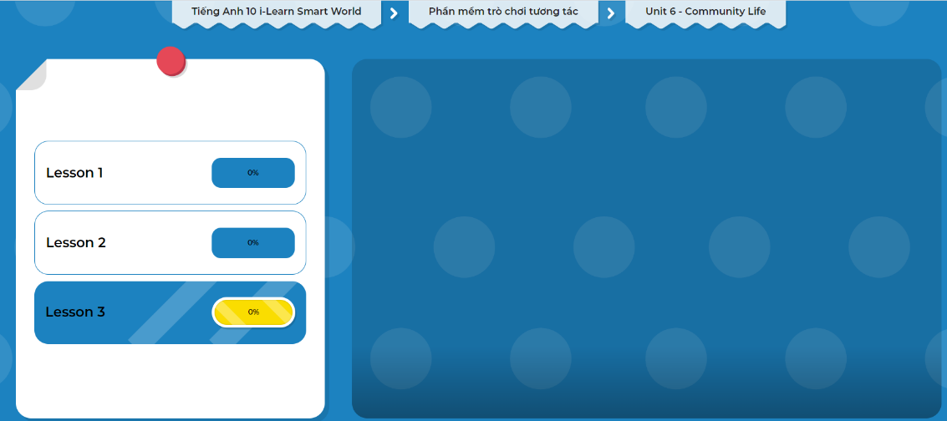
Extra Practice
DHA on Eduhome
Let’s Play!
Click here to play the games.

Slide 33

WRAP-UP

Slide 34
Today’s lesson
Listening & Reading: for specific information
Speaking: talk about how to improve community

Slide 35
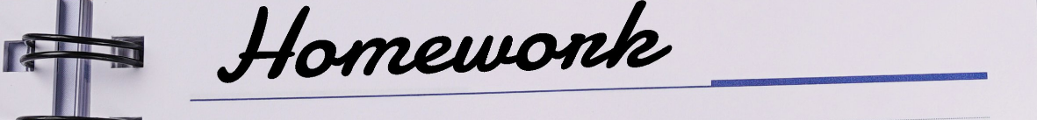
Do the exercises in Tiếng Anh 10 i-Learn Smart World Notebook on page 36.
Prepare the next lesson – Writing on page 55 in SB.
Play the consolidation games in Tiếng Anh 10 i-Learn Smart World DHA App on www.eduhome.com.vn

