Slide 1

Unit 6: Be green
Lesson: Overview
Pages 94 & 95

Slide 2
Lesson Outline
Warm-up
Vocabulary
Listening
Consolidation
Wrap-up

Slide 3
Objectives
By the end of this lesson, students will be able to…
- learn and develop vocabulary related to environmental problems (endangered animals, air pollution, deforestation, plastic pollution) and solutions (recycle, reuse, reduce, create).
- listen for key and specific information.
- talk about environmental problems & solutions.

Slide 4

WARM-UP

Slide 5
Work in groups of 3-4
Students spend 5 minutes to work in groups to brainstorm the environmental problems in the world nowadays.
Environmental problems

Slide 6

New words
endangered animals
air pollution
deforestation
plastic pollution

Slide 7

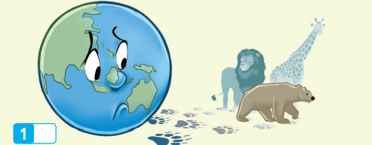
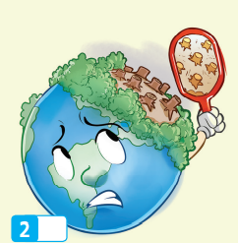


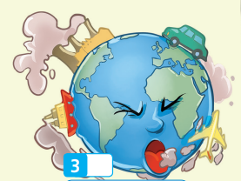



Work in pairs. Match the pictures with the correct words or phrases.

Slide 8
Listen and repeat. Click each phrase to hear the sound.
air pollution (n. phr) /eə(r) pəˈluːʃn/ ô nhiễm không khí
endangered animals (n. phr) /ɪnˈdeɪndʒərd ˈænɪmlz/ những loài
động vật đang gặp nguy hiểm
plastic pollution (n. phr) /ˈplæstɪk pəˈluːʃn/ ô nhiễm rác thải nhựa
deforestation (n) /ˌdiːˌfɔːrɪˈsteɪʃn/ việc phá rừng

Slide 9
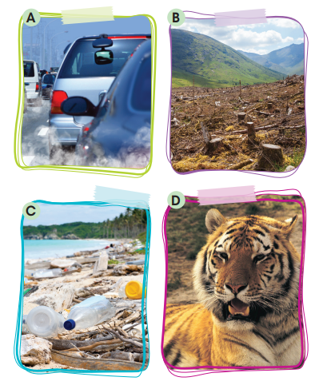
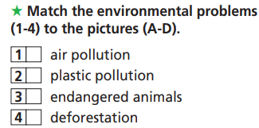
Extra Practice
WB page 48
A
C
D
B

Slide 10
Work in groups of 3-4
Students spend 5 minutes to work in groups to brainstorm the solutions to the environmental problems.
Environmental problems | Solutions
Air pollution
Plastic pollution
Deforestation
Endangered animals

Slide 11
New words
recycle
reuse
reduce
create

Slide 12
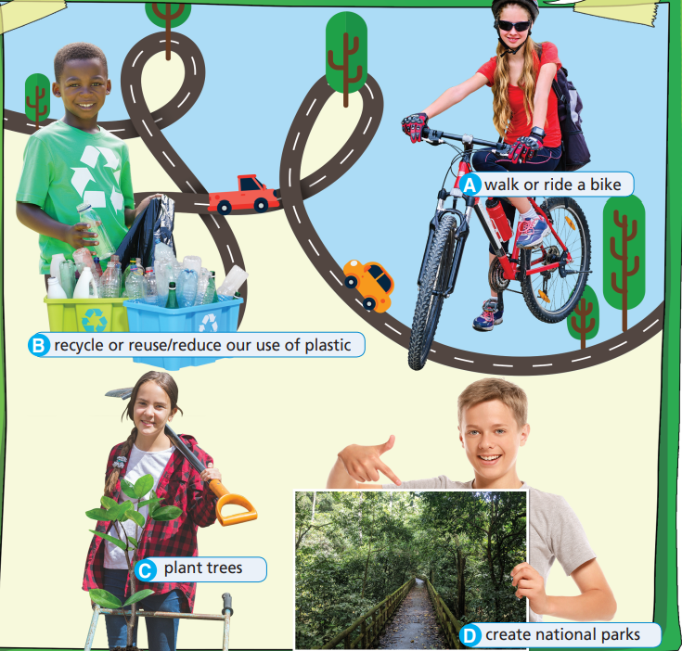
Complete the phrases with the correct words.
walk or ride
create
plant
recycle or reuse/reduce

Slide 13
Listen and repeat. Click each phrase to hear the sound.
create (v) /kriˈeɪt/ tạo ra
recycle (v) /riːˈsaɪkl/ tái chế
reuse (v) /riːˈjuːz/ tái sử dụng
reduce (v) /rɪˈdjuːs/ giảm

Slide 14
Please complete the words about the environmental problems and solutions:
en_a_g_ _e_ animals
a_ _ p_l_ _t_on
pl_ _s_ _c p_l_ _t _on
d_ _o_est_ _ion
cr_ _te
r_ _y_ _e
re_uc_
r_ _s_
endangered animals
air pollution
plastic pollution
deforestation
create
recycle
reduce
reuse

Slide 15
Match the words in the left column to the words/phrases in the right column.
endangered
air
plastic
create
reduce
plant
recycle/reuse
ride
a bike
national parks
pollution
trees
animals
pollution
our use of plastic
plastic

Slide 16

GROUPWORK
If we _______________, we can reduce/save ___________.

Slide 17

Listening

Slide 18
Pre-Listening
Read the instruction quickly. Underline the key words. What are we going to do?
Listen and match.
What does each person decide to do? Listen and match.

Slide 19

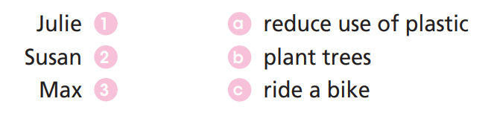
While-Listening
Now listen and match.  FIRST TIME
☞ YOUR ANSWER?
☞ WHY?

Slide 20
While - listening
Now listen again and check.  SECOND TIME
While you are listening, focus on what each person decides to do.
Julie: On Environment Day I’m going to ride my bike.
Susan: What’s Susan going to do? She’s going to reuse some plastic bottles
Max: I’m going to plant trees.
☞ THE ANSWER IS …

Slide 21
Pre-Listening
Read the instruction and questions quickly. Underline the key words. What are we going to do?
Listen and decide if the statements are TRUE OR FALSE.
Julie’s dad usually takes him to school in his car.
2. Susan and Max ride to school everyday.
3. Susan is going to make dolls out of plastic bottles.
4. Max and Julie are going to plant trees.

Slide 22
While - listening
Now listen again and decide if the statements are TRUE OR FALSE.  FIRST TIME
☞ YOUR ANWERS?
Julie’s dad usually takes him to school in his car.
T
2. Susan and Max ride to school everyday.
F
T
3. Susan is going to make dolls out of plastic bottles.
☞ WHY?
4. Max and Julie are going to plant trees.
F

Slide 23
Now listen again and check.  SECOND TIME
Julie’s dad usually takes him to school in his car.
T
Max: Hi, Julie! What are you going to do on Environment Day?
Julie: Oh, hello, Max! Well, my dad usually drives me to school in his car, but on Environment Day I’m going to ride my bike.

Slide 24
Now listen again and check.  SECOND TIME
2. Susan and Max ride to school everyday.
F
Max: That’s a good idea! That way, you’ll help to reduce air pollution. My sister, Susan, and I walk to school every day anyway, so we’re going to do something else as well.

Slide 25
Now listen again and check.  SECOND TIME
3. Susan is going to make dolls out of plastic bottles.
T
Julie: Really? What’s Susan going to do?
Max: She’s going to reuse some plastic bottles and make dolls out of them. It’s a fun way to protect the environment and be creative.

Slide 26
Now listen again and check.  SECOND TIME
4. Max and Julie are going to plant trees.
F
Julie: Cool! What about you?
Max: I’m going to plant trees with my classmates. Julie: That sounds great!

Slide 27
Audio Scripts
Practise the conversation in pairs.
Max: Hi, Julie! What are you going to do on Environment Day?
Julie: Oh, hello, Max! Well, my dad usually drives me to school in his car, but on Environment Day I’m going to ride my bike. Max: That’s a good idea! That way, you’ll help to reduce air pollution. My sister, Susan, and I walk to school every day anyway, so we’re going to do something else as well.
Julie: Really? What’s Susan going to do?
Max: She’s going to reuse some plastic bottles and make dolls out of them. It’s a fun way to protect the environment and be creative.
Julie: Cool! What about you?
Max: I’m going to plant trees with my classmates.
Julie: That sounds great!

Slide 28

Post-Listening
Work in pairs and discuss what are you going to do to protect the environment.
What are you going to do on Environment day?
Well, I am going to ride my bike to school.
That’s a good idea. That way, you’ll help to reduce air pollution. I am going to …..
Cool! And I am going to …..

Slide 29

CONSOLIDATION

Slide 30
Write at least 4 sentences to describe your “Go-Green Week” plan. You can use the information from the Listening Section.
E.g.
I am going to reuse plastic bottles.
I am going to ………………………………

Slide 31

WRAP-UP

Slide 32
Today’s lesson
Vocabularies
endangered animals
air pollution
plastic pollution
deforestation
create
reduce
reuse
recycle
Language skills
Listening:
Listening for key and specific information.
Speaking:
Talk about environmental problems and solutions using “be going to”.

Slide 33
Homework
Do the exercises on page 48 WB.
Prepare the next lesson (page 96 SB).
Do the exercise in TA 7 Right on Notebook (pages 42 & 43).

Slide 34

Enjoy your day!

