Slide 1

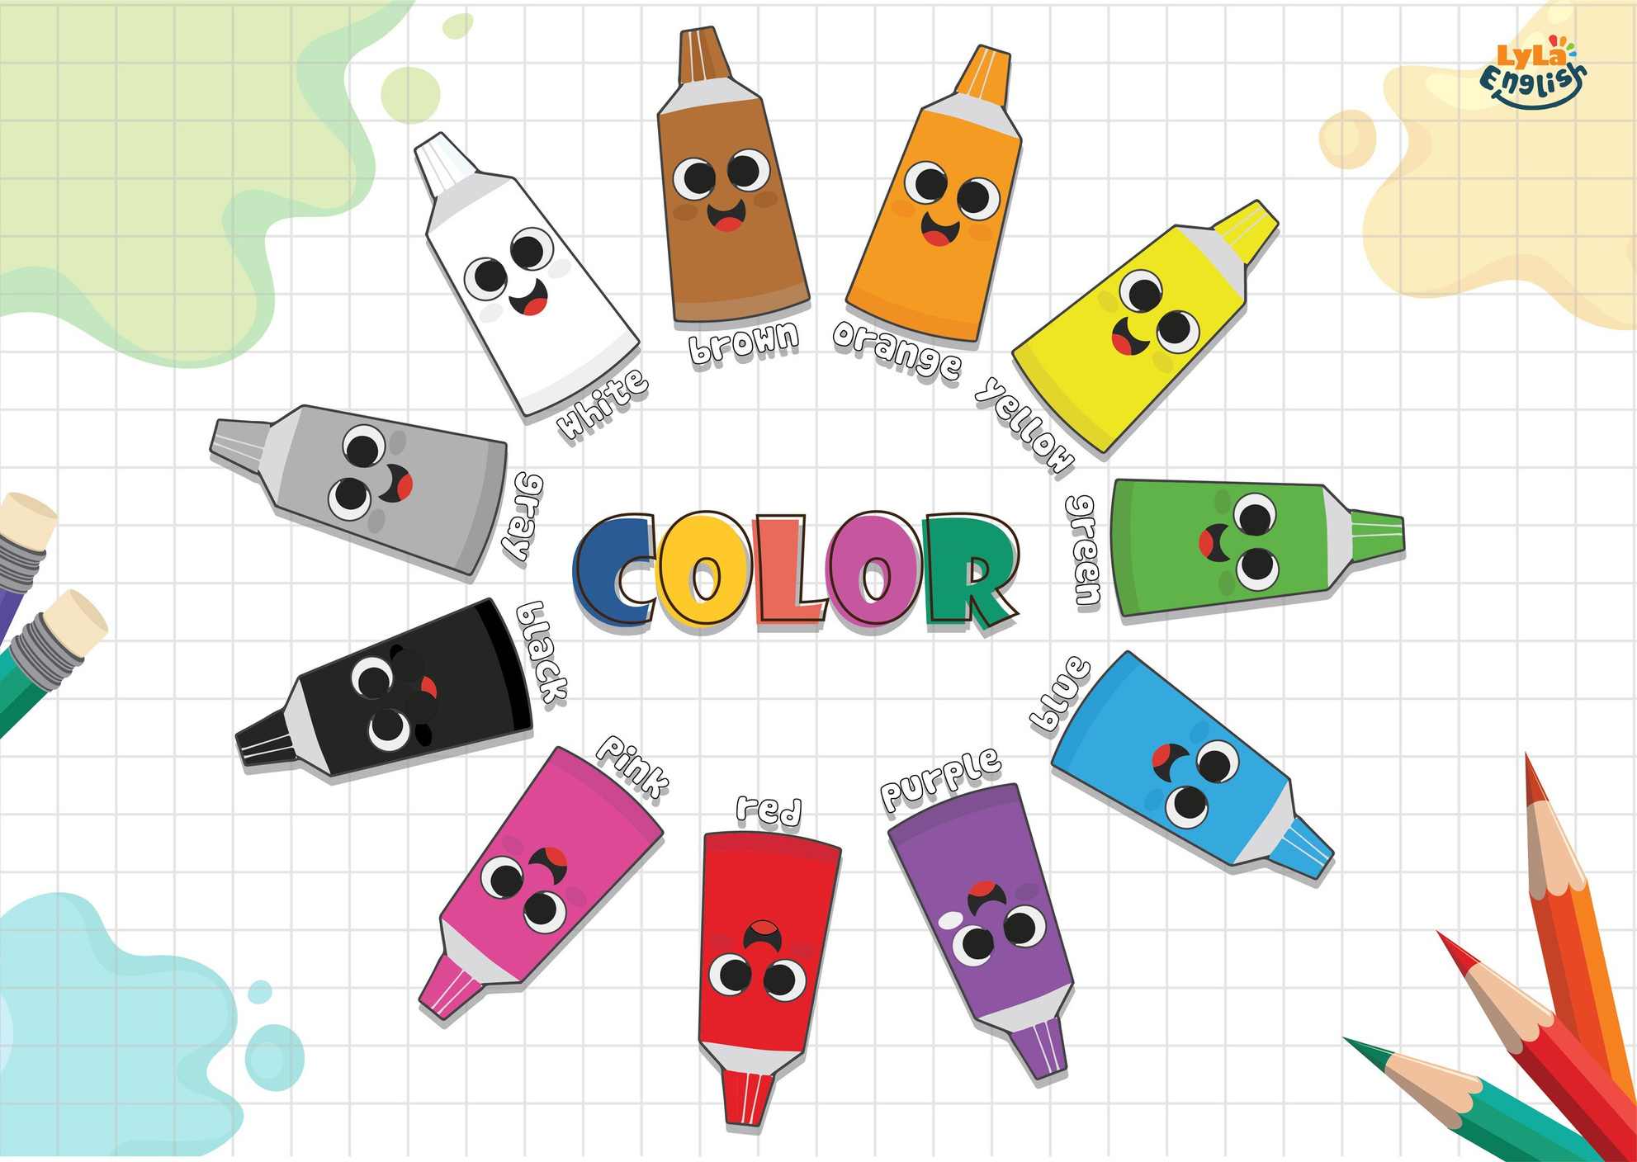




Slide 2


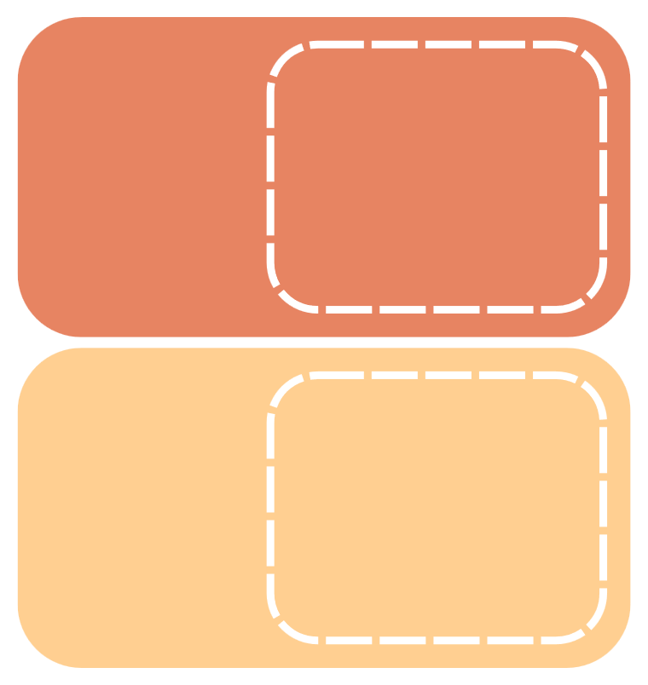
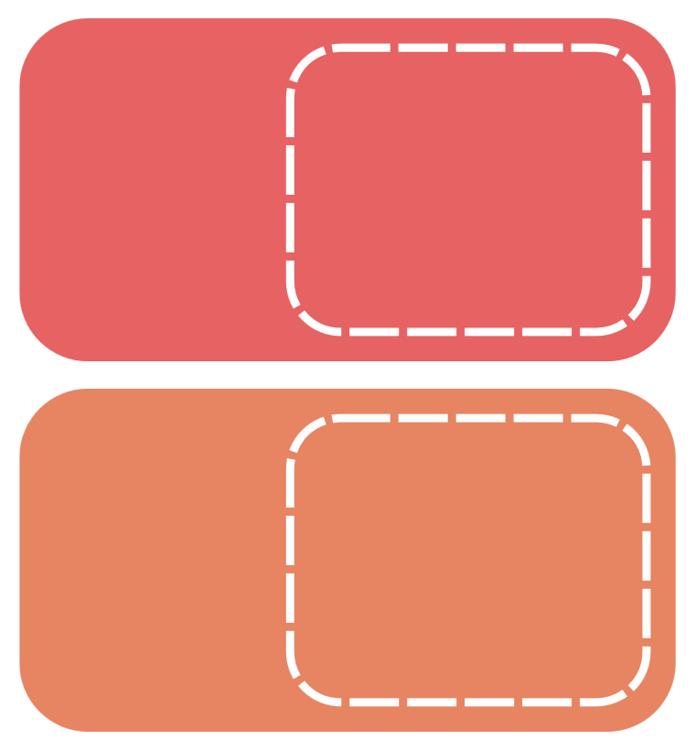
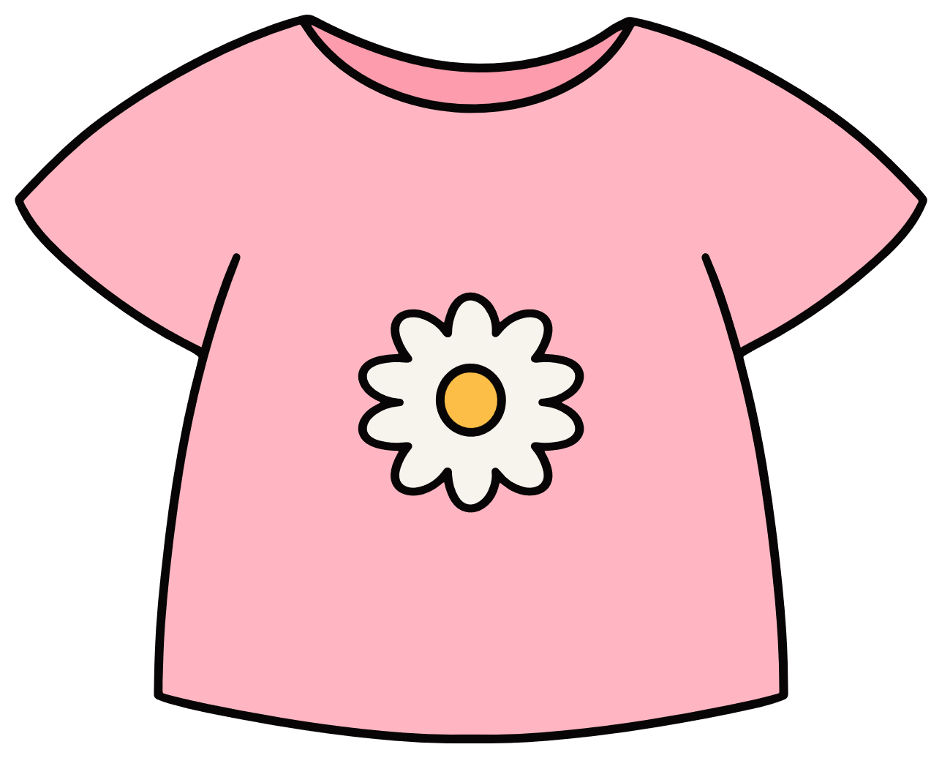

I. QUESTION
1.What color is this?
-It’s....
2. What color is the T-shirt? -It’s...

Slide 3

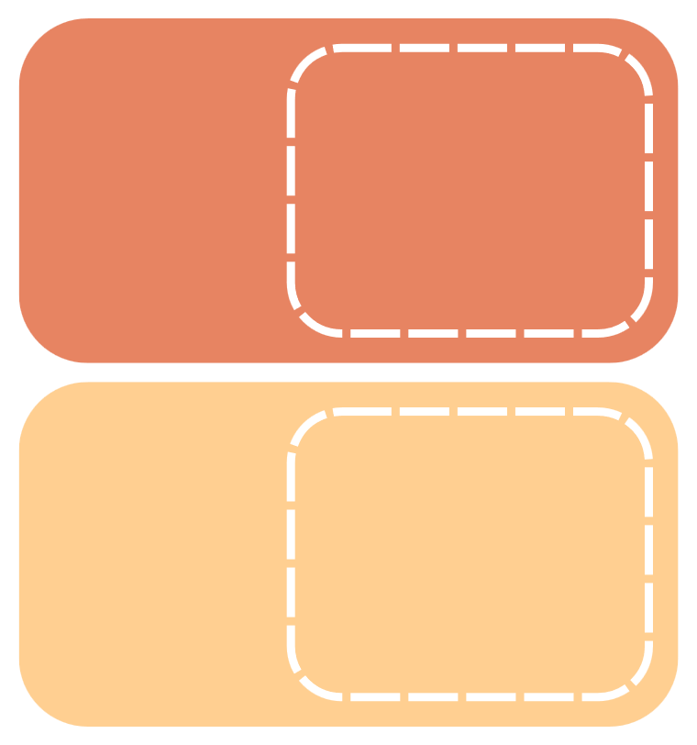
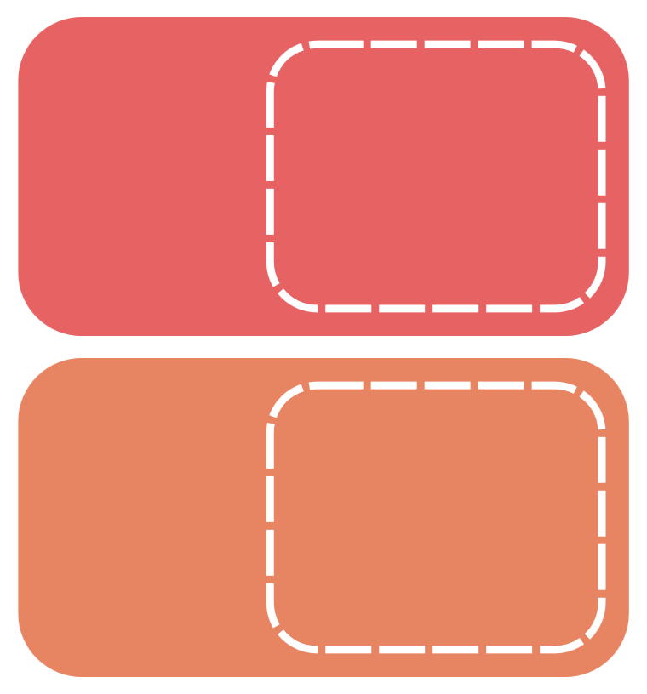

I. QUESTION
3. What is it? - It’s a...
4. How many colors are there in the rainbow?
There are...
5. When do you see the rainbow?
After...
6. Where do you see the rainbow?
In the...

Slide 4



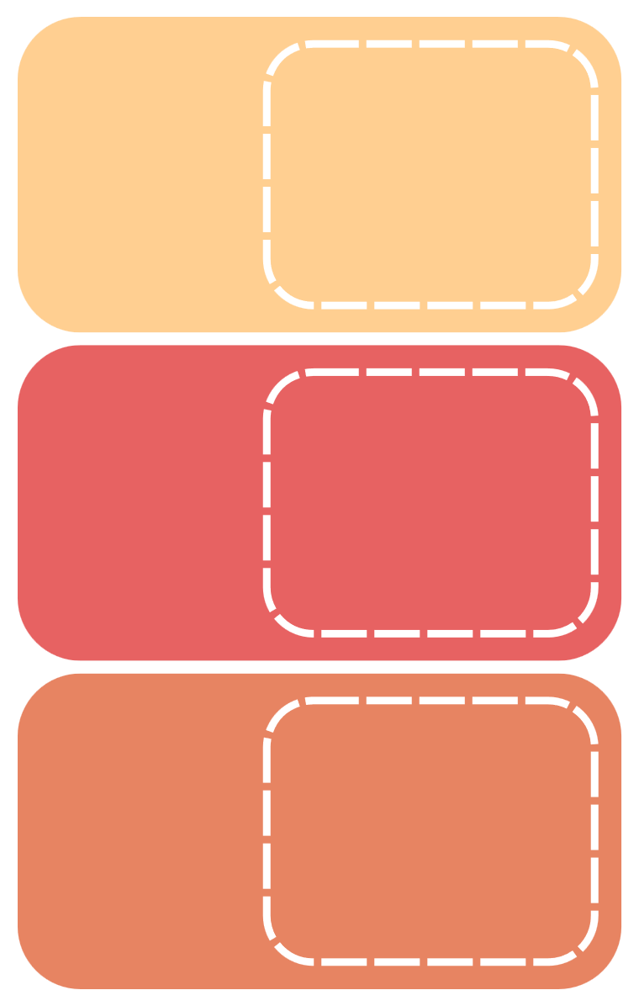

II. VOCABULARY
Orange:.....................................................
Yellow:....................................................
Green:.....................................................
Blue:........................................................

Slide 5



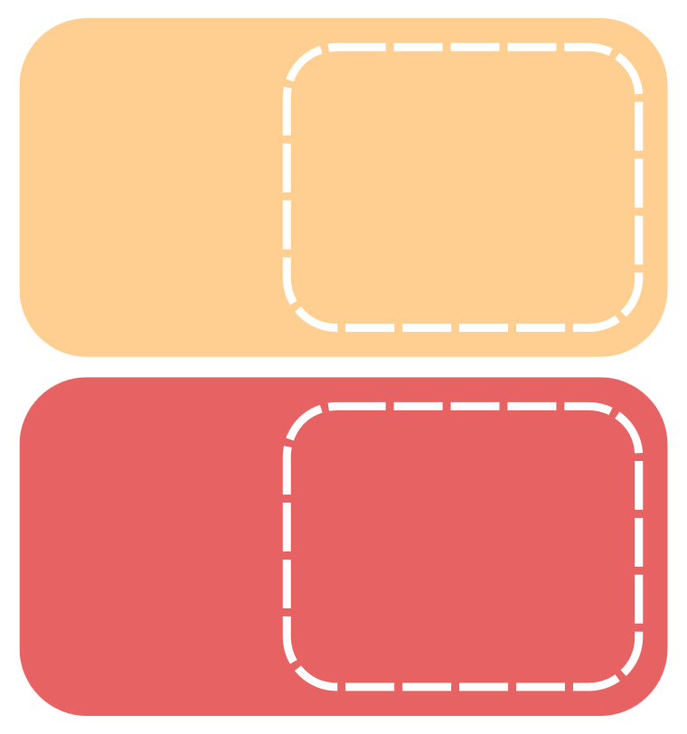


II. VOCABULARY
Purple:.....................................................
Red:.......................................................
Pink:........................................................
Black:........................................................

Slide 6



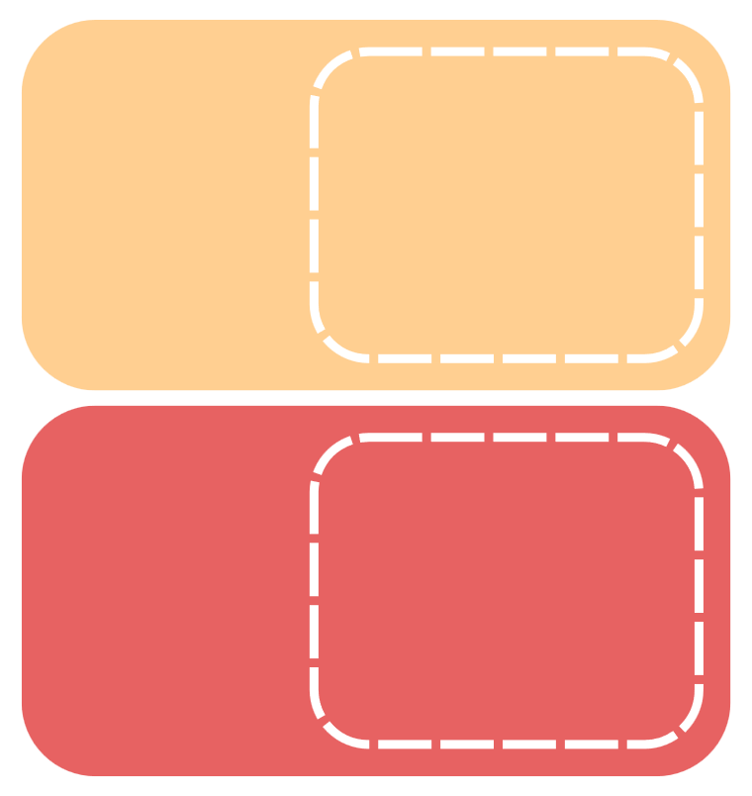




III. EXERCISES
1. Match the words and colors:
pink
blue
purple
green

Slide 7



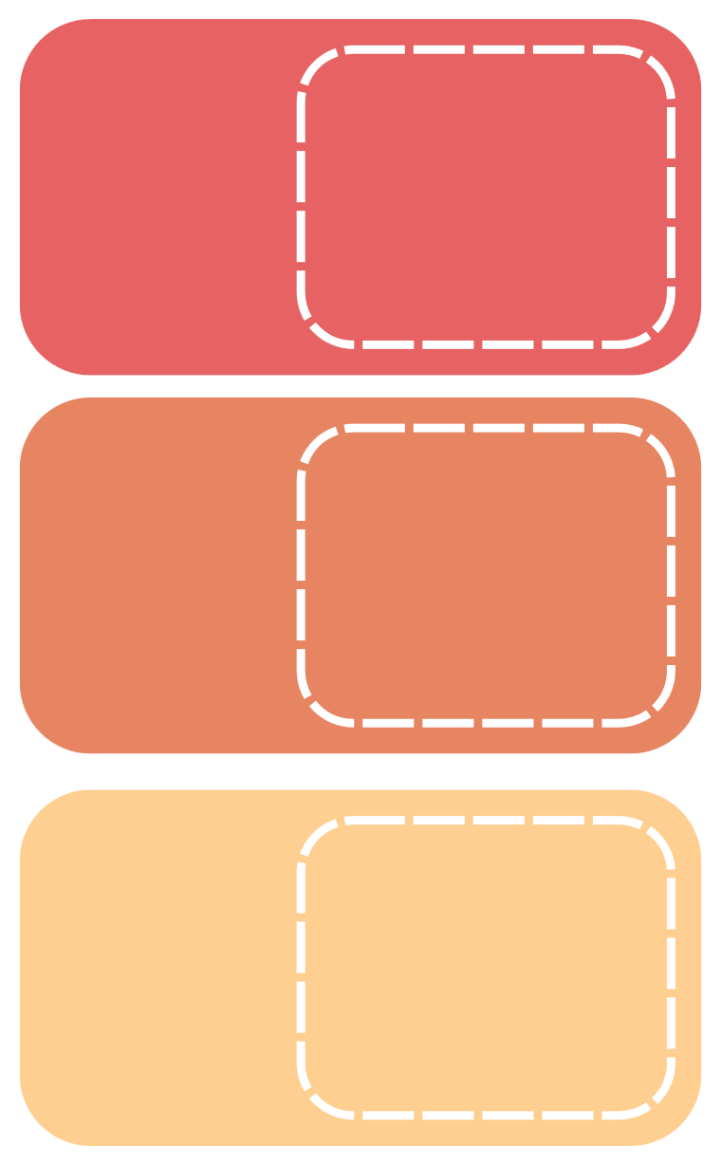
III. EXERCISES
2. Read and color:
BLUE
YELLOW
GREEN
RED
PURPLE

Slide 8




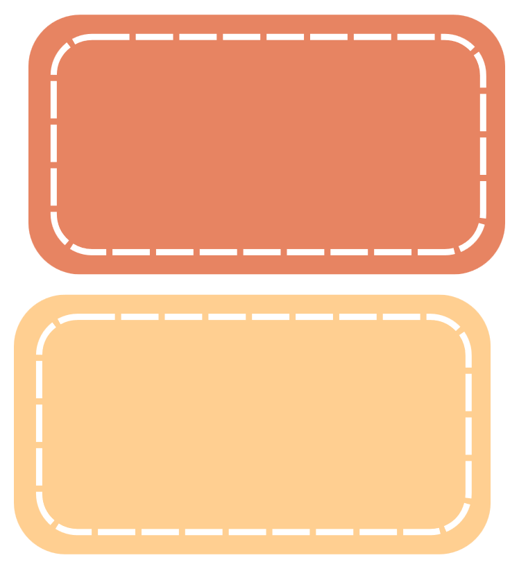


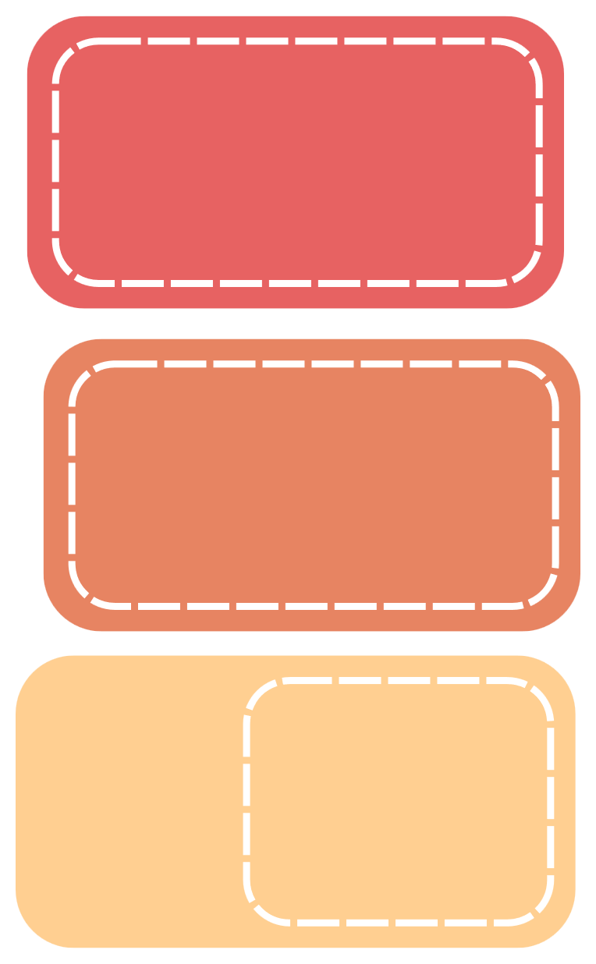



III. EXERCISES
3. Which is different?

Slide 9





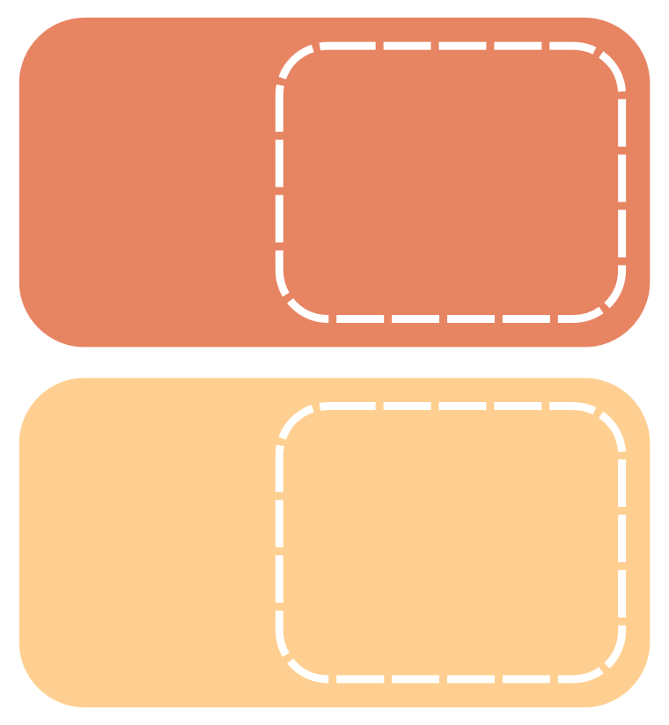
III. EXERCISES
4. Reorder the words:
p/r/u/e/l/p .....
e/b/u/l ...
y/l/e/l/w/o ...
o/g/n/r/a/e ...

Slide 10

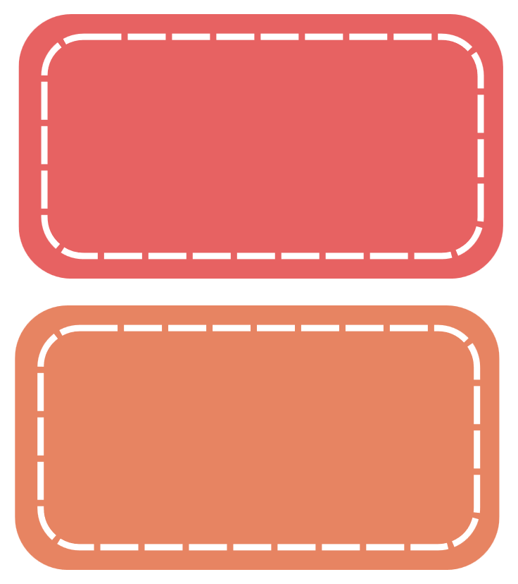
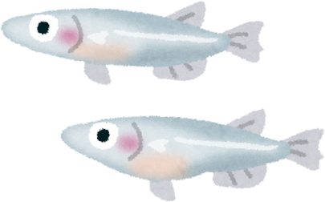


III. EXERCISES
5. Count and write number of objects:
....
....
....

Slide 11

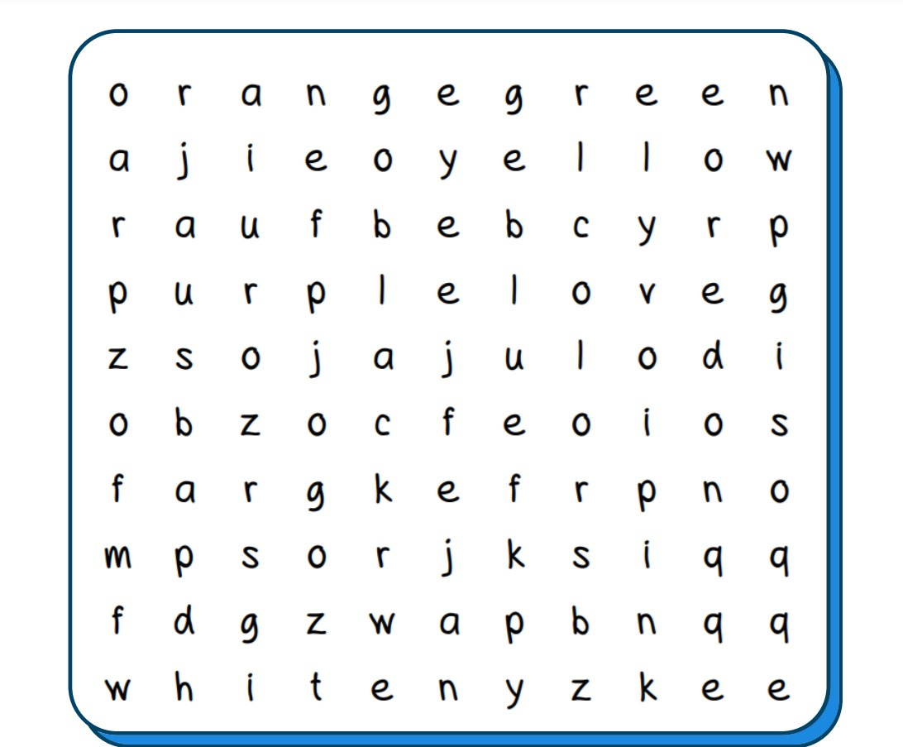
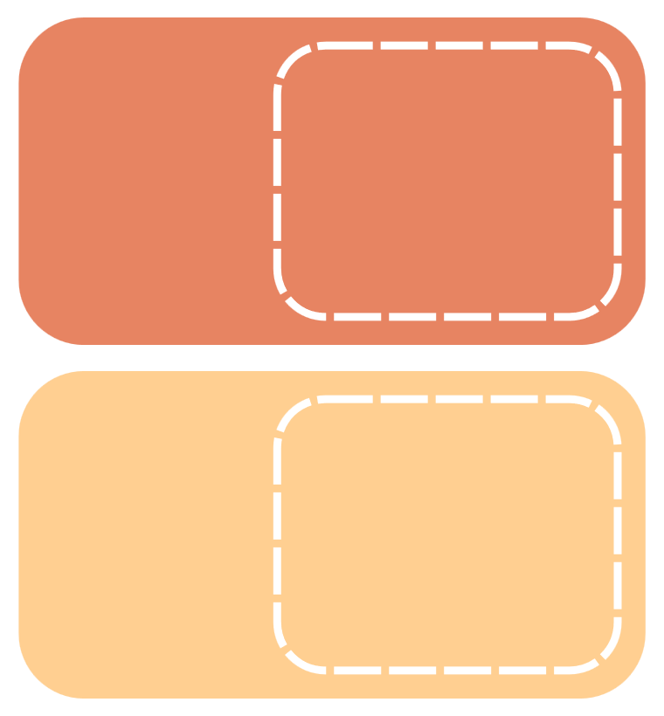
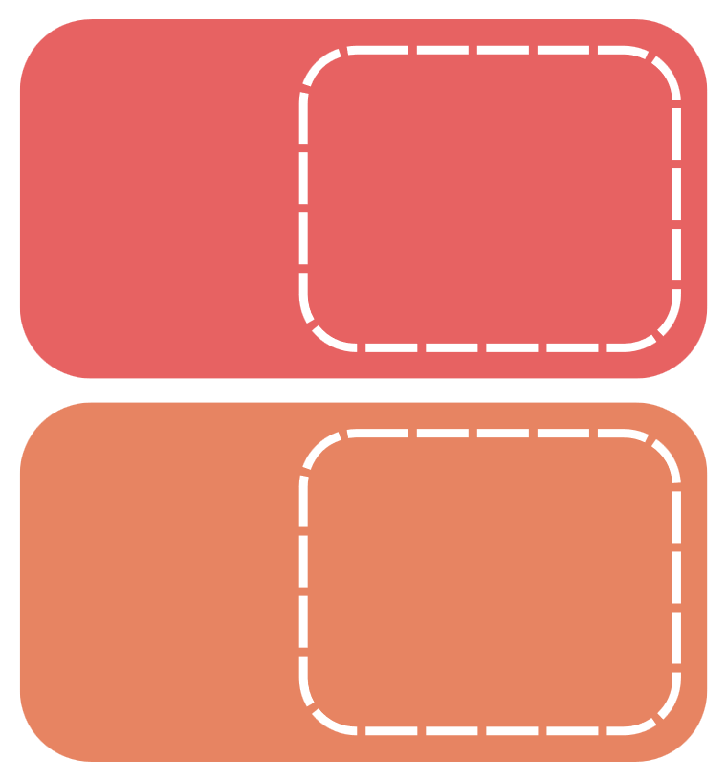
III. EXERCISES
6. Find the word:
orange
yellow green purple

Slide 12
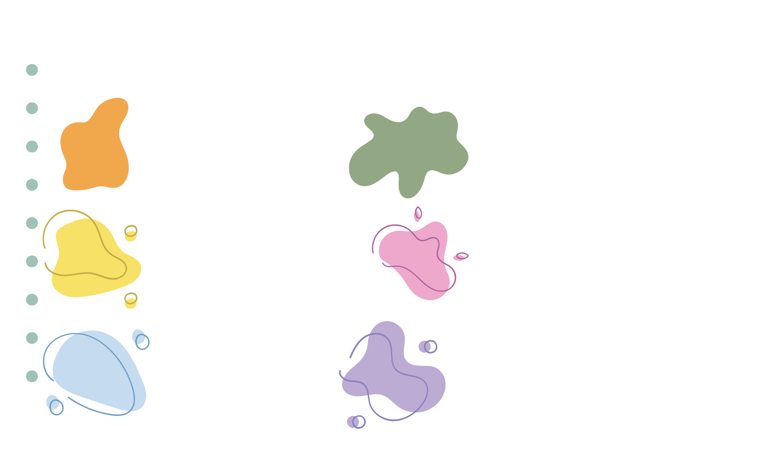
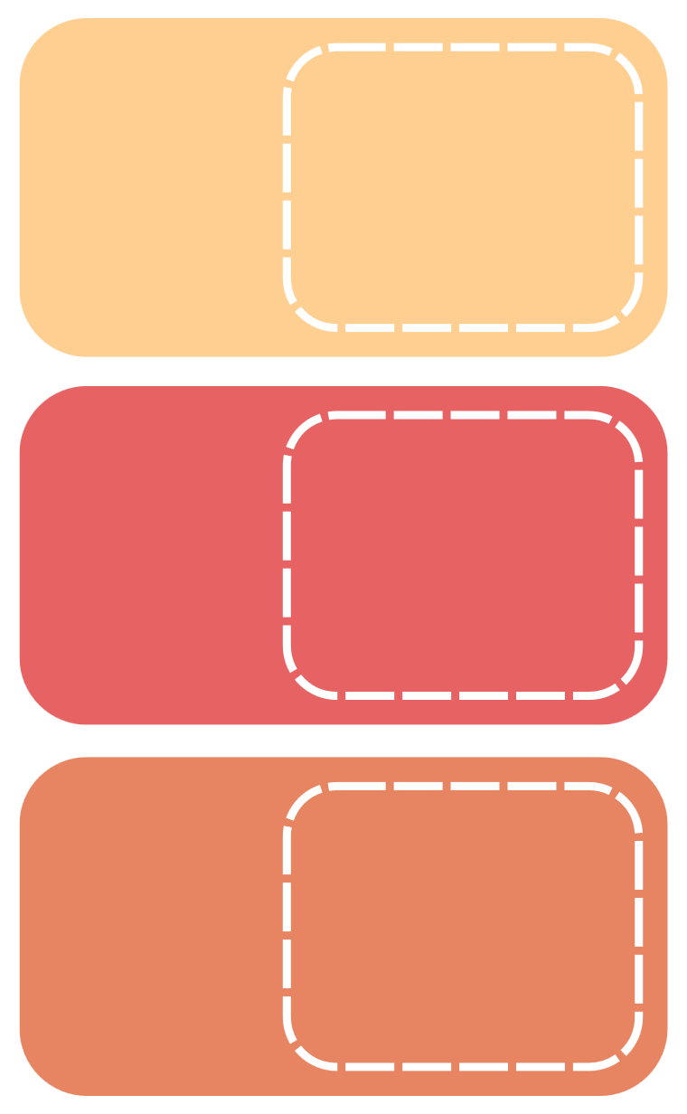
III. EXERCISES
7. True or False:
pink
orange
yellow
black
blue
purple

Slide 13







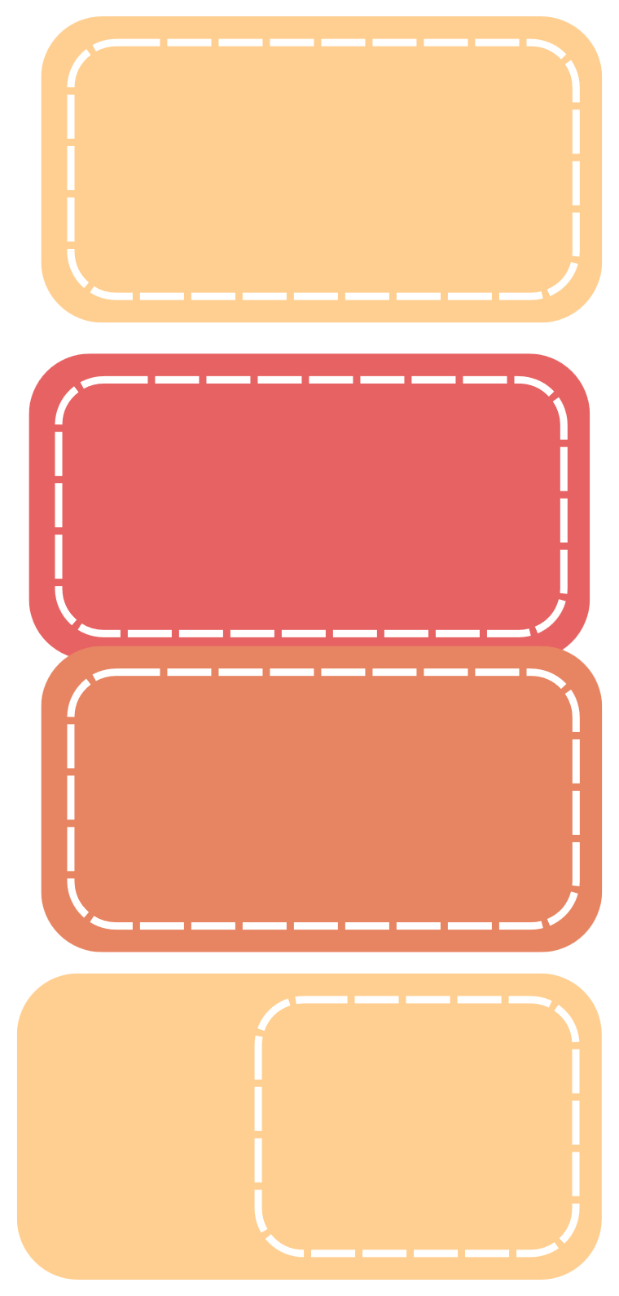
III. EXERCISES
8. Fill the missing letters:
Gre_n
Ye_ _ow
_ed
Bla_k

