Slide 1



Unit 4: OUR PLANET
Lesson 4H: Writing

Slide 2



www.phuongnam.edu.vn

Slide 3
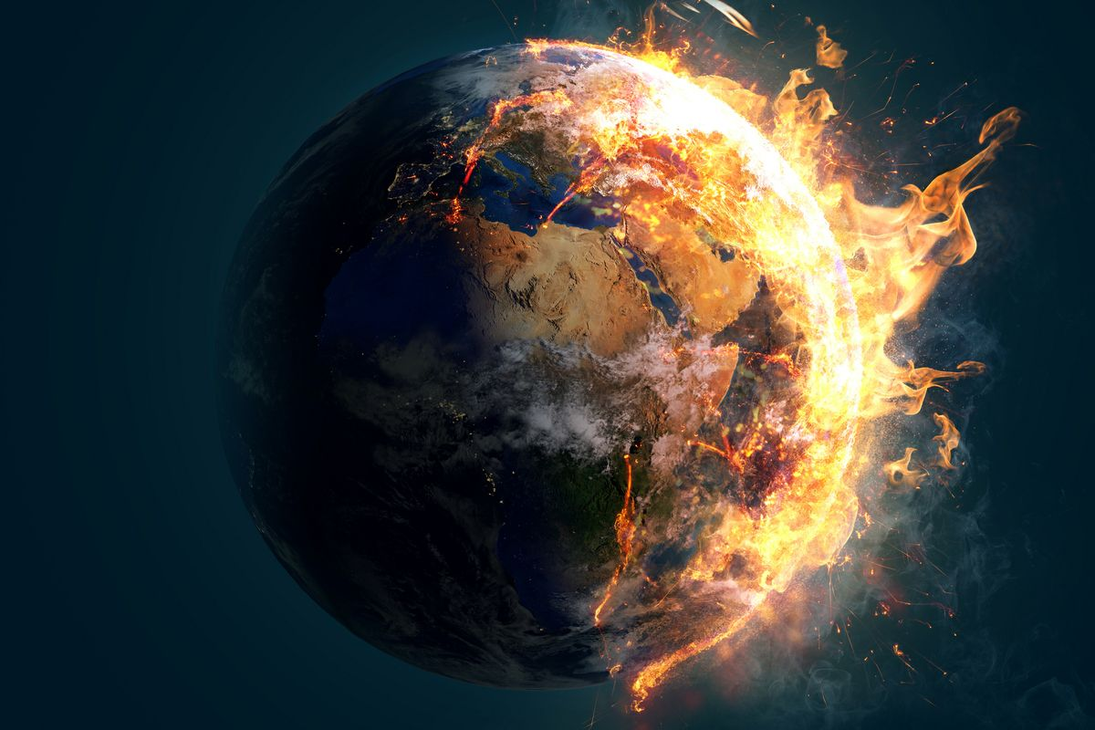

GUESSING GAME
GLOBAL ISSUES

Slide 4
HOW TO PLAY
1. There is an opinion “Most people do not take global warming serious enough.”
2. There are 4 sentences in each question. You will work in pairs and choose which one agrees or disagrees with the opinion based on the requirement.
3. Read the sentences carefully and choose the correct answers.

Slide 5

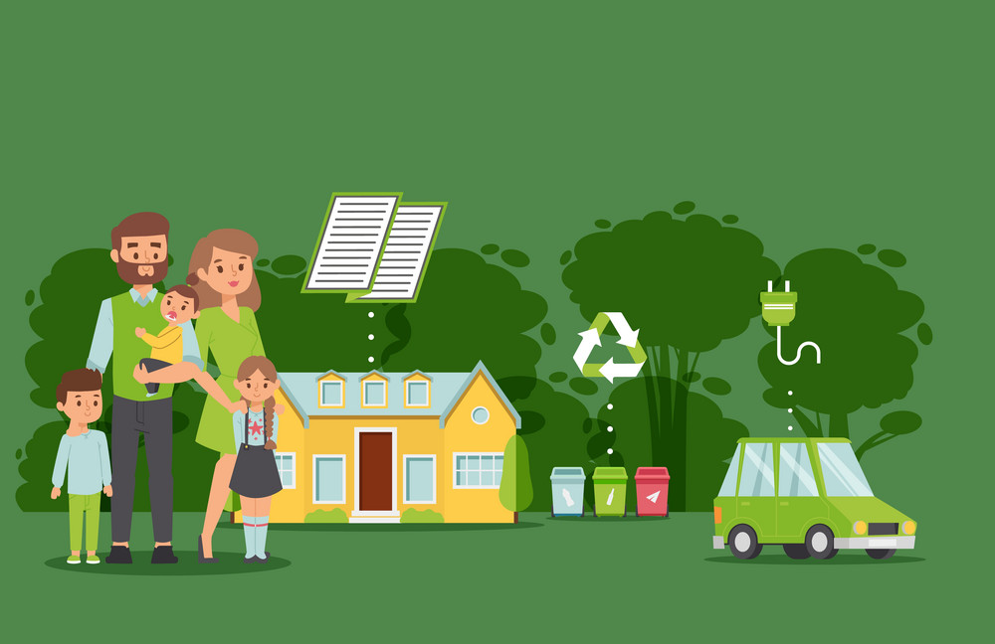
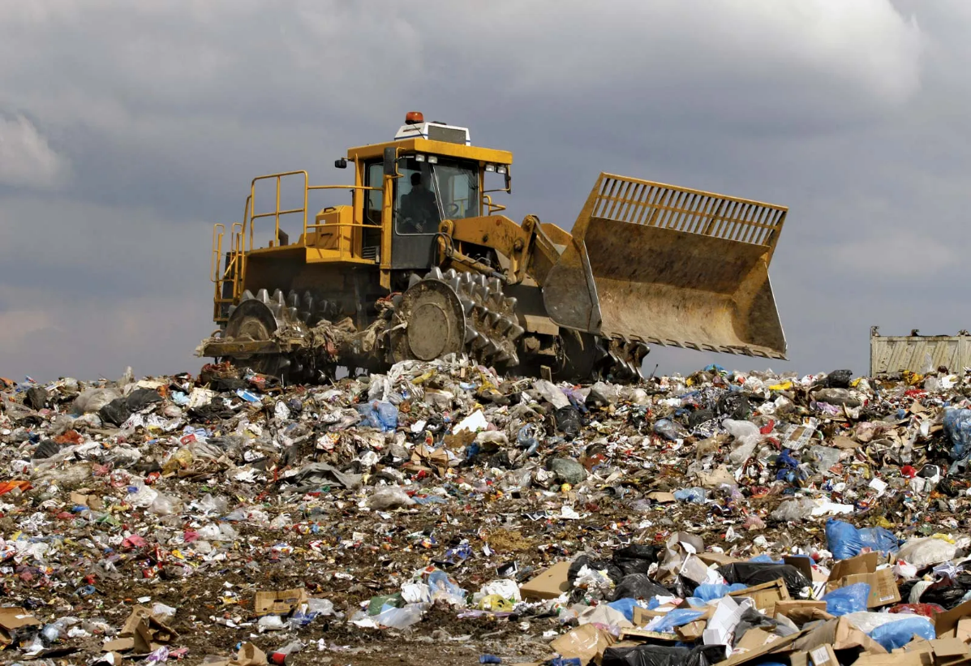

Choose the correct answer that shows the AGREEMENT:
‘Most people do not take global warming seriously enough.’
A. People can find another planet to live.
B. It’s maybe hard to change to a green lifestyle.
D. The temperature of the Earth is normal to go up and down
D. People consume too much

Slide 6
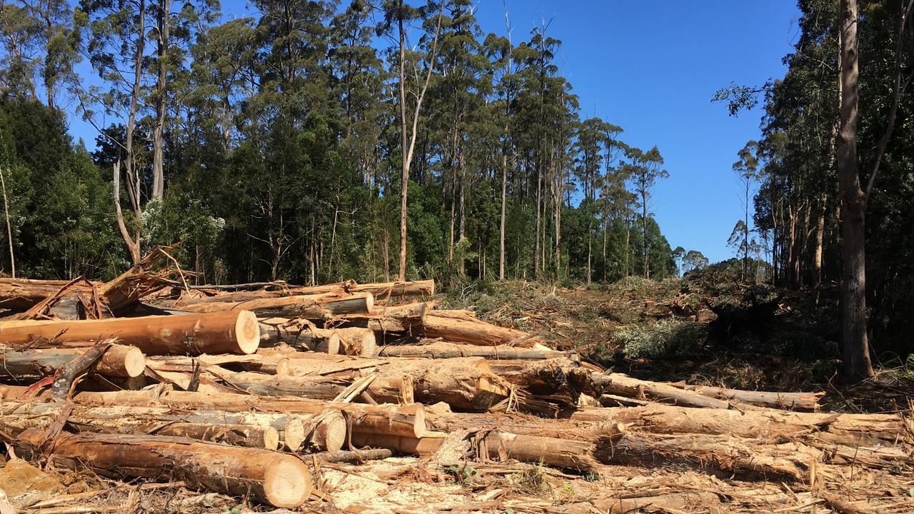
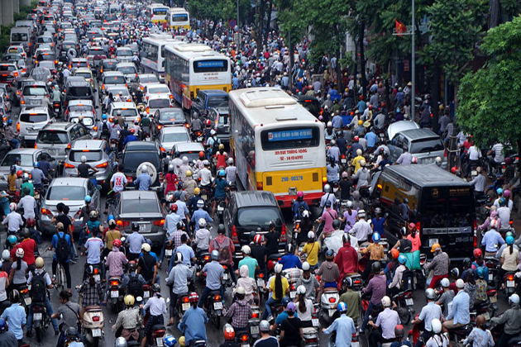
Choose the correct answer that shows the DISAGREEMENT:
‘Most people do not take global warming seriously enough.’
B. People do not cause global warming
.
A. People cut down forests.
C. People using transportation
D. People litter.

Slide 7
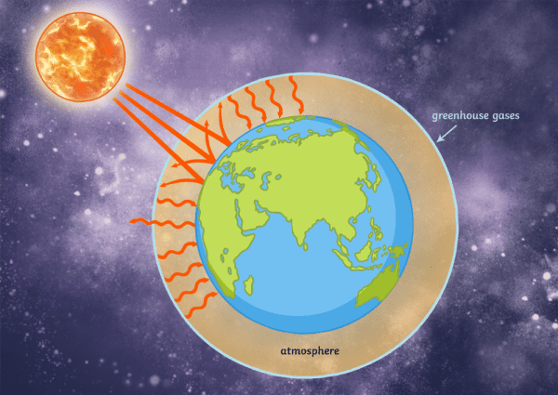
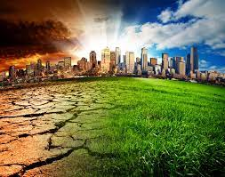
Choose the correct answer that shows the AGREEMENT:
‘Most people do not take global warming seriously enough.’
A. People can find another planet to live.
B. The temperature of the Earth goes up is natural.
C. The greenhouse effects cause global warming
D. People believe they don’t contribute to climate change.

Slide 8
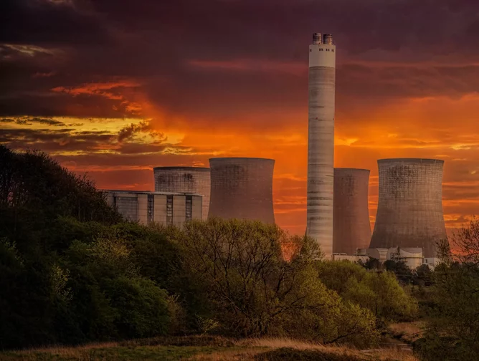
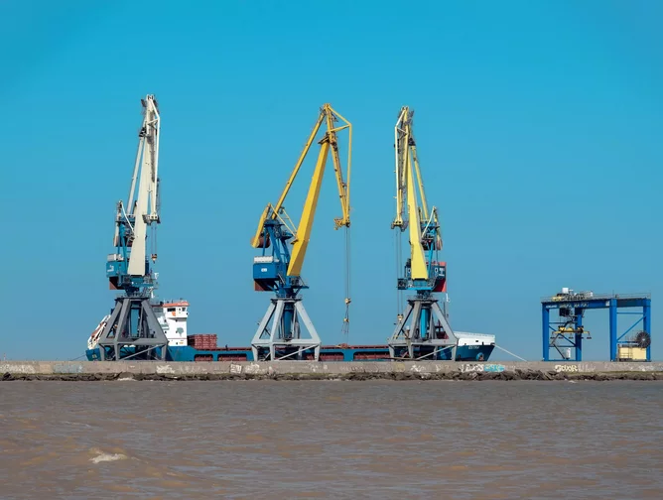
Choose the correct answer that shows the DISAGREEMENT:
‘Most people do not take global warming seriously enough.’
A. The temperature of the Earth is normal to go up and down
B. Oil drilling contributes to climate change
C. Industrialization is harmful for the Earth
D. Power plants are responsible for air pollution

Slide 9
‘Most people do not take global warming seriously enough.’
WHAT ABOUT YOU?
DO YOU AGREE?

Slide 10
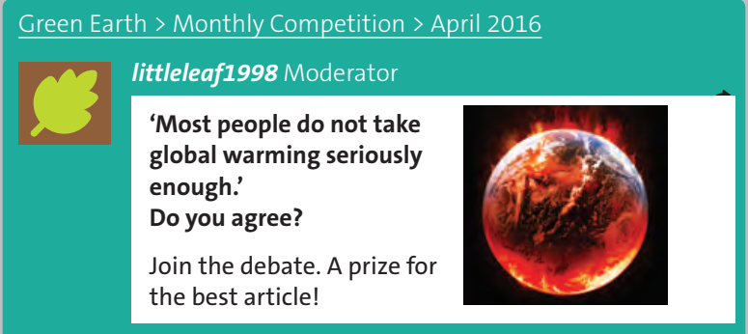
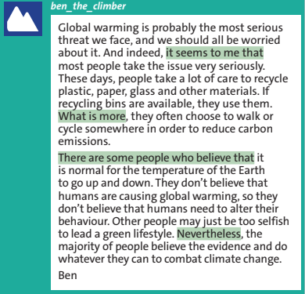
www.phuongnam.edu.vn

Slide 11
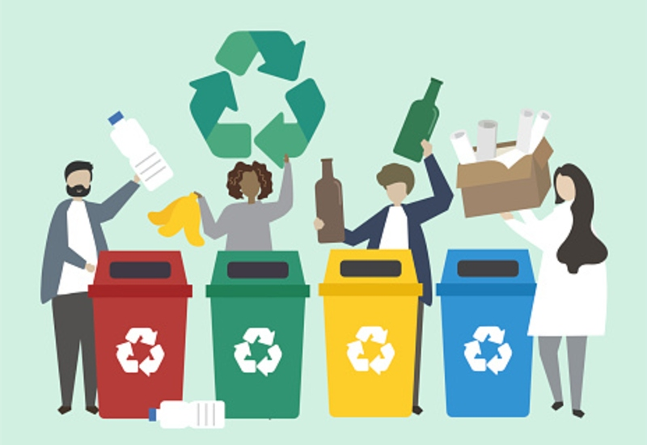
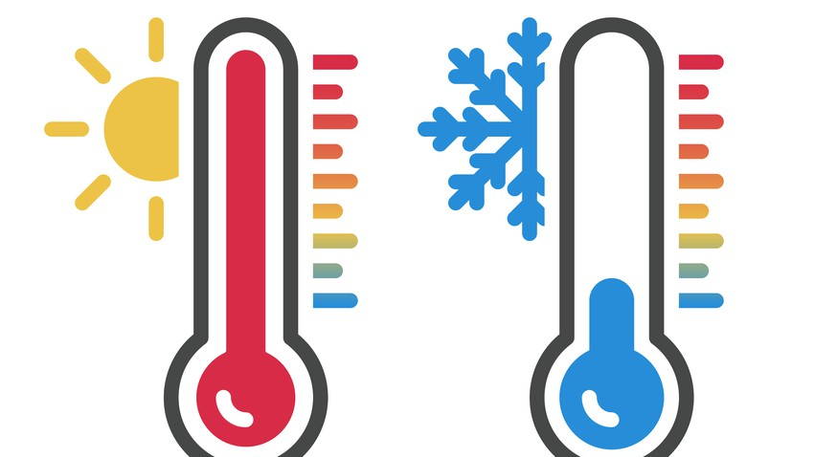
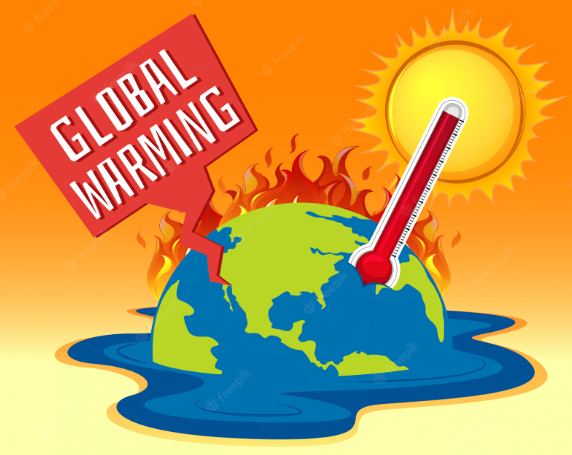
Vocabulary
1. Temperature (n) /ˈtem.prə.tʃər/: the measured amount of heat in a place or in the body
2. Global warming (n) /ˌɡləʊ.bəl ˈwɔː.mɪŋ/: a gradual increase in the earth’s temperature, caused by gases, esp. carbon dioxide, surrounding the earth
3. Recycle (v) /ˌriːˈsaɪ.kəl/: to sort and collect rubbish in order to treat it and produce useful materials that can be used again.
www.phuongnam.edu.vn

Slide 12

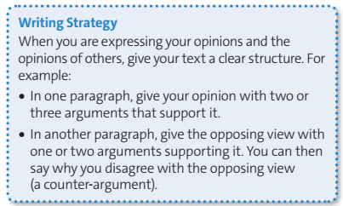
In paragraph 1 of Ben’s article, how many arguments does he give in support of his opinion?
In paragraph 2, how many arguments does he give in support of the opposing view?
Does he give a counter-argument?
Two
Two
Yes
www.phuongnam.edu.vn

Slide 13

Climate change
alter
1. __________ plastic / paper / glass
cause
2. __________carbon emissions
combat
3. __________global warming
lead
4. __________your behaviour
recycle
5. __________a green lifestyle
reduce
6. __________climate change
www.phuongnam.edu.vn

Slide 14

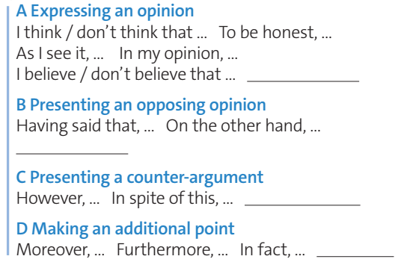
It seems to me that
There are some people who believe that
Nevertheless
What is more
www.phuongnam.edu.vn

Slide 15





www.phuongnam.edu.vn

Slide 16

"Global warming is the most important problem facing us today." Do you agree?
www.phuongnam.edu.vn

Slide 17
SAMPLE ARTICLE:
Global warming which it is observed that the rising temperature of the earth is the most important problem facing us today, and we should be worried about it.
In my opinion, we need to protect the planet from global warming. For a long period of time, it has been affecting the wildlife, animals, humans, and every living organism on earth. Many countries have encountered water shortage, flooding, erosion and all this is because of global warming. If global warming decreases, we can prevent climate change. Moreover, we can also save endangered species.
On the other hand, there are also other lethal problems such as poverty, disease, and famine. It cannot be denied that millions of people die every year because of them. However, they are, in fact, an effect of global warming. Therefore, the result of global warming should be considered the deadliest threat.
No one can be blamed for global warming except for humans. Spreading awareness about global warming will contribute in big or small amounts. It’s important that we learn 1% effort is better than no effort. Pledge to take care of mother nature and speak up about global warming.
www.phuongnam.edu.vn

Slide 18
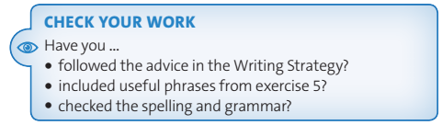
www.phuongnam.edu.vn

Slide 19
Homework
 Learn by heart all the new words.
 Prepare for next lesson – culture: Extreme weather
www.phuongnam.edu.vn

Slide 20
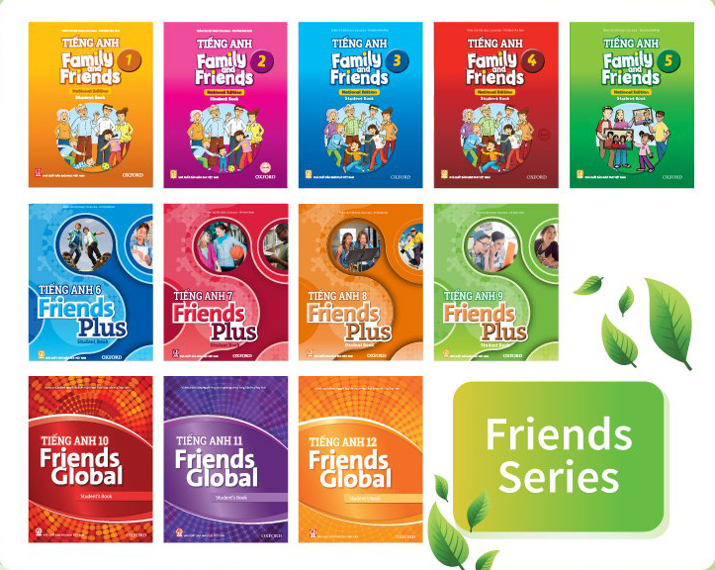
www.phuongnam.edu.vn

Slide 21



Thank you!
CTCP ĐẦU TƯ VÀ PHÁT TRIỂN GIÁO DỤC PHƯƠNG NAM

