Slide 2
Review 2
LESSON 2
SKILLS (1)
Listening & Speaking

Slide 3
LESSON 2
SKILLS (1)
WARM-UP
Video watching
Task 1: Listen to a talk about a city. What is it about?
Task 2: Listen and complete the notes.
LISTENING
Task 1: Complete the table.
Task 2: Discussion.
SPEAKING
Wrap-up
Homework
CONSOLIDATION

Slide 4
WARM-UP
VIDEO WATCHING
What do cities of the future look like?

Slide 5

WARM-UP
Notes:
Link: https://www.youtube.com/watch?v=TiIFzV4d2NE

Slide 6

LISTENING
1
Listen to a talk about a city. What is it about?
A. How Dream City has changed.
B. The modern facilities in Dream City.
C. Why people want to live in Dream City.

Slide 7
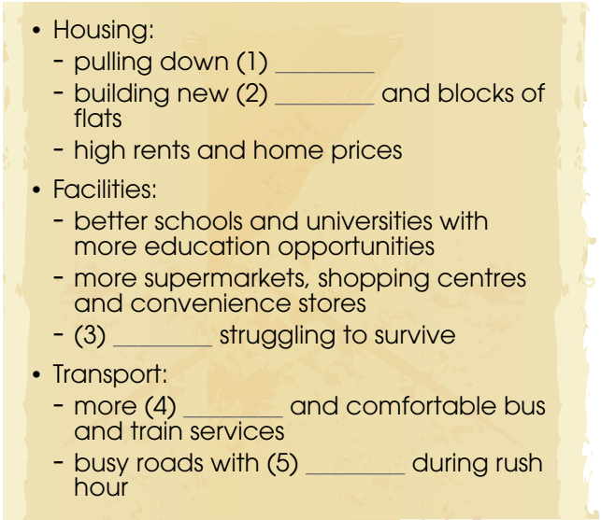
LISTENING
2
Listen again and complete the notes.
Key:
1. old houses
2. high-rise buildings
3. traditional markets
4. frequent
5. traffic jams

Slide 8
SPEAKING
1
Discuss the impact of urban development on people’s life and complete the following table.
Urban development | Positive and/or negative impact on urban life
1. Growing population | Housing shortage, higher rents and home prices
2. More schools and universities
3. Expanded roads
4. More shops, restaurants, and supermarkets
Higher unemployment
More convenient traffic
More convenient shopping, but more difficulties for traditional markets.

Slide 9
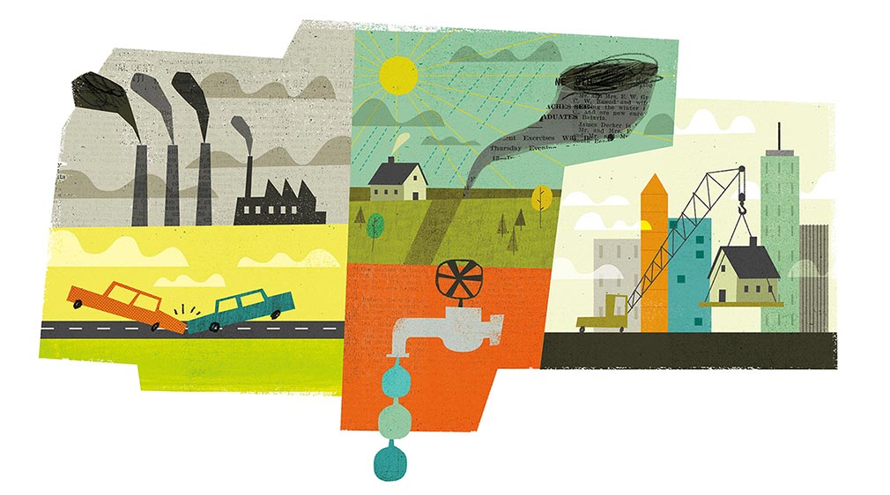

SPEAKING
2
Which change in 1 do you think has the most positive impact, and which one has the most negative impact on urban life?

Slide 10
CONSOLIDATION
1
Wrap-up
What have you learnt today?
Revise listening and speaking skills

Slide 11
CONSOLIDATION
2
Homework
Do exercises in the workbook.
Prepare for Review 2: Skills (Reading & Writing)

Slide 12
Website: hoclieu.vn
Fanpage: facebook.com/www.tienganhglobalsuccess.vn

