Slide 1



Unit 1: Feelings
Lesson 1F: Reading

Slide 2







I went to school.
I went to school.
Guess the signs
www.phuongnam.edu.vn

Slide 3



can enter, but don’t let owner see you
shouldn’t enter at night
may not enter at all cost

Slide 4
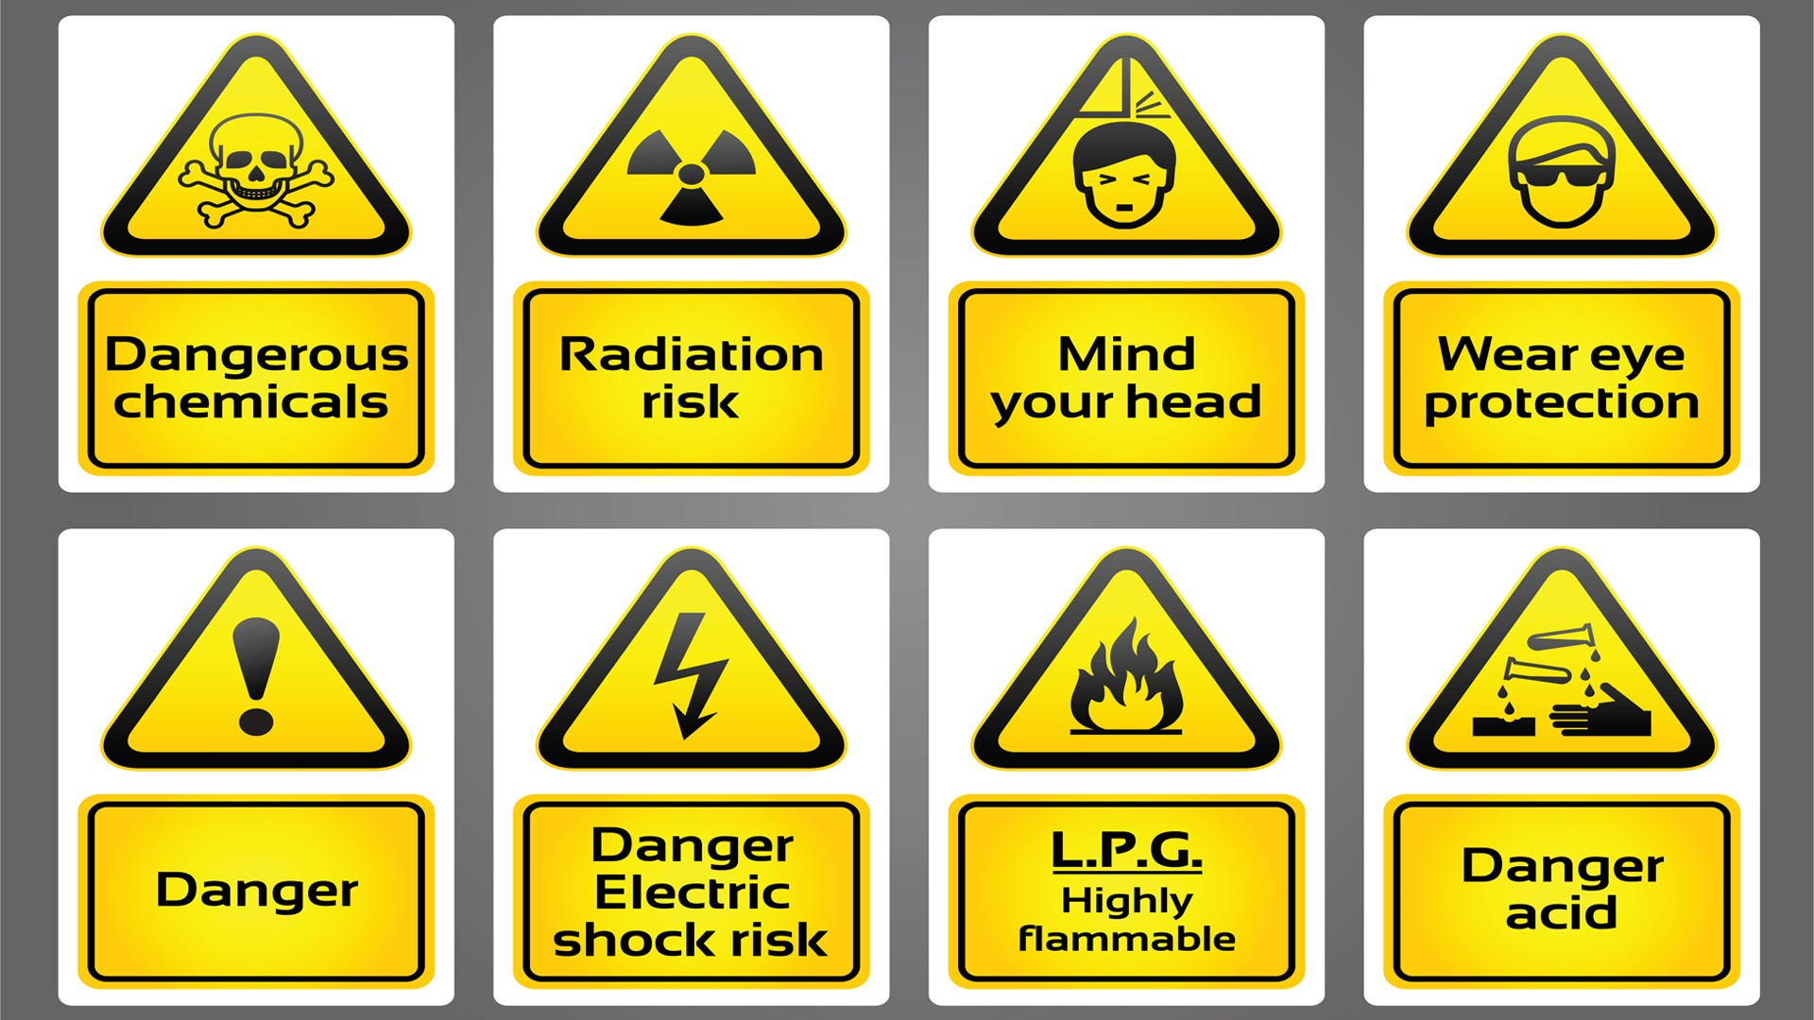
close your eyes
don’t worry about your head
mind your head

Slide 5
electric shock risk
stand right here please
eat some snacks

Slide 6
caution, wet floor
highly flammable
do your homework

Slide 7

put your hand up
slippery when wet
hiphop never dies

Slide 8

just smoke freely
no smoking here
don’t eat cigarette

Slide 9

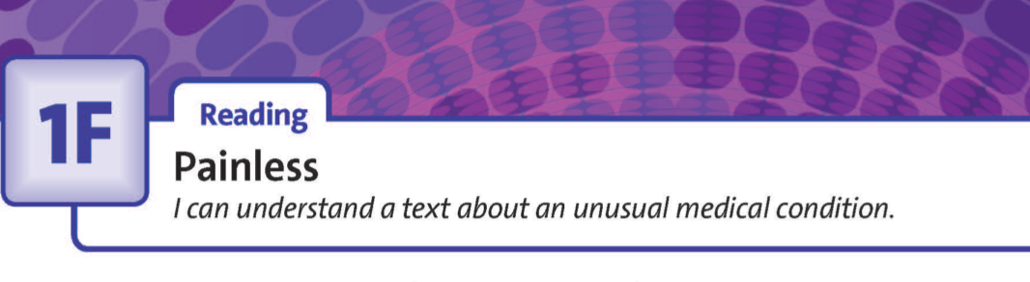

UNIT 1:
FEELINGS
www.phuongnam.edu.vn

Slide 10

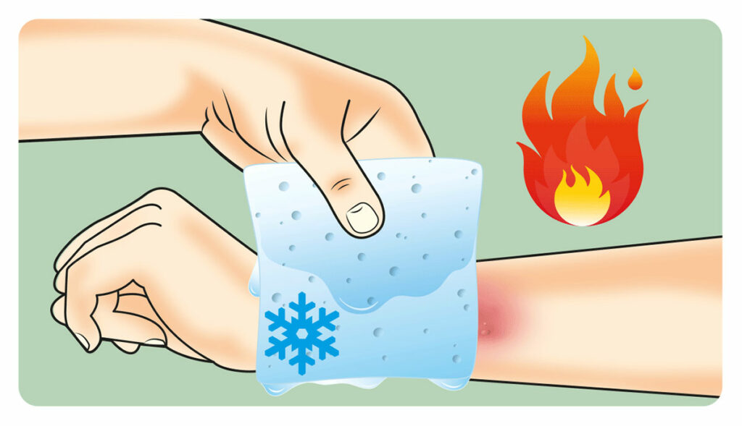
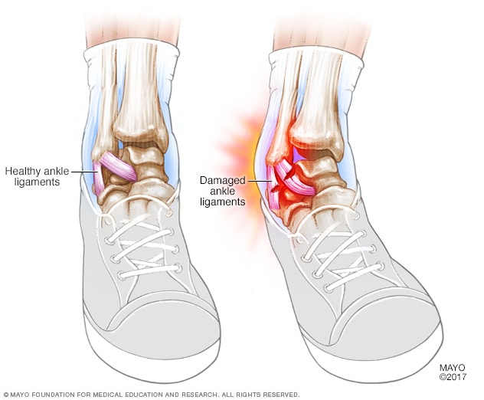
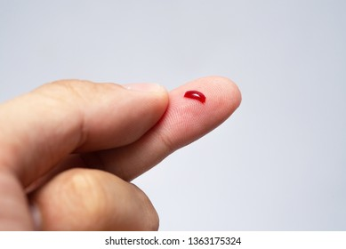
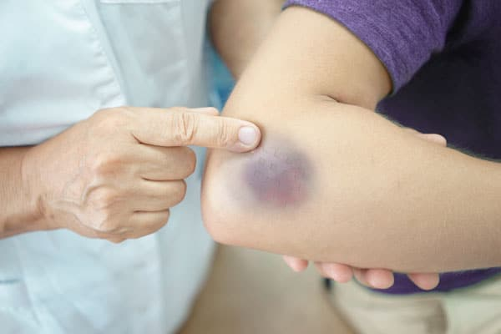
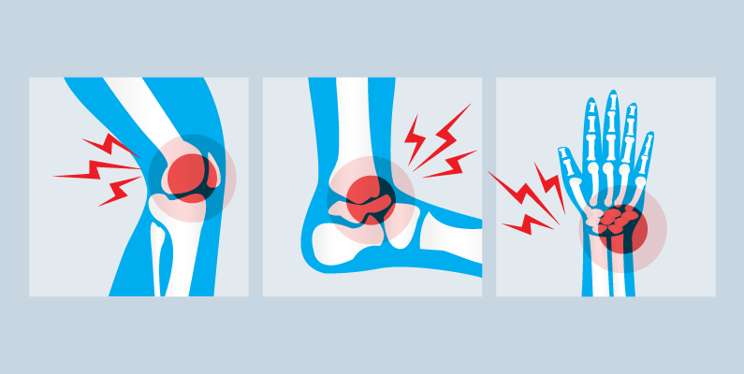
New words
- injury (n) /ˈɪn.dʒər.i/
: physical harm or damage done to a living thing
- injure (v) UK:/ˈɪn.dʒər/ US:/ˈɪn.dʒɚ/
- blood (n) /blʌd/
: the red liquid that is sent around the body by the heart and that is necessary for life
- bleed (v) /bliːd/
: a place on a person’s skin that is darker from bleeding under the skin, usually from an injury
- bruise (n) /bruːz/
- sprain (n,v) /spreɪn/
: an injury to a joint (= a place where two bones are connected) caused by a sudden movement
- burn (n,v) UK:/bɜːn/ US:/bɝːn/
: to be hurt, damaged, or destroyed by fire or extreme heat, or to cause this to happen
www.phuongnam.edu.vn

Slide 11
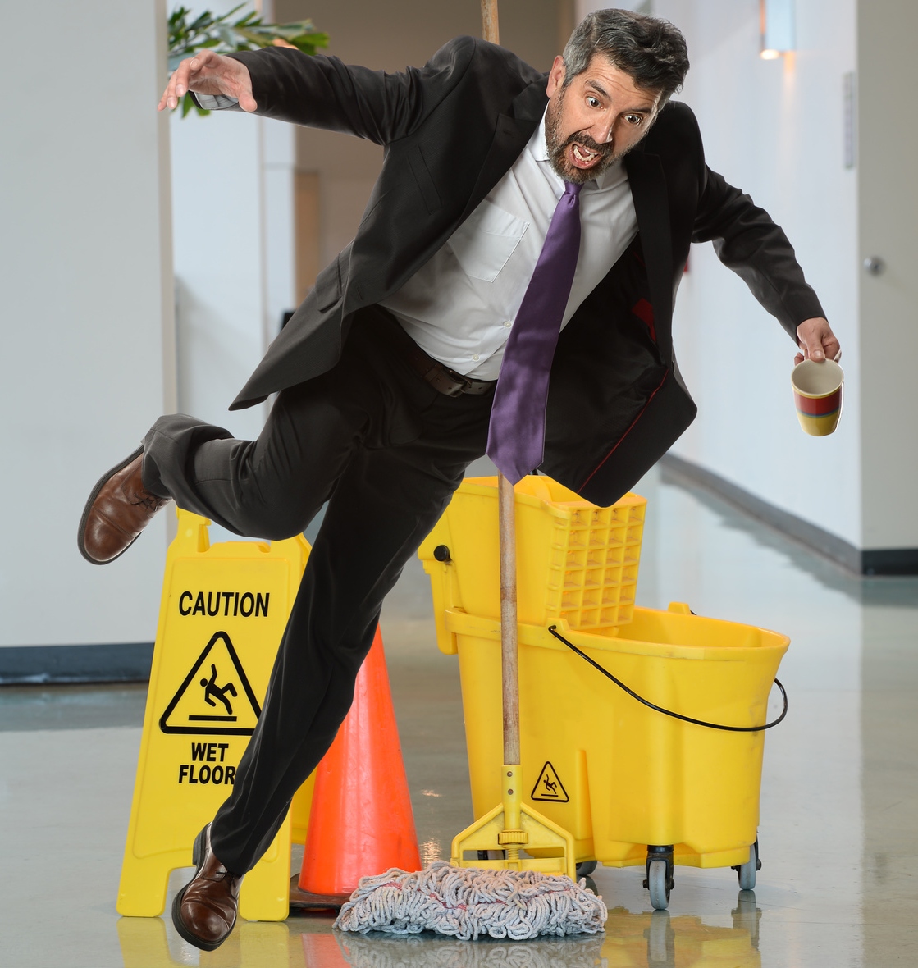
- fall / trip / slip over (phrasal verb):
: To trip or stumble and almost fall as a result of bumping into someone or something with one's feet.
www.phuongnam.edu.vn

Slide 12
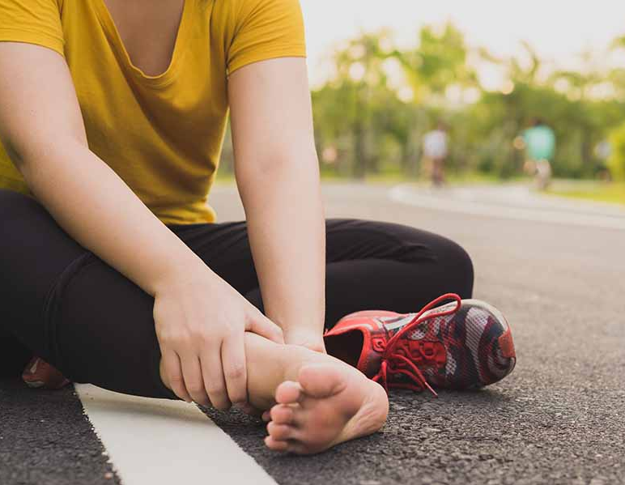
- sprain your ankle / wrist (phrase):
: when your ankle / wrist is forced to move out of its normal position
www.phuongnam.edu.vn

Slide 13
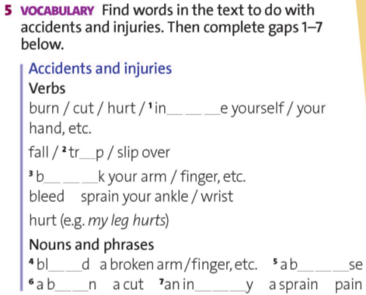


j u r
i
r e a
o o
r u i
u r
j u r
www.phuongnam.edu.vn

Slide 14

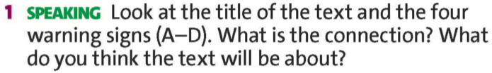
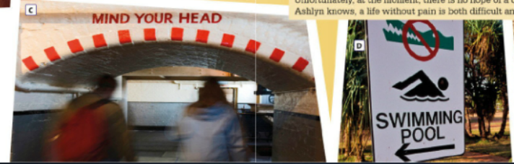
The text may be about the life of a girl who cannot feel pain.
www.phuongnam.edu.vn

Slide 15

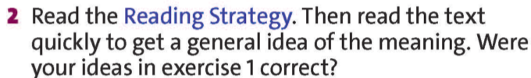
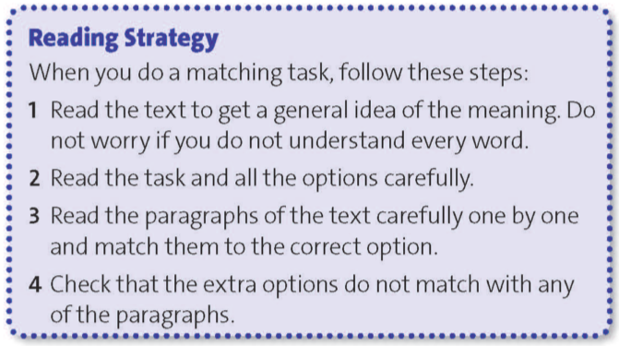
www.phuongnam.edu.vn

Slide 16
3. Read the text again. Match the questions below with paragraphs A-E of the text.
1. when doctors realized Ashlyn had a medical problem?
A
2. what causes her condition?
B
3. what happened when she burned her hands?
C
Check all
4. why some people die from this condition?
D
5. how school life for Ashlyn was unusual?
E
www.phuongnam.edu.vn

Slide 17
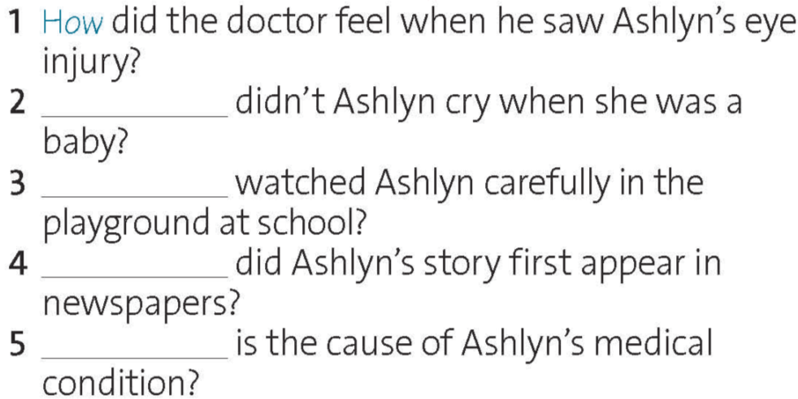
4. Complete the questions using the question words below.
When
What
Who
Why
Check all
www.phuongnam.edu.vn

Slide 18
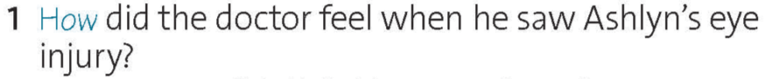
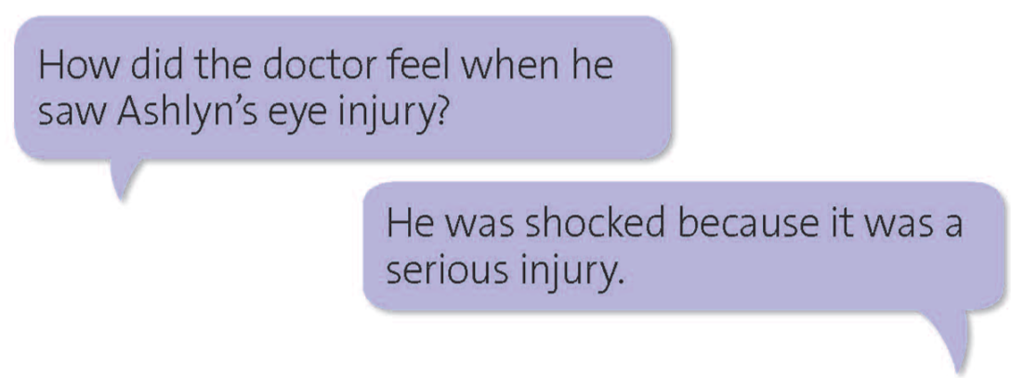
4. Take turns to ask and answer the question in pairs.
(Paragraph B, line 4)
www.phuongnam.edu.vn

Slide 19
4. Take turns to ask and answer the question in pairs.
2. Why didn’t Ashlyn cry when she was a baby?
She didn’t cry when she was a baby because she couldn’t feel any pain.
(Paragraph B, line 6)
www.phuongnam.edu.vn

Slide 20
4. Take turns to ask and answer the question in pairs.
3. Who watched Ashlyn carefully in the playground at school?
A teacher watched her.
(Paragraph D, line 3)
www.phuongnam.edu.vn

Slide 21
4. Take turns to ask and answer the question in pairs.
4. When did Ashlyn’s story first appear in newspapers?
It appeared when Ashlyn was five.
(Paragraph E, line 1)
www.phuongnam.edu.vn

Slide 22
4. Take turns to ask and answer the question in pairs.
5. What is the cause of Ashlyn’s medical condition?
It is a genetic disorder. Pain signals do not reach the brain.
(Paragraph E, line 3)
www.phuongnam.edu.vn

Slide 23

GROUP DISCUSSION
www.phuongnam.edu.vn

Slide 24
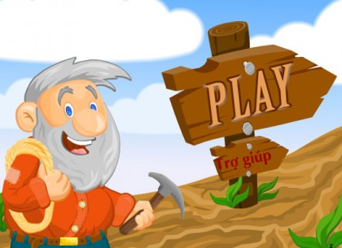

Mining
game
www.phuongnam.edu.vn

Slide 25
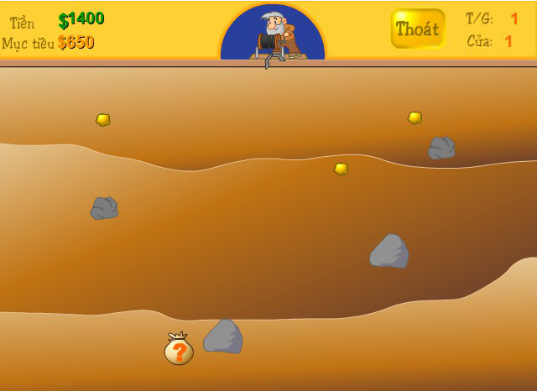




10$
20$
50$
150$
150$
www.phuongnam.edu.vn

Slide 26
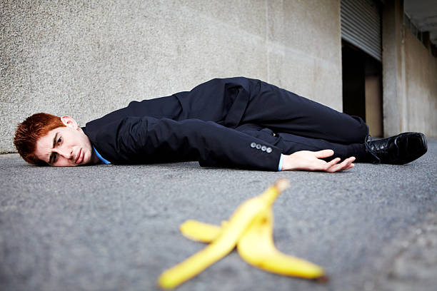

I slipped over the banana when I…

Slide 27
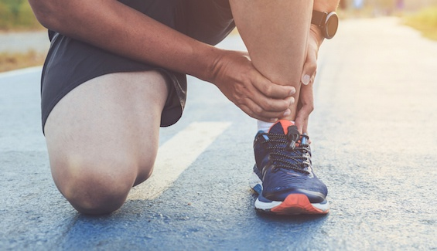
I sprained my ankle when I…

Slide 28
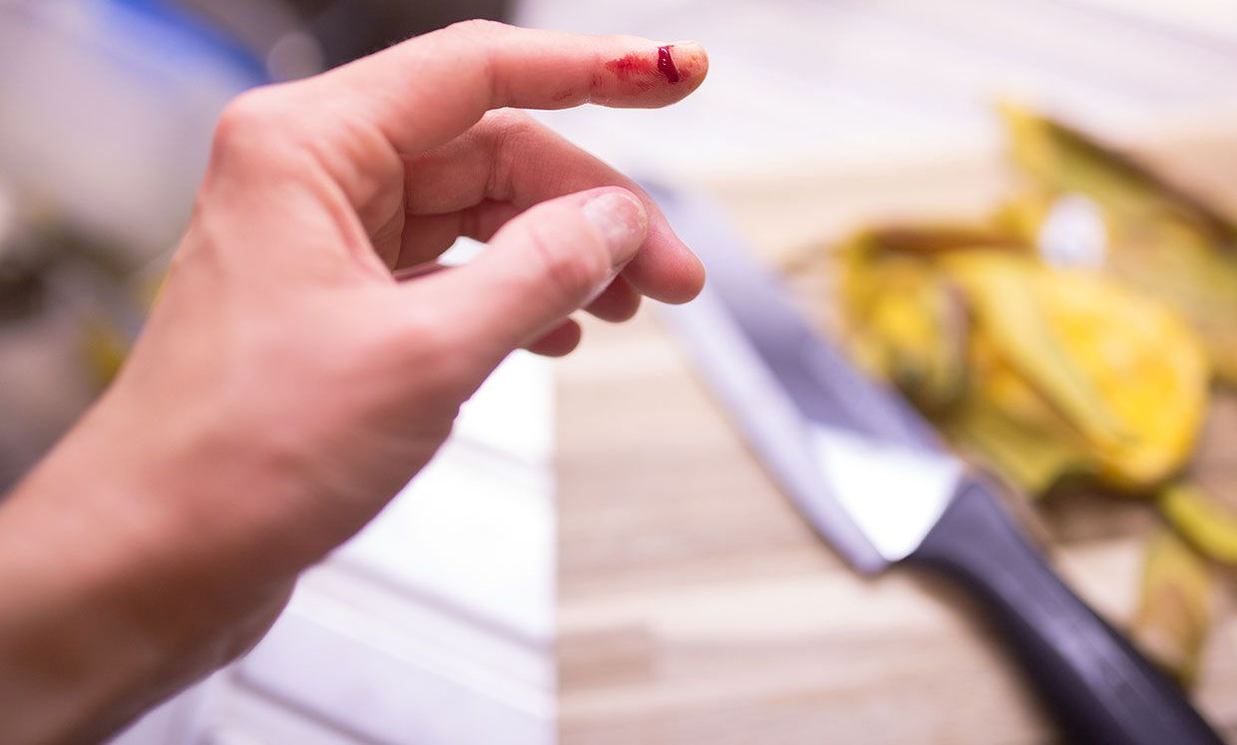
I cut my finger when I…

Slide 29
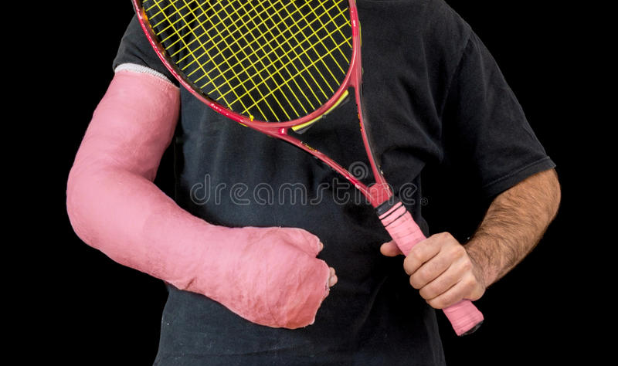
I broke my arm when I…

Slide 30
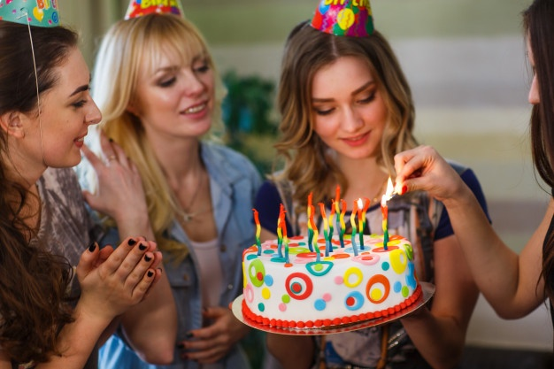
I burned my hand when I…

Slide 31

Homework
Prepare next lesson – Speaking.
+ Review all new vocabulary.
+ Practice talking about a time
when you hurt or injured yourself.
www.phuongnam.edu.vn

Slide 32

www.phuongnam.edu.vn

Slide 33



Thank you!
CTCP ĐẦU TƯ VÀ PHÁT TRIỂN GIÁO DỤC PHƯƠNG NAM

