Slide 1

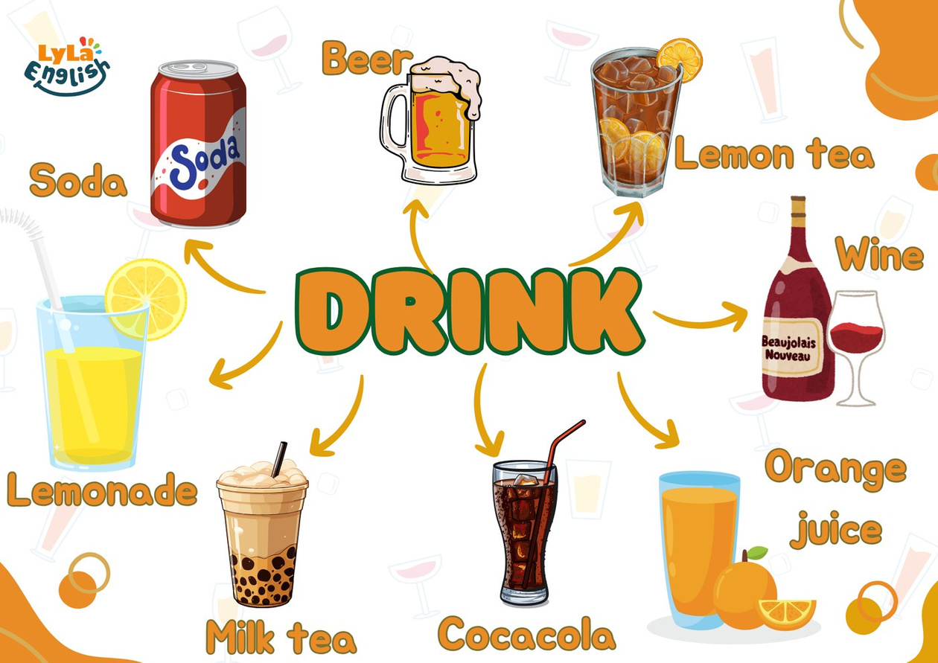


Slide 2
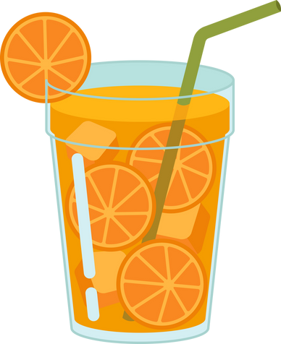

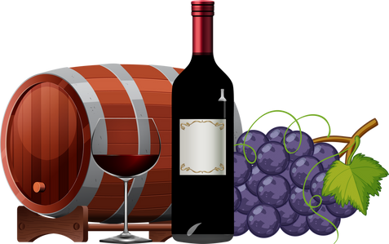
I. QUESTION
1. What is your favorite drink? - It’s ...
2. How does it taste? - It’s ...
3. What drink is bad for your health? - It’s ...

Slide 3

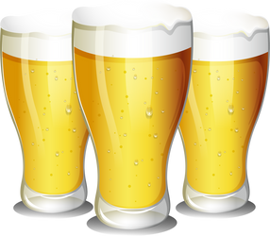
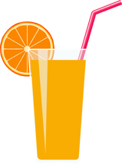
II. VOCABULARY
Soda:.....................................................
Wine:.....................................................
Beer:.......................................................
Orange juice:............................................

Slide 4
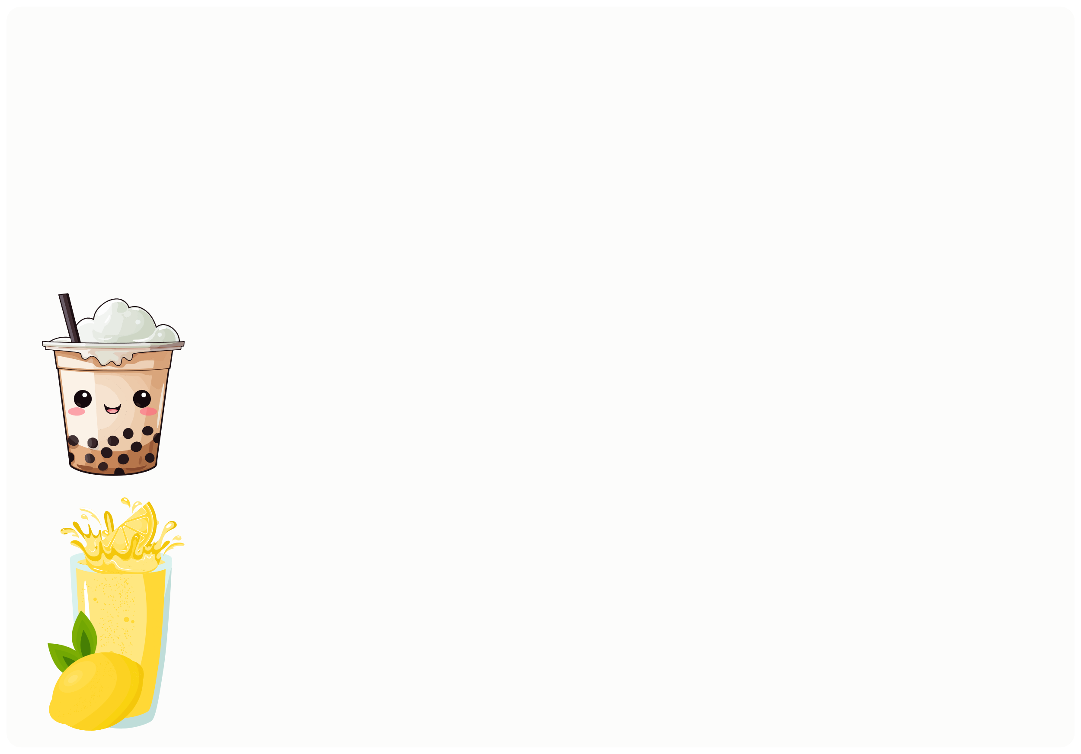
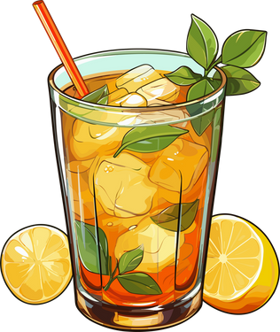
II. VOCABULARY
Lemontea:.....................................................
Milk tea:........................................................
Lemonade:.......................................................

Slide 5
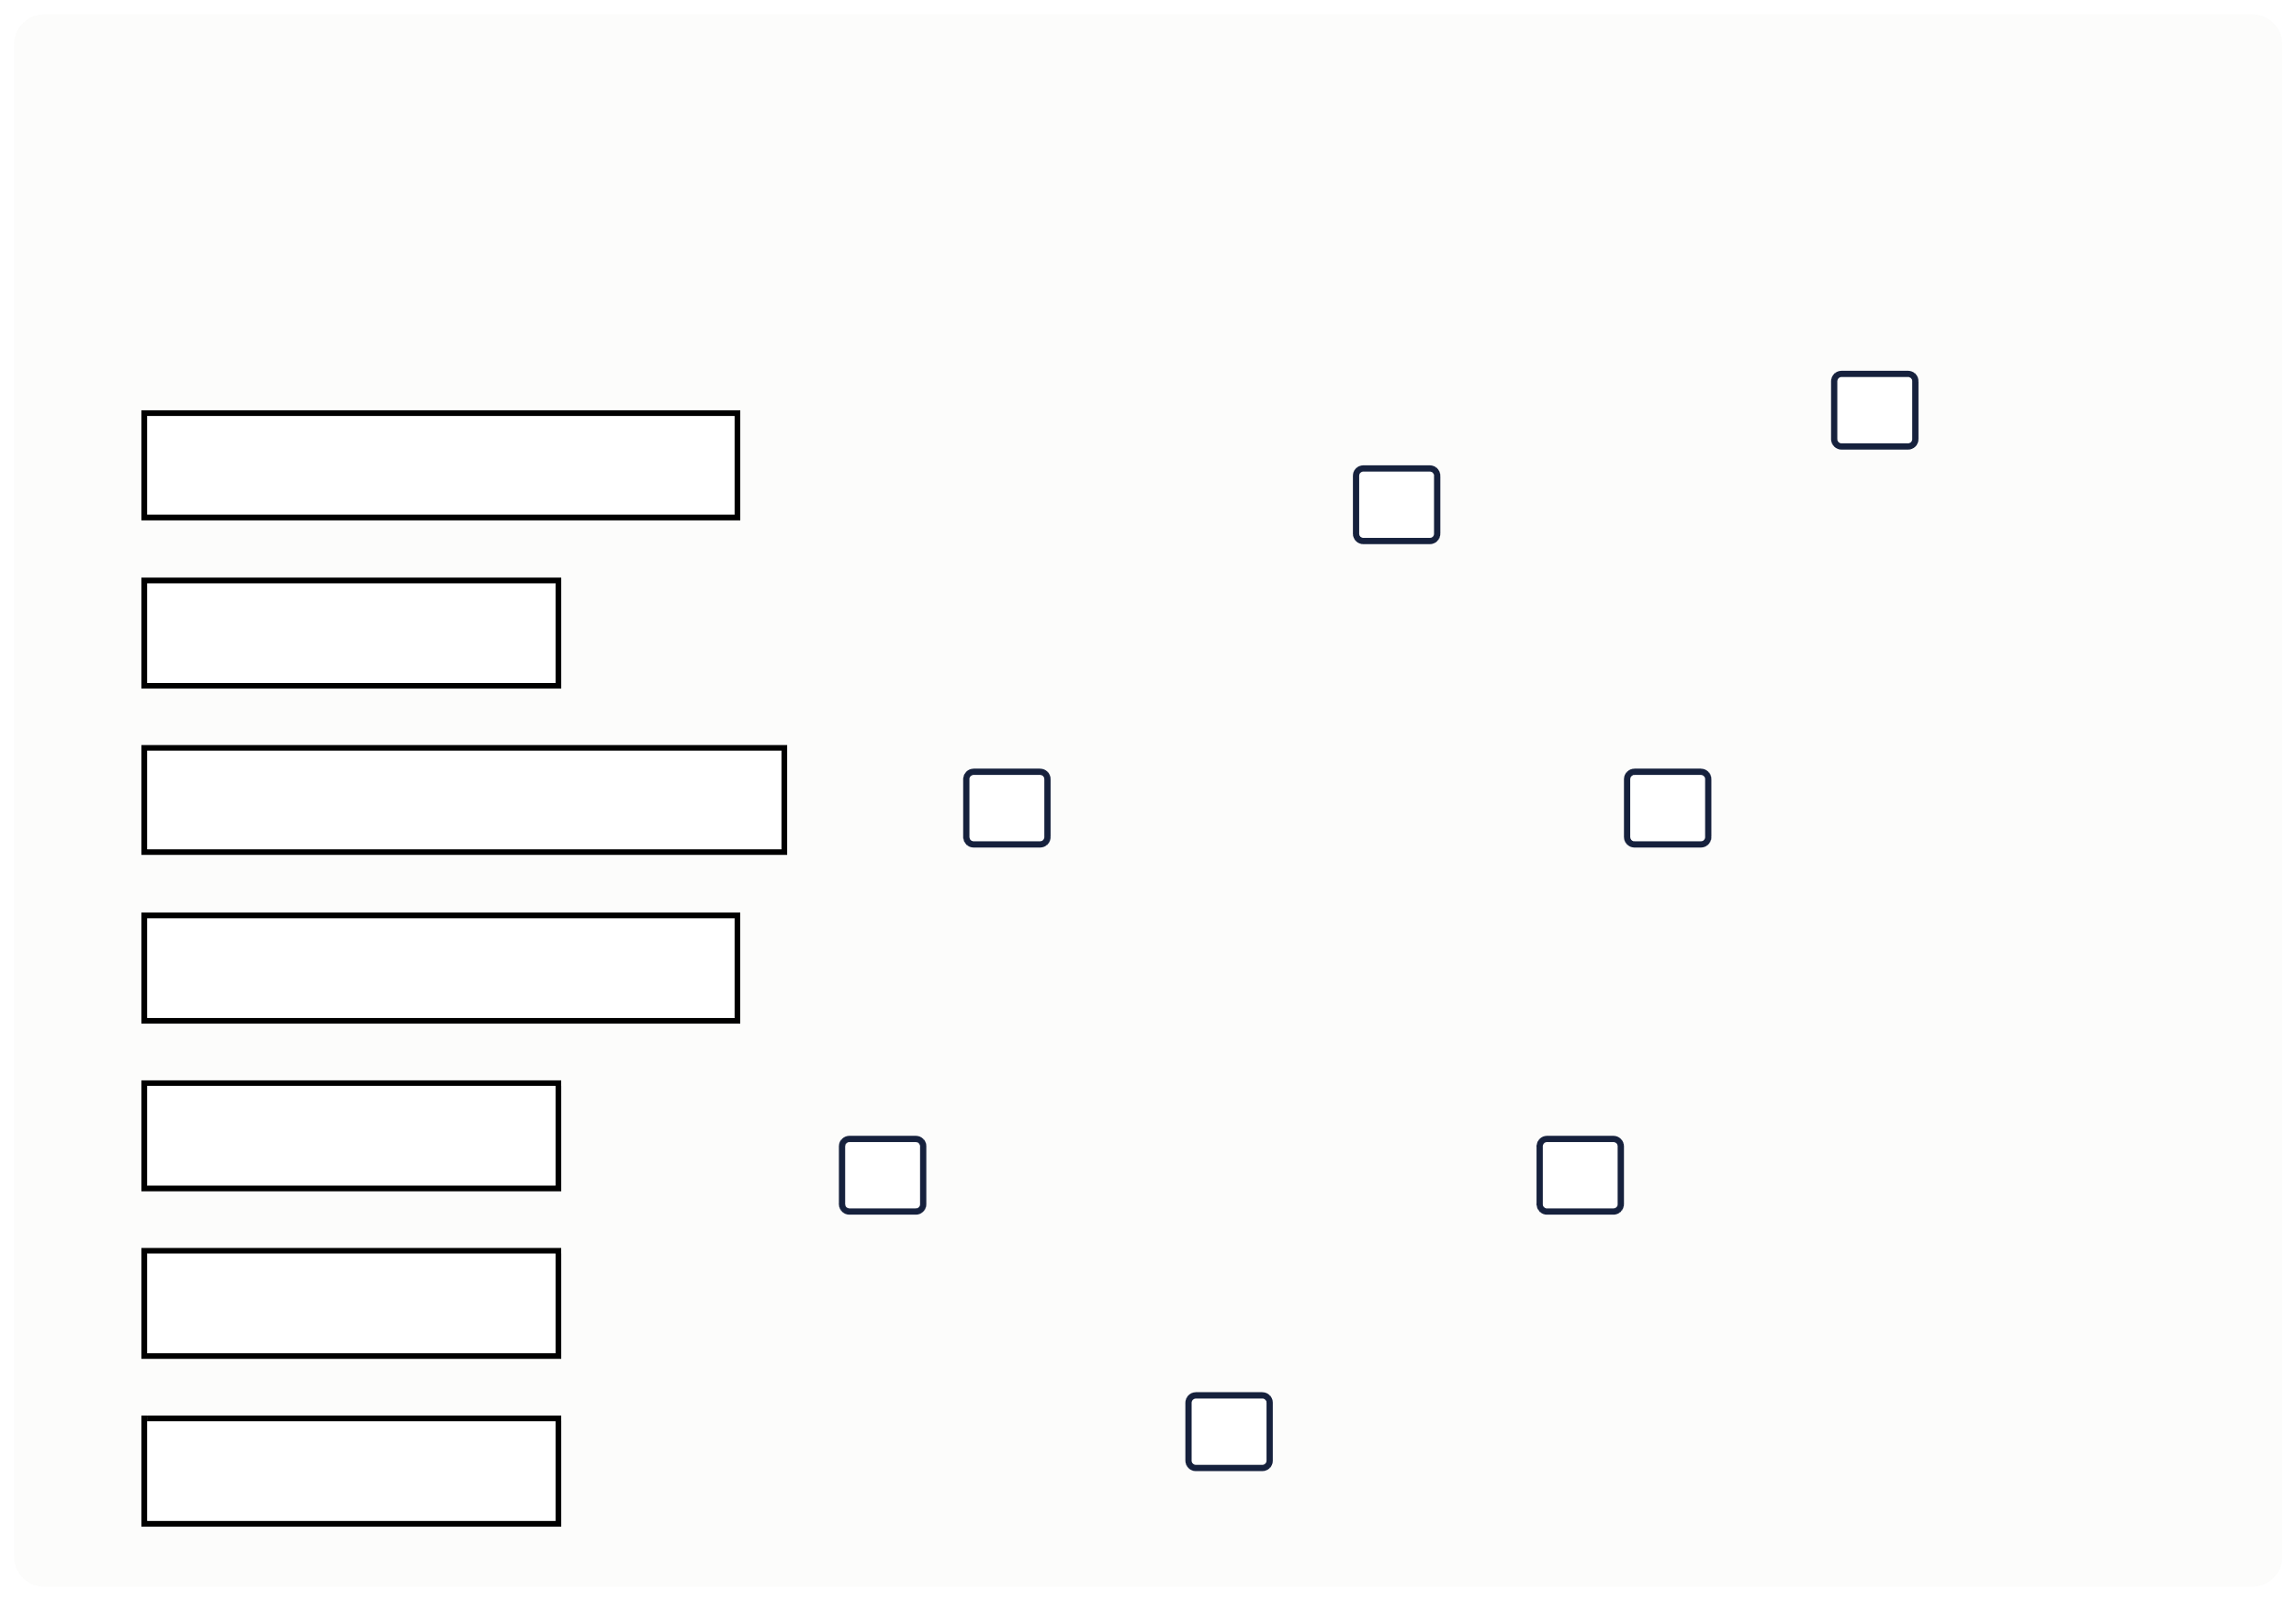
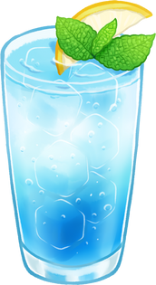
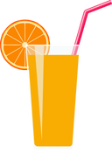

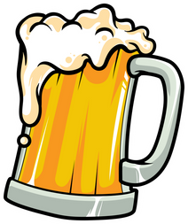
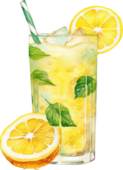
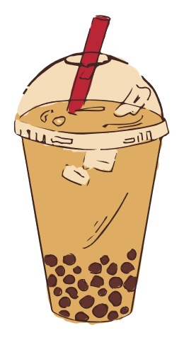
III. EXERCISES:
1.Write the number in the box:
1. Lemonade
2. Milktea
3. Orange juice
4. Lemon tea
5. Beer 6. Wine 7. Soda

Slide 6
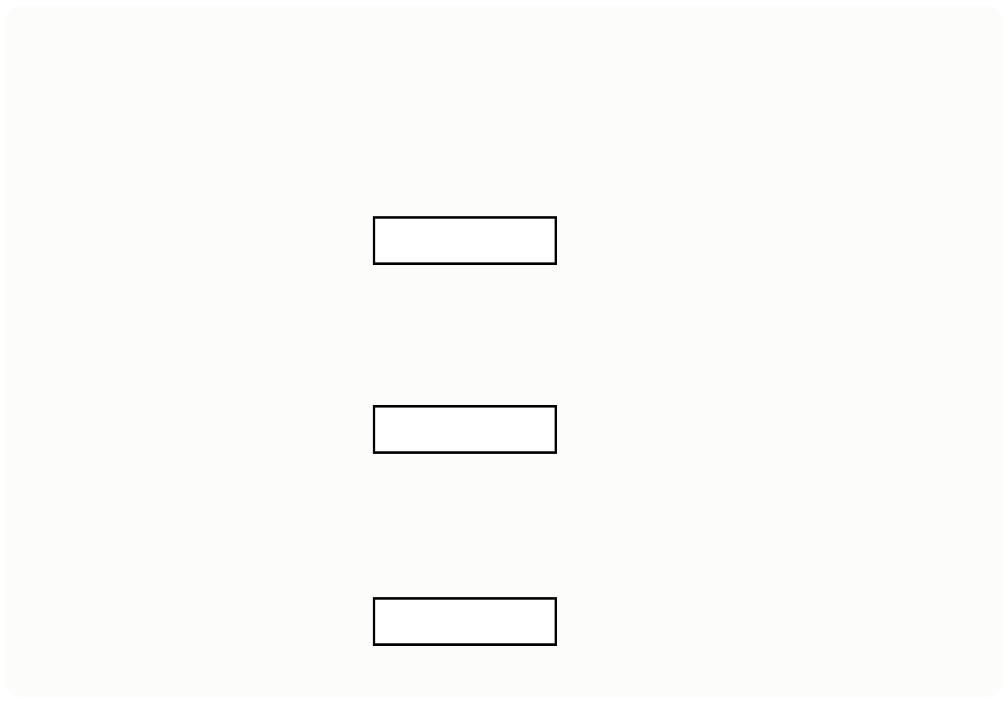
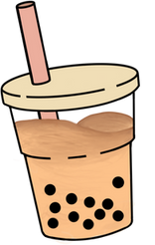
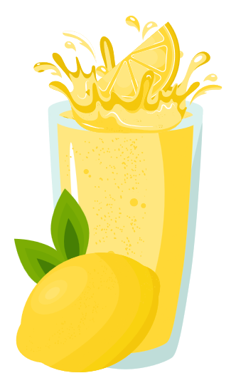
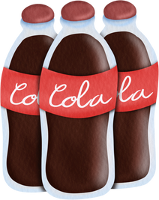
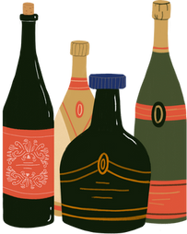
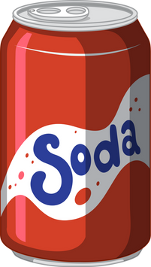
III. EXERCISES:
2. Match the picture and its name:
wine
soda
cocacola
orange juice
lemonade

Slide 7
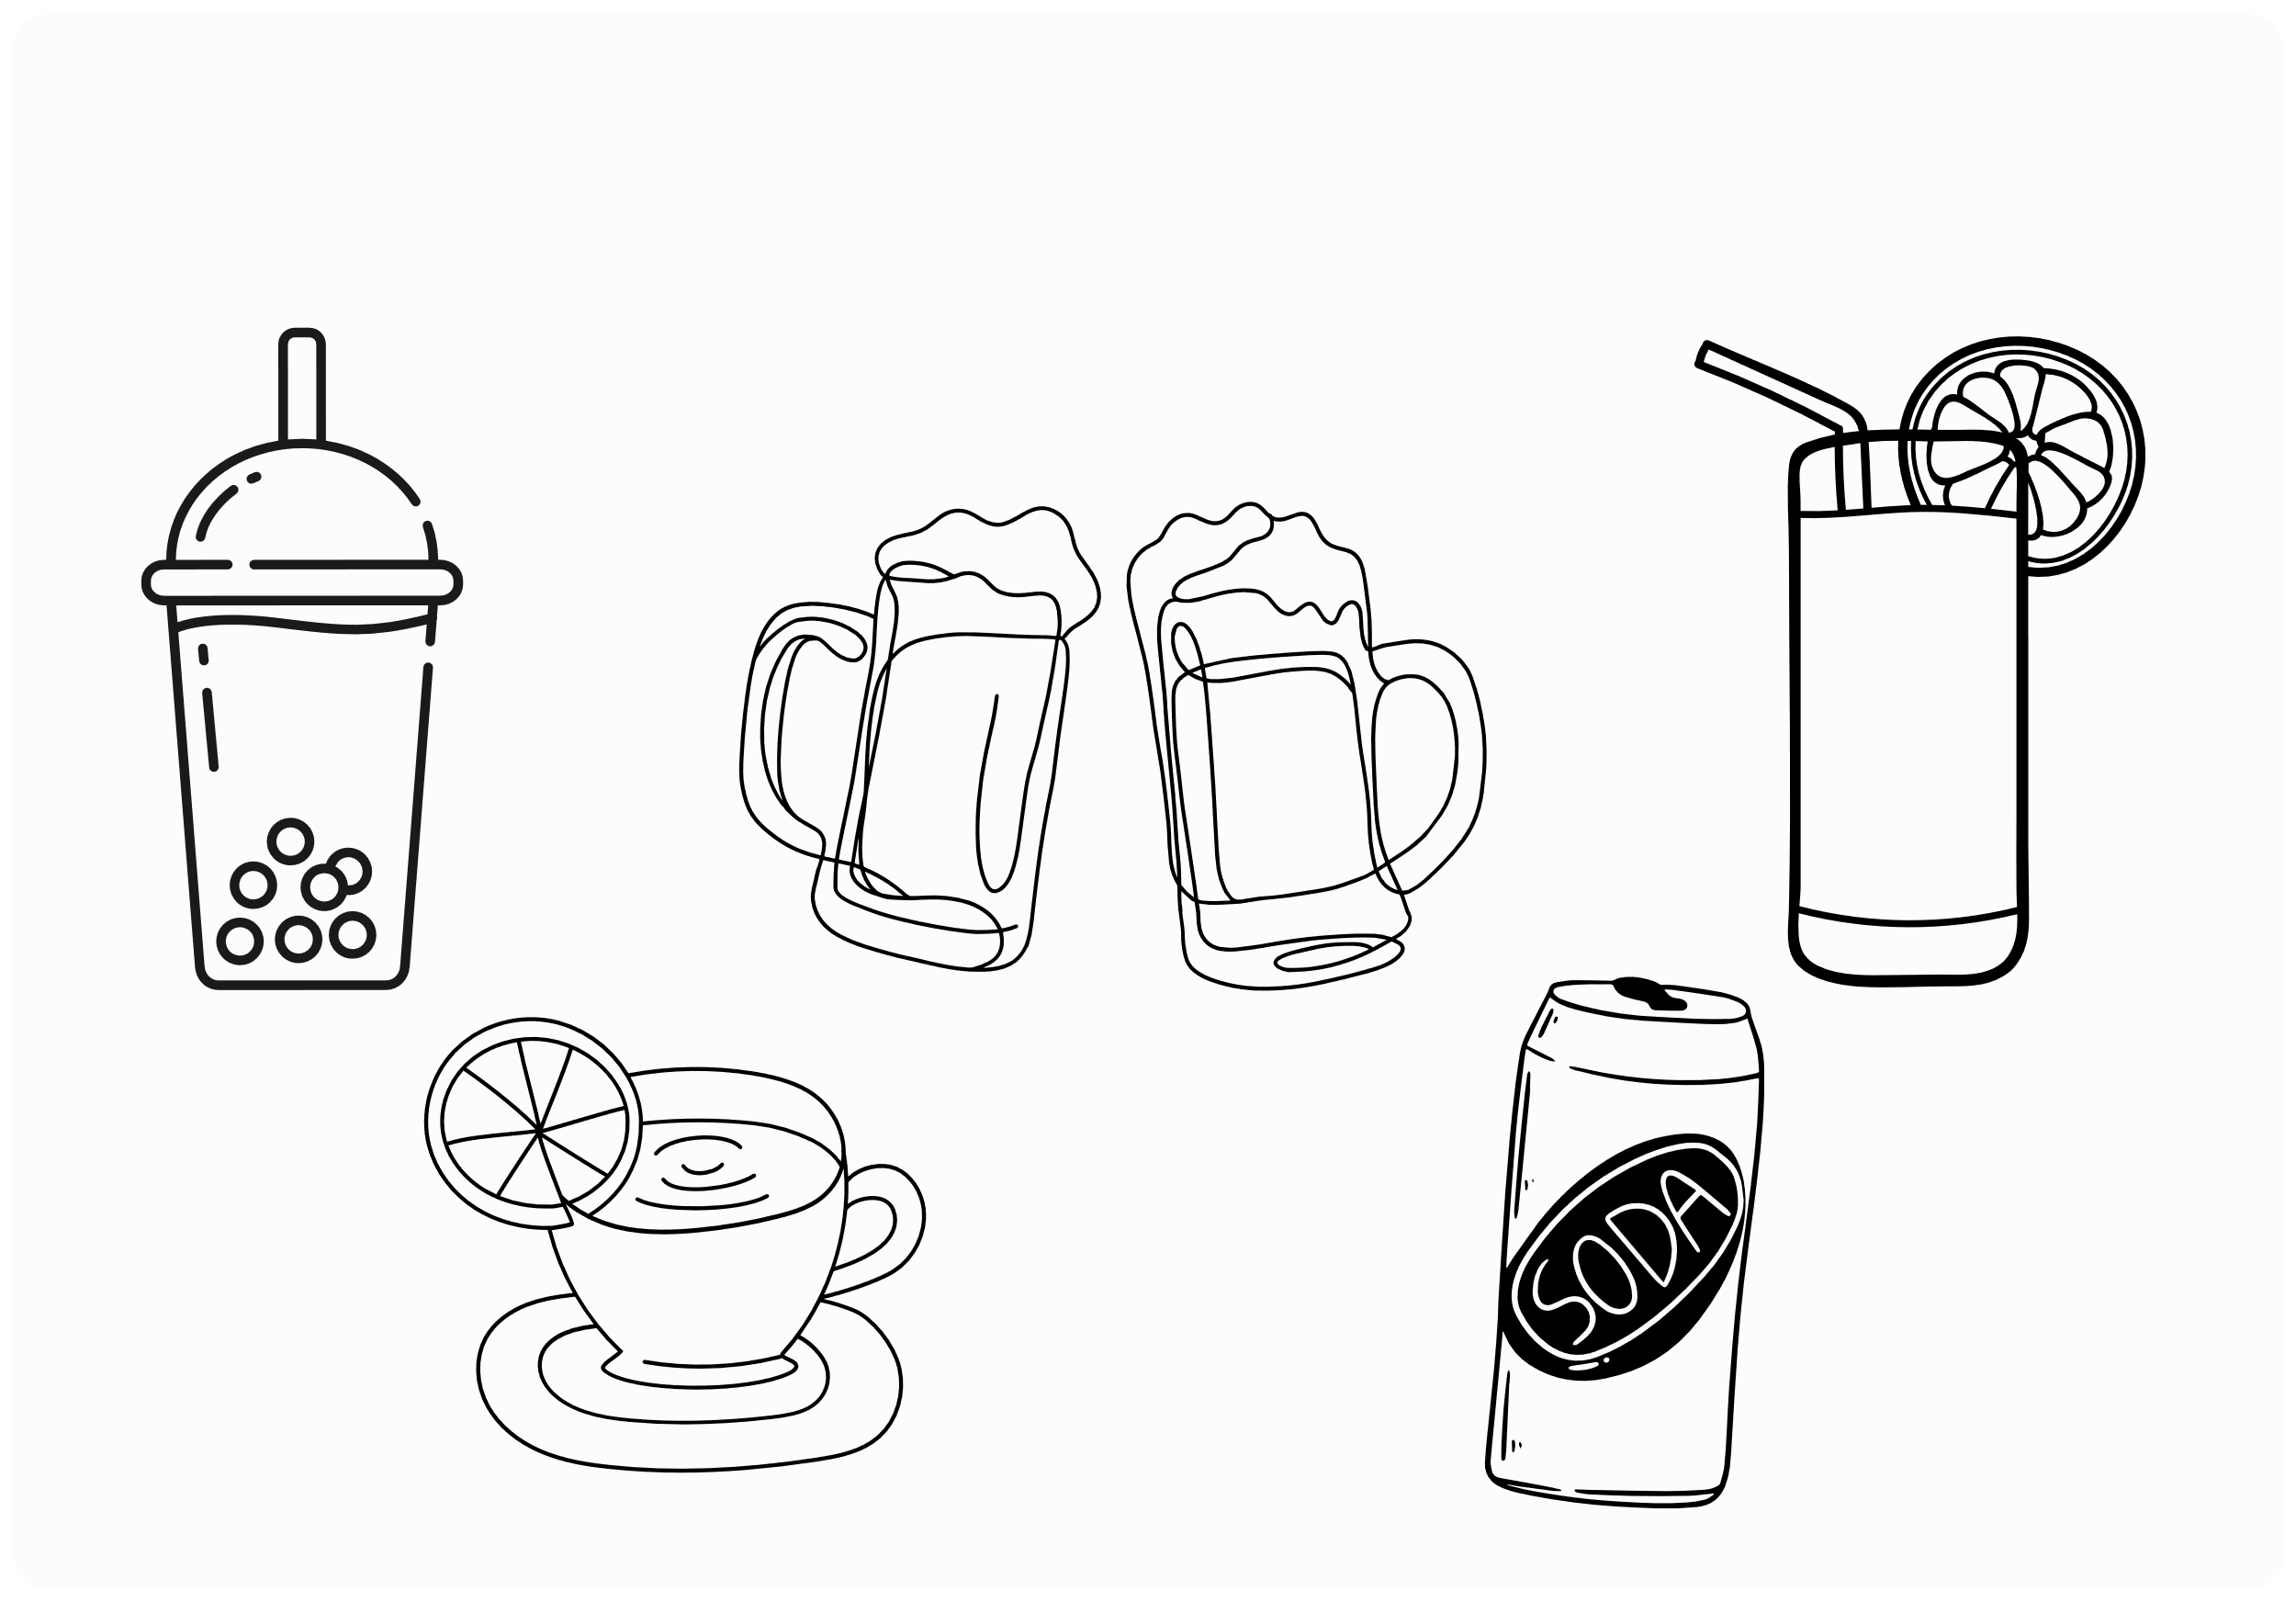
III. EXERCISES:
3. Color drinks you like:

Slide 8
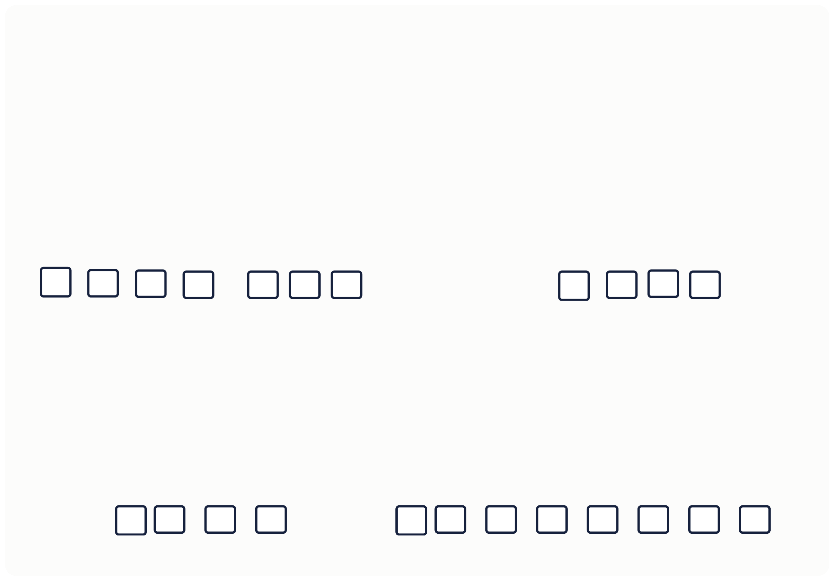

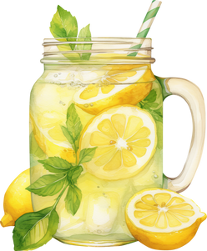
III. EXERCISES:
4. Fill the letters below:
M
S
W
L

Slide 9
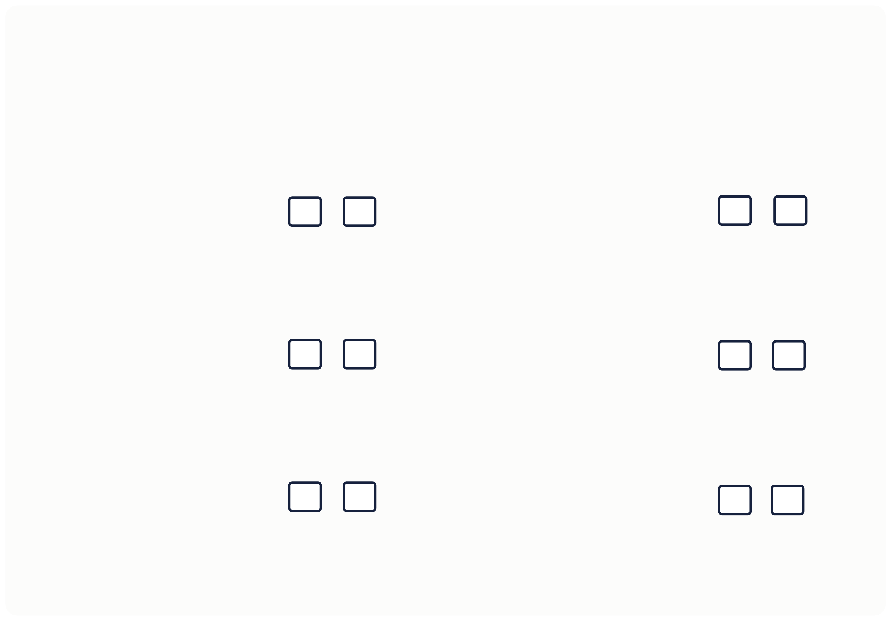
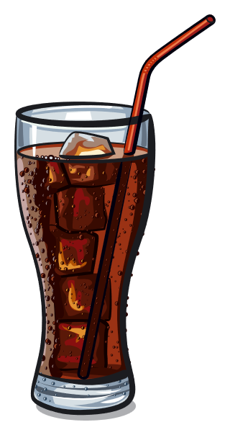
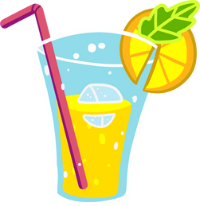
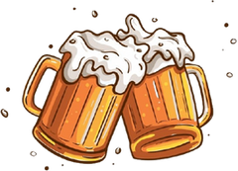
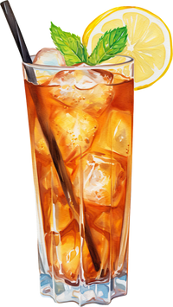

III. EXERCISES:
5. Choose True or False:
Orange juice
Cocacola
Lemon tea
Beer
Wine
Milk tea

Slide 10

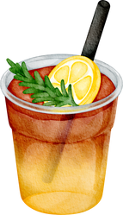
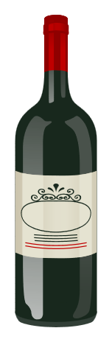
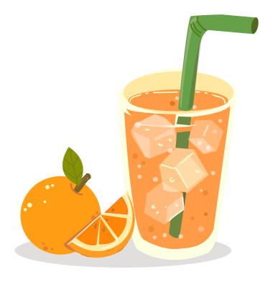



III. EXERCISES:
6. Find and line the similar picture:

Slide 11

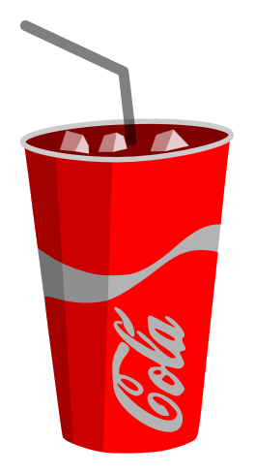

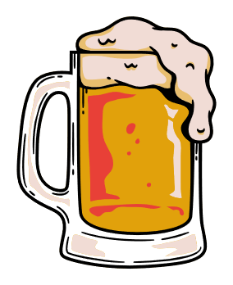
III. EXERCISES:
7. Classify the good and bad drinks for our health:
Good
Bad

Slide 12
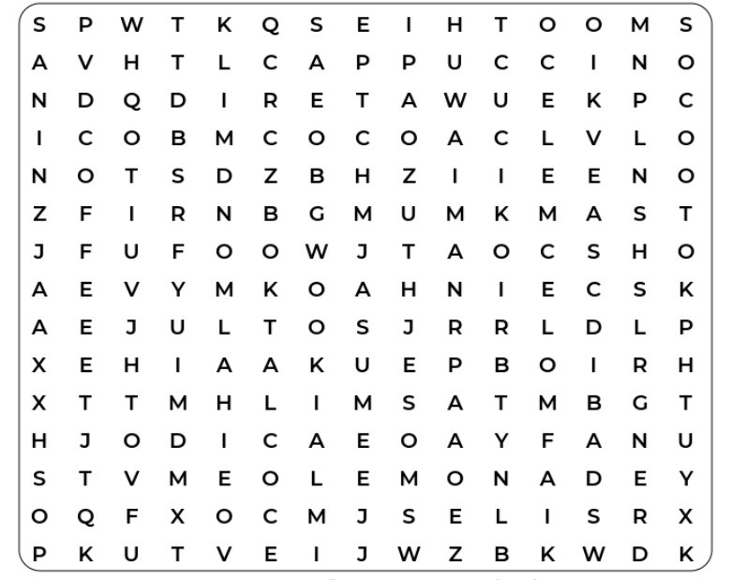
III. EXERCISES:
8. Find some words below:
Coffee
Lemonade
water
soda

