Slide 1

Unit 6: Entertainment
Progress Check (Cont.)
Page 117

Slide 2
Lesson Outline
Warm-up
Reading
Writing
Listening
Consolidation
Wrap-up

Slide 3
Objectives
By the end of this lesson, students will be able to…
improve listening and reading skills.
write about their neighbourhood.
practise test-taking skills.

Slide 4

WARM-UP

Slide 5
Choose the word whose underlined part is pronounced differently from that of the others.
1. A. keep B. free C. beer D. bee
/kiːp/ /friː/ /bɪə/ /biː/
2. A. house B. hour C. home D. hope
/haʊs/ /aʊə/ /həʊm/ /həʊp/
3. A. chocolate B. chicken C. headache D. kitchen
/ˈtʃɒklət/ /ˈtʃɪkɪn/ /ˈhedeɪk/ /ˈkɪtʃən/

Slide 6
Choose the word whose main stress is placed differently from that of the others.
1. A. explain B. order C. perform D. advise
/ɪkˈspleɪn/ /ˈɔːdər/ /pəˈfɔːm/ /ədˈvaɪz/
2. A. interested B. excited C. fantastic D. amazing
/ˈɪntrəstɪd/ /ɪkˈsaɪtɪd/ /fænˈtæstɪk/ /əˈmeɪzɪŋ/
3. A. awful B. boring C. silly D. beside
/ˈɔːfəl/ /ˈbɔːrɪŋ/ /ˈsɪli/ /bɪˈsaɪd/

Slide 7

It’s time to learn …

Slide 8

Reading

Slide 9
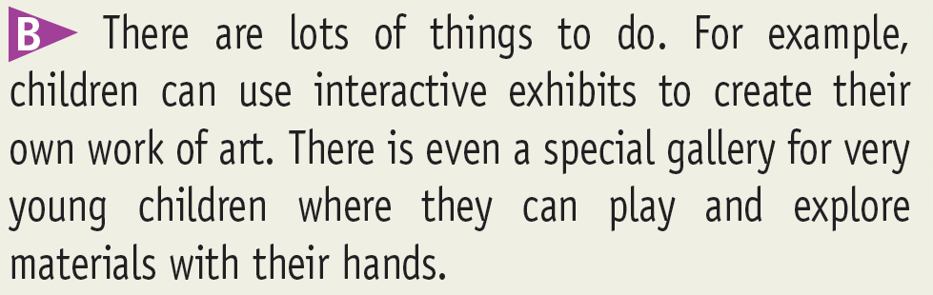
6. Read the text. Decide if the sentences are R (right), W (wrong) or DS (doesn’t say).
W
1 You are not allowed to touch the exhibits in the museum.
2 The museum isn’t suitable for very young kids.
3 You can have a birthday party there.
4 Summer camp at the museum lasts for a month.
5 You need to be 15 years old to volunteer at the museum.
W

Slide 10
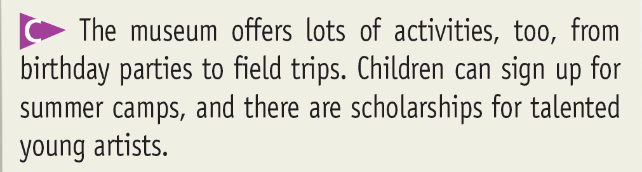
1. Read the text. Decide if the sentences are R (right), W (wrong) or DS (doesn’t say).
W
1 You are not allowed to touch the exhibits in the museum.
2 The museum isn’t suitable for very young kids.
3 You can have a birthday party there.
4 Summer camp at the museum lasts for a month.
5 You need to be 15 years old to volunteer at the museum.
W
R
DS

Slide 11
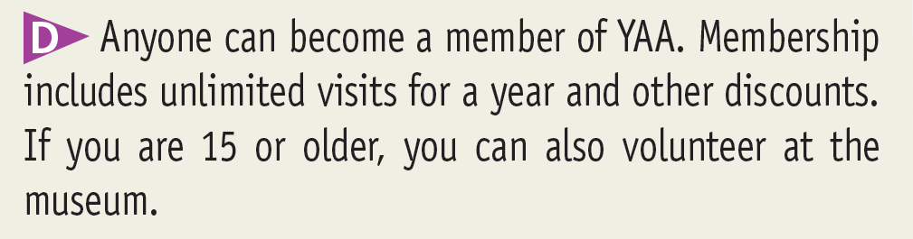
1. Read the text. Decide if the sentences are R (right), W (wrong) or DS (doesn’t say).
W
1 You are not allowed to touch the exhibits in the museum.
2 The museum isn’t suitable for very young kids.
3 You can have a birthday party there.
4 Summer camp at the museum lasts for a month.
5 You need to be 15 years old to volunteer at the museum.
W
R
DS
R

Slide 12
More Practice
Read the text again and choose the correct answer.
1. The aim of the Young At Art Children’s Museum is __________.
A. to introduce children to art B. to gain money C. to join summer camp
2. Children can do a lot of activities at Young At Art’s Museum EXCEPT:
A. create their own work of art B. celebrate birthday parties C. study English
3. What can talented young artists receive?
A. discounts B. scholarships C. materials
4. Who can become a member of YAA?
A. no-one B. anyone C. children under 15

Slide 13

Writing

Slide 14
7. Write a letter to your English friend about your plans for the summer (about 50-60 words). Write about where you are going to go, who you are going to go with and what you are going to do there. Invite your friend to come with you.

Slide 15

Listening

Slide 16

8 Listen to Suzanne and Kent talking about a film. For the questions (1-4), choose the correct answer (A, B or C).
1 What kind of film does Suzanne suggest?
A a horror film B a drama film C a science-fiction film
2 The sitcom Suzanne’s brother wants to watch is at _______.
A 7:00 B 9:00 C 9:30
3 Kent will watch the film with his ______.
A brother B cousin C aunt
4 What will Kent eat while watching the film?
A popcorn B crisps C carrots

Slide 17
Tapescripts
Suzanne: Hi, Kent. Do you fancy watching a science fiction film at the cinema this evening? It looks really good.
Kent: No, thanks, Suzanne. I’m going to stay in to watch a horror film on TV. It’s called The Back Room.
Suzanne: Oh, I’ve heard of that film - but I always thought it was a drama. If I stay in, I’ll watch it, but my brother usually watches TV on Friday evenings.
Kent: Really? What does he watch?
Suzanne: He really loves a sitcom that’s on at 7:00 p.m. He never misses an episode.
Kent: Well, the film is on at 9:00 or 9:30 - I can’t remember. But it’ll probably start after the sitcom has finished.
Suzanne: Yes, you’re right. Maybe I’ll watch it then. Will you watch it on your own?
Kent: Well, my cousin’s staying with us for a few days, but he’s a bit young for horror films. I’m sure my aunt doesn’t allow him to watch films like that. So, I’ll probably watch it with my brother.
Suzanne: OK, enjoy it then. I have to go to the supermarket to get some carrots for my mum. And I think I’ll pick up some popcorn to watch the film with, too!
Kent: Oh, good idea! I think there’s some crisps in the house that I can snack on.

Slide 18

CONSOLIDATION

Slide 19
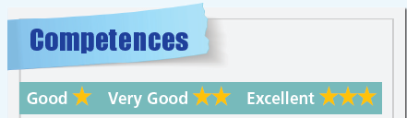
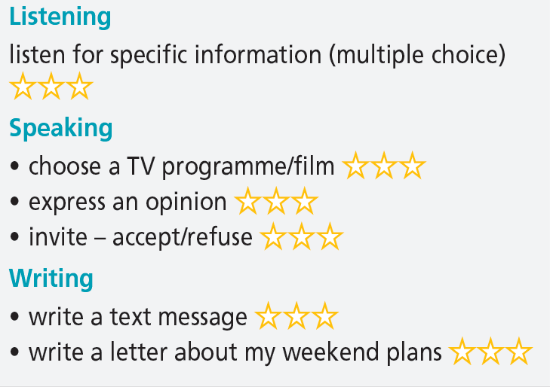
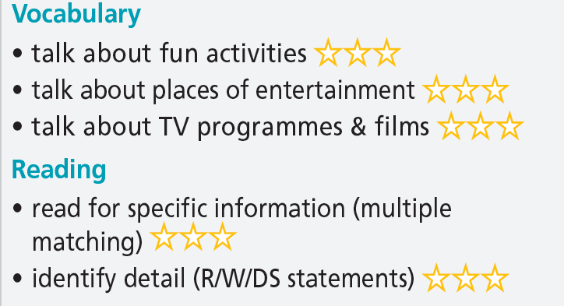

Slide 20

WRAP-UP

Slide 21
Today’s lesson
Skills
Reading: Young At Art Museum.
Writing: plan for the summer.
Listening: a conversation about a film.

Slide 22
Homework
Do the exercises in TA 6 Right on WB (pp. 60 & 61).
Do Term 2 Test in TA 6 Right on Notebook (pp. 64 – 67).
Do Unit 6 Test 2 in Bài Tập Bổ Trợ TA 6 Right on (pp. 56 & 57).

Slide 23
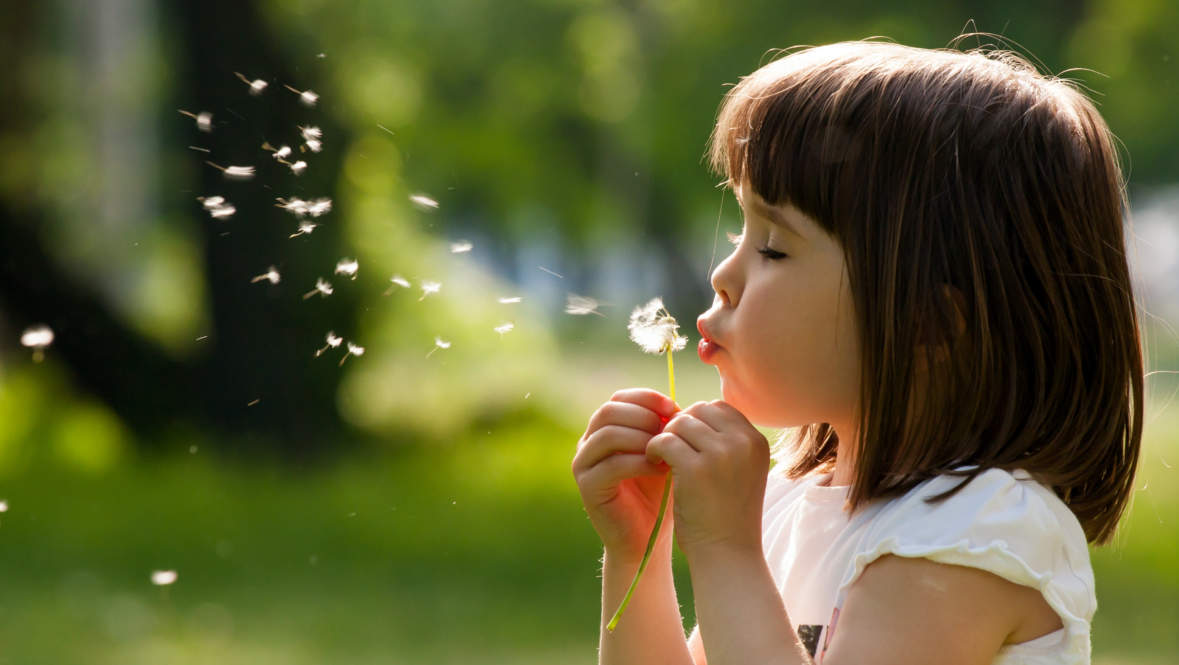
Enjoy your day!

