Slide 1


Slide 2




Unit
7
TRAFFIC
LESSON 3: A CLOSER LOOK 2
GRAMMAR:
- It to indicate distance
- should and shouldn’t
Unit
HOBBIES

Slide 3

OBJECTIVES
By the end of the lesson, students will be able to:
Know how to use:
  - It to indicate distance
- should and shouldn’t

Slide 4
LESSON 3: A CLOSER LOOK 2
WARM-UP
Slap the board
PRESENTATION
- It to indicate distance
- should and shouldn’t
Task 1: Write sentences with It. Use these cues.
Task 2: Work in pairs. Ask and answer questions about distances in your neighbourhood.
Task 3: Choose the correct option in brackets.
Task 4: Complete each sentence, using should / shouldn’t.
PRACTICE
PRODUCTION
Task 5: Look at the pictures. Make sentences, using should /shouldn’t and the cues.
CONSOLIDATION
Wrap-up
Home work

Slide 5

LESSON 3: A CLOSER LOOK 2
WARM-UP
Slap the board
Aims of the stage:
To activate students’ prior knowledge and vocabulary related to the targeted grammar

Slide 6
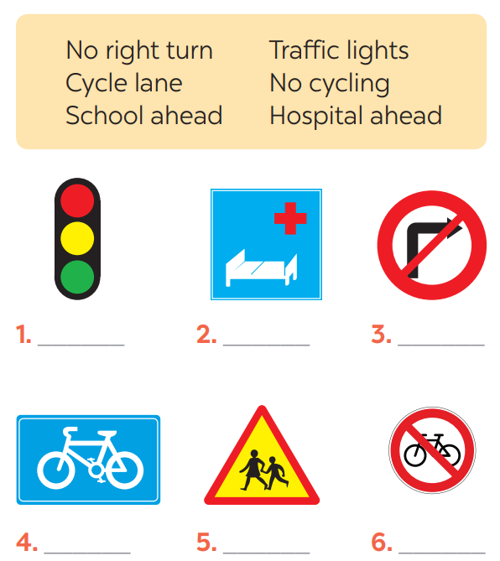
WARM-UP

Slide 7
LESSON 3: A CLOSER LOOK 2
WARM-UP
Slap the board
PRESENTATION
- It to indicate distance
- should and shouldn’t

Slide 8
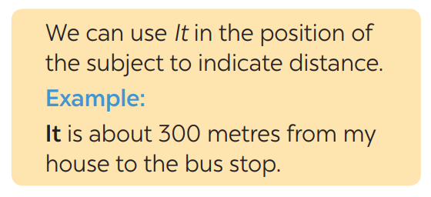

PRESENTATION
What does the sentences tell us about?
IT – INDICATING DISTANCE
What is the structure using in the sentence?

Slide 9
LESSON 3: A CLOSER LOOK 2
WARM-UP
Slap the board
PRESENTATION
- It to indicate distance
- should and shouldn’t
Task 1: Write sentences with It. Use these cues.
Task 2: Work in pairs. Ask and answer questions about distances in your neighbourhood.
Task 3: Choose the correct option in brackets.
Task 4: Complete each sentence, using should / shouldn’t.
PRACTICE

Slide 10
PRACTICE
1
Write sentences with It. Use these cues.
Aim of the task:
-To get students practice using the form

Slide 11
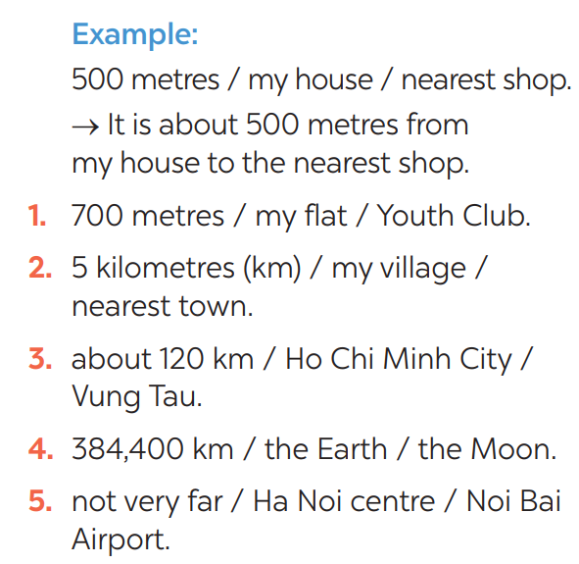

PRACTICE
1
Write sentences with It. Use these cues.
KEY
1- It is 700m from my house/home to the Youth club.
2- It is 5 kilometres from my village to the nearest town.
3- It is about 120 km from Ho Chi Minh city to Vung Tau.
4- It is 384,400 km from the Earth to the Moon.
5- It is not very far from Hanoi centre to Noi Bai airport.

Slide 12

PRACTICE
2
Work in pairs. Ask and answer questions about distances in your neighbourhood
Aim of the task:
To practise asking and answering about distance.

Slide 13
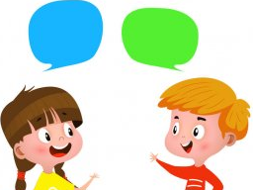
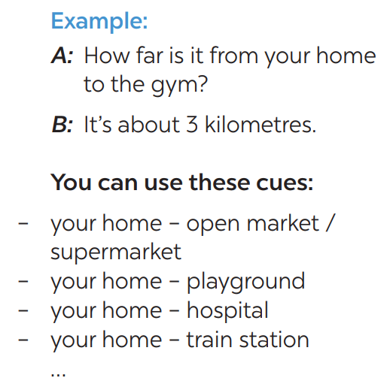
PRACTICE
2
How far is it from your house to the open market?
It’s about 1 km.

Slide 14
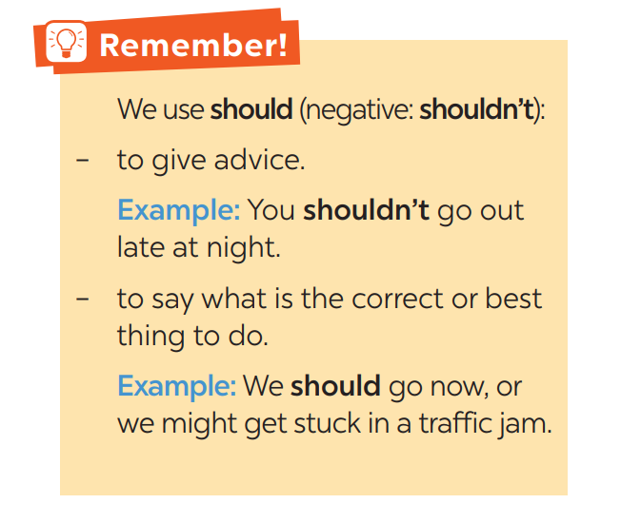
PRODUCTION
3
Choose the correct option in brackets.
1. That’s an interesting book. You
(should / shouldn’t) read it.
2. You nearly fell off your bike! You really
(should / shouldn’t) be more careful.
3. We (should / shouldn’t) go swimming
right after eating.
4. I think that he (should / shouldn’t)
eat less. He’s becoming overweight.
5. There are a lot of cars out today.
He (should / shouldn’t) drive so fast.

Slide 15
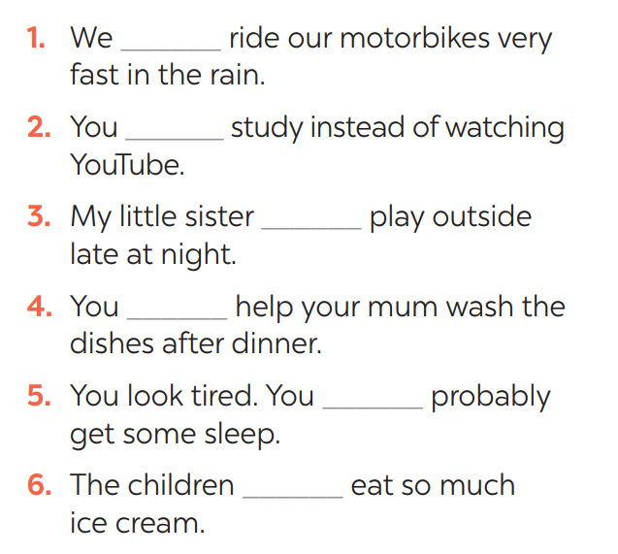
PRODUCTION
4
Complete each sentence, using should / shouldn’t.
shouldn’t
should
shouldn’t
should
should
shouldn’t

Slide 16
LESSON 3: A CLOSER LOOK 2
WARM-UP
Slap the board
PRESENTATION
- It to indicate distance
- should and shouldn’t
Task 1: Write sentences with It. Use these cues.
Task 2: Work in pairs. Ask and answer questions about distances in your neighbourhood.
Task 3: Choose the correct option in brackets.
Task 4: Complete each sentence, using should / shouldn’t.
PRACTICE
PRODUCTION
Task 5: Look at the pictures. Make sentences, using should /shouldn’t and the cues.

Slide 17
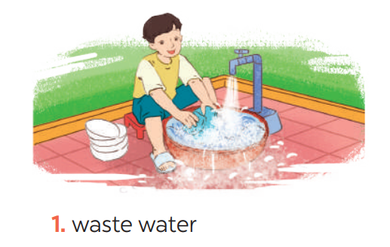
PRODUCTION
5
Look at the pictures. Make sentences, using should / shouldn’t and the cues
He shouldn’t waste water.

Slide 18
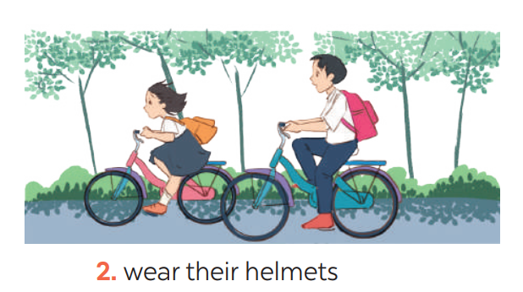
PRODUCTION
5
Look at the pictures. Make sentences, using should / shouldn’t and the cues
They should wear their helmets.

Slide 19
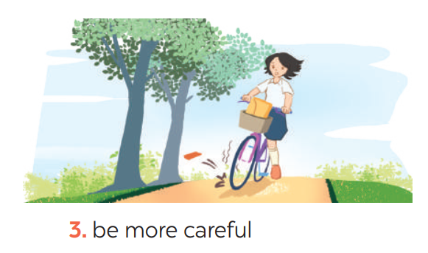
PRODUCTION
5
Look at the pictures. Make sentences, using should / shouldn’t and the cues
She should be more careful.

Slide 20
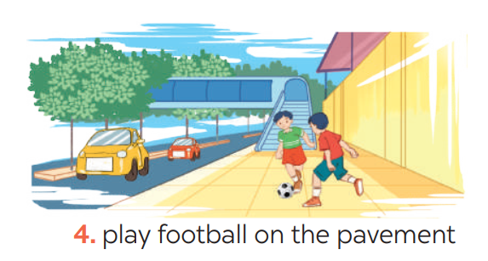
PRODUCTION
5
Look at the pictures. Make sentences, using should / shouldn’t and the cues
They shouldn’t play football on the pavement.

Slide 21
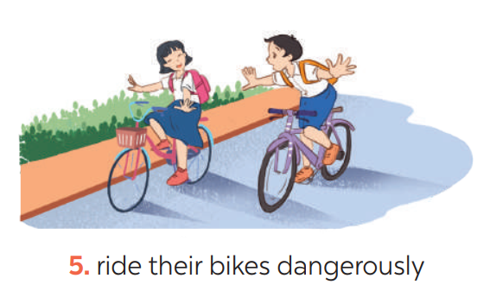
PRODUCTION
5
Look at the pictures. Make sentences, using should / shouldn’t and the cues
They shouldn’t ride their bikes dangerously.

Slide 22
LESSON 3: A CLOSER LOOK 2
WARM-UP
Slap the board
PRESENTATION
- It to indicate distance
- should and shouldn’t
Task 1: Write sentences with It. Use these cues.
Task 2: Work in pairs. Ask and answer questions about distances in your neighbourhood.
Task 3: Choose the correct option in brackets.
Task 4: Complete each sentence, using should / shouldn’t.
PRACTICE
PRODUCTION
Task 5: Look at the pictures. Make sentences, using should /shouldn’t and the cues.
CONSOLIDATION
Wrap-up
Home work

Slide 23
CONSOLIDATION
1
WRAP-UP
GRAMMAR:
- It to indicate distance
- should and shouldn’t

Slide 24
CONSOLIDATION
2
HOMEWORK
Exercises in the workbook.

Slide 25


