Slide 1


Slide 2
LESSON 4
SPEAKING
WARM-UP
Play Quiz about Peer Pressure
PRE-SPEAKING
Task 1: Order the examples of peer pressure below from 1 (most powerful) to 6 (least
powerful).
Task 2: Work in pairs.
Task 3: Read the situations below and think of some possible responses. Provide reasons for each answer.
WHILE-SPEAKING
POST-SPEAKING
Task 4: Report your answers to the whole class. Vote for the most interesting responses.
Wrap-up
Homework
CONSOLIDATION

Slide 3
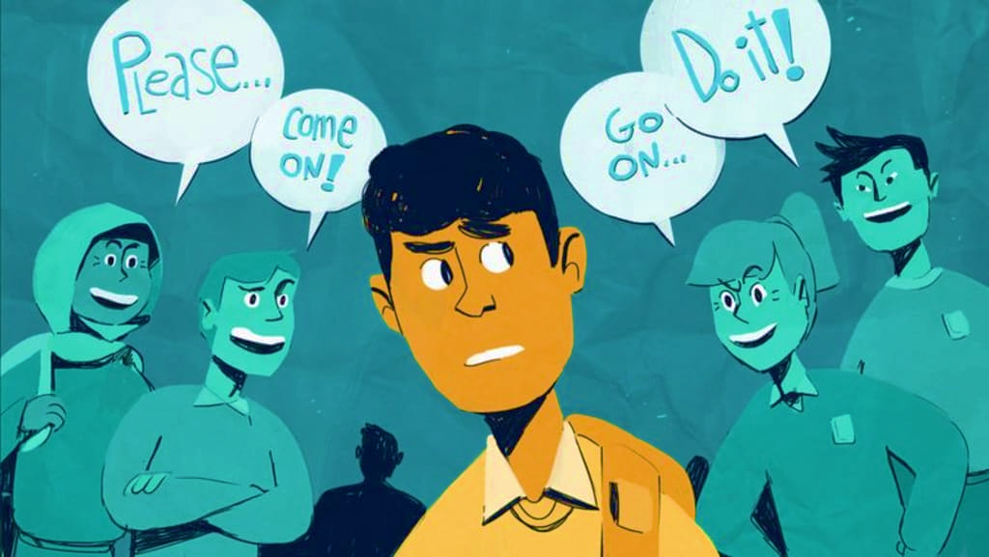
WARM-UP
Let‘s Quiz!
What do you know about Peer Pressure

Slide 4


1. Your Peers are...
Your teachers
A
People about your own age
B
Your parents
C
Your cousins
D

Slide 5
2. When people your age try to influence you to believe or act like them it is called?
Communication
A
Friendship
B
Peer pressure
C
Negotiation
D

Slide 6
3. Peer Pressure can be...
Positive
A
Negative
B
Positive OR Negative
C
None of them
D

Slide 7
4. Peer Pressure can influence which of the following:
Clothing styles
A
Taste in music
B
Hairstyles
C
All of the above
D

Slide 8
5. A friend wants you to smoke with them. This is an example of .....
Positive peer pressure
A
Negative peer pressure
B

Slide 9
EXPERIENCING PEER PRESSURE
Unit
9
SOCIAL ISSUES
Unit
FAMILY LIFE
LESSON 4
SPEAKING

Slide 10


PRE-SPEAKING
Positive (adj)
/ˈpɒz.ə.tɪv/
full of hope and confidence, or giving cause for hope and confidence

Slide 11

PRE-SPEAKING
Permission (n)
/pəˈmɪʃ.ən/
the act of allowing someone to do something, or of allowing something to happen

Slide 12
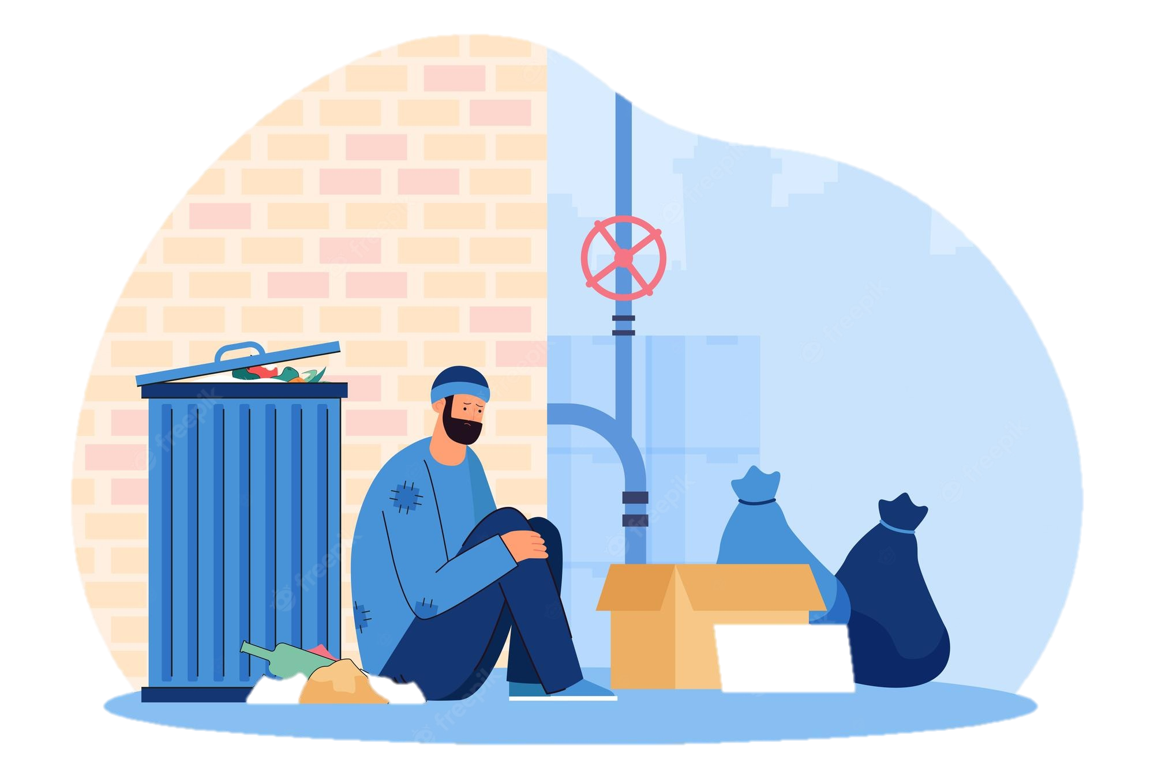
PRE-SPEAKING
Poverty (n)
/ˈpɒv.ə.ti/
the condition of being extremely poor

Slide 13
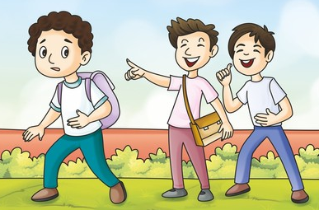
PRE-SPEAKING
make fun of
/ˌmeɪk ˈfʌn əv/
to make a joke about someone or something in a way that is not kind

Slide 14
PRE-SPEAKING
Form | Pronunciation | Meaning
1. Positive (adj) | /ˈpɒz.ə.tɪv/ | full of hope and confidence, or giving cause for hope and confidence
2. Permission (n) | /pəˈmɪʃ.ən/ | the act of allowing someone to do something, or of allowing something to happen
3. Poverty (n) | /ˈpɒv.ə.ti/ | the condition of being extremely poor
4. make fun of | /ˌmeɪk ˈfʌn əv/ | to make a joke about someone or something in a way that is not kind

Slide 15
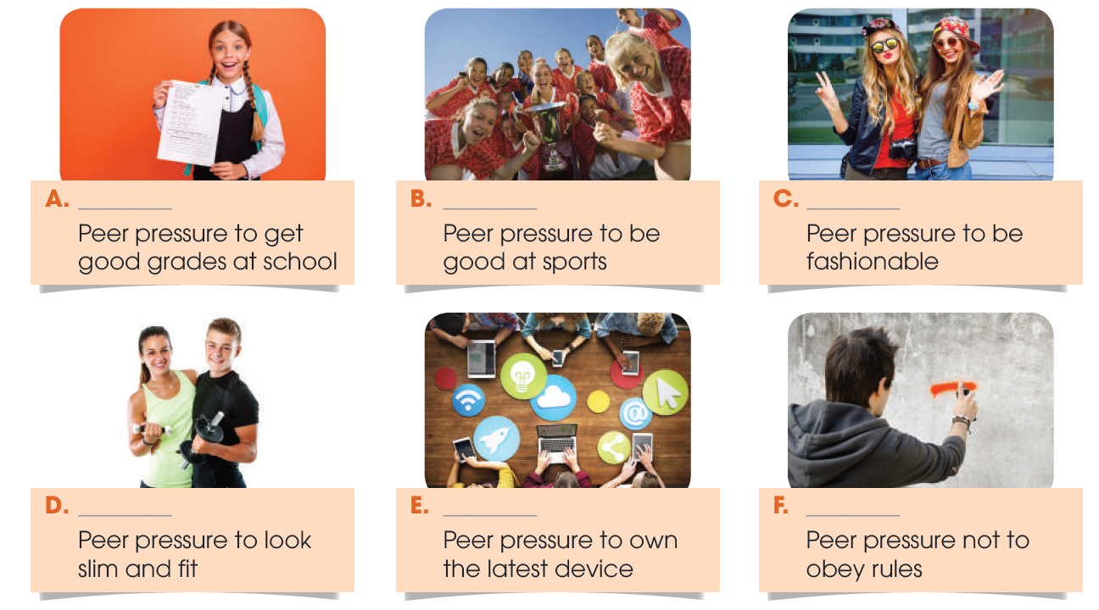
PRE-SPEAKING
1
Order the examples of peer pressure below from 1 (most powerful) to 6 (least powerful).

Slide 16
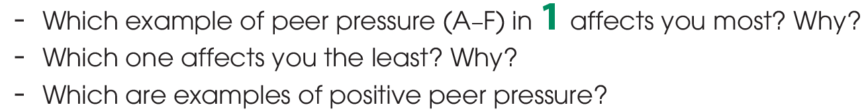
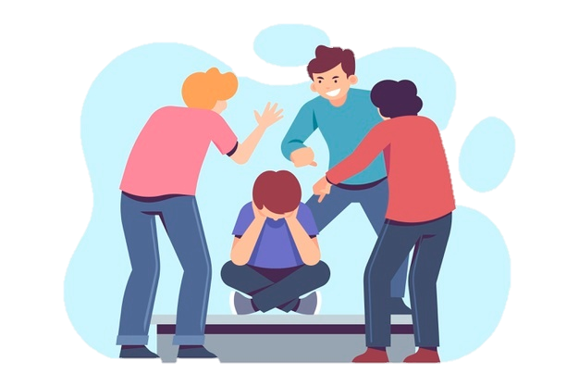
WHILE-SPEAKING
2
Work in pairs. Talk about your experiences of peer pressure. Use the following guiding questions.

Slide 17
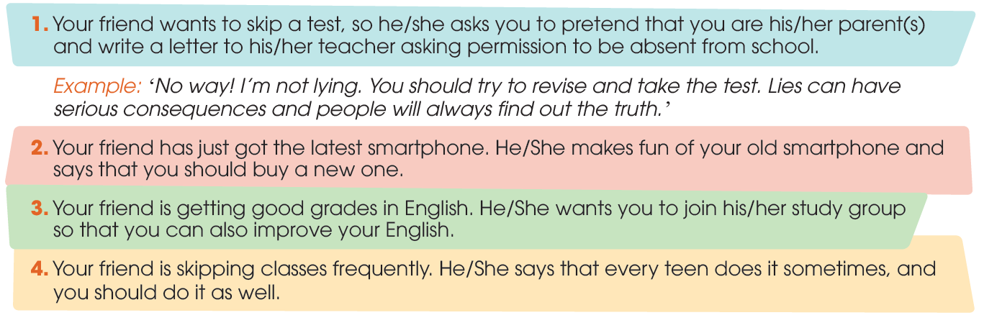
WHILE-SPEAKING
3
Work in groups. Read the situations below and think of some possible responses. Provide reasons for each answer.

Slide 18

SUGGESTED ANSWERS
WHILE-SPEAKING
I’m not ashamed of my old phone. We are students and not making any money yet, so buying a new phone will cost our parents too much money. Besides, my phone is still working properly and I don’t see any reason why I should buy a new one.
That’s a great idea! Learning with stronger students will motivate me to study harder. Besides, I could learn some useful techniques from you and others to improve my grades.
No way! Skipping class without permission is disrespecting our teachers. Besides, I don’t want to fall behind with my school work.

Slide 19

POST-SPEAKING
4
Report your answers to the whole class. Vote for the most interesting responses.

Slide 20

CONSOLIDATION
What have you learnt today?
New vocabularies
Talk about experiences of peer pressure and respond to peer pressure situations.

Slide 21


CONSOLIDATION
Do exercises in the workbook.
Prepare for Lesson 5 - Unit 9.

Slide 22

Website: hoclieu.vn
Fanpage: facebook.com/sachmem.vn/

