Slide 1


Slide 2



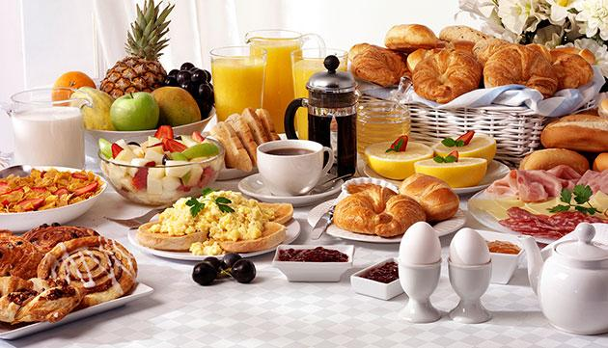
Unit
5
FOOD AND DRINK
LESSON 4: COMMUNICATION

Slide 3

OBJECTIVES
By the end of this lesson, Ss will be able to:
1. Knowledge
Use lexical items related to the favourite food and drink in everyday life
Understand and use ways to ask and answer about prices in English
2. Core competence
Develop communication skills
Be collaborative and supportive in pairwork and teamwork
Actively join in class activities
3. Personal qualities
Promote pride in the values ​​of Vietnamese culture
Develop love for family

Slide 4
LESSON 4: COMMUNICATION
WARM-UP
Restaurant
VOCABULARY
Vocabulary
Task 1: Listen and read the conversation.
Task 2: Work in pairs. Take turns to ask and answer about the prices of the food and drink on the menu.
EVERYDAY ENGLISH
Task 3: Listen to the conversation and answer the questions.
Task 4: Work in groups. Interview two friends about their favourite food and drink. Write their answers in the table.
YOUR FAVOURITE FOOD & DRINK
CONSOLIDATION
Wrap-up
Homework

Slide 5
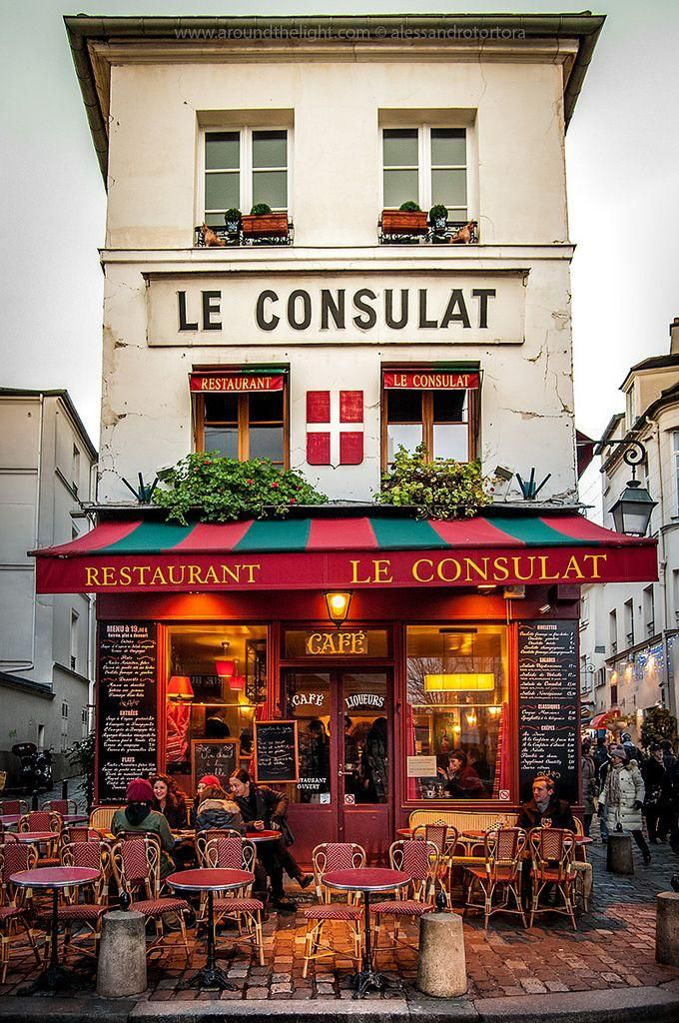
LESSON 4: COMMUNICATION
WARM-UP
Restaurant
Aims of the stage:
To activate students’ knowledge
To get students interested in the topic

Slide 6
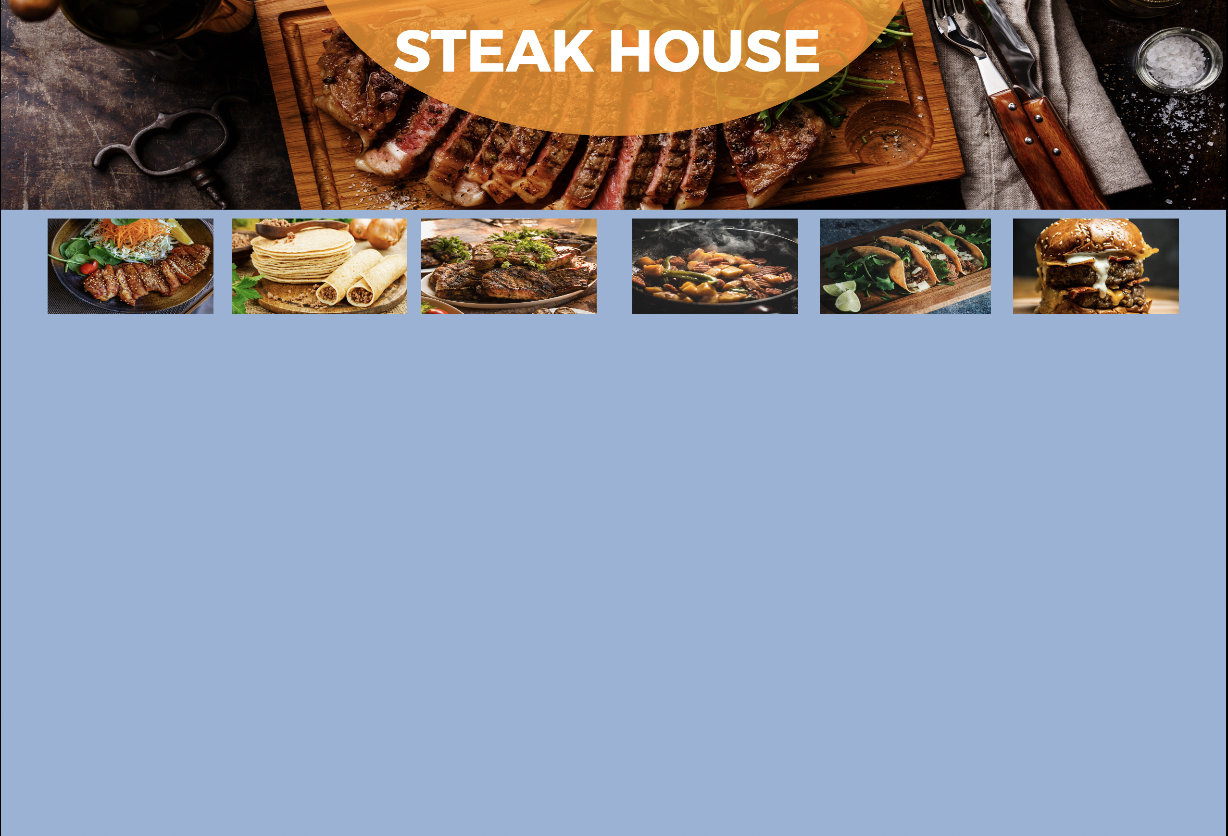
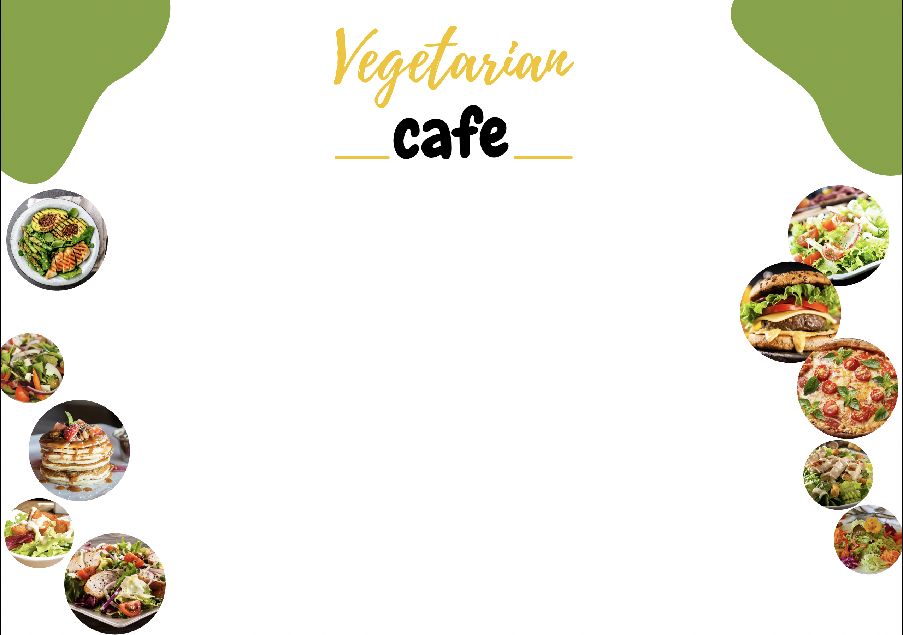
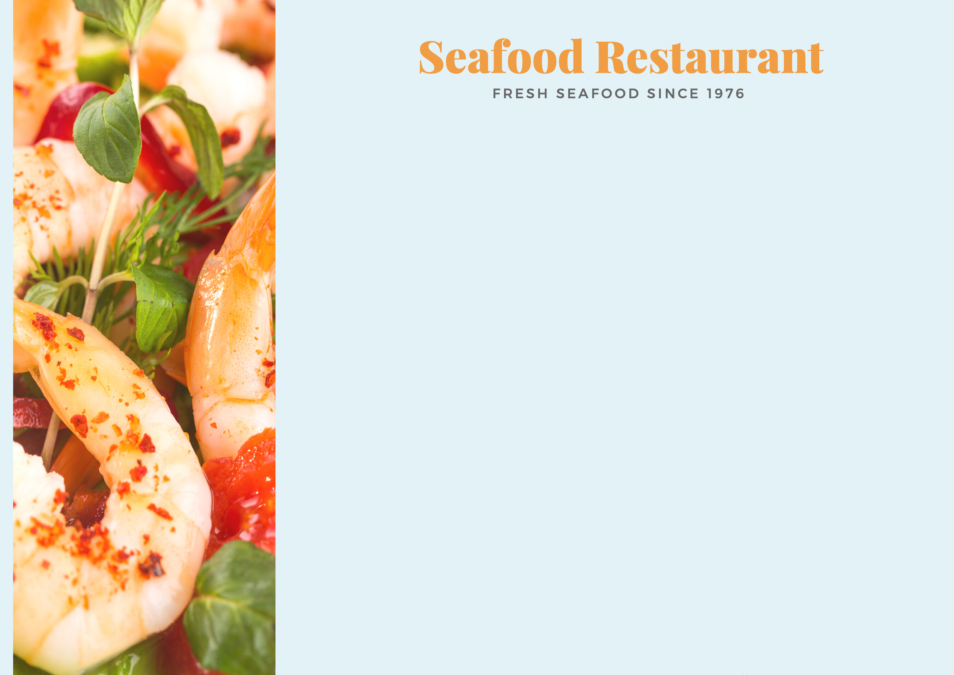

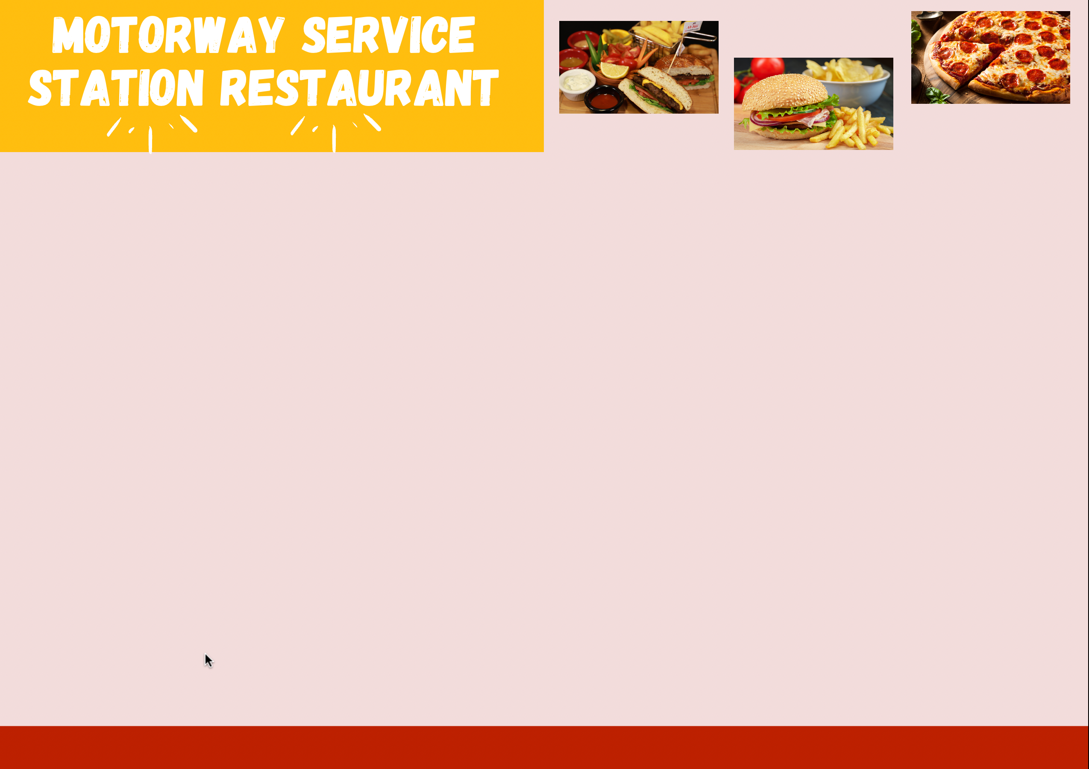
WARM-UP
Restaurants
Work in small groups.
Pick your type of restaurant.
Create a menu (with starters, main courses, side dishes, desserts and drinks), including prices.
Write on your board, raise the board up and say "Bingo" when finishing.
Look at others' restaurant menus and say which you want to go to.

Slide 7
LESSON 4: COMMUNICATION
WARM-UP
Restaurant
VOCABULARY
Vocabulary
Aims of the stage:
To help students use key language more appropriately.

Slide 8
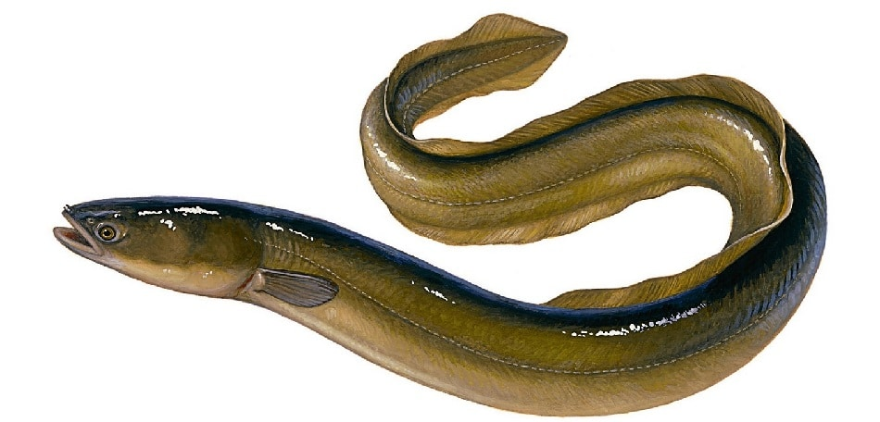
VOCABULARY
eel
/iːl/
con lươn

Slide 9
VOCABULARY
foreign
/ˈfɒr.ən/
ngoại quốc

Slide 10

VOCABULARY
interview
/ˈɪn.tə.vjuː/
cuộc phỏng vấn

Slide 11
VOCABULARY
try
/traɪ/
thử làm

Slide 12
VOCABULARY
New words | Pronunciation | Meaning
1. eel (n) | /iːl/ | con lươn
2. foreign (adj) | /ˈfɒr.ən/ | ngoại quốc
3. favourite (adj) | /ˈfeɪ.vər.ɪt/ | ưa thích
4. interview (n) | /ˈɪn.tə.vjuː/ | cuộc phỏng vấn
5. try (v) | /traɪ/ | thử làm

Slide 13
LESSON 4: COMMUNICATION
WARM-UP
Restaurant
VOCABULARY
Vocabulary
Task 1: Listen and read the conversation.
Task 2: Work in pairs. Take turns to ask and answer about the prices of the food and drink on the menu.
EVERYDAY ENGLISH
Aims of the stage:
To introduce ways to ask and answer about prices in English.
To help Ss practise asking and answering about prices.

Slide 14
EVERYDAY ENGLISH
1
Listen and repeat the conversation. Pay attention to the questions and answers.
Mark: How much is a bottle of mineral water?
Mi: It's 5,000 dong.
Mark: And how much are two kilos of apples?
Mi: They're 50,000 dong.

Slide 15
EVERYDAY ENGLISH
1
Work in pairs. Take turns to ask and answer about the prices of the food and drink on the menu.
2
LY'S RESTAURANT Breakfast Menu
Food
bowl of beef noodle soup | 30,000 dong
bowl of eel soup | 35,000 dong
toast | 20,000 dong
Drink
glass of milk | 9,000 dong
bottle of mineral water | 8,000 dong
cup of green tea | 5,000 dong
Sample:
A: How much is a bowl of beef noodle soup?
B: It’s 30,000 dong.

Slide 16
LESSON 4: COMMUNICATION
WARM-UP
Restaurant
Vocabulary
VOCABULARY
Task 1: Listen and read the conversation.
Task 2: Work in pairs. Take turns to ask and answer about the prices of the food and drink on the menu.
EVERYDAY ENGLISH
Task 3: Listen to the conversation and answer the questions.
Task 4: Work in groups. Interview two friends about their favourite food and drink. Write their answers in the table.
YOUR FAVOURITE FOOD & DRINK
Aims of the stage:
To help Ss revise the vocabulary related to the topic.
To help Ss practise asking and answering about the favourite food and drink.
To help Ss practise reporting the results of their interviews.

Slide 17
YOUR FAVOURITE FOOD AND DRINK
3
Listen to the conversation and answer the following questions.
2
1. What's Nam's favourite food?
2. What's his favourite drink?
3. What foreign food does he like?
4. What food does he want to try?
5. What food can he cook?
Spring rolls.
Lemonade.
Apple pie and pancakes.
Hu tieu (in Ho Chi Minh City).
Omelettes, rice, and spring rolls.

Slide 18
YOUR FAVOURITE FOOD AND DRINK
2
Work in groups. Interview two of you friends about their favourite food and drink. Write their answers in the table below.
4
Questions | Student 1 | Student 2
1. What's your favourite food?
2. What's your favourite drink?
3. What food or drink do you want to try?
4. What foreign food or drink do you like?
5. What can you cook?

Slide 19
LESSON 4: COMMUNICATION
WARM-UP
Restaurant
VOCABULARY
Vocabulary
Task 1: Listen and read the conversation.
Task 2: Work in pairs. Take turns to ask and answer about the prices of the food and drink on the menu.
EVERYDAY ENGLISH
Task 3: Listen to the conversation and answer the questions.
Task 4: Work in groups. Interview two friends about their favourite food and drink. Write their answers in the table.
YOUR FAVOURITE FOOD & DRINK
CONSOLIDATION
Wrap-up
Homework

Slide 20
CONSOLIDATION
1
WRAP-UP
In this lesson, we have learn to:
Use lexical items related to the favourite food and drink
in everyday life
Understand and use ways to ask and answer about prices
in English

Slide 21
CONSOLIDATION
2
HOMEWORK
Make a conversation, record a video and upload on a given drive link.
Prepare for the next lesson: Skills 1

Slide 22

Website: hoclieu.vn
Fanpage: facebook.com/www.tienganhglobalsuccess.vn/

