Slide 1

Unit 3: School
Lesson 3.2
Page 45

Slide 2
Lesson Outline
Warm-up
Listening
Consolidation
Wrap-up

Slide 3
Objectives
By the end of this lesson, students will be able to pronounce the sound /æ / and talk about their school timetables.
Phonic: /æ /
Structure: When do you have English?
- I have English on Wednesdays and Fridays.

Slide 4

Notes:
459539764

Slide 5

WARM UP

Slide 6

LET’S CHANT!

Slide 7
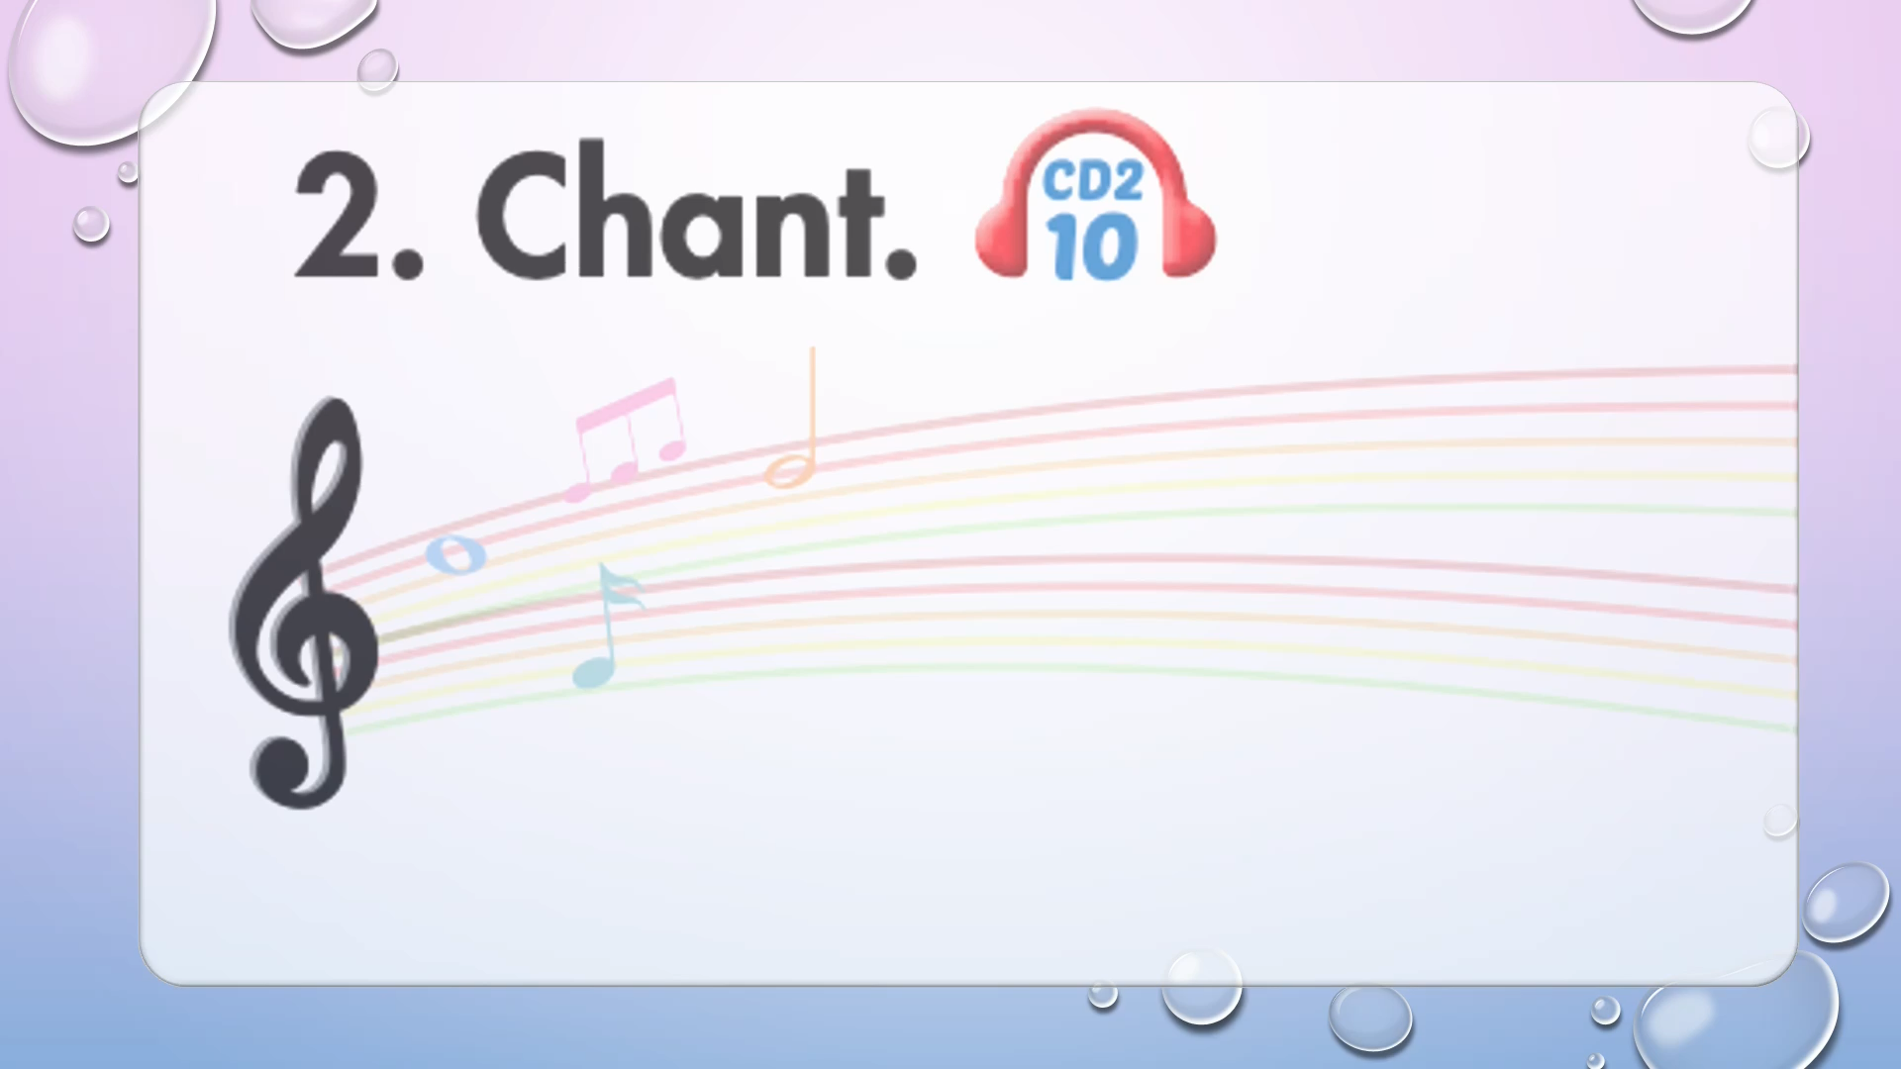

Slide 8
Let’s play!

Slide 9

Days of the week

Slide 10


How to play
. Listen to a sound
. Choose the correct day

Slide 11



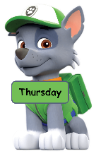


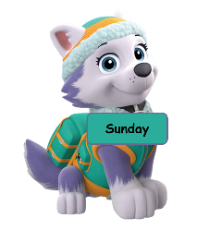




Slide 18

It’s time to learn …

Slide 19
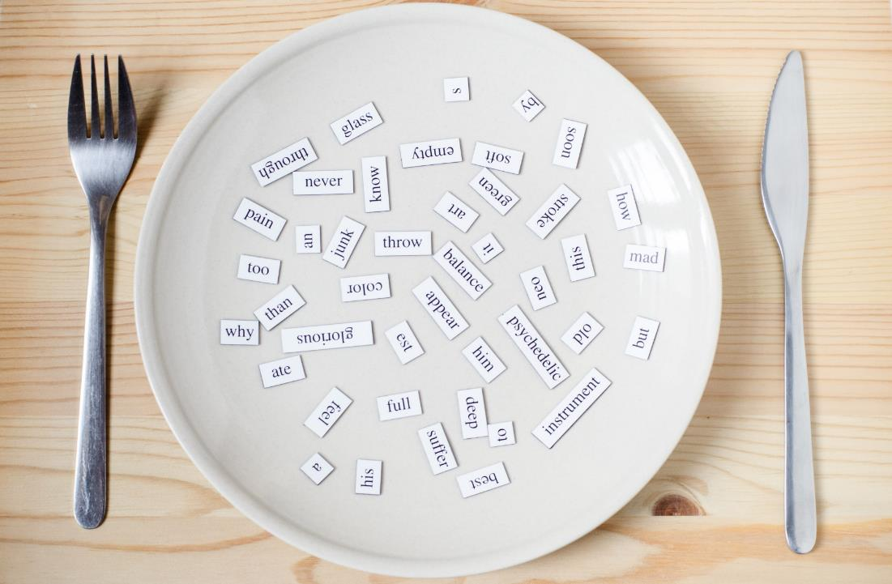
Phonics
/æ /

Slide 20

Presentation

Slide 21
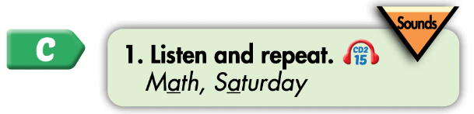
Click on the icon to hear the sound
Click on each word to hear the sound
Math
Saturday
/æ /
/æ /

Slide 22

Practice

Slide 23
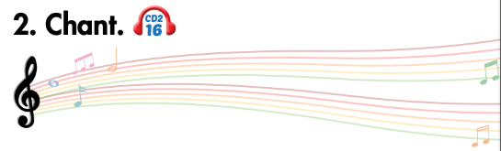
Listen and point
Listen and clap
Listen and chant

Slide 24
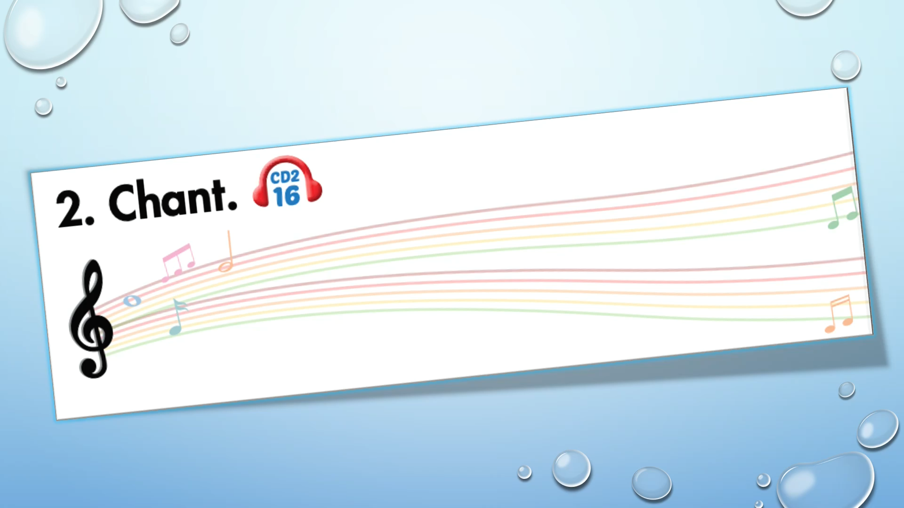

Slide 25

Listening

Slide 26
Pre-Listening
Look at the pictures and answer these questions.

Slide 27
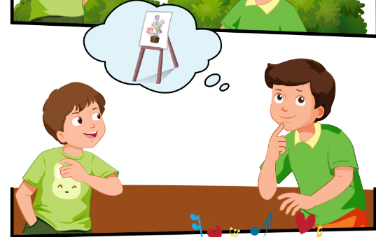
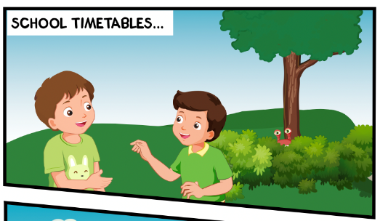
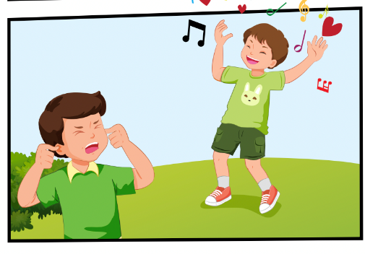
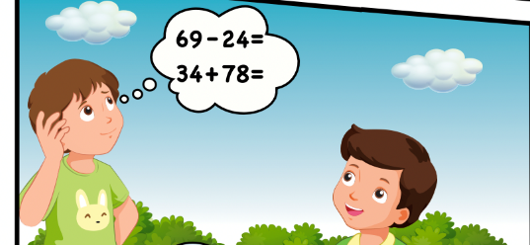
Who can you see?
Can Tom sing?
What do they talk about?

Slide 28

While-Listening
Click on the icon to hear the sound

Slide 29

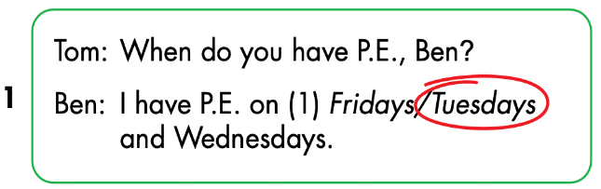
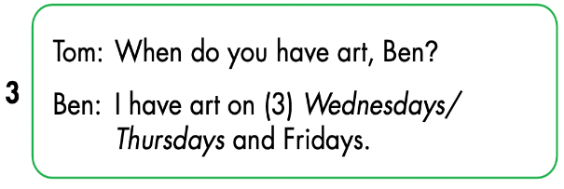
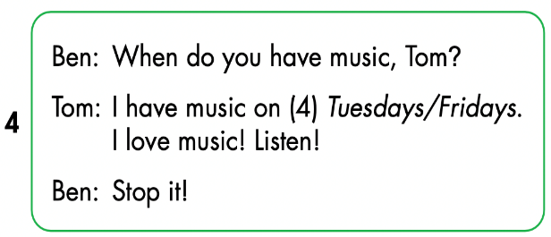
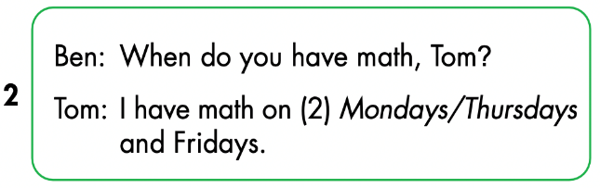
Click on the icon to hear the sound

Slide 30
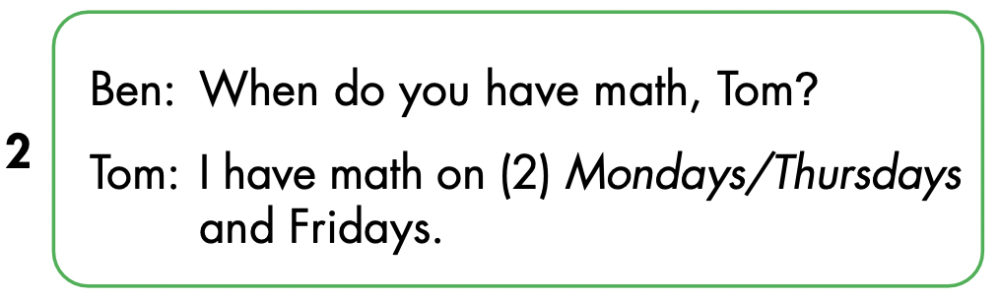
Let’s check!

Slide 31
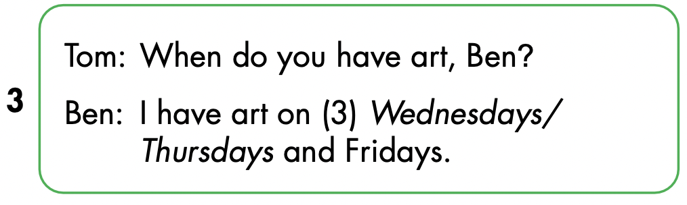

Slide 32
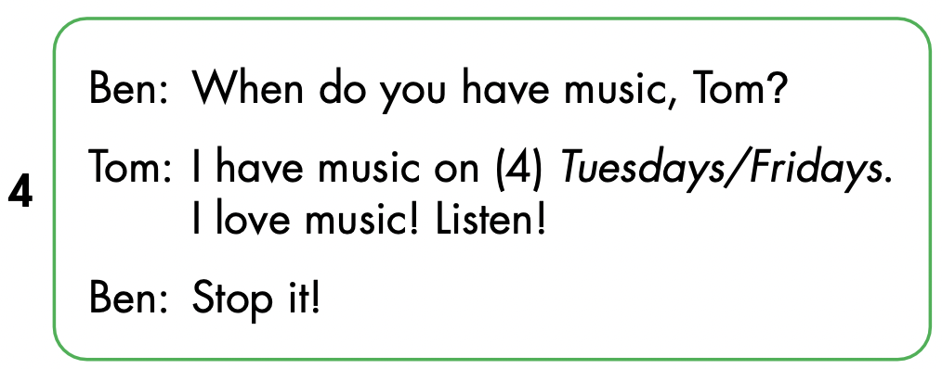

Slide 33

Speaking

Slide 34



Slide 35

CONSOLIDATION

Slide 36
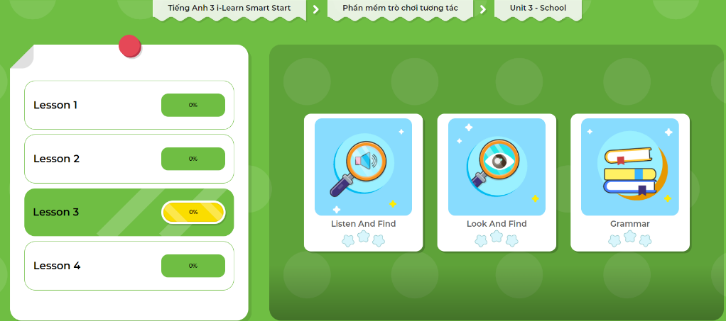
Extra Practice
DHA App
Let’s play!
Click here to play the game

Slide 37

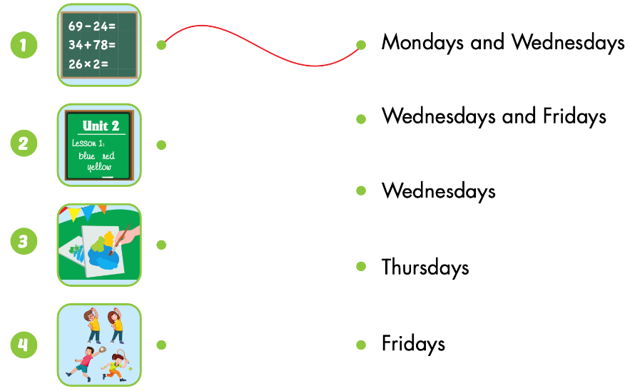
Extra Practice
WB p. 33
Click on the icon to hear the sound

Slide 38

Chain Spelling Activity
The students stand up and you say a word (Wednesday).
Students have to spell it out, letter by letter.
If someone misses a letter, they sit down and are out of the game.
The last person left standing is the winner.

Slide 39

WRAP-UP

Slide 40
Lesson 3
Today’s lesson
Phonics
/eɪ/ and /ɪə/
Structures/ Sentence patterns
Is this your (eraser)?
- Yes, it is./No, it isn't.
Are these your (notebooks)?
- Yes, they are./No, they aren't.

Slide 41
Lesson 3
Homework
Practice the vocabularies/ structures and make sentences using them.
Do the exercises on page 33 WB
Do the exercises in Tiếng Anh 3 i-Learn Smart Start Notebook on page 24.
Prepare the next lesson (page 46 SB)
Play the consolidation games in Tiếng Anh 3 i-Learn Smart Start DHA App on www.eduhome.com.vn

Slide 42
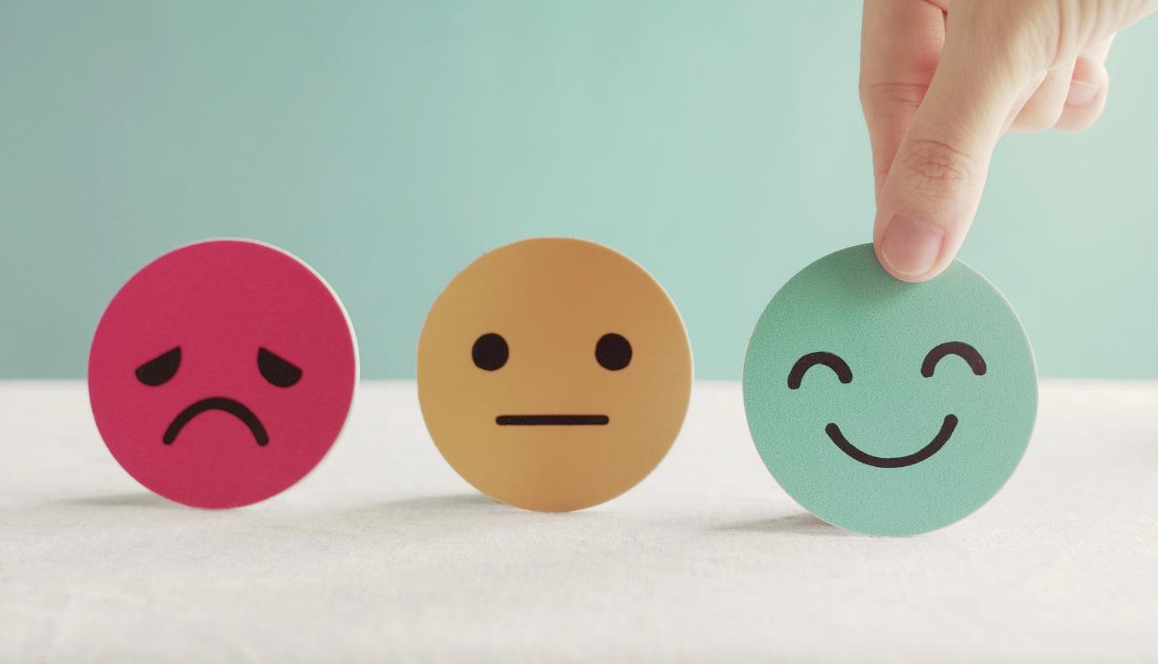
Lesson 3
Stay positive and have a nice day!

