Slide 1
KET SPEAKING
Time allowed - 8-10 minutes
Normally you will do the speaking test with another candidate. The two of you will meet two examiners. One of the examiners will talk to you, the other does not particpate in the conversations.
There are two parts to the speaking test:
Speaking part 1: short questions and answers between you and the examiner
Speaking part 2: the examiner gives you some information or a card with some ideas for questions. You have to talk with the other candidate and ask or answer questions.
How to prepare for KET Speaking
Speak as much as you can, with your friends
Practise asking and asnwering questions about daily life
Practise giving information about yourself

Slide 2

KEY ENGLISH TEST 3
SPEAKING TEST 4

Slide 3

Part 1:
What do you think of your hometown?
Which other towns have you visited in your country?
Have you travelled to another country?
Which country would you like to visit? Why?
Do you like travelling? Why/Why not?
Talk about your favorite travelling destination.

Slide 4

VOCABULARY
accommodation: a room or building in which you stay during holidays or live.
guided tour: a tour in which a group of people is guided by an expert
holiday destination: where you go for a holiday
package tour: a holiday at a fixed price in which the travel company arranges your travel, hotels, and sometimes meals for you
go sightseeing: to go visiting sights of interest
travel agency: a shop that specializes in booking holidays

Slide 5


Phrasal verbs - Travelling

Slide 6
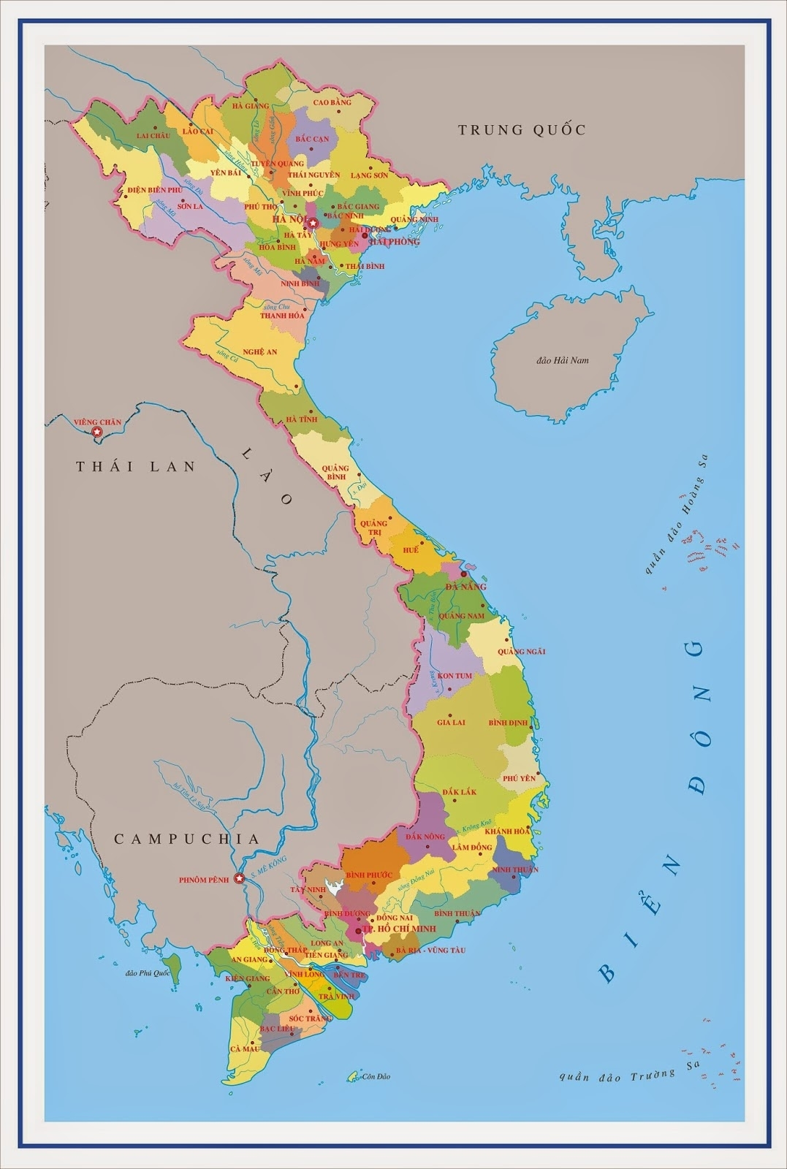
TALK ABOUT A DESTINATION
In Vietnam/ In other countries

Slide 7
Outline
What is the place
What time of the year is better to go there
What can you see and do there
How can you get there

Slide 8
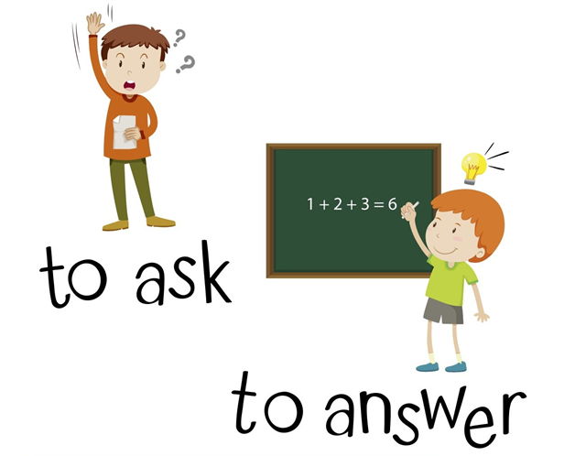
SPEAKING pART 2
Asking and answering questions using these prompt cards

Slide 9

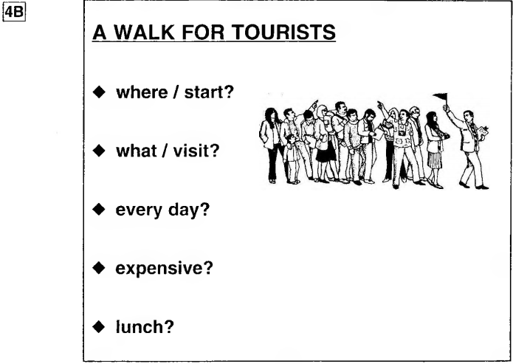
Ask and answer
What are other questions and answers you can think of?

Slide 10
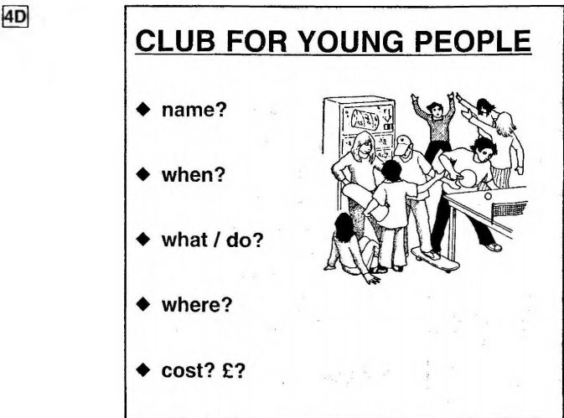
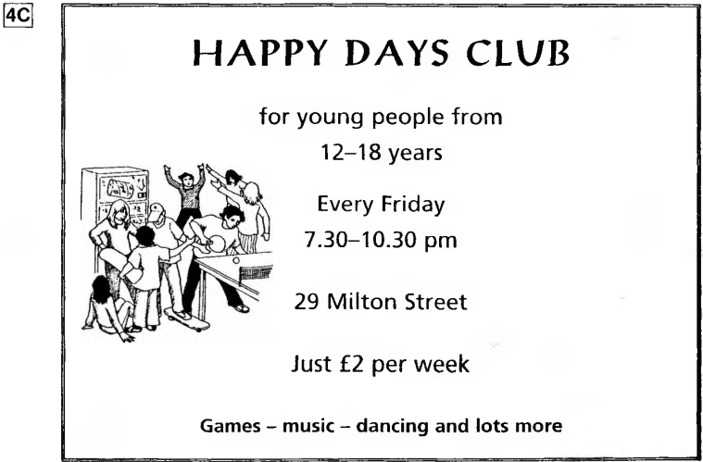
Ask and answer

Slide 11
Talk about the Happy Days Club

