Slide 1
Basic Template: Simple Acid MK Plan Infographics
MK Plan
Target
Marketing
Business
Here is where this template begins
MK Plan

Slide 2
MK plan infographics
This template contains an assortment of complementary infographic resources for Basic Template: Simple Acid MK Plan presentation
These infographics are adapted to the style of the before mentioned presentation, so you can insert them easily and have the completely integrated at once. You just need to do the following:
Select the element that you want to copy
Right-click and choose “Copy”
Go to the slide where you want the element to appear
Right-click and choose “Paste”

Slide 3
MK plan infographics
02
04
Jupiter
Saturn
01
03
It’s the biggest planet in the Solar System
Saturn is a gas giant and has several rings
Venus
Mars
Venus is the second planet from the Sun
Despite being red, Mars is a cold place

Slide 4
MK plan infographics
Month 2XXX
Mon | Tue | Wed | Thu | Fri | Sat | Sun
1 | 2 | 3 | 4 | 5 | 6 | 7
8 | 9 | 10 | 11 | 12 | 13 | 14
15 | 16 | 17 | 18 | 19 | 20 | 21
22 | 23 | 24 | 25 | 26 | 27 | 28
29 | 30 | 31
Venus
It has a beautiful name
Mars
Mars is a very cold place

Slide 5
MK plan infographics
 | First quarter | Second quarter | Third quarter
Key action 1 | Describe your items for the quarter here | Describe your items for the quarter here | Describe your items for the quarter here
Key action 2 | Describe your items for the quarter here | Describe your items for the quarter here | Describe your items for the quarter here
Key action 3 | Describe your items for the quarter here | Describe your items for the quarter here | Describe your items for the quarter here

Slide 6
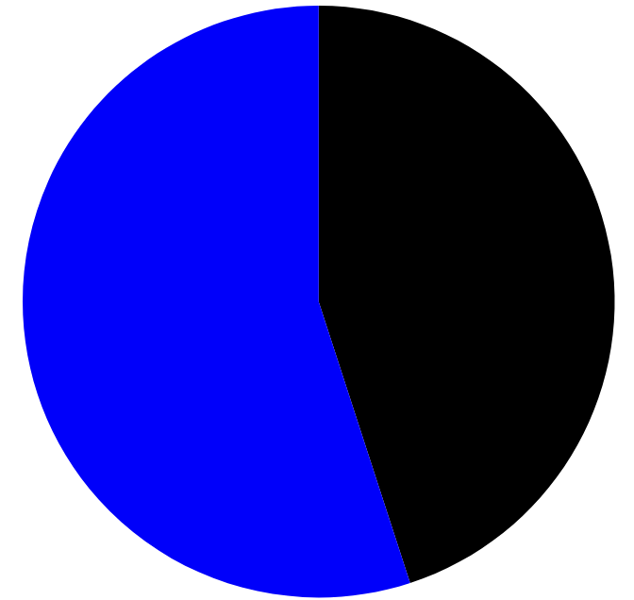
MK plan infographics
45%
Mercury
Mercury is a small planet
55%
Venus
Venus is a very hot planet
Follow the link in the graph to modify its data and then paste the new one here. For more info, click here

Slide 7
MK plan infographics
Goals
Earth is the planet with life
Short term
Long term
Neptune is far away from Earth
Mercury is the closest planet to the Sun
Mars
Venus
Jupiter
Saturn
Despite being red, Mars is a cold place
Venus is the second planet from the Sun
It’s the biggest planet in the Solar System
Saturn is a gas giant and has several rings

Slide 8
MK plan infographics
Campaign | Description | Budget | Date
Mercury | Mercury is the closest planet to the Sun and is very small | $350 | 09/05/2XXX
Venus | Venus is the second planet from the Sun and is hot | $450 | 09/12/2XXX
Neptune | Neptune is the farthest planet from the Sun | $200 | 09/17/2XXX

Slide 9
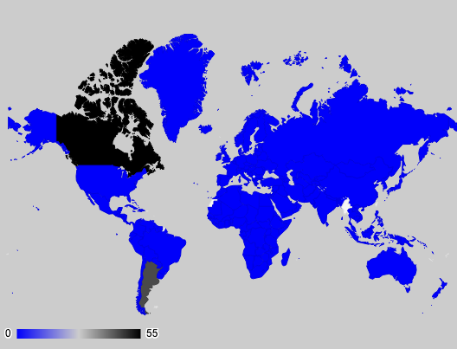
MK plan infographics
20%
Saturn
It’s a gas giant and has several rings
10%
Venus
Venus is the second planet from the Sun
70%
Mars
Despite being red, Mars is a cold place
Follow the link in the graph to modify its data and then paste the new one here. For more info, click here

Slide 10
MK plan infographics
Mars
Despite being red, Mars is a cold place
Saturn
It’s a gas giant and has several rings
Neptune
25%
50%
75%
Neptune is far away form us

Slide 11
MK plan infographics
25%
50%
75%
Venus
Mars
Earth
Venus has a beautiful name and is the second planet from the Sun. It’s terribly hot, even hotter than Mercury
Despite being red, Mars is actually a cold place. It's full of iron oxide dust, which gives the planet its reddish cast
Earth is the third planet from the Sun and the only one that harbors life in the Solar System. This is where we live

Slide 12
MK plan infographics
Strengths
S
Venus has a beautiful name
W
Weaknesses
Mercury is the smallest planet
Opportunities
O
Mars is a very cold place
T
Threats
Neptune is an ice giant

Slide 13
MK plan infographics
Jupiter
Venus
It’s the biggest planet
It has a beautiful name
Earth
Saturn
We all live on Earth
Saturn is a gas giant
Mercury
Mars
It’s a small planet
Mars is a cold place

Slide 14
MK plan infographics
15%
Year 1
Despite being red, Mars is actually a cold place
75%
Year 2
Jupiter is a gas giant and the biggest planet
55%
Year 3
Venus has a beautiful name and is a very hot planet
30%
Year 4
Saturn is a gas giant and has several rings

Slide 15
MK plan infographics
Earth
Mars
We all live on Earth
Mars is very cold
Jupiter
Venus
Jupiter is a gas giant
Venus is a hot planet

Slide 16
MK plan infographics
Jupiter
Mars
Venus
Saturn
It’s the biggest planet in the Solar System
Despite being red, Mars is a cold place
Venus is the second planet from the Sun
Saturn is a gas giant and has several rings

Slide 17
MK plan infographics
Awareness
Jupiter is a gas giant and the biggest planet in the Solar System
Interest
Venus has a beautiful name and is the second planet from the Sun
Decision
Despite being red, Mars is actually a cold place
Purchase
Mercury is the closest planet to the Sun

Slide 18
MK plan infographics
20%
Neptune
50%
Saturn
Neptune is far away form us
Saturn is a gas giant
70%
Mars
90%
Mercury
Mars is a very cold place
It’s the closest planet to the Sun

Slide 19
MK plan infographics
01
Mars
Despite being red, Mars is a cold place
02
Neptune
Neptune is far away from us
03
Mercury
It’s the closest planet to the Sun

Slide 20
MK plan infographics
Gender
25%
Women
40%
Other
35%
Men
Mars is cold
Venus is hot
Earth has life
Age range
25-30
20%
31-35
30%
36-40
50%
Interests
Food
4/5
Travel
3/5
Music
2/5

Slide 21
MK plan infographics
45%
Neptune
Neptune is far away from us
55%
Mercury
It’s the smallest planet

Slide 22
MK plan infographics
 | Goal | Priority | Check
01 | Mercury is the closest planet to the Sun |  | Yes
02 | Venus is the second planet from the Sun |  | Yes
03 | Ceres is located in the main asteroid belt |  | No
Mars
Saturn
Neptune
Mars is a cold place
Saturn is a gas giant
It's far away form us

Slide 23
MK plan infographics
Mars
Neptune
Mars is a cold place
It's far away form us
Saturn
Earth
Saturn is a gas giant
We all live on Earth

Slide 24
MK plan infographics
60%
40%
Mercury
Neptune
It’s the closest planet to the Sun
Neptune is far away from us

Slide 25
MK plan infographics
Budget
Chanel
$35,000
Youtube
Goals
Description
You can list your goals here
You can list your goals here
You can list your goals here
You can list your goals here
You can list your goals here
Venus has a beautiful name and is the second planet from the Sun. It’s terribly hot, even hotter than Mercury, and its atmosphere is extremely poisonous. It’s the second-brightest natural object

Slide 26
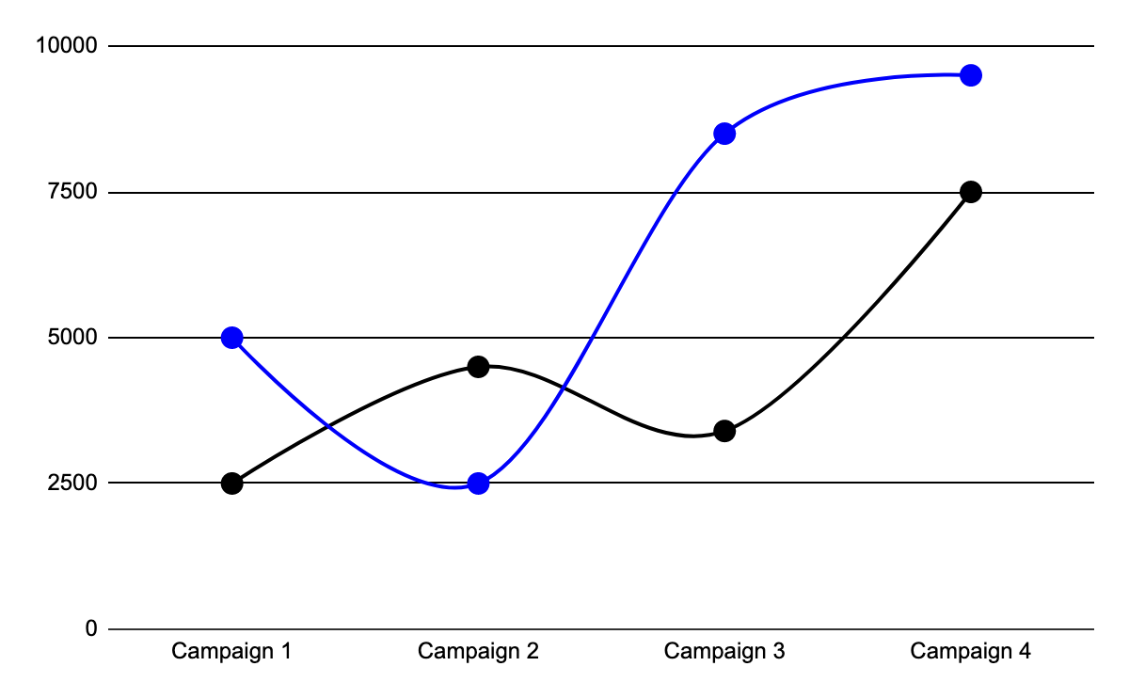
MK plan infographics
17,900
Outreach
Despite being red, Mars is cold
25,500
Interactions
Follow the link in the graph to modify its data and then paste the new one here. For more info, click here
Venus has a beautiful name

Slide 27
MK plan infographics
Kim Sons
Jay Johns
Venus has a nice name
Jupiter is a big planet
Paul Trend
Team 1
Earth is the planet with life
Neptune is far from us
John Harry
Saturn is a gas giant
Ray Fray
Mars is a very cold place

Slide 28
MK plan infographics
Competitor | Description | Strength
Competitor 1 | Mercury is the closest planet to the Sun
Competitor 2 | Venus is the second planet from the Sun
Competitor 3 | Neptune is the farthest planet from the Sun
Competitor 4 | Jupiter is the biggest planet in the Solar System
Competitor 5 | Saturn is a gas giant and has several rings
Competitor 6 | Earth is the beautiful planet where we all live

Slide 29
MK plan infographics
Venus
Mars
Earth
Venus has a beautiful name and is the second planet from the Sun. It’s terribly hot, even hotter than Mercury
Despite being red, Mars is actually a cold place. It's full of iron oxide dust, which gives the planet its reddish cast
Earth is the third planet from the Sun and the only one that harbors life in the Solar System. This is where we live
$50
$70
$90

Slide 30
MK plan infographics
$
Venus
50%
Mars
25%
Earth
25%
Venus has a beautiful name
Mars is a very cold place
Earth is the planet with life

Slide 31
MK plan infographics
Jupiter
01
02
Mercury
Jupiter is the biggest planet
Mercury is the smallest planet
Venus
03
04
Neptune
Venus is a very hot planet
Neptune far away from us
Earth
05
06
Saturn
We all live on Earth
Saturn is a gas giant

Slide 32
MK plan infographics
 | Jan | Feb | Mar | Jun | Jul | Aug
Campaign 1
Campaign 2
Campaign 3
Campaign 4
Campaign 5

Slide 33
Instructions for use
If you have a free account, in order to use this template, you must credit Slidesgo in your final presentation. Please refer to the next slide to read the instructions for premium users.
As a Free user, you are allowed to:
- Modify this template.
- Use it for both personal and commercial projects.
You are not allowed to:
- Sublicense, sell or rent any of Slidesgo Content (or a modified version of Slidesgo Content).
- Distribute Slidesgo Content unless it has been expressly authorized by Slidesgo.
- Include Slidesgo Content in an online or offline database or file.
- Offer Slidesgo templates (or modified versions of Slidesgo templates) for download.
- Acquire the copyright of Slidesgo Content.
For more information about editing slides, please read our FAQs or visit our blog:
https://slidesgo.com/faqs and https://slidesgo.com/slidesgo-school

Slide 34
Instructions for use (premium users)
As a Premium user, you can use this template without attributing Slidesgo.
You are allowed to:
Modify this template.
Use it for both personal and commercial purposes.
Share this template in an editable format with people who are not part of your team.
You are not allowed to:
Sublicense, sell or rent this Slidesgo Template (or a modified version of this Slidesgo Template).
Distribute this Slidesgo Template (or a modified version of this Slidesgo Template) or include it in a database or in any other product or service that offers downloadable images, icons or presentations that may be subject to distribution or resale.
Use any of the elements that are part of this Slidesgo Template in an isolated and separated way from this Template.
Register any of the elements that are part of this template as a trademark or logo, or register it as a work in an intellectual property registry or similar.
For more information about editing slides, please read our FAQs or visit our blog:
https://slidesgo.com/faqs and https://slidesgo.com/slidesgo-school

Slide 35
Infographics
You can add and edit some infographics to your presentation to present your data in a visual way.
Choose your favourite infographic and insert it in your presentation using Ctrl C + Ctrl V or Cmd C + Cmd V in Mac.
Select one of the parts and ungroup it by right-clicking and choosing “Ungroup”.
Change the color by clicking on the paint bucket.
Then resize the element by clicking and dragging one of the square-shaped points of its bounding box (the cursor should look like a double-headed arrow). Remember to hold Shift while dragging to keep the proportions.
Group the elements again by selecting them, right-clicking and choosing “Group”.
Repeat the steps above with the other parts and when you’re done editing, copy the end result and paste it into your presentation.
Remember to choose the “Keep source formatting” option so that it keeps the design. For more info, please visit our blog.

