Slide 1


GOOD MORNING
EVERYONE !!!

Slide 2

Unit 3: Peoples of Viet Nam
Lesson 2: A closer look 1

Slide 3
1
h
e
r
d
2
t
i
m
e
3
h
o
r
s
e
4
f
r
i
e
n
d
l
y
5
r
i
s
e
6
c
o
u
n
t
r
y

Slide 4
herd

Slide 5
time

Slide 6
horse

Slide 7
friendly

Slide 8
rice

Slide 9
countryside

Slide 10
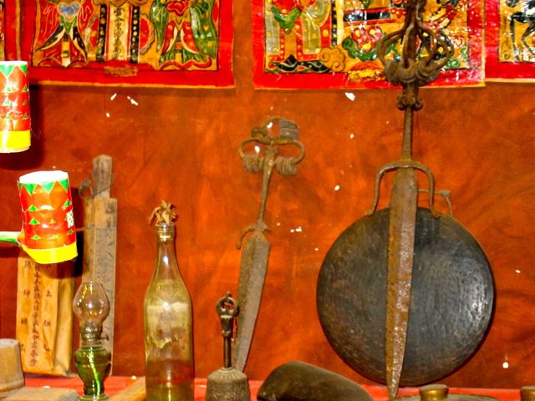
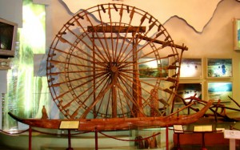
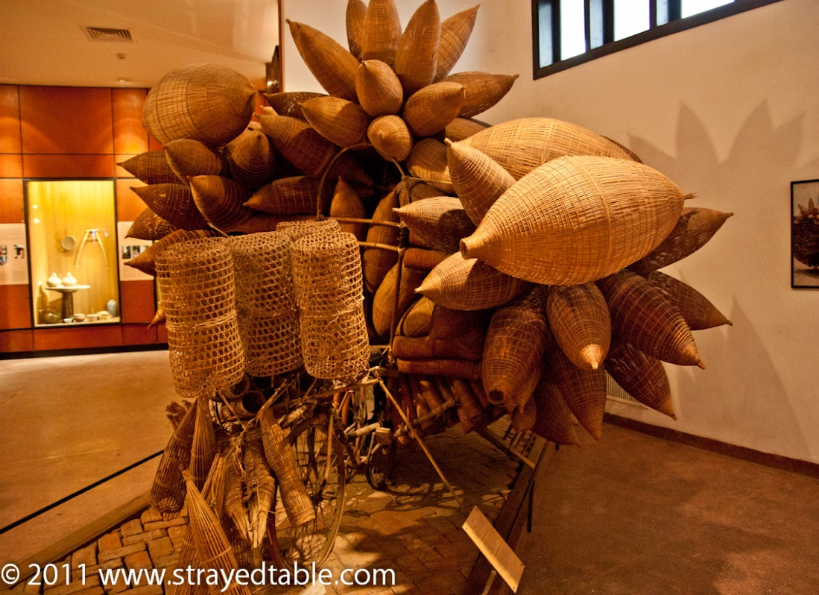
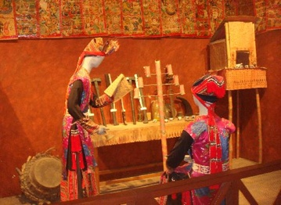

Slide 11
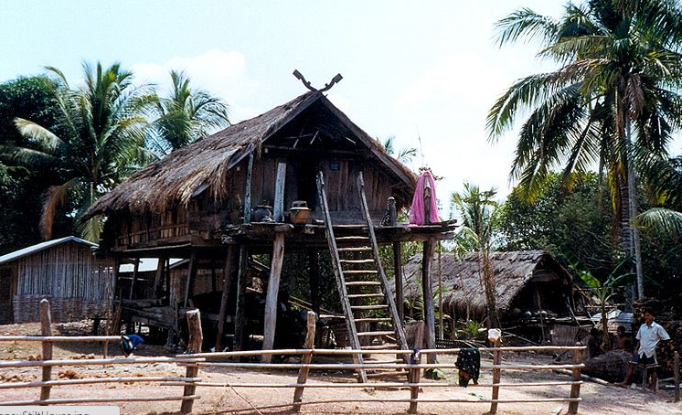
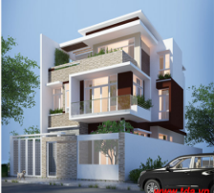

Slide 12
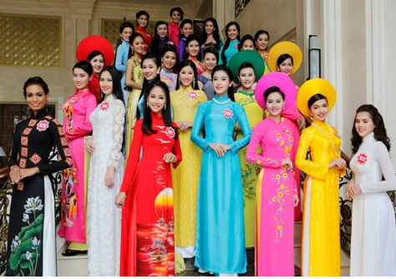

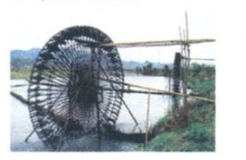
- Poor (a): nghèo
- Traditional (a):truyền thống
- Ceremony (n):nghi lễ
-Water wheel (n):cối xay nước

Slide 13





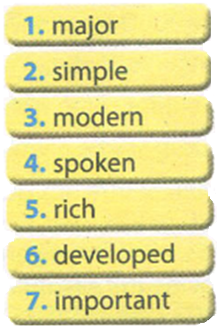
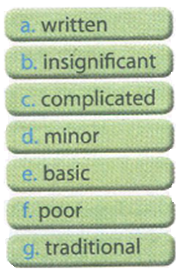
All Call
Student Demo

Slide 14

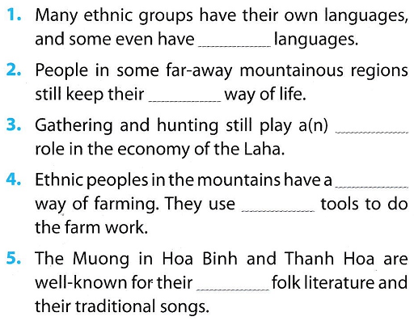
written
traditional
important
simple
basic
rich
All Call
Student Demo

Slide 15

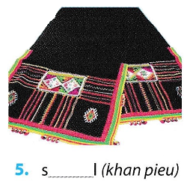
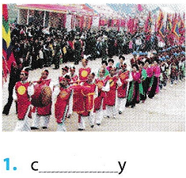
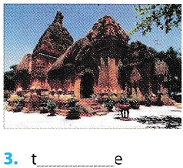
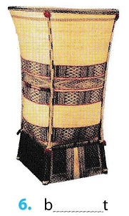
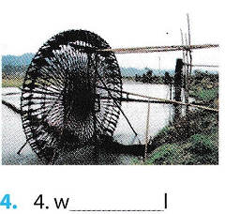
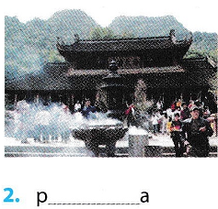
shawl
(of the Thai women)
ceremony
temple (Ly Son)
pagoda
water wheel
basket
(in the North)
(of the Sedang)
All Call
Pair
Student Demo

Slide 16



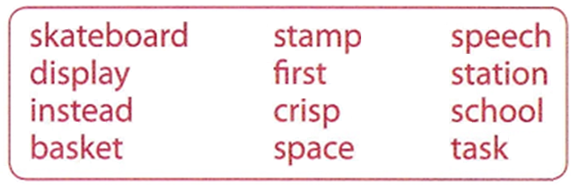
All Call
ABProgram + StartA + AV1
Student Demo

Slide 17

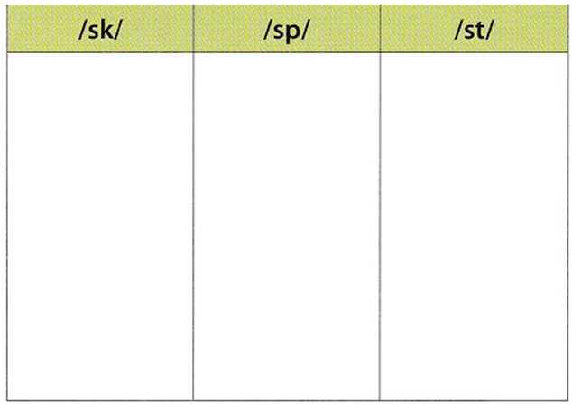
skateboard
speech
stamp
school
display
first
basket
crisp
station
task
space
instead
All Call
ABProgram + StartA + AV1
Student Demo

Slide 18
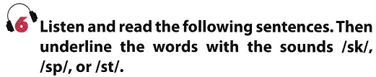
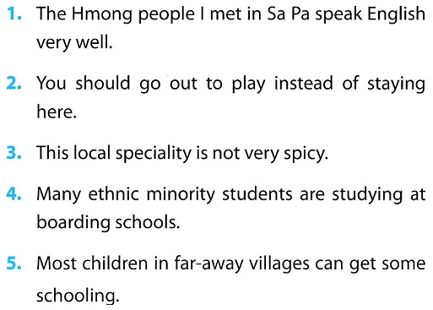
/sp/
/st/
/st/
/sp/
/sp/
/st/
/st/
/sk/
/st/
/sk/
All Call
ABProgram + StartA + AV1
Student Demo

Slide 19
Homework
Learn by heart the new words.
Speak with your friends
Prepare for the next..

