Slide 1

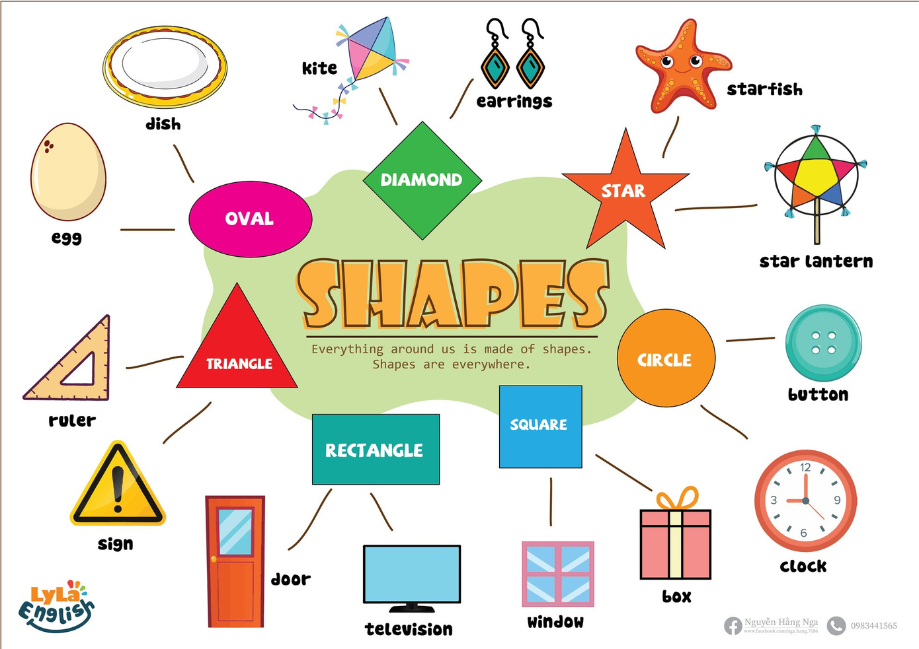


Slide 2

I. QUESTION
1.What shape is it?
- It’s a ...
2. What color is this circle?
- It’s ...
3. What shape is the TV? - It’s a ...

Slide 3
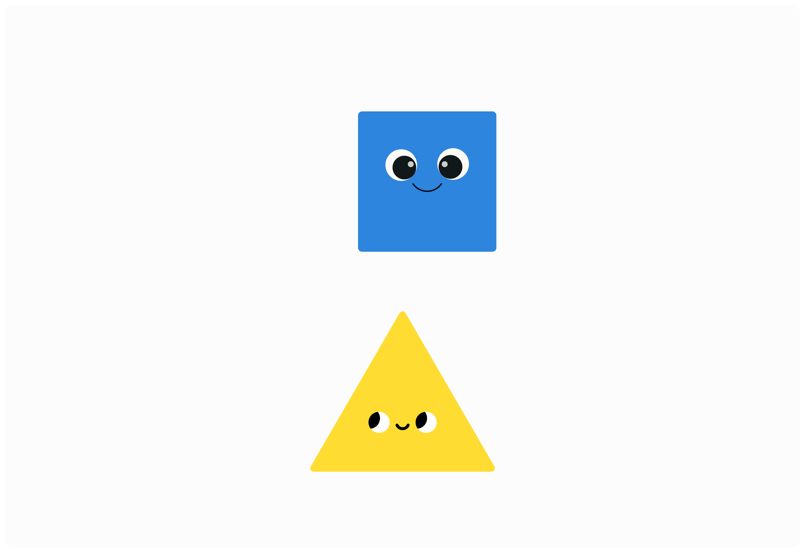
I. QUESTION
4. Can you make a square? - Yes/No...
5. What shape has 3 sides
and 3 corners?
- It’s a ...
6. Where are sides?
7. Where are corners?

Slide 4

II. VOCABULARY
Circle:.................................................
Square:..............................................
Rectangle:..........................................
Triangle:.............................................
Star:...................................................

Slide 5
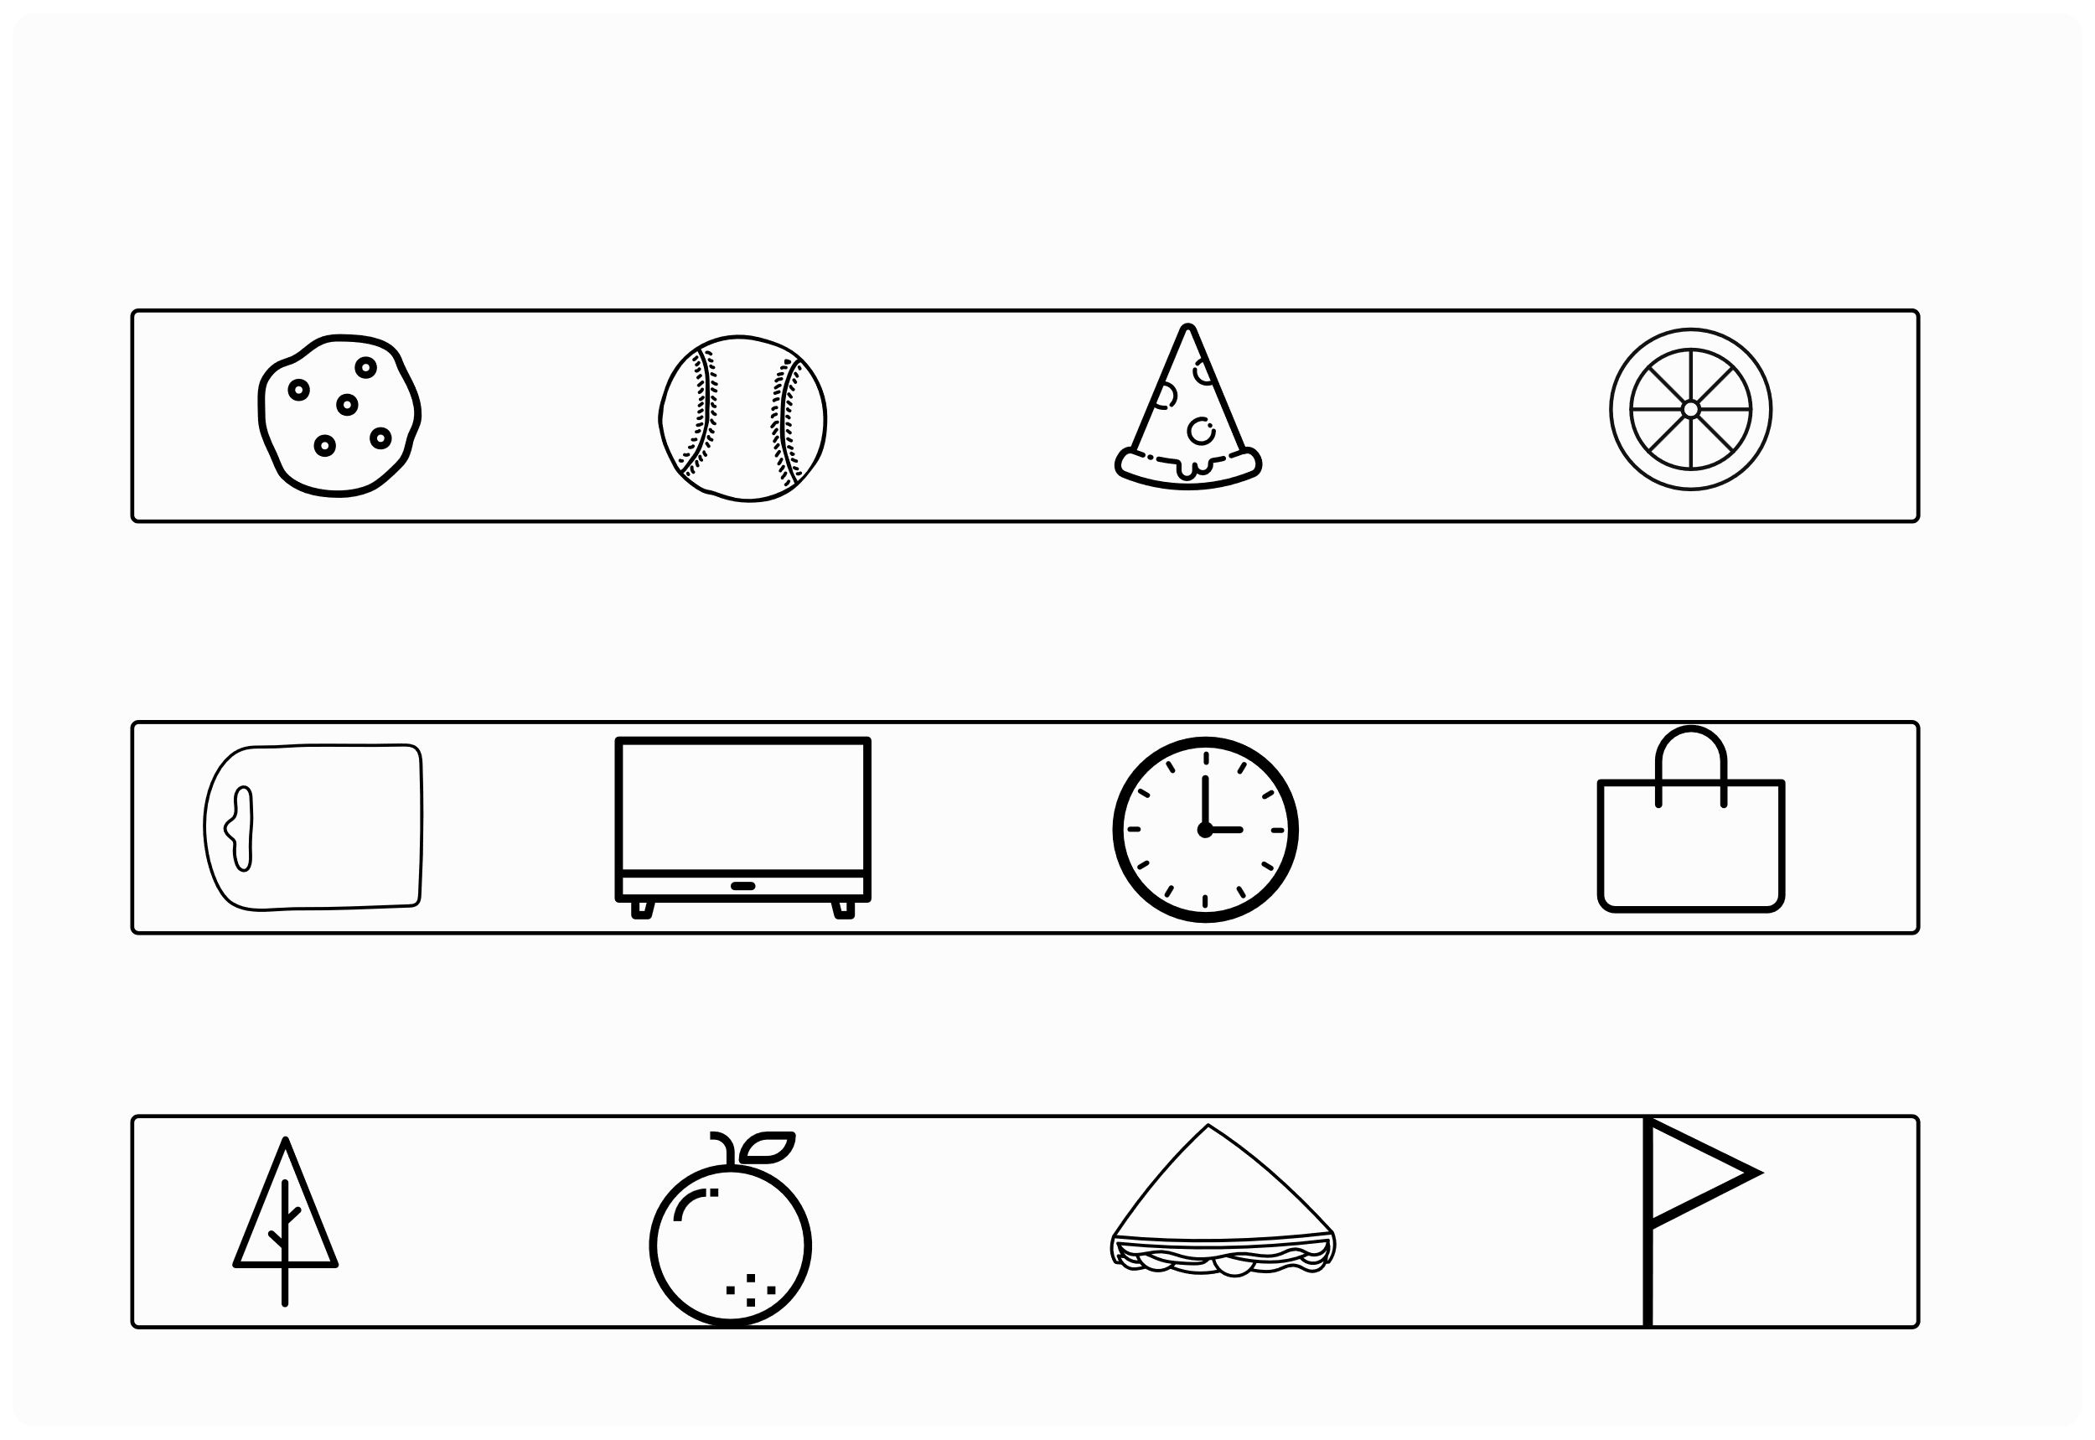
III. EXERCISES:
1.Which is different in shape?

Slide 6
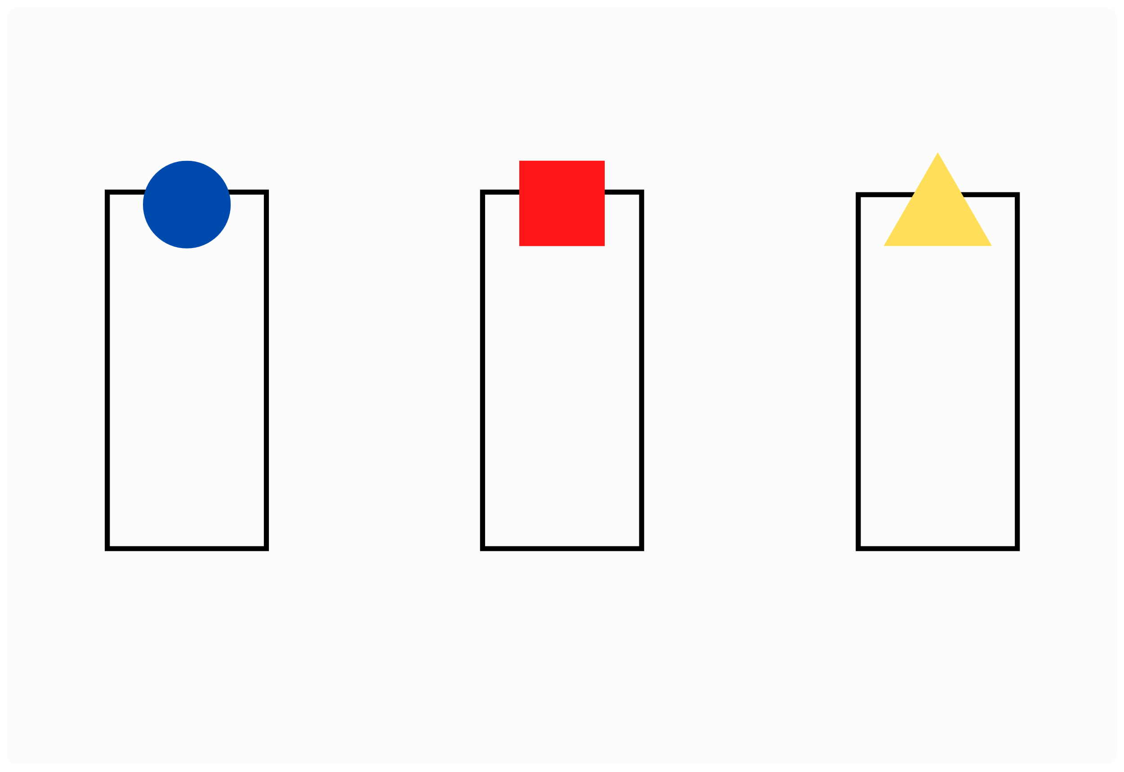

III. EXERCISES:
2.Classify the pictures in correct box:

Slide 7


III. EXERCISES:
3. Match the pictures with its shape:
Circle
Triangle
Square
Rectangle

Slide 8
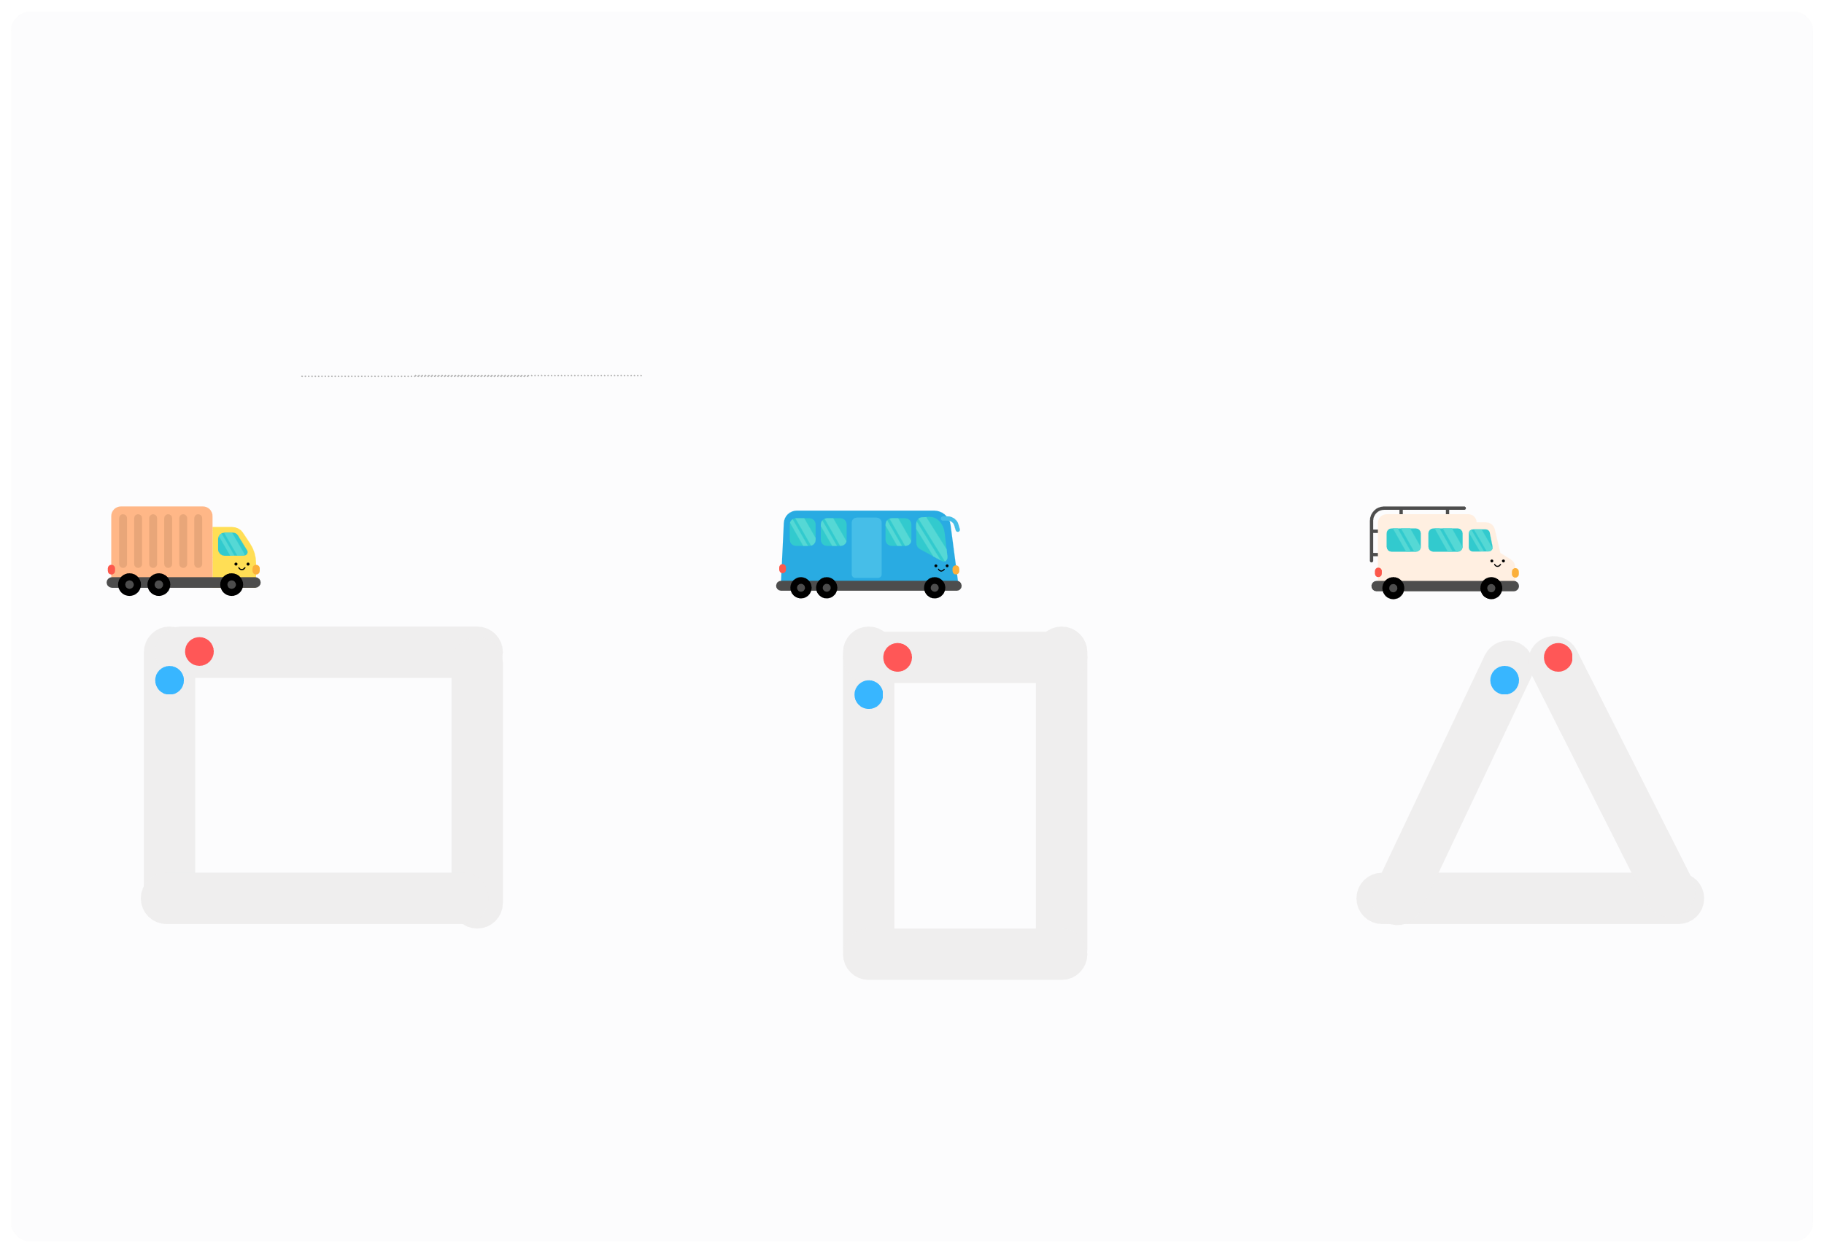
III. EXERCISES:
4. Draw the shape:

Slide 9
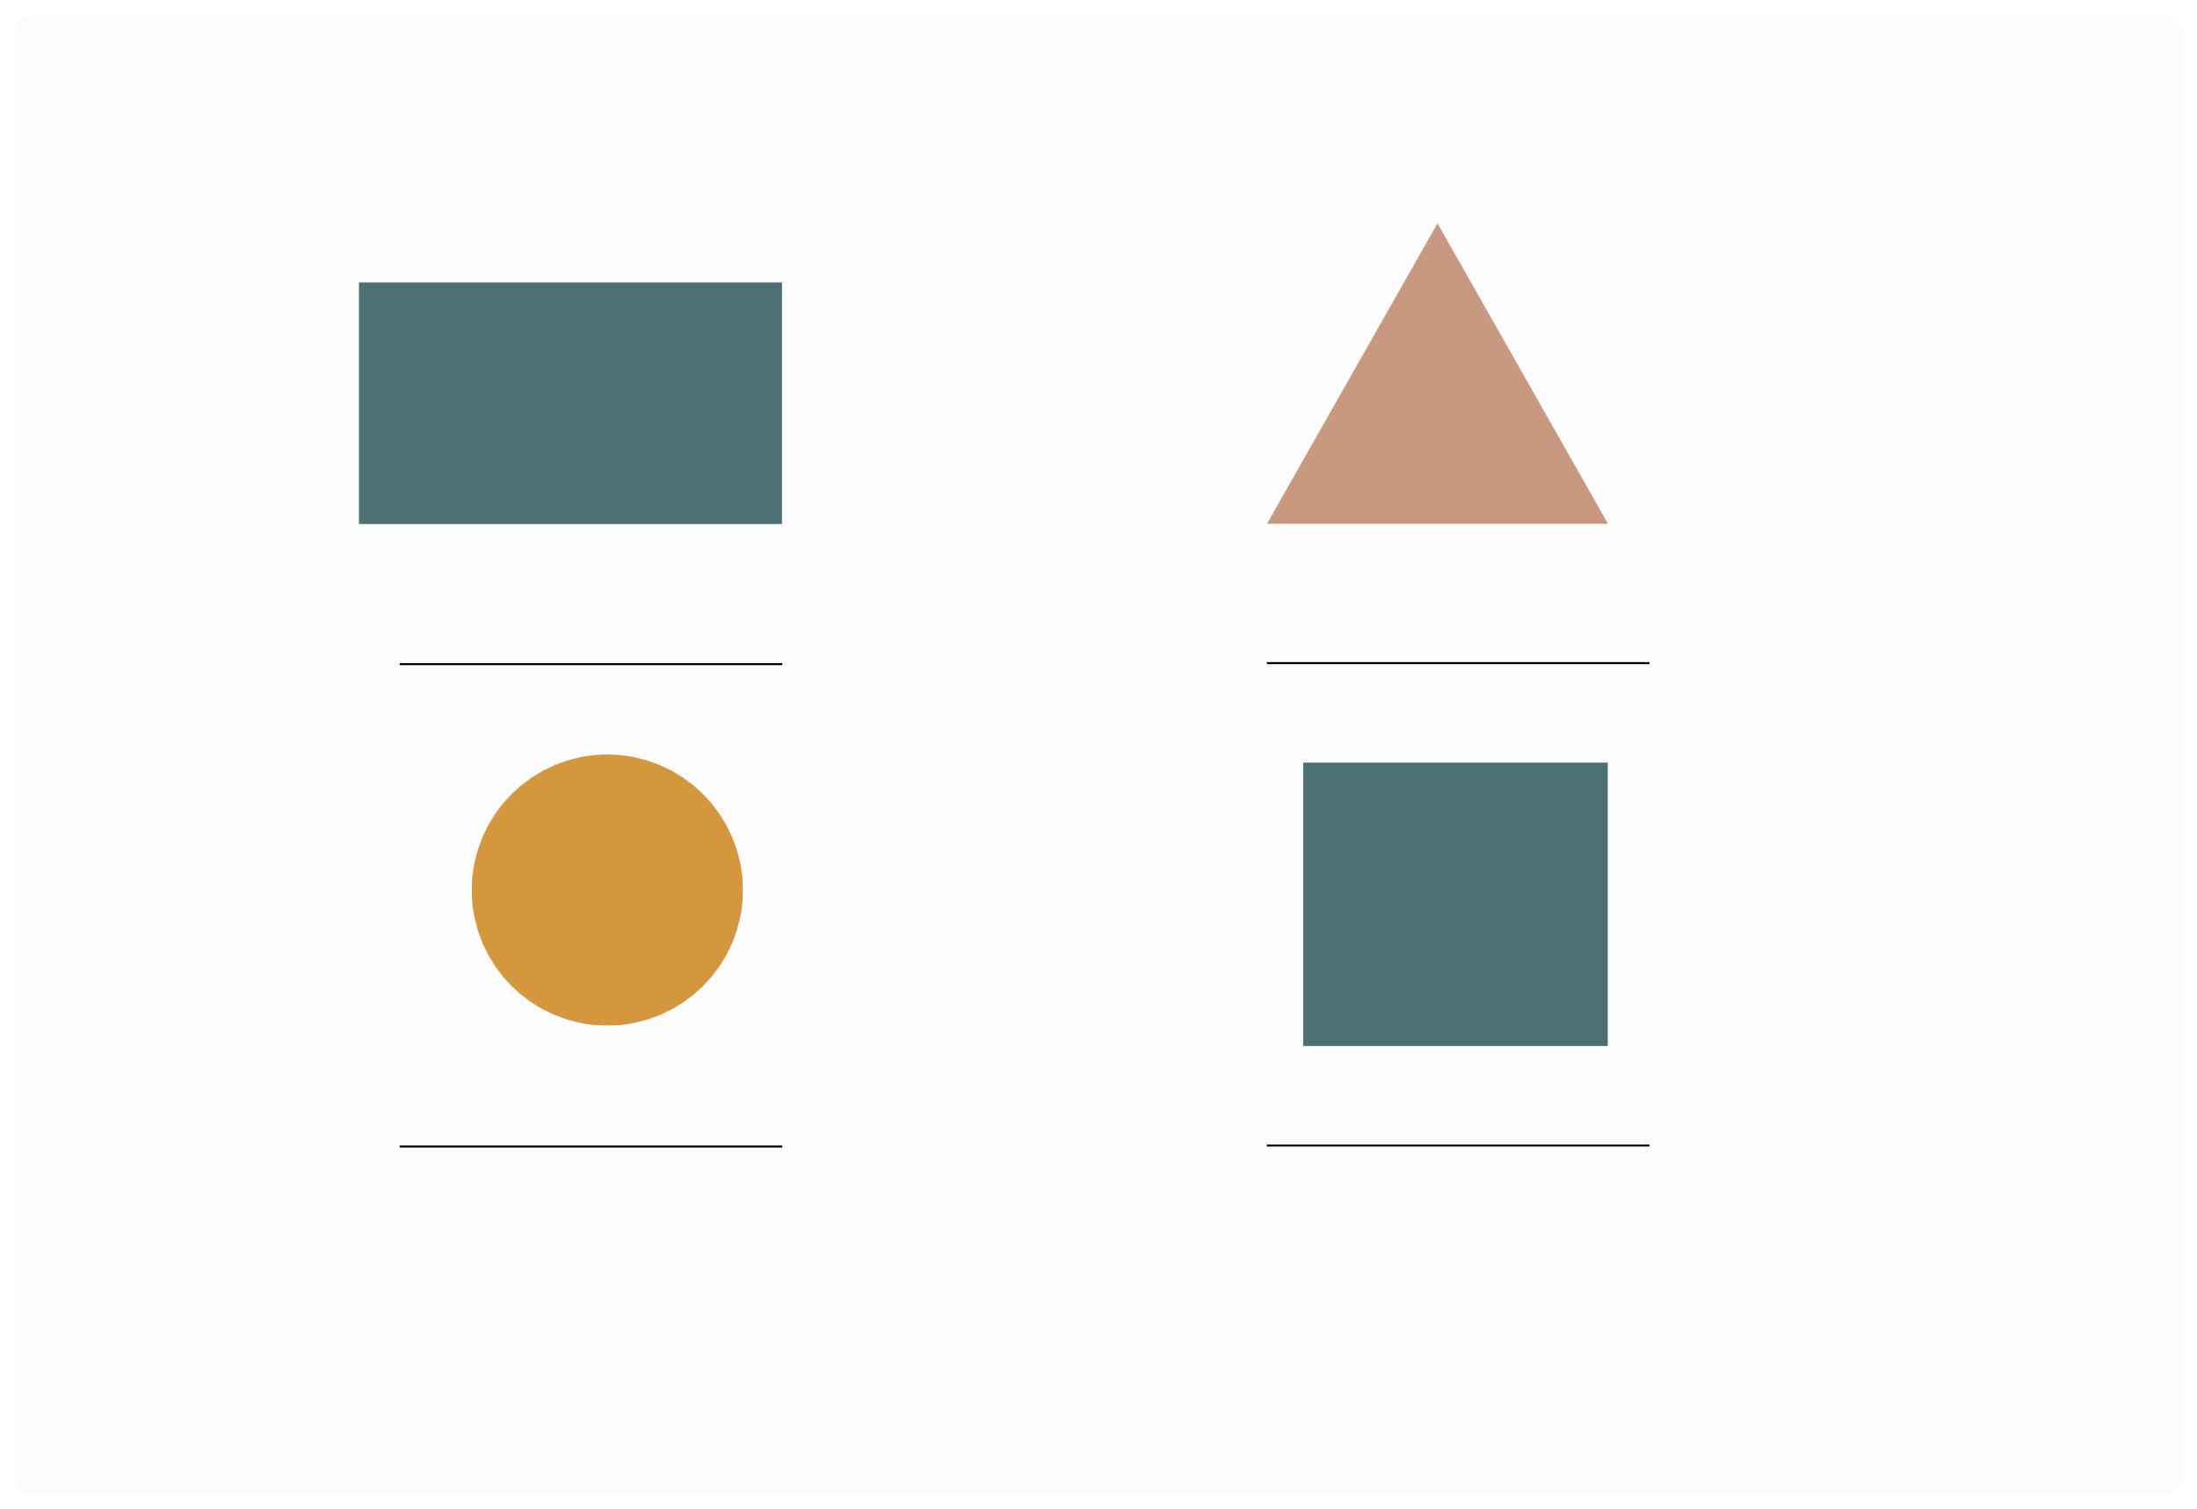
III. EXERCISES:
5. Write name of shapes:

Slide 10
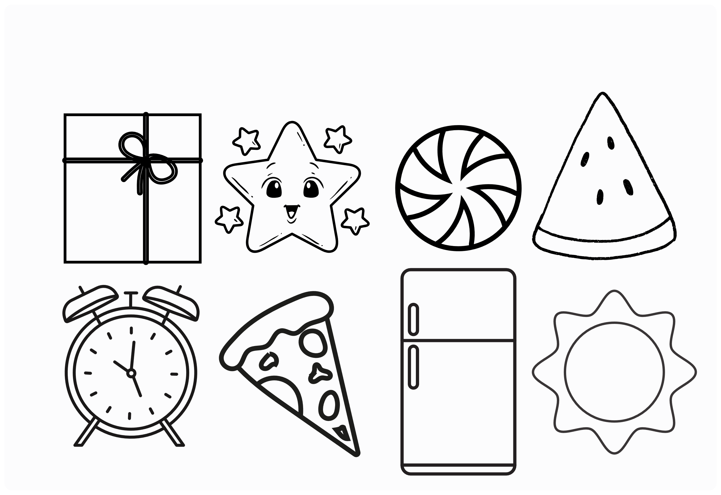
III. EXERCISES:
6. Color the SQUARE shapes:

Slide 11

III. EXERCISES:
7. Trace the line:
circle square rectangle triangle diamond

Slide 12
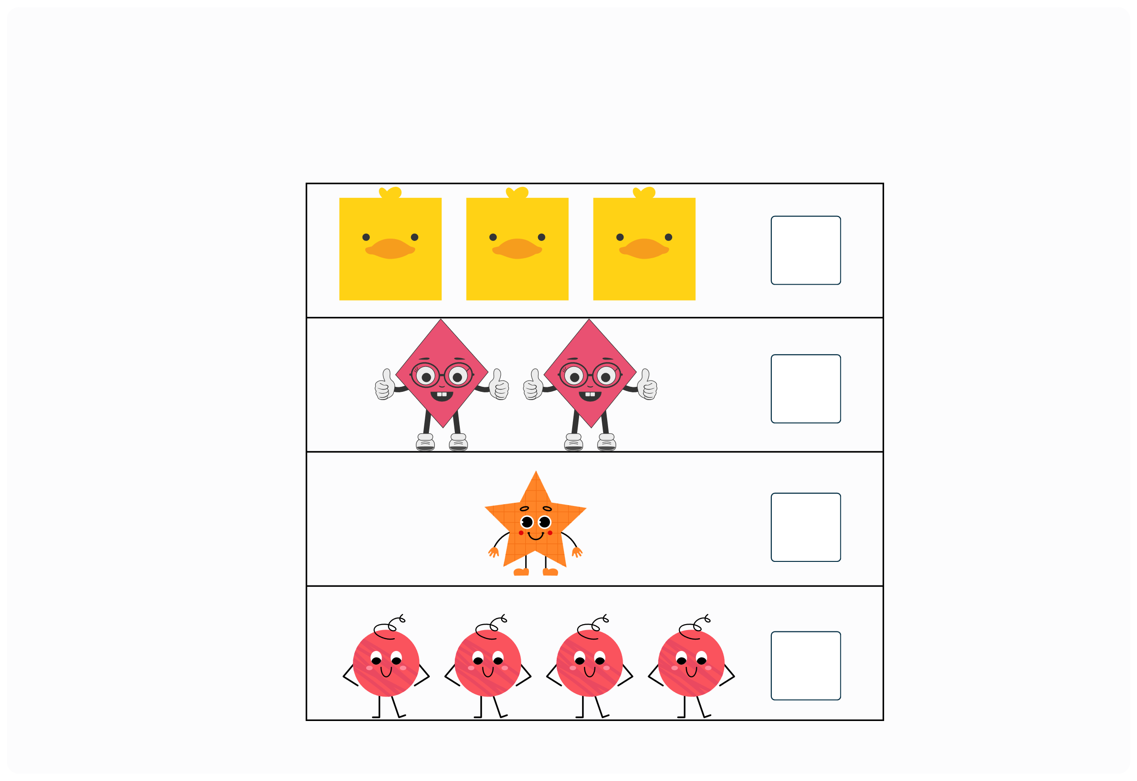
III. EXERCISES:
8. Count the shapes:

