Slide 1

Unit 4: Holidays!
Lesson 4a: Reading
Page 72

Slide 2
Lesson Outline
Warm-up
Vocabulary
Reading
Consolidation
Wrap-up

Slide 3
Objectives
By the end of this lesson, students will be able to…
use some vocabulary related to holidays: celebrate, parade, hang flags, dress up, fireworks, steamed.
read for main ideas and important details.

Slide 4

WARM-UP

Slide 5

Work in pairs.
Ask and answer the following question:
What’s your favourite holiday in a year? Why?
E.g. My favourite holiday is Tet holiday because all members of my family can stay home and get together.
Which month of the year is that holiday in?
E.g. It is usually in January or February.
Do people often give gifts on that holiday?
E.g. No. People only give lucky money to young children.

Slide 6

It’s time to learn …

Slide 7
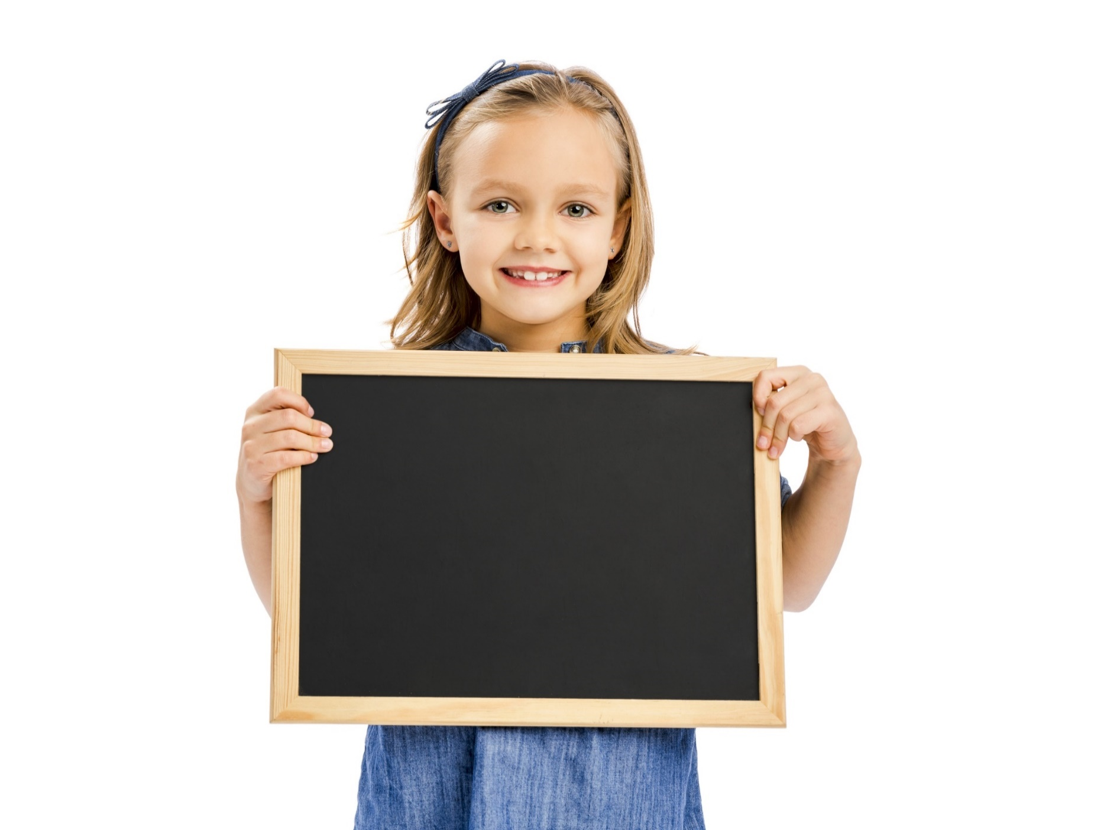
Reading

Slide 8
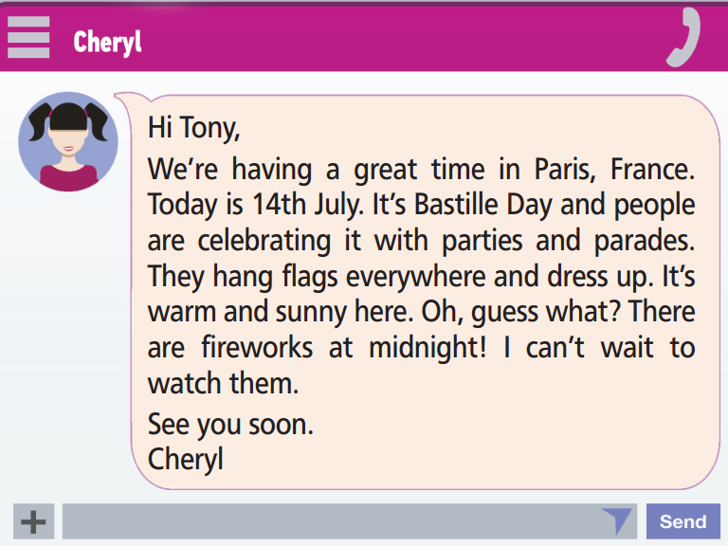
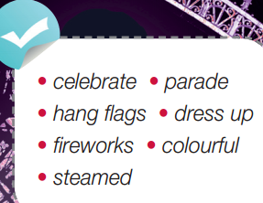
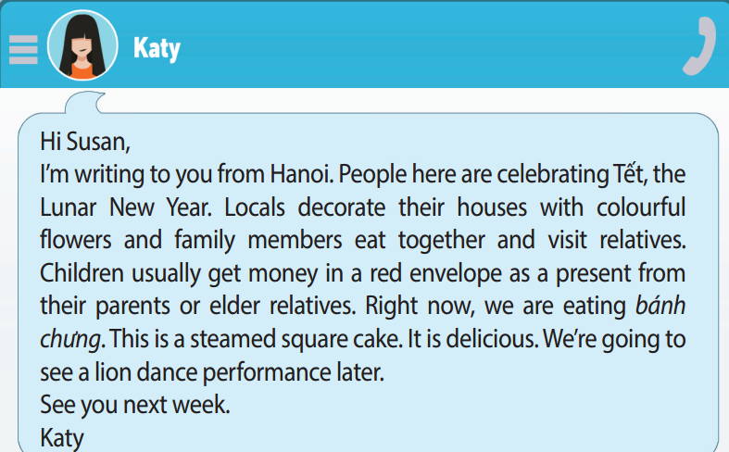
Pre-reading
Find these words in the text, try to guess their meanings.

Slide 9

Vocabulary
Listen and repeat.
celebrate /ˈseləbreɪt/ (v): kỷ niệm, chúc mừng
parade /pəˈreɪd/ (n): cuộc diễu hành
hang flags /hæŋ flæɡz/ (phr): treo cờ
dress up /ˌdres ˈʌp/ (v): ăn diện, mặc quần áo đẹp
firework /ˈfaɪəwɜːk/ (n): pháo hoa
colourful /ˈkʌləfəl/ (adj): nhiều màu sắc
steamed /stiːmd/ (adj): đã được hấp

Slide 10
Choose the suitable words to fill in the gaps.
celebrate * parade * hang flags * dress up * fireworks * colourful * steamed
On New Year’s Eve, which is the night before New Year’s Day, a lot of people will watch ______________ and wish for a happy new year.
On national holidays in Vietnam, people often ______________ in front of their house.
Her dad brought her a ______________ picture book on her birthday.
I often eat ______________ fish and vegetables.
I’m going to ______________ my birthday party this weekend.
On Tet holiday, Vietnamese people often ______________ because they think it will bring good luck in the new year.
In a ______________, many people move in order down a street.
fireworks
hang flags
colourful
steamed
celebrate
dress up
parade

Slide 11
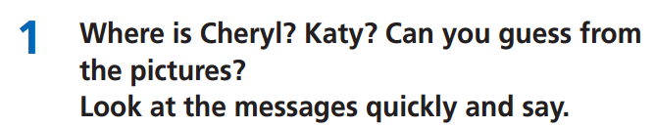
Pre-Reading
Read the instruction quickly. Underline the key words. What are we going to do?
Guess where is Cheryl and Kate

Slide 12
While-reading
Cheryl is in Paris, France.
Katy is in Hanoi, Vietnam.

Slide 13
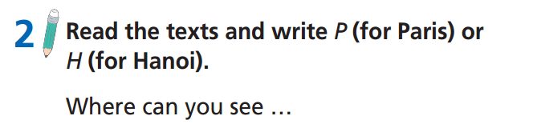
Read the instruction quickly. Underline the key words. What are we going to do?
Write P for Paris and H for Hanoi

Slide 14
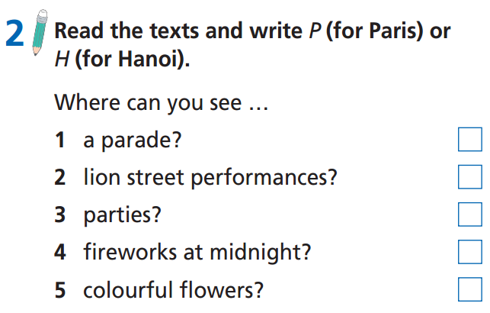
While-reading
P
H
P
P
H

Slide 15
Extra Practice
Please read the messages from Cheryl and Katy again and decide whether the following statements are True, False, or Doesn’t say:
Cheryl is feeling very sad in France.
Bastille Day is on 14th July.
Cheryl doesn’t want to watch the fireworks.
Katy is visiting her relatives in Hanoi.
Bánh chưng is a steamed square cake.

Slide 16
Extra Practice
Read the task and underline the key words.
Please read the messages from Cheryl and Katy again and decide whether the following statements are True, False, or Doesn’t say:
Cheryl is feeling very sad in France.
Bastille Day is on 14th July.
Cheryl doesn’t want to watch the fireworks.
Katy is visiting her relatives in Hanoi.
Bánh chưng is a steamed square cake.

Slide 17
Read again to check the answers.
Cheryl is feeling very sad in France.
Bastille Day is on 14th July.
Cheryl doesn’t want to watch the fireworks.
Katy is visiting her relatives in Hanoi.
Bánh chưng is a steamed square cake.
False
True
False
Doesn’t say
True

Slide 18
Post-reading
Work in pairs
Discuss the special things you do on Tet holiday or a different holiday in your country.
I often dress up, visit my relatives, wish them good health, and receive lucky money in red envelopes.
What do you often do on Tet holiday?

Slide 19

CONSOLIDATION

Slide 20
Write a paragraph (50-70 words) about your favourite holiday in a year. You can include the following information:
Where do you live?
What’s your favourite holiday in a year? Why?
When is that holiday in a year?
What do people often do on that holiday? (Are there any special foods, gifts, or clothes on that holiday?)
What are your favourite activities on that holiday?

Slide 21
Write a paragraph (50-70 words) about your favourite holiday in a year.
E.g.
I live in Vietnam. My favourite holiday is Tet holiday because it is the time when we can stay at home together. It is celebrated at the beginning of the Lunar New Year. People often decorate their houses, cook delicious meals, dress up, and visit their relatives. On Tet holiday, I like wearing new clothes, watching fireworks, and eating delicious food with my family.

Slide 22

WRAP-UP

Slide 23
Today’s lesson
Vocabulary
celebrate
parade
hang flags
dress up
firework
steamed
Reading
read for main ideas and important details.

Slide 24
Homework
Practise vocabulary and make sentences using them.
Do the exercises in TA 6 Right on WB (p. 38).
Prepare for the next lesson (p. 73 SB).

Slide 25
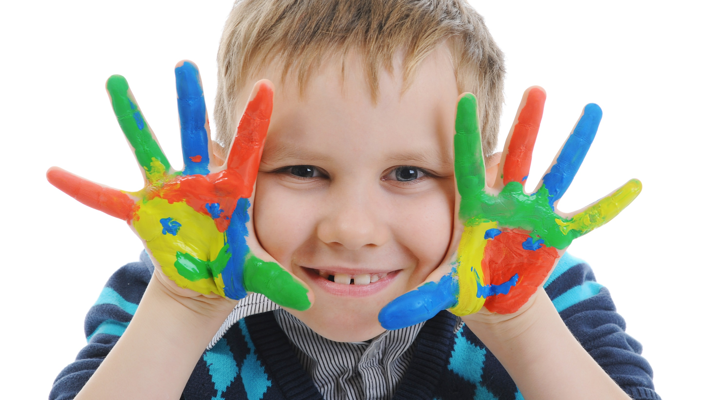
Enjoy your day!

