Slide 1


Slide 2

Unit
10
1
Unit
FAMILY LIFE
ECOTOURISM
LESSON 3
READING
Ecotour brochures

Slide 3

Unit
1
1
FAMILY LIFE
Family Life
Unit
OBJECTIVES
Develop reading skill for specific information in a brochure about ecotours.

Slide 4
LESSON 3
READING
Unit
GETTING STARTED
WARM-UP
Name the tours
PRE-READING
Vocabulary
Task 1: Work in pairs. answer these questions. (p. 113)
Task 2: Read the brochures below. Then work in pairs to solve the crossword using words from the brochures. (p. 113)
Task 3: Which tour does each statement below talk about? Write a, b, c or d. (p. 113)
WHILE-READING
POST-READING
Task 4: Work in groups. Think of new ideas for making one of the tours better for the environment. (p. 114)
Wrap-up
Homework
CONSOLIDATION

Slide 5
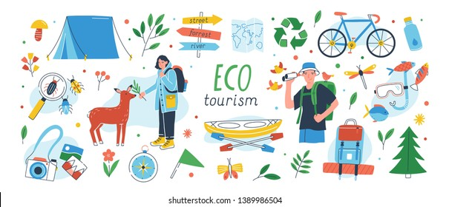
LESSON 3
READING
Unit
GETTING STARTED
WARM-UP
Name the tours

Slide 6
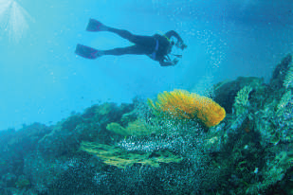
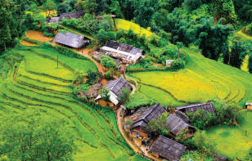
WARM-UP
Reef Tour
Trekking Tour

Slide 7
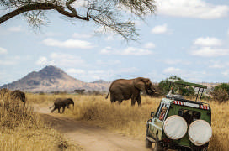
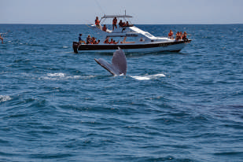
WARM-UP
National Park Tour
Whale-watching Tour

Slide 8
LESSON 3
READING
Unit
GETTING STARTED
WARM-UP
Name the tours
PRE-READING
Vocabulary
Task 1: Work in pairs. answer these questions. (p. 113)

Slide 9


VOCABULARY
protect (v)
/prəˈtekt/
to keep someone or something safe from injury, damage, or loss

Slide 10
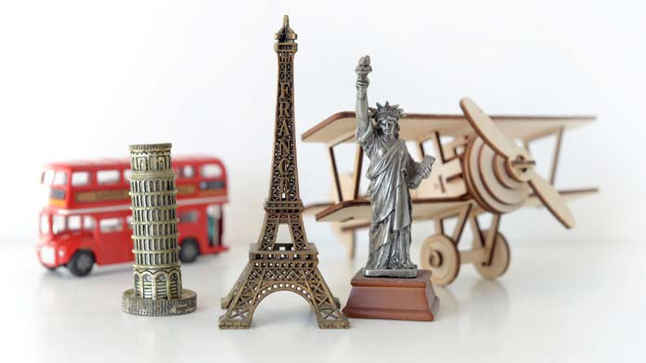
VOCABULARY
souvenir (n)
/ˌsuː.vənˈɪər/
something you buy or keep to help you remember a holiday or special event

Slide 11
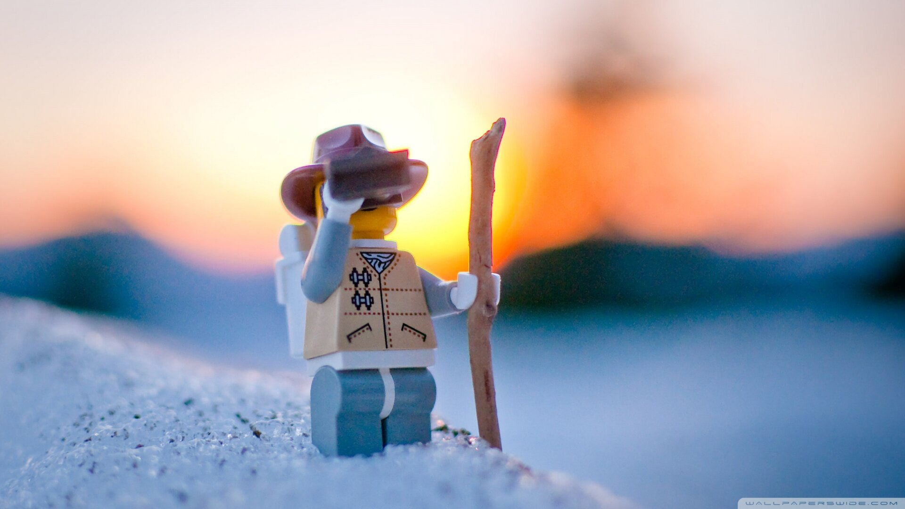
VOCABULARY
explore (v)
/ɪkˈsplɔːr//
to search and discover
(about something)

Slide 12
VOCABULARY
Form | Pronunciation | Meaning
protect (v) | /prəˈtekt/ | to keep someone or something safe from injury, damage, or loss
souvenir (n) | /ˌsuː.vənˈɪər/ | something you buy or keep to help you remember a holiday or special event
explore (v) | /ɪkˈsplɔːr/ | to search and discover (about something)

Slide 13
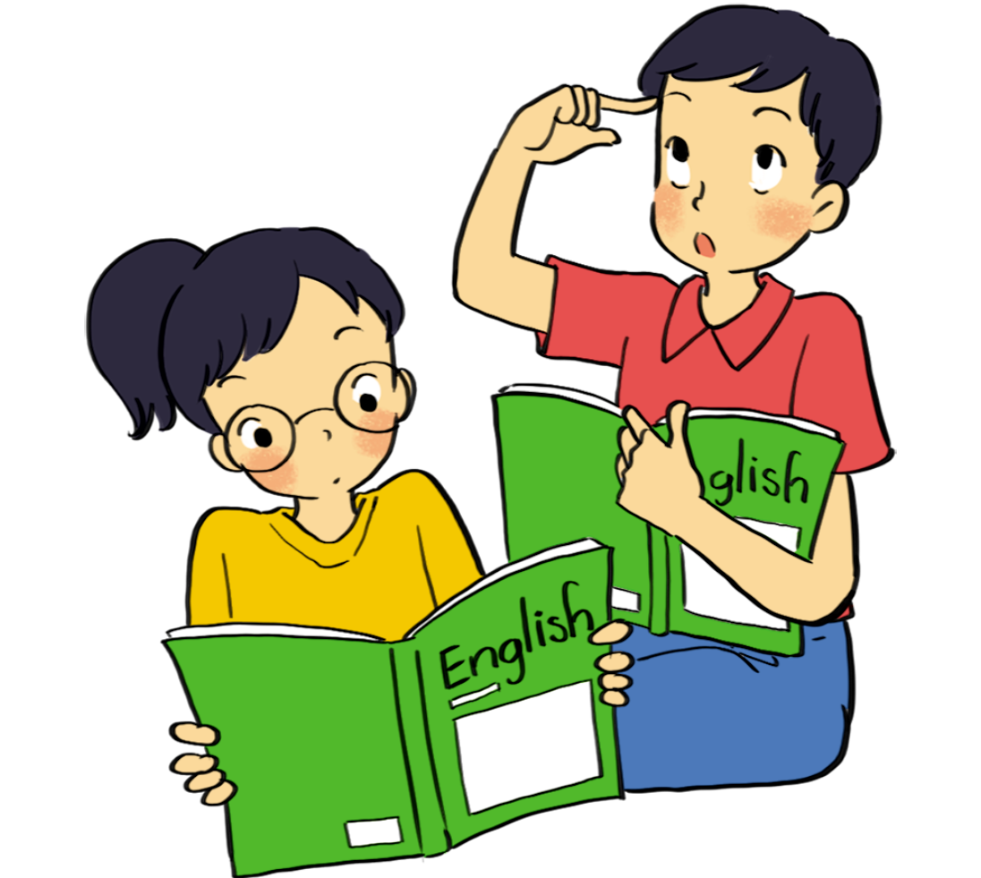
PRE-READING
1
Work in pairs. Answer these questions.
1. Have you ever been on an ecotour?
2. Look at the photos in 2. What do you think tourists do on these tours?

Slide 14
LESSON 3
READING
Unit
GETTING STARTED
WARM-UP
Name the tours
PRE-READING
Vocabulary
Task 1: Work in pairs. answer these questions. (p. 113)
Task 2: Read the brochures below. Then work in pairs to solve the crossword using words from the brochures. (p. 113)
Task 3: Which tour does each statement below talk about? Write a, b, c or d. (p. 113)
WHILE-READING

Slide 15
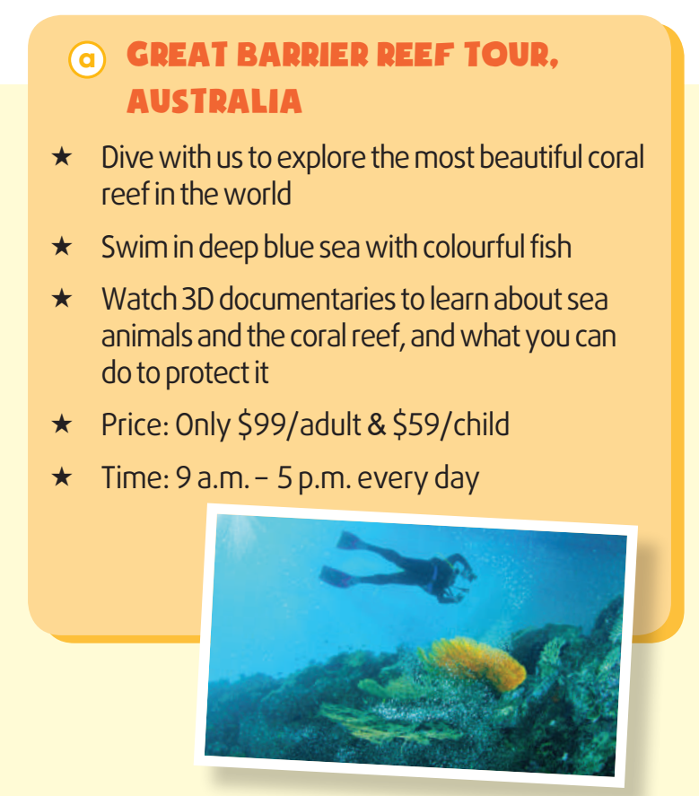
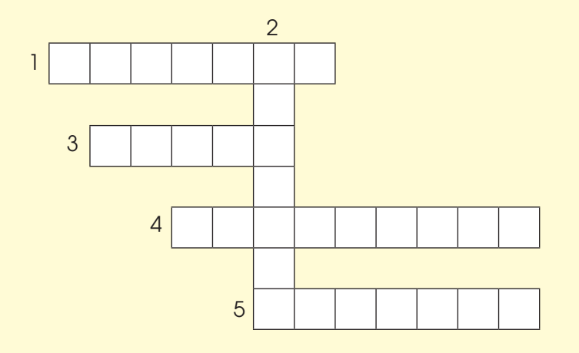

WHILE-READING
2
Read the brochures below. Then work in pairs to solve the crossword using words from the brochures.
ACROSS
1. (v) to keep something safe from damage or harm

Slide 16
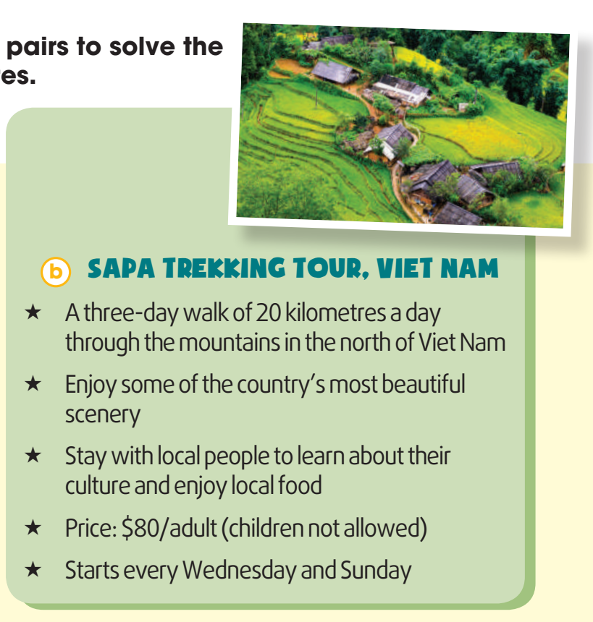

WHILE-READING
2
Read the brochures below. Then work in pairs to solve the crossword using words from the brochures.
DOWN
2. (n) the way of life of a group of people orcountries

Slide 17

WHILE-READING
2
Read the brochures below. Then work in pairs to solve the crossword using words from the brochures.
ACROSS
3. (adj) connected with the place you are living

Slide 18
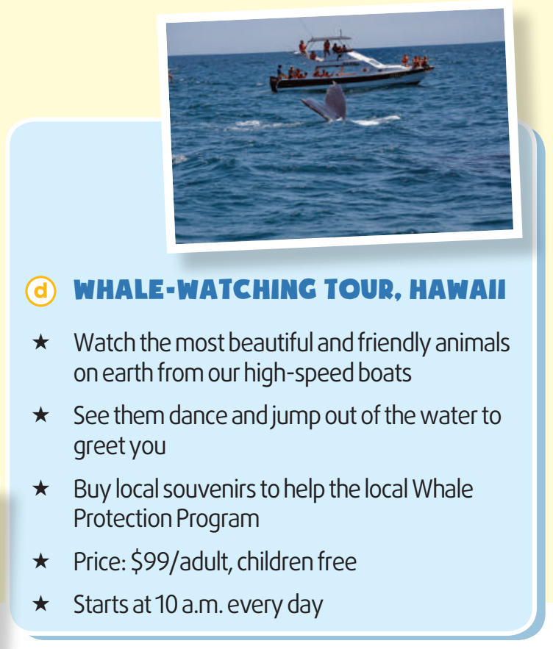

WHILE-READING
2
Read the brochures below. Then work in pairs to solve the crossword using words from the brochures.
ACROSS
4. (n) things you buy or keep to remind yourself of a place or holiday

Slide 19
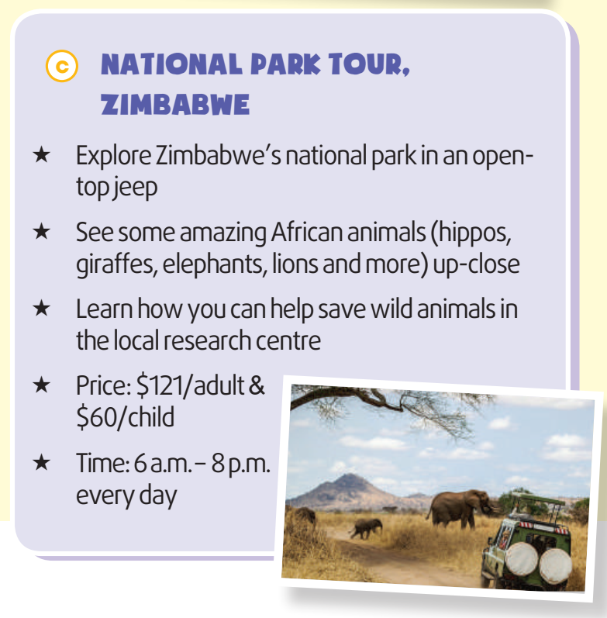

WHILE-READING
2
Read the brochures below. Then work in pairs to solve the crossword using words from the brochures.
ACROSS
5. (v) to find more about a place (Brochures a and c)

Slide 20
WHILE-READING
3
Which tour does each statement below talk about? Write a, b, c or d.
1. You can buy arts and crafts to help protect the environment. _________
2. You can learn how to help protect wildlife. _________
3. this tour is not suitable for families with children. _________
4. this tour offers educational videos about the environment. _________
d
c
b
a

Slide 21
LESSON 3
READING
Unit
GETTING STARTED
WARM-UP
Name the tours
PRE-READING
Vocabulary
Task 1: Work in pairs. answer these questions. (p. 113)
Task 2: Read the brochures below. Then work in pairs to solve the crossword using words from the brochures. (p. 113)
Task 3: Which tour does each statement below talk about? Write a, b, c or d. (p. 113)
WHILE-READING
POST-READING
Task 4: Work in groups. Think of new ideas for making one of the tours better for the environment. (p. 114)

Slide 22

POST-READING
4
Work in groups. Think of new ideas for making one of the tours better for the environment.

Slide 23
POST-READING
4
Work in groups. Think of new ideas for making one of the tours better for the environment.
Suggested answer:
A. If they ban swimming with fish, the Great Barrier Reef will be better protected. Tourists should not be allowed to dive very close to the coral reefs.

Slide 24
POST-READING
4
Work in groups. Think of new ideas for making one of the tours better for the environment.
Suggested answer:
B. Tourists should always follow the walking paths and trails on the Sapa Trekking Tour. The local people with whom the tourists stay should only use local ingredients. If they only use local ingredients, their carbon footprint will be lower.

Slide 25
POST-READING
4
Work in groups. Think of new ideas for making one of the tours better for the environment.
Suggested answer:
D. The boats on the Whale-watching Tour should not get too close to the whales or make too much noise. If the boats are environmentally friendly, they will not harm the whales or their habitats. This is because environmentally-friendly boats use less fuel and oil, make small waves and are quiet.

Slide 26
LESSON 3
READING
Unit
GETTING STARTED
WARM-UP
Name the tours
PRE-READING
Vocabulary
Task 1: Work in pairs. answer these questions. (p. 113)
Task 2: Read the brochures below. Then work in pairs to solve the crossword using words from the brochures. (p. 113)
Task 3: Which tour does each statement below talk about? Write a, b, c or d. (p. 113)
WHILE-READING
POST-READING
Task 4: Work in groups. Think of new ideas for making one of the tours better for the environment. (p. 114)
Wrap-up
Homework
CONSOLIDATION

Slide 27
CONSOLIDATION
1
Wrap-up
Develop reading skill for specific information in a brochure about ecotours.

Slide 28
CONSOLIDATION
2
Homework
Prepare for the next lesson: Unit 10: Speaking
2. Do exercises in the workbook

Slide 29


