Slide 1


Slide 2



Unit
12
ENGLISH-SPEAKING COUNTRIES
LESSON 3: A CLOSER LOOK 2
Unit

Slide 3

OBJECTIVES
By the end of the lesson, students will be able to:
understand the use of use articles
practice using articles correctly

Slide 4
LESSON 3: A CLOSER LOOK 2
WARM-UP
Picture drescribing
PRESENTATION
Articles “a/an” review & Article “the”
Task 1: Complete the sentences with “a / an” or “the” (p. 127)
Task 2: Put in "the" where necessary. (p. 127)
Task 3: Put in “a / an” or “the”. (p. 127)
Task 4: Complete the sentences with “a / an”, or “the” (p. 128)
PRACTICE
PRODUCTION
Task 5: Game – Faster detective
CONSOLIDATION
Wrap-up
Homework

Slide 5
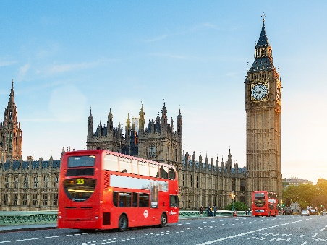
LESSON 3: A CLOSER LOOK 2
WARM-UP
Picture drescribing
Describe the picture

Slide 6
LESSON 3: A CLOSER LOOK 2
WARM-UP
Picture drescribing
PRESENTATION
Articles “a/an” review & Article “the”

Slide 7
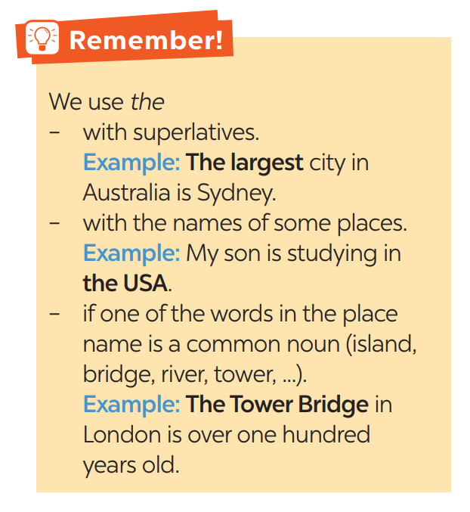

PRESENTATION
Notes:
https://www.youtube.com/watch?v=drTyYqbz6Xk

Slide 8
LESSON 3: A CLOSER LOOK 2
WARM-UP
Picture drescribing
PRESENTATION
Articles “a/an” review & Article “the”
Task 1: Complete the sentences with “a / an” or “the” (p. 127)
Task 2: Put in "the" where necessary. (p. 127)
Task 3: Put in “a / an” or “the”. (p. 127)
Task 4: Complete the sentences with “a / an”, or “the” (p. 128)
PRACTICE

Slide 9
PRACTICE
1
Complete the sentences with “a / an” or “the”
1. Is Washington D.C. __________ capital of the USA?
2. Can you give me __________ example of an English-speaking country?
3. The London Eye is __________ great attraction in London.
4. Canada is __________ very cold country.
5. I love __________ New Zealand’s countryside.
the
an
a
a
the

Slide 10
PRACTICE
2
Put in "the" where necessary.
1. __________ Statue of Liberty is in __________ New York.
2. __________ Scotland is a part of __________ UK.
3. New Zealand consists of __________ North Island and __________ South Island.
4. Disneyland in California is one of __________ biggest entertainment centres in the world.
5. Bangkok is __________ most popular city for tourists in __________ Kingdom of Thailand.
The
x
x
the
the
the
the
the
the

Slide 11
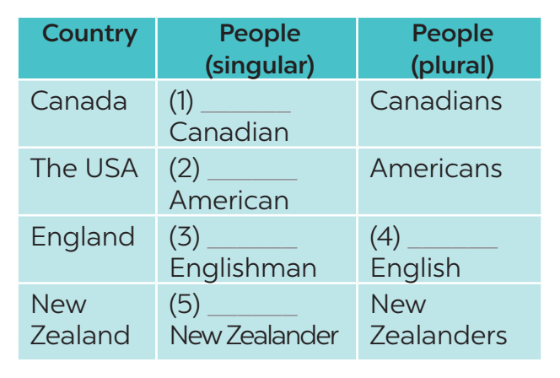
PRACTICE
3
Put in a / an or the.
a
an
an
the
a

Slide 12
PRACTICE
4
Complete the sentences with “a / an”, or “the”
1. The man sitting next to her is ____________ Englishman.
2. ____________ River Thames runs through London.
3. Here is ____________ map of the city of Edinburgh.
4. What is ____________ most popular sport in Canada?
5. We want to visit ____________ attraction in Sydney.
6. ____________ Statue of Liberty was a present from France.
an
The
the
the
an
The

Slide 13

PRODUCTION
5
Game – Faster detective.
Nhờ BTV xem lại câu 4+5
Tick if the underlined articles are correct. If they aren’t, write the correct ones in the space provided.
1. “What do you call a person from England?” – “The Englishman.” ________________
2. Edinburgh is a capital city of Scotland. ________________
3. Queenstown is a amazingly beautiful town. ________________
4. Are ancient castles an attraction of Scotland? ________________
5. Where can you see a red telephone box? ________________
the
an

Slide 14
LESSON 3: A CLOSER LOOK 2
WARM-UP
Picture drescribing
PRESENTATION
Articles “a/an” review & Article “the”
Task 1: Complete the sentences with “a / an” or “the” (p. 127)
Task 2: Put in "the" where necessary. (p. 127)
Task 3: Put in “a / an” or “the”. (p. 127)
Task 4: Complete the sentences with “a / an”, or “the” (p. 128)
PRACTICE
PRODUCTION
Task 5: Game – Faster detective
CONSOLIDATION
Wrap-up
Homework

Slide 15

CONSOLIDATION
1
WRAP-UP
In this lesson, students have:
understood the use of use articles
practiced using articles correctly

Slide 16

CONSOLIDATION
2
HOMEWORK
Complete exercises in the Workbook.

Slide 17


