Slide 1
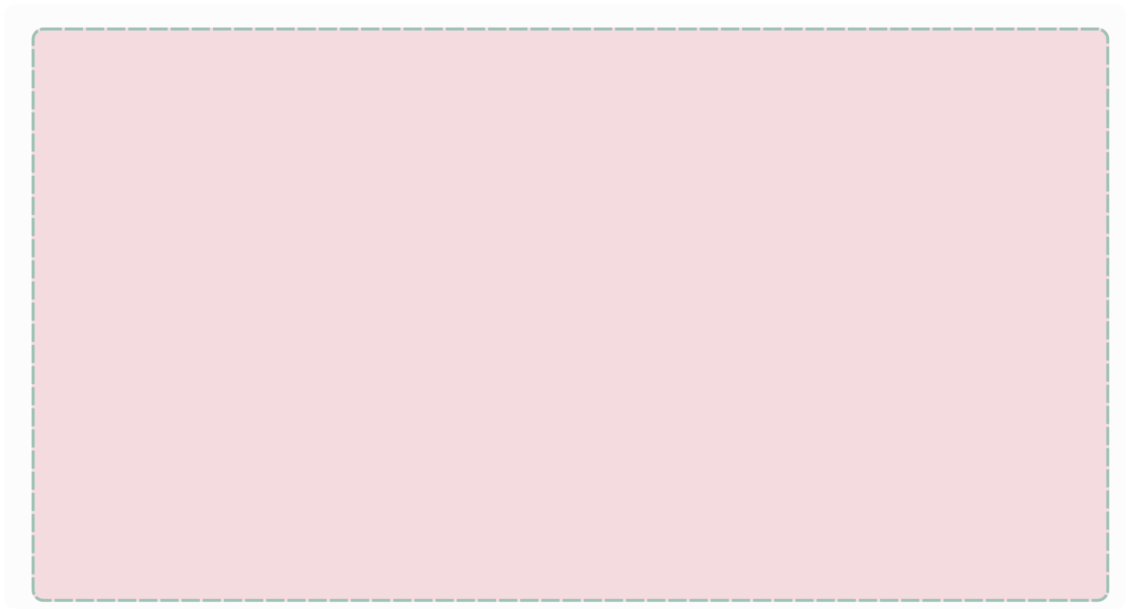
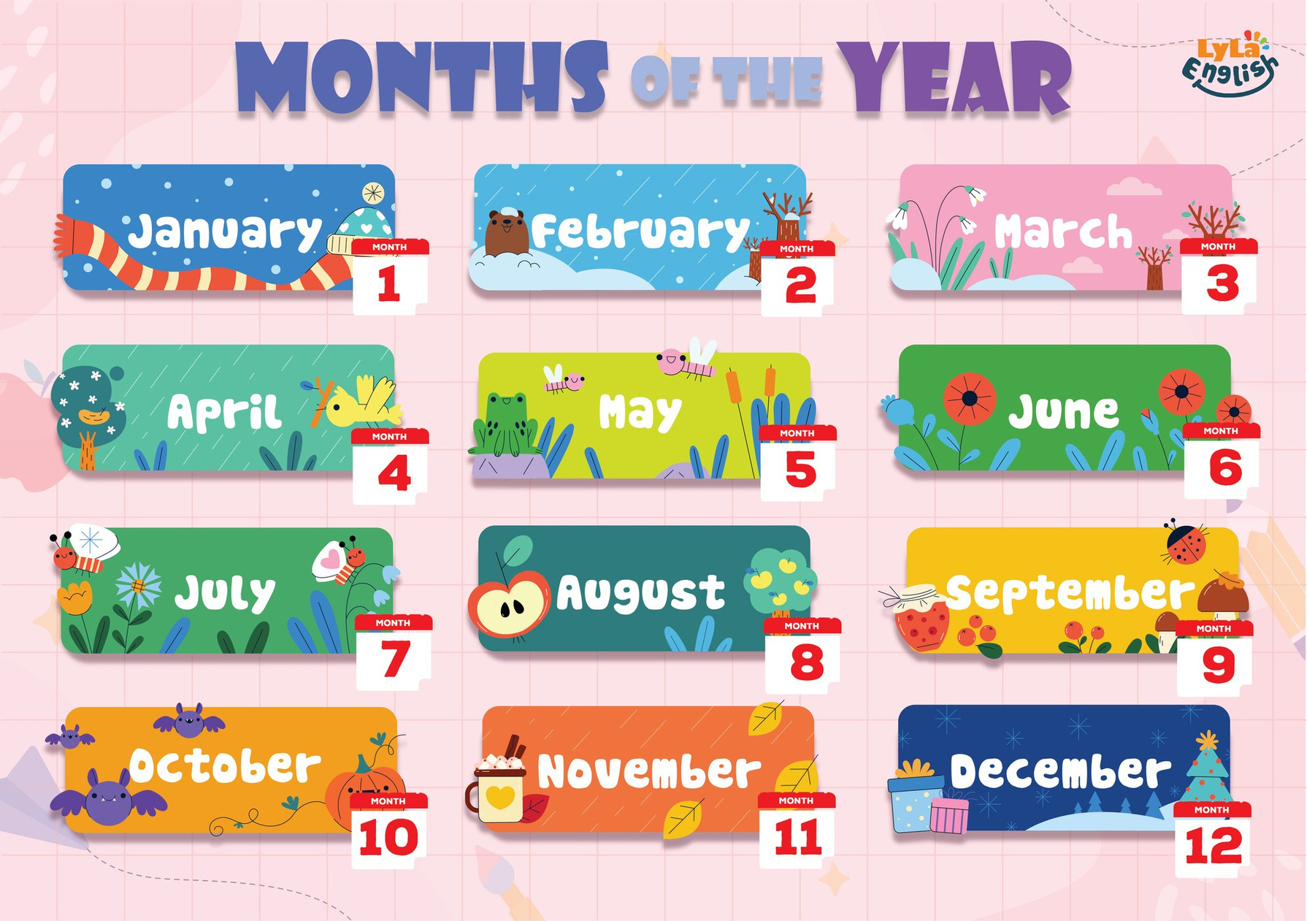


Slide 2

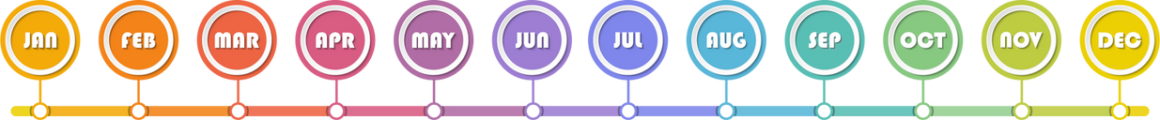
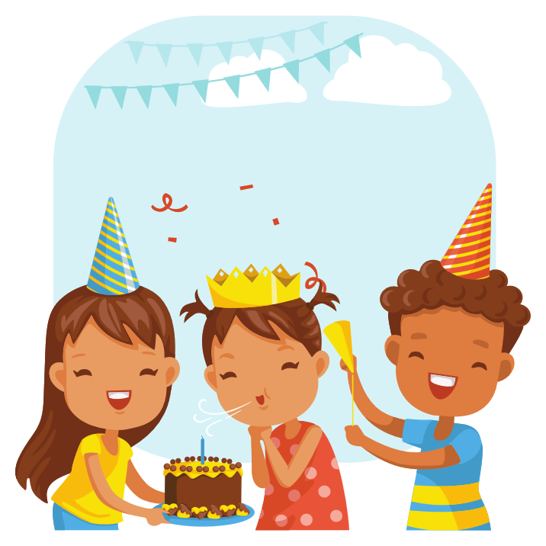
I. QUESTION
1. How many months are there in the year?
- There are ... months.
2. What is the first month in the year?
- It’s ...
3. What is the last month in the year?
- It’s ...
4. What is your birth month?
- It’s ...
5. What is your favorite month?
It’s ... because ...

Slide 3
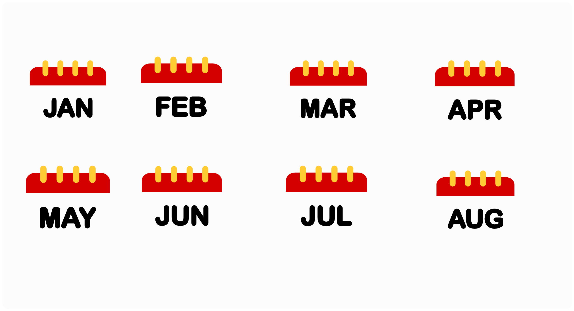
II. VOCABULARY
January
February
March
April
May
June
July
August

Slide 4
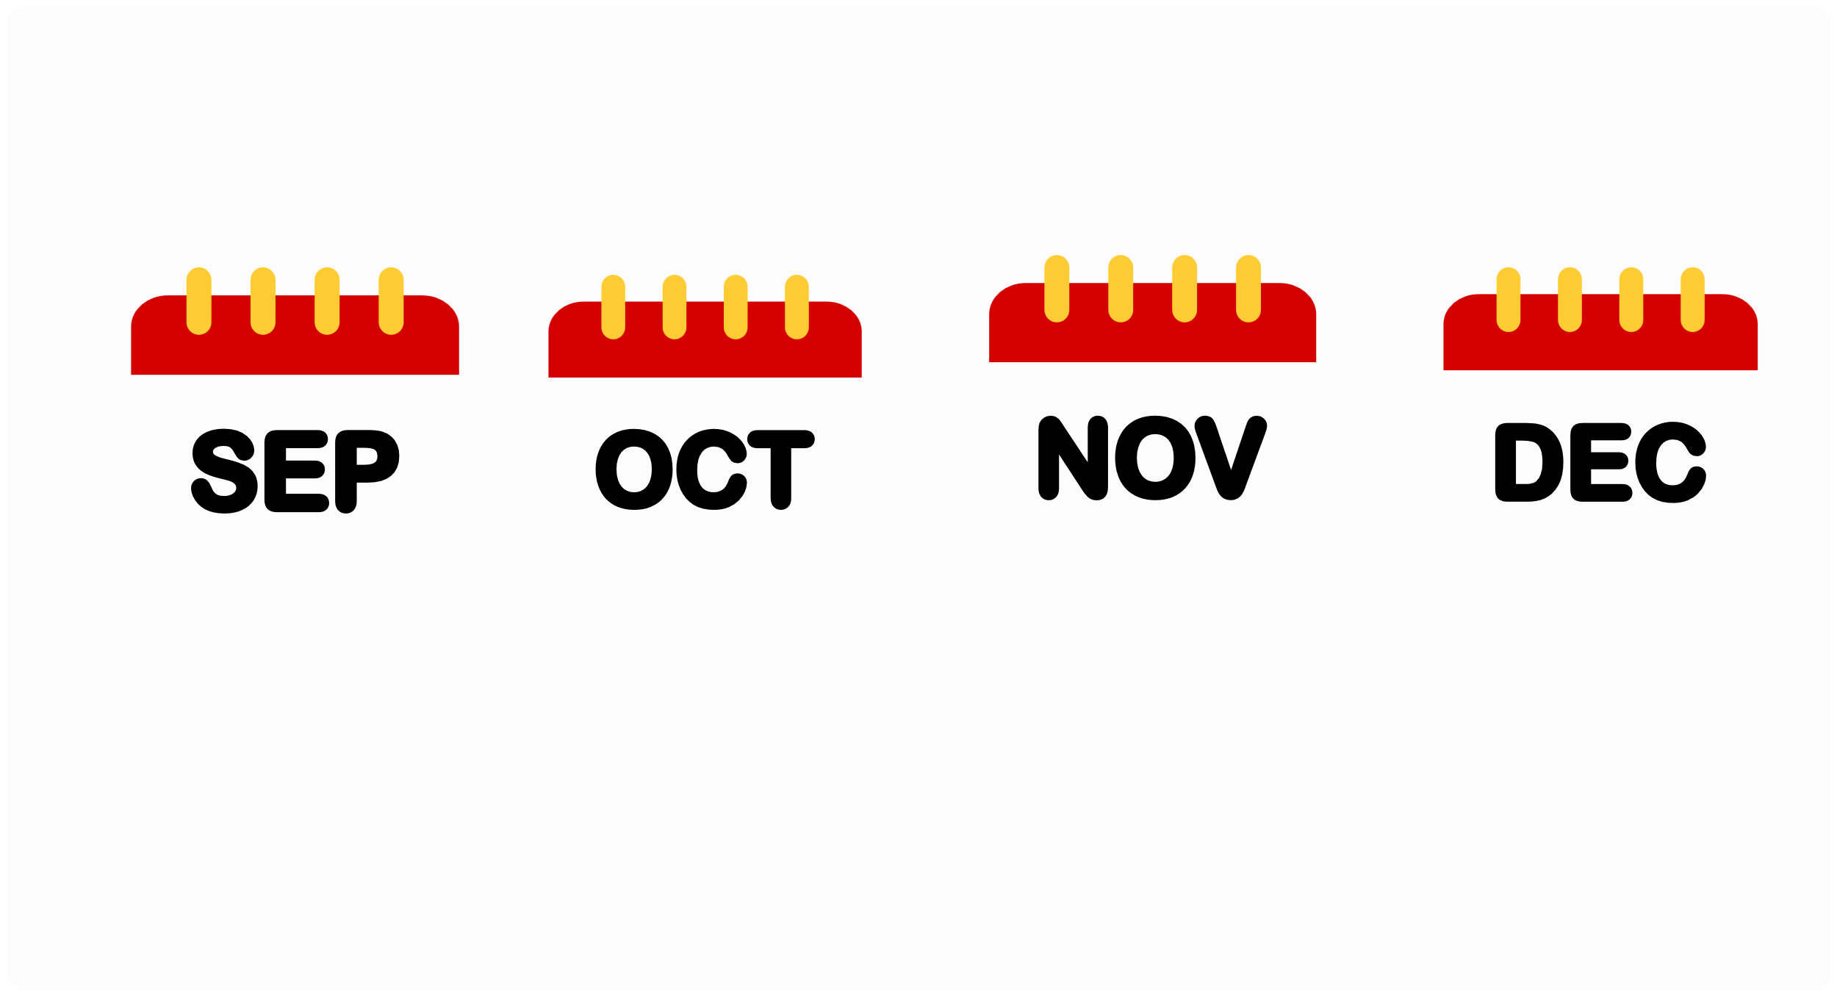
II. VOCABULARY
September
October
November
December

Slide 5
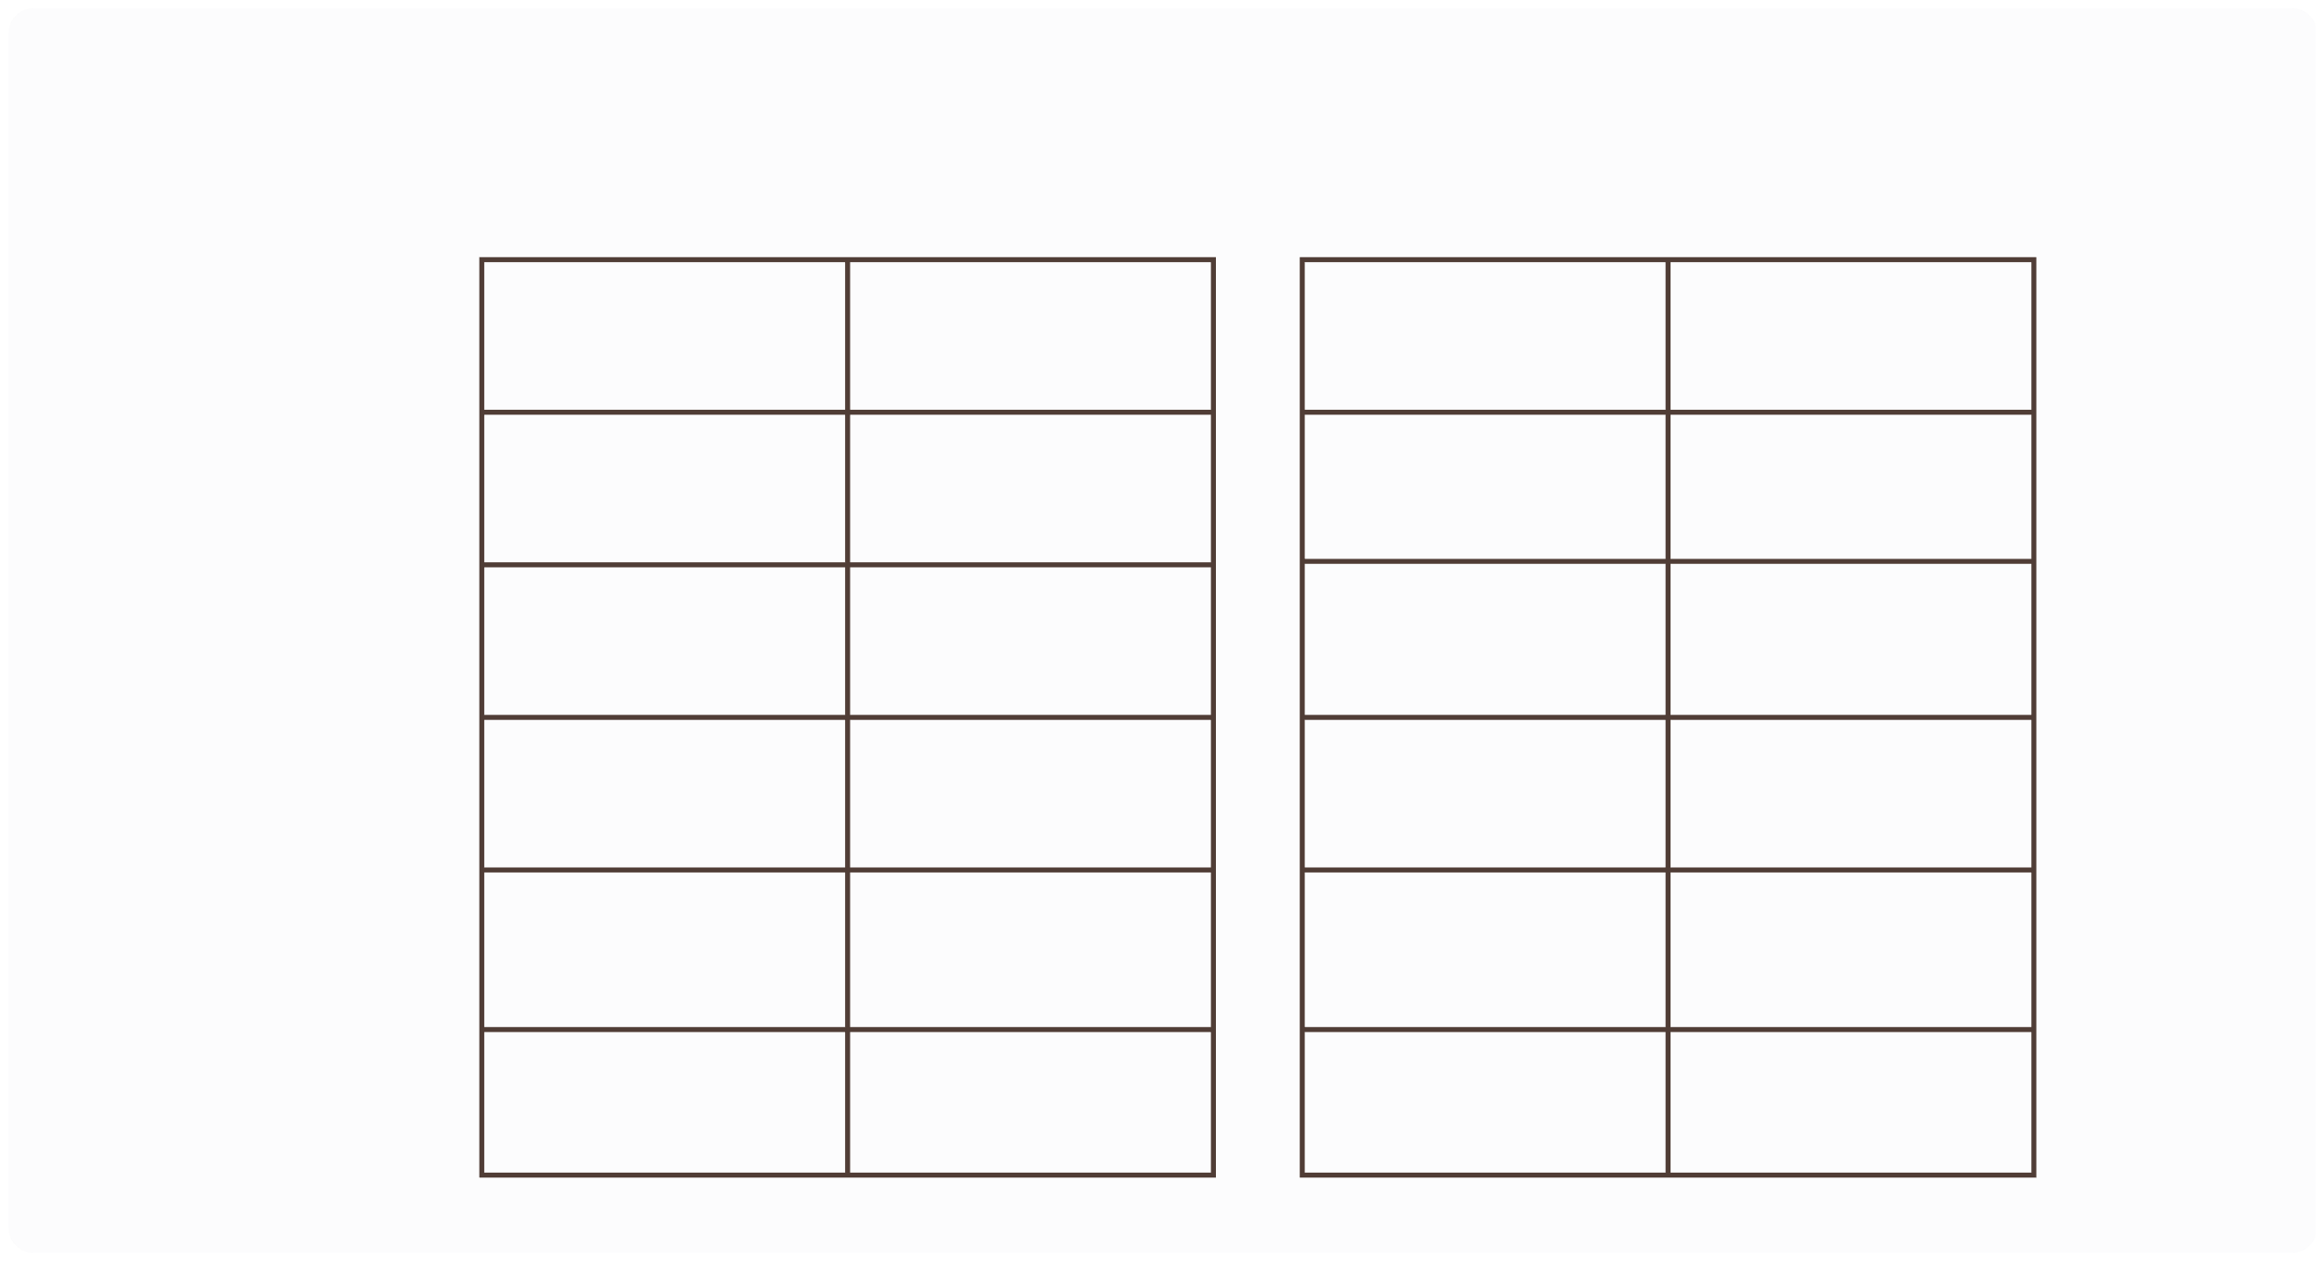
III. EXERCISES
1.Write the number of months below:
February March July December January
October June April August
7
September
May
May

Slide 6
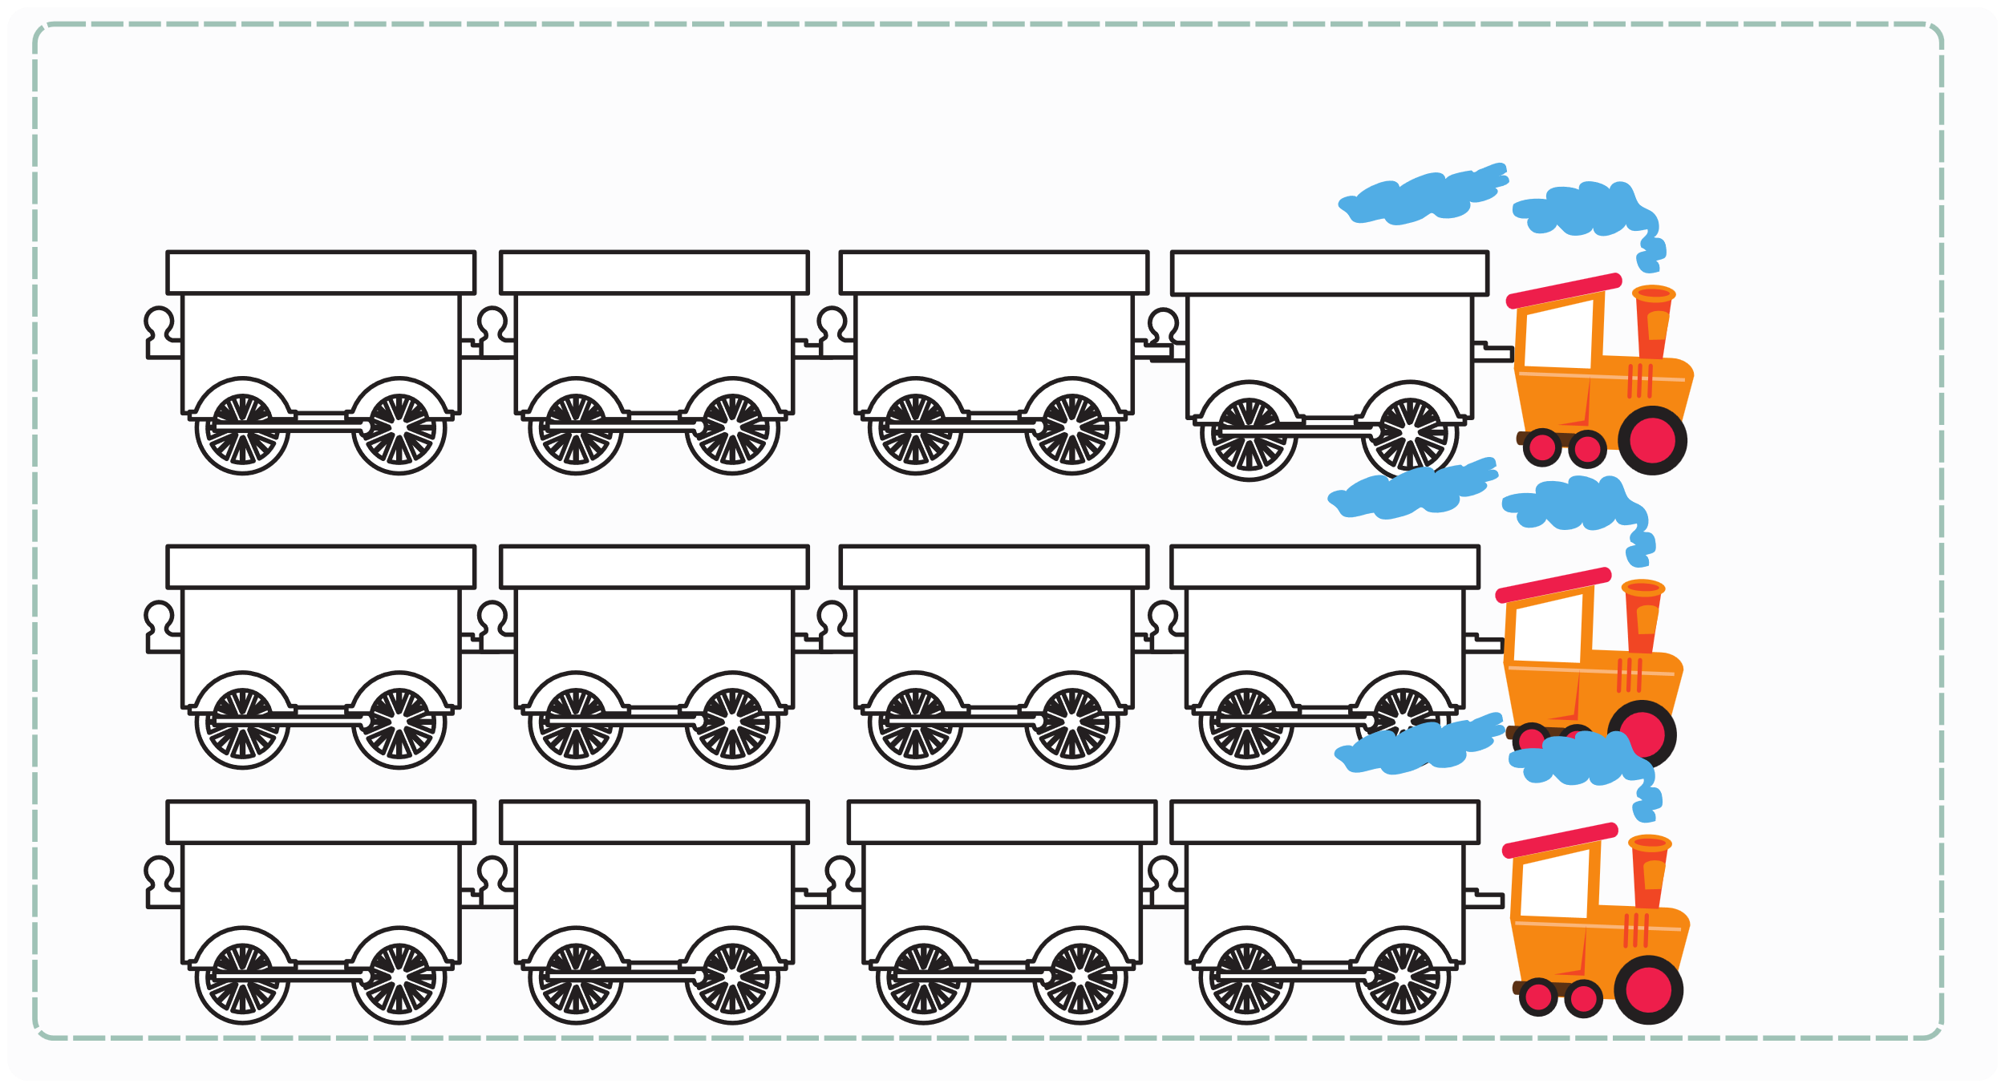
III. EXERCISES:
2. Which month comes next?
January
....
March
...
May
June
...
....
...
October
November
....

Slide 7
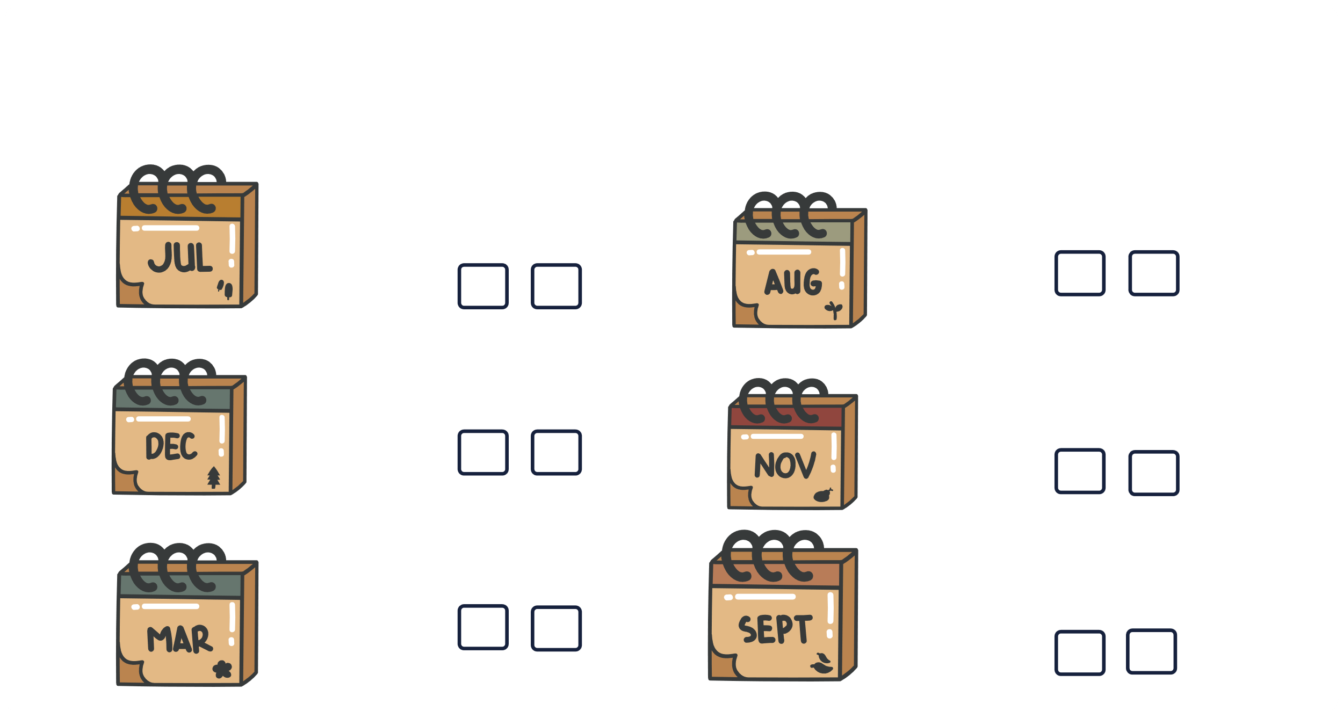
III. EXERCISES
3. Choose True or False:
July
August
November
May
December
September

Slide 8

III. EXERCISES
4. Trace and read:
January February
September
May June July
August
October
March
November
December
April

Slide 9
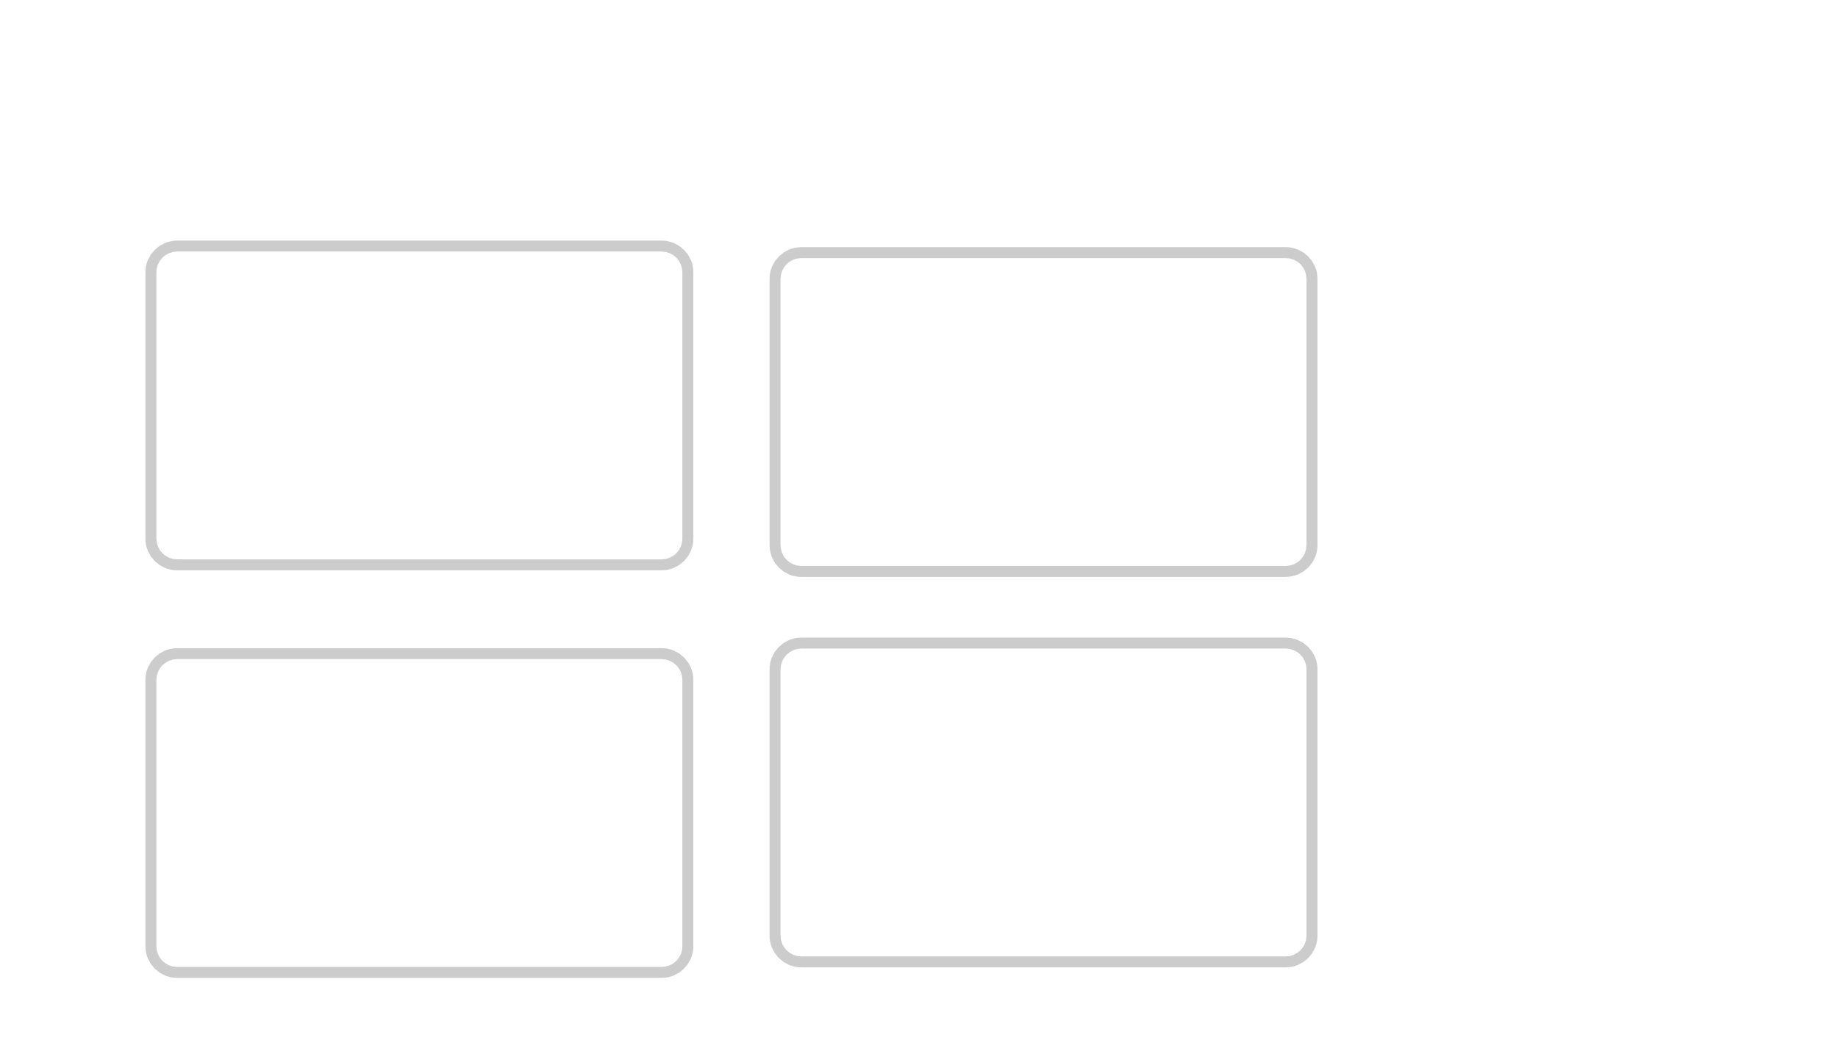
III. EXERCISES
5. Classify the seasons according to months:
January February March April May June July August September October November December
Spring
Summer
Autumn
Winter

Slide 10

III. EXERCISES:
6. Fill the missing words:
1.J_ _ _ _ _ _
7. J_ _ _ 8. A _ _ _ _ _
9. S_ _ _ _ _ _ _
10. O_ _ _ _ _
11. N_ _ _ _ _ _
12. D_ _ _ _ _ _
2. F_ _ _ _ _ __
3. M_ _ _ _ 4. A_ _ _ _
5. M_ _
6. J_ _ _

Slide 11
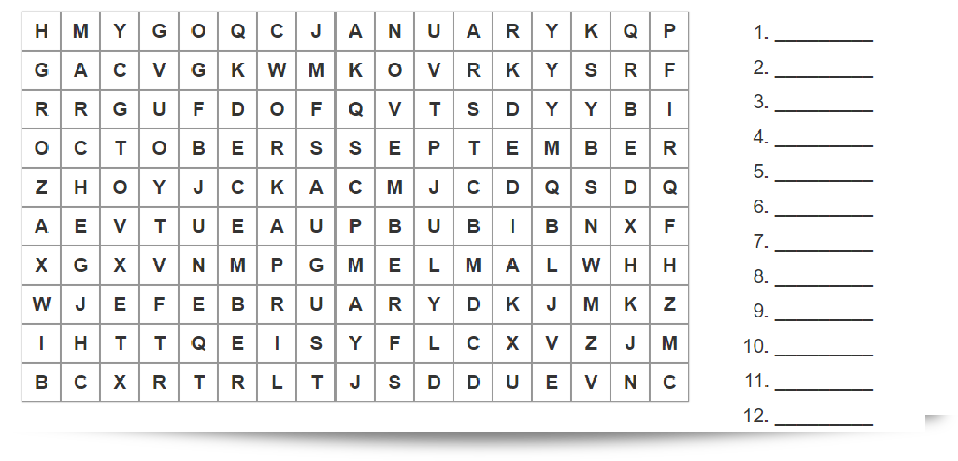
III. EXERCISES:
7. Find the months of the year:

Slide 12
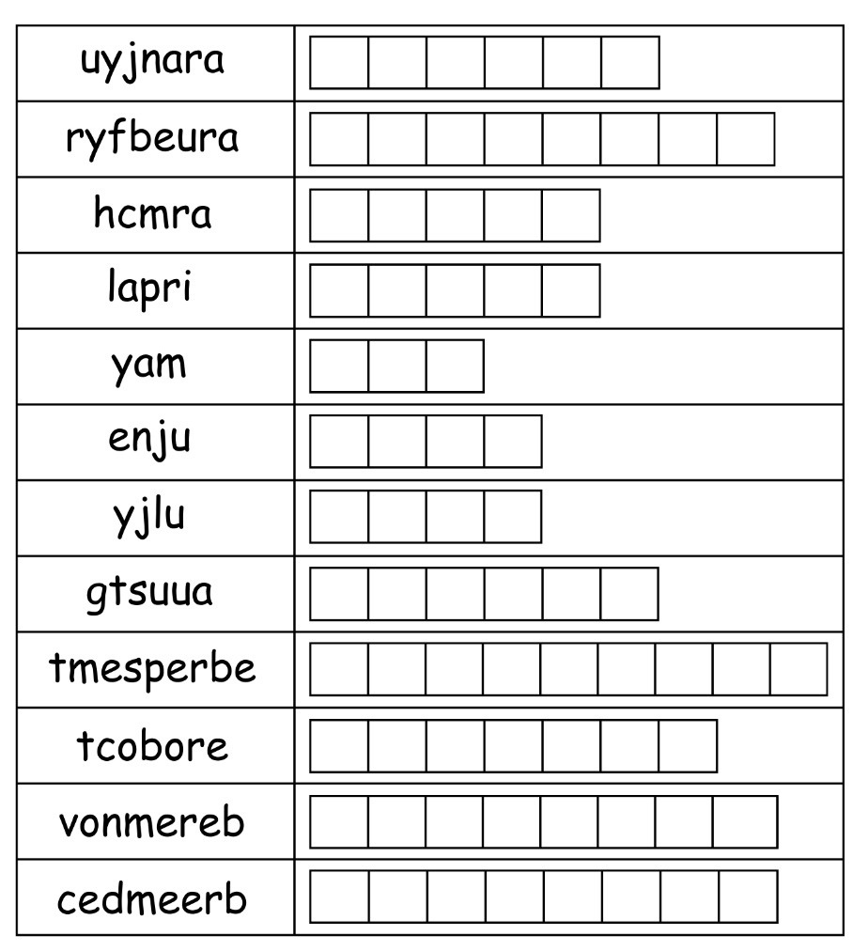
III. EXERCISES:
8. Unscramble the months of year:

