Slide 1


Slide 2



Unit
11
TRAVELLING IN THE FUTURE
LESSON 2: A CLOSER LOOK 1
VOCABULARY
PRONUNCIATION
Unit
HOBBIES

Slide 3

OBJECTIVES
By the end of the lesson, students will be able to:
use the lexical items related to the topic Travelling in the future
say sentences with correct stress

Slide 4
LESSON 2: A CLOSER LOOK 1
WARM-UP
Game: Miming
Task 1: Write the words or phrases under the correct pictures. Then listen, check, and repeat.
Task 2: Write words or phrases from 1 in the correct columns.
Task 3: Complete the sentences, using the words from the box.
VOCABULARY
Task 4: Listen to the sentences and repeat. Pay attention to the bold syllables.
Task 5: Listen to the sentences and repeat. How many stresses are there in each sentence?
PRONUNCIATION
CONSOLIDATION
Wrap-up
Homework

Slide 5
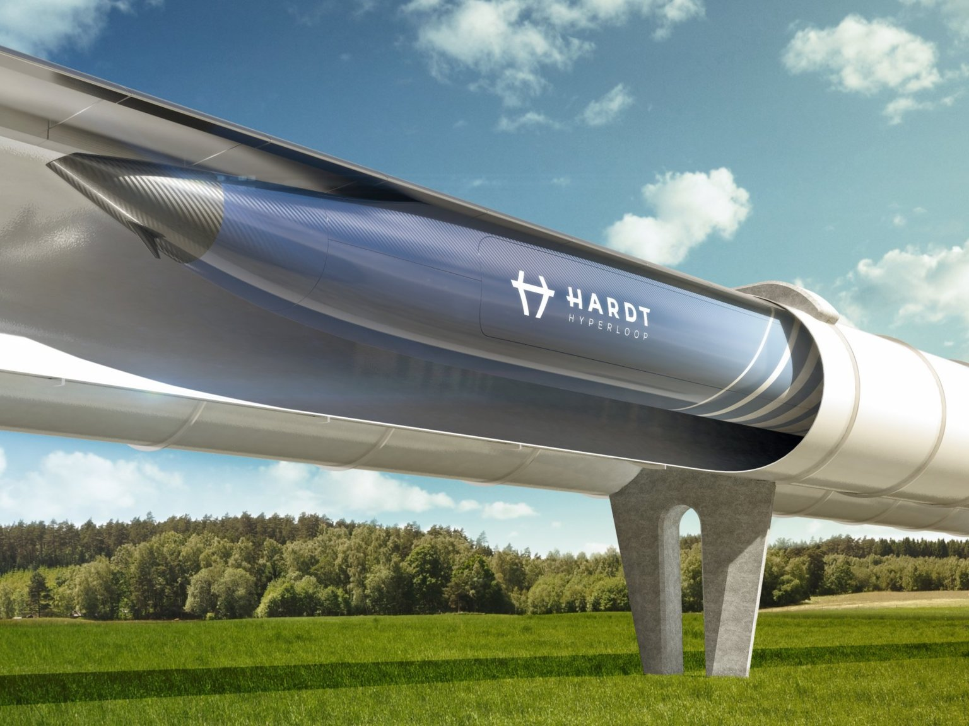
WARM-UP: MIMING
1

Slide 6
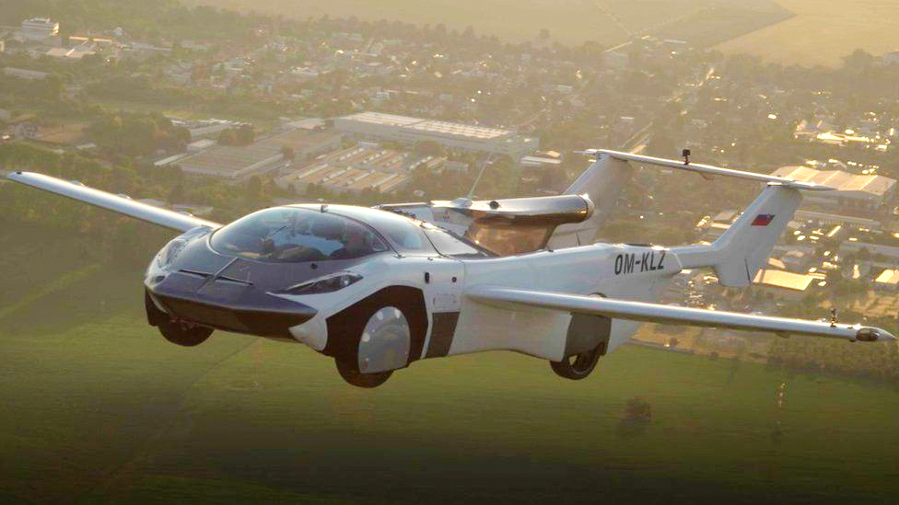
WARM-UP: MIMING
2

Slide 7
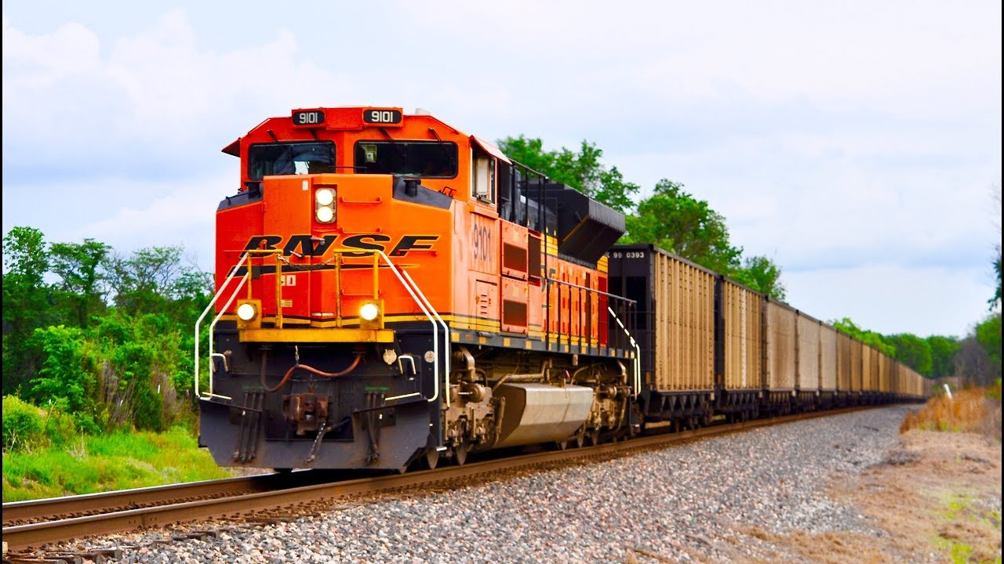
WARM-UP: MIMING
3

Slide 8
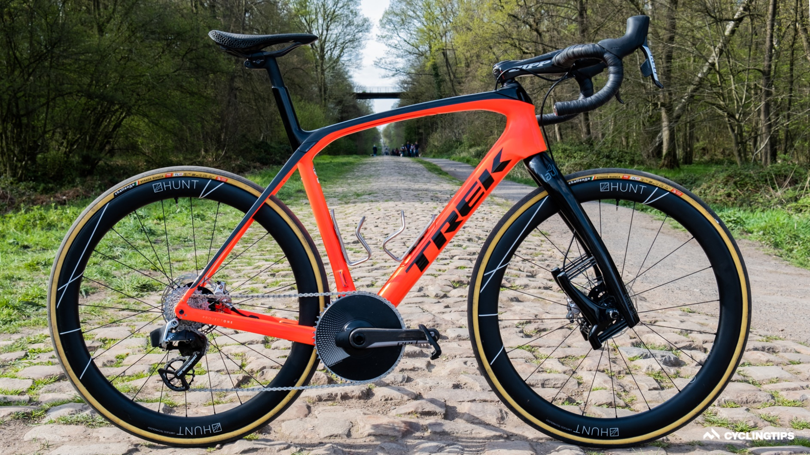
WARM-UP: MIMING
4

Slide 9
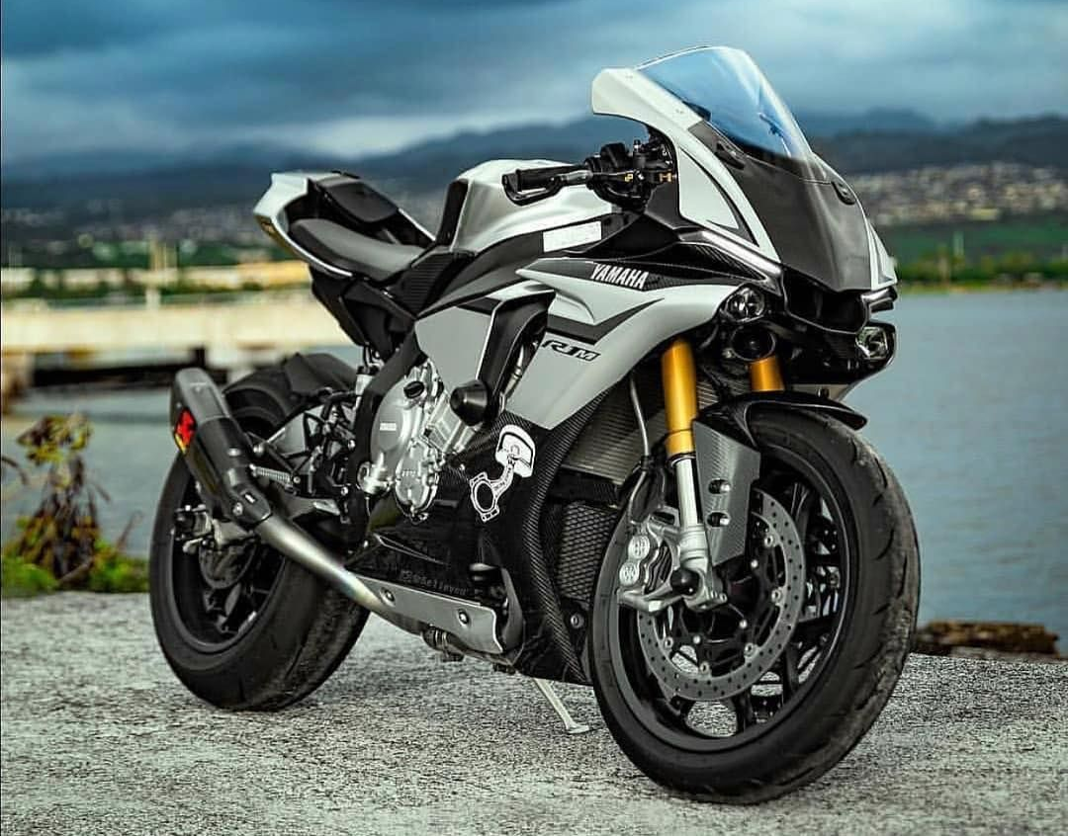
WARM-UP: MIMING
5

Slide 10
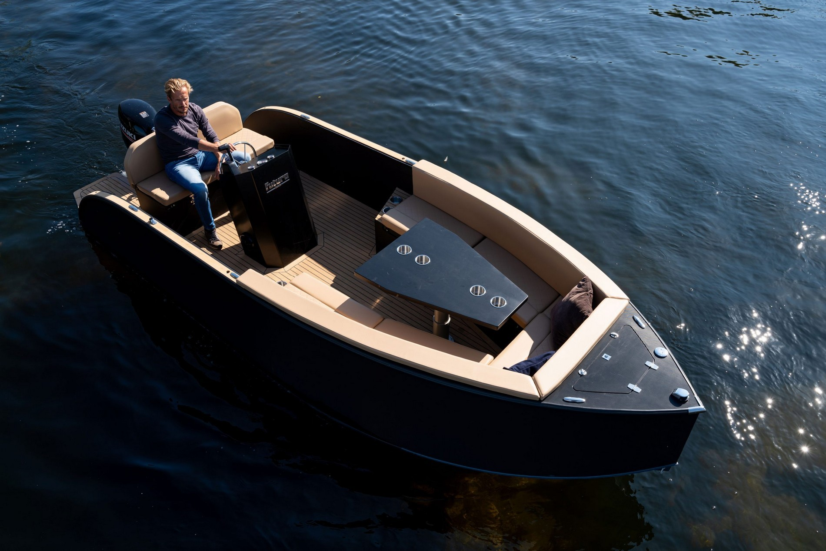
WARM-UP: MIMING
6

Slide 11
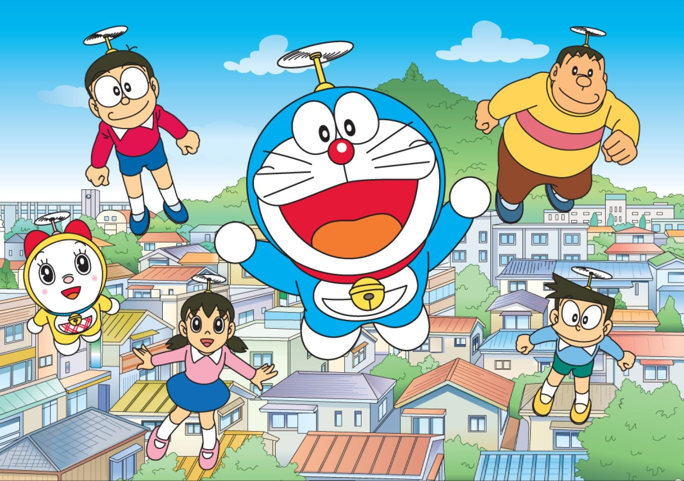
VOCABULARY
bamboo-copter (n)
/bæmˈbuːˈkɒptər/
chong chóng tre

Slide 12
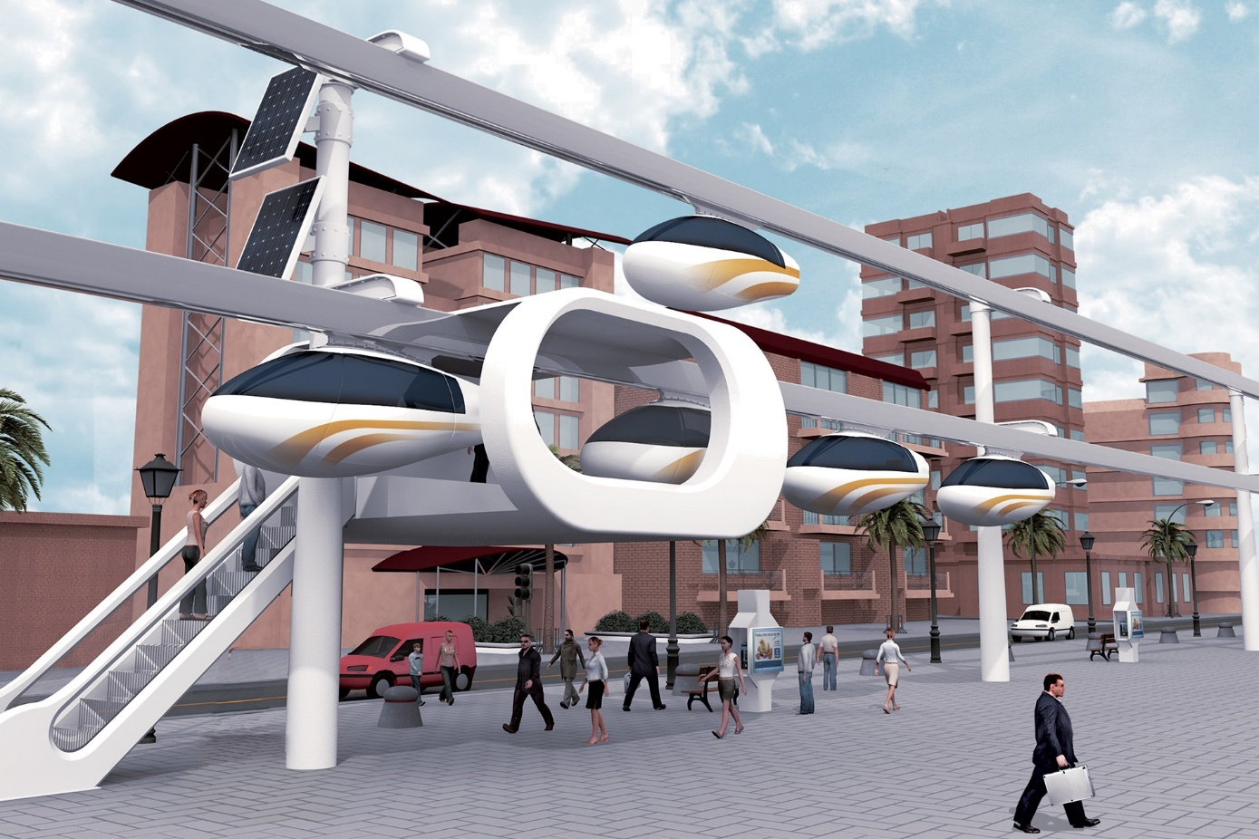
VOCABULARY
skyTran (n)
/skaɪtræn/
hệ thống tàu điện
trên không

Slide 13

VOCABULARY
solar-powered (adj)
/ˌsəʊlə ˈpaʊər/
chạy bằng năng lượng mặt trời

Slide 14

VOCABULARY
sail (v)
/seɪl/
lướt buồm

Slide 15
VOCABULARY
New words | Pronunciation | Meaning
1. bamboo-copter (n) | /bæmˈbuːˈkɒptər/ | chong chóng tre
2. skyTran (n) | /skaɪtræn/ | hệ thống tàu điện trên không
3. solar-powered (adj) | /ˌsəʊlə -ˈpaʊər/ | chạy bằng năng lượng mặt trời
4. sail (v) | /seɪl/ | lướt buồm

Slide 16

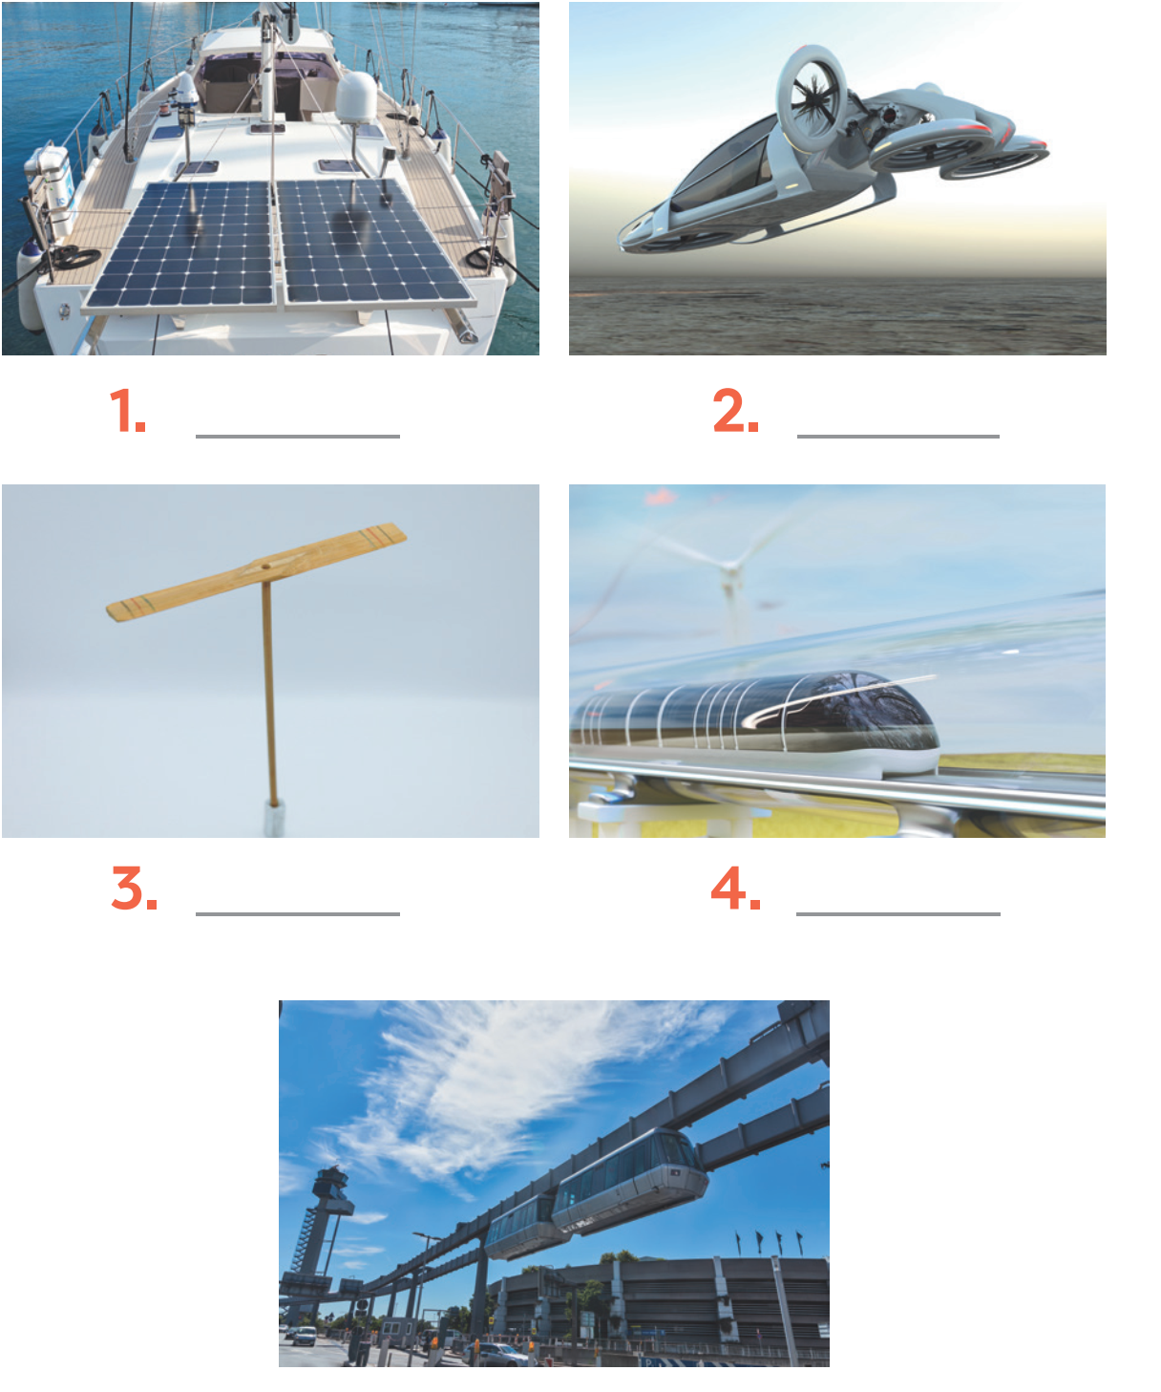
VOCABULARY
1
Write the words or phrases under the correct pictures. Then listen, check, and repeat.
flying car bamboo-copter hyperloop skyTran solar-powered ship
1. _______________
flying car
solar-powered ship
2. _______________
3. _______________
bamboo-copter

Slide 17
VOCABULARY
1
Write the words or phrases under the correct pictures. Then listen, check, and repeat.
flying car bamboo-copter hyperloop skyTran solar-powered ship
hyperloop
4. _______________
5. _______________
skyTran

Slide 18
VOCABULARY
2
Write words or phrases from 1 in the correct columns.
flying car bamboo-copter hyperloop skyTran solar-powered ship
ride | fly | sail
skyTran
bamboo-copter
solar-powered ship
hyperloop
flying car

Slide 19
VOCABULARY
3
1
Complete the sentences, using the words from the box.
eco-friendly bamboo-copter fly ride hyperloop
1. Travelling by ________________ is simple. You just put it on and fly away.
2. People will soon ______________ in flying cars instead of driving normal cars.
3. It will be fun to ______________ a skyTran to work.
4. Travelling by ________________ will be faster than by airplane.
5. Solar-powered ships are ________________. They will not cause pollution
bamboo-copter
fly
ride
hyperloop
eco-friendly

Slide 20

PRONUNCIATION
SENTENCE STRESS
Aims of the stage:
To help Ss be aware of which words in a sentence should be stressed, which should not
To help Ss say sentences with correct stress

Slide 21
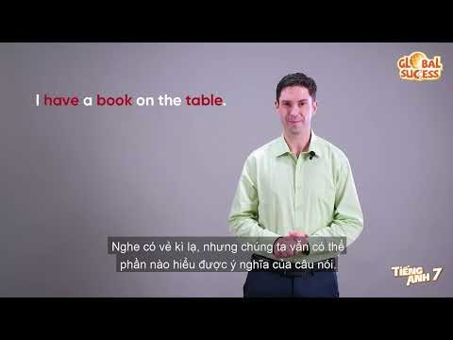

PRONUNCIATION
Notes:
Video link: https://www.youtube.com/watch?v=S09SP3trcnY

Slide 22
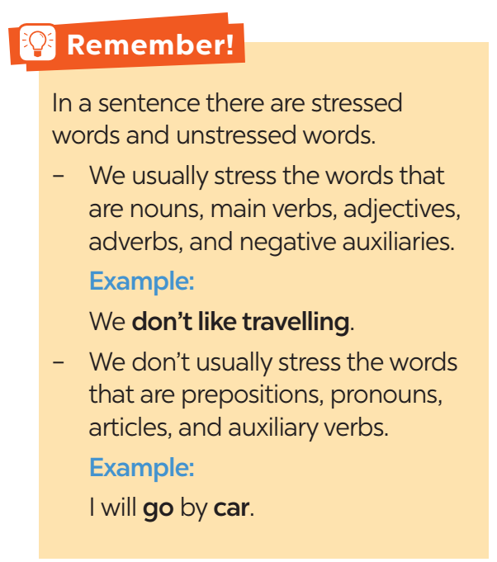
PRONUNCIATION

Slide 23

PRONUNCIATION
4
Listen to the sentences and repeat. Pay attention to the bold syllables.
1. We’ll have driverless cars.
2. We’ll have driverless cars in the future.
3. I think driverless cars will run faster.
4. I don’t think we’ll have driverless cars.
5. I think driverless cars will be safer and greener.

Slide 24
PRONUNCIATION
5
Listen to the sentences and repeat. How many stresses are there in each sentence?
1. That is a solar-powered ship.
2. They will travel by ﬂying car.
3. They introduced a new autopilot model.
4. Will bullet trains pollute the environment?
5. I don’t think those trains will be popular here.

Slide 25
PRONUNCIATION
5
Listen to the sentences and repeat. How many stresses are there in each sentence?
1. That is a solar-powered ship.
2. They will travel by ﬂying car.
3. They introduced a new autopilot model.
4. Will bullet trains pollute the environment?
5. I don’t think those trains will be popular here.
→ 3 stresses
→ 3 stresses
→ 4 stresses
→ 4 stresses
→ 5 stresses

Slide 26
CONSOLIDATION
1
WRAP-UP
VOCABULARY
PRONUNCIATION

Slide 27

CONSOLIDATION
2
HOMEWORK
Practice saying the sentences at home.

Slide 28

Website: hoclieu.vn
Fanpage: facebook.com/www.tienganhglobalsuccess.vn/

