Slide 1

Unit 8: Food
Lesson 3.3
Page 118

Slide 2
Lesson Outline
Warm-up
Practice
Speaking
Consolidation
Wrap-up

Slide 3
Objectives
By the end of this lesson, students will be able to…
Vocabulary: Practice the vocabularies learnt earlier in the lesson.
Structure: Practice structures:
Would you like some ____?
Yes, please.
No, thank you.

Slide 4

WARM UP

Slide 5
Let’s find
the food!
c
a
k
e
i
a
p
p
l
e
p
i
z
z
a
e
f
i
s
h
Click on the first letter of each word to see the name of food.
e
g
g
u
n

Slide 6

It’s time to learn …

Slide 7

Listen and write
Pre-Speaking
______ _______ _______ ______ _______Mrs. Brown?
Would you like some pizza, Mrs. Brown?
Notes:
Click textbox: pre-speaking to hear the sound

Slide 8
Listen and write
Pre-Speaking
______ _______,Alfie .
No, thank you, Alfie.
Notes:
Cắt: Would you like some pizza (lấy của lesson trước)

Slide 9
Pre-Speaking
Listen and write
______ _______ _______ ______ _______,Lucy?
Would you like some fries, Lucy?
Notes:
Cắt: Would you like some fries (lấy của lesson trước)

Slide 10
Listen and write
Pre-Speaking
______ _______ .
Yes, please.
Notes:
Cắt: Would you like some pizza (lấy của lesson trước)

Slide 11
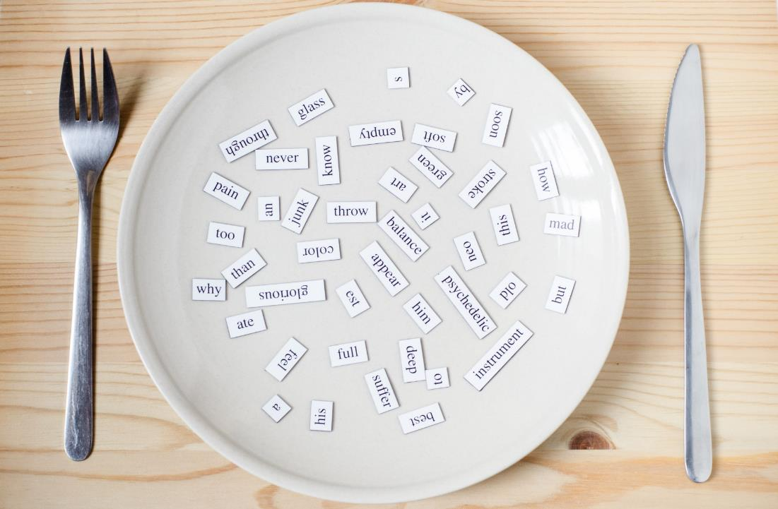
Structure
Would you like some…..?
- Yes, please.
- No, thank you.

Slide 12

While-Speaking
Practice

Slide 13
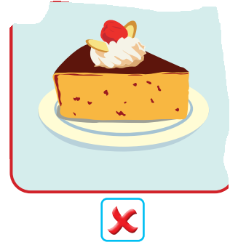
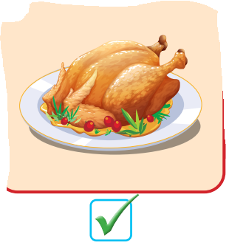
Match
No, thank you
Yes, please.
Click on the picture

Slide 14
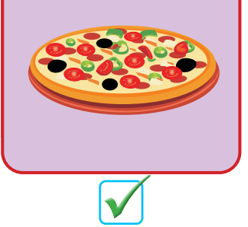
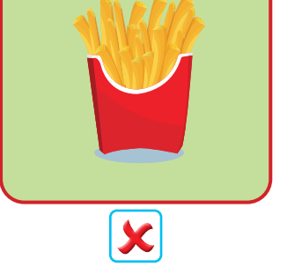
Match
No, thank you
Yes, please.

Slide 15
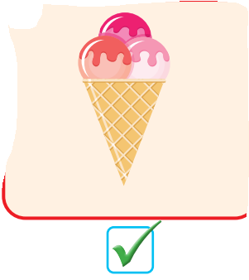
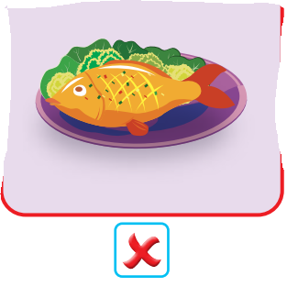
Match
Yes, please.
No, thank you

Slide 16

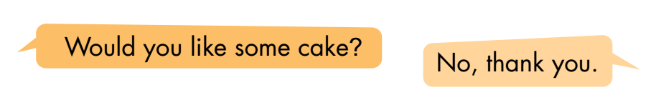
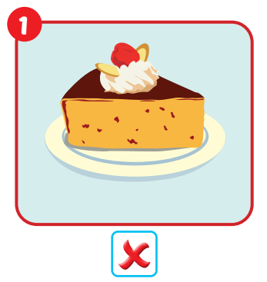

Slide 17
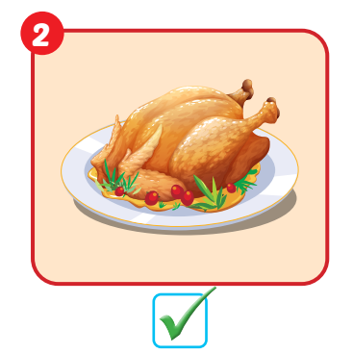

Slide 18
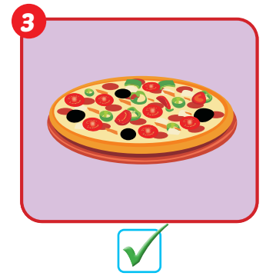

Slide 19
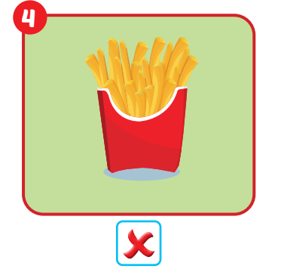

Slide 20
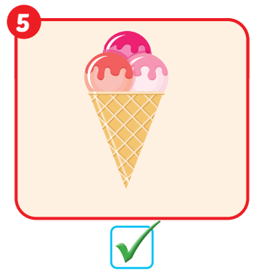

Slide 21
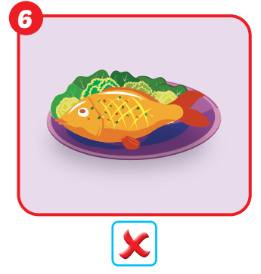

Slide 22
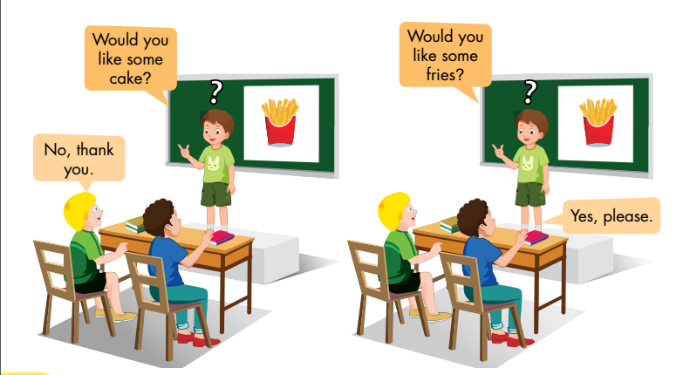
Post speaking
Guess the food by asking questions

Slide 23
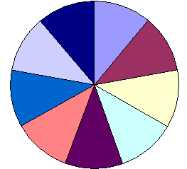

20
10
30
100
Question 1
Question 2
40
80
Question 3
Question 4
50
70
60
Click here to go to the consolidation
Click here to spin the wheel and choose the question
Points
Notes:
Divide class into 2 groups. Each turn, The teacher turn the wheel to see how much point for each turn and the group will choose the question. 1 member from each group come in front, face the class-> the T click on the question the group chose-> the member in front has to ask question to find out what is missing

Slide 24
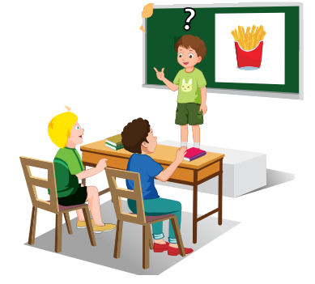



Guess the food by asking questions

Slide 25
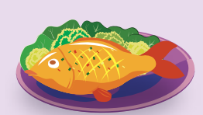
Guess the food by asking questions

Slide 26
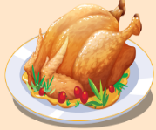
Guess the food by asking questions

Slide 27
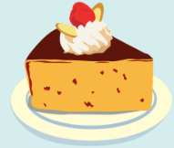
Guess the food by asking questions

Slide 28

CONSOLIDATION

Slide 29
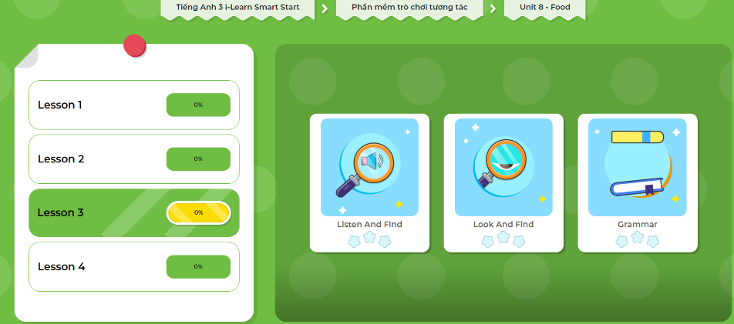
Extra Practice
DHA App
LET’S PLAY!
Click here to play the games

Slide 30

WRAP-UP

Slide 31
Lesson 3
Today’s lesson
Structures/ Sentence patterns
Would you like some ____?
Yes, please.
No, thank you.

Slide 32
Lesson 3
Homework
Practice the vocabularies and structure; and make sentences using them.
Do the exercises in Tiếng Anh 3 i-Learn Smart Start WB (page 83)
Do the exercises in Tiếng Anh 3 i-Learn Smart Start Notebook (page 54)
Prepare the next lesson (page 119 SB)
Play the consolidation games in Tiếng Anh 3 i-Learn Smart Start DHA App on www.eduhome.com.vn

Slide 33
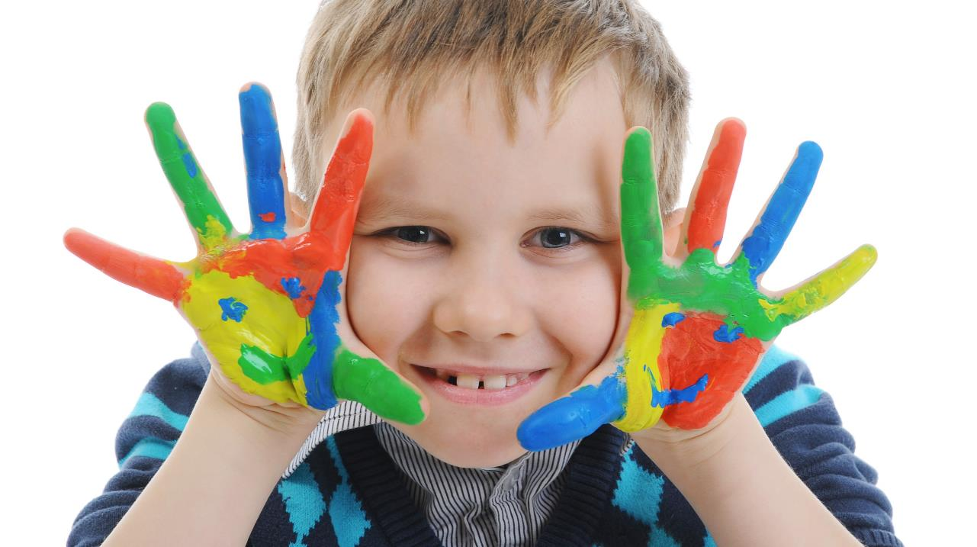
Enjoy your day!

