Slide 1


Slide 2


REVIEW
4
Units 10 - 11 - 12
LESSON 1: LANGUAGE
1

Slide 3
LESSON 1: LANGUAGE
WARM-UP
Whisper game
Task 1a: Choose the word which has a different stress pattern.
Task 1b: Read the sentences out loud with the correct stress. How many stressed words are there in each sentence?
Task 1c: Draw a suitable arrow above each underlined word to show intonation.
PRONUNCIATION
VOCABULARY
Task 2: Choose the best answer A, B, or C.
Task 3: Fill in each blank with the suitable form of the word given.
GRAMMAR
Task 4: Rewrite the sentences.
Task 5: Change the sentences into reported speech.
CONSOLIDATION
Wrap-up
Homework

Slide 4
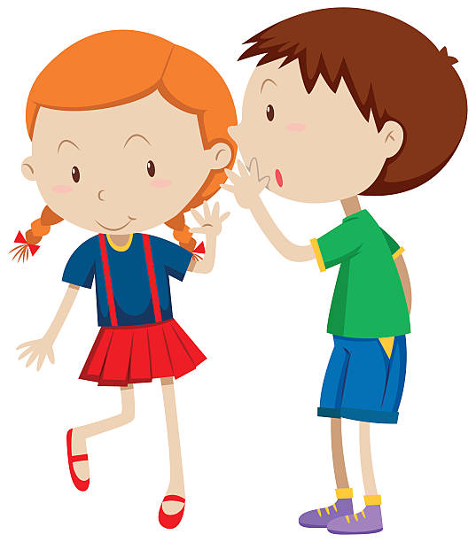
WARM-UP
- Work in teams.
- One students from each team comes to the board.
- Teacher gives her/him a sentence.
-That person will then whisper what she/he heard to the next person. (Each person can only say "Can you please repeat that?" one time.)
- The last student will speak out loud the sentence.
WHISPER GAME
Write on the board the list of future technology you expect to see in the future in 2 minutes.

Slide 5
WARM-UP
WHISPER GAME
Write on the board the list of future technology you expect to see in the future in 2 minutes.
1. We can’t connect the Internet in this room.

Slide 6
WARM-UP
WHISPER GAME
Write on the board the list of future technology you expect to see in the future in 2 minutes.
2. There are eight planets in our solar system.

Slide 7
WARM-UP
WHISPER GAME
Write on the board the list of future technology you expect to see in the future in 2 minutes.
3. I have one TV, one radio and two tables.

Slide 8
PRONUNCIATION
1a
Choose the word which has a different stress pattern from that of the others.
’
’
’
’
1. A. referee B. amazing C. historic D. invention
2. A. digital B. conference C. Japanese D. difficult
’
’
’
’

Slide 9

PRONUNCIATION
1b
Read the sentences out loud with the correct stress. How many stressed words are there in each sentence? Listen, check, and repeat.
3. How will people travel to work in the future?
4. A: Will technology replace humans in the future?
B: No, it won’t.
=> 5 stressed words.
=> 4 stressed words.
=> 2 stressed words.

Slide 10
PRONUNCIATION
1c
Draw a suitable arrow above each underlined word to show intonation. Then listen and repeat.
5. I can remember the names of some planets,
such as Venus, Neptune, and Mars.
6. They have a TV, a fridge, a table, and four chairs.

Slide 11
VOCABULARY
2
Choose the best answer A, B, or C.
1. A(n) ______ is a small digital image used on social media to express emotions.
A. symbol B. emoji C. picture
2. We had a ______ with students from diﬀerent countries yesterday.
A. video conference B. video group C. private message
3. The results of the ______ were very interesting.
A. finding B. communication C. experiment

Slide 12
VOCABULARY
2
Choose the best answer A, B, or C.
4. When you look at the ______ for too long, your eyes may get tired.
A. contact lenses B. computer screen C. online class
5. Do you know how many stars there are in the ______?
A. spaceship B. planet C. galaxy

Slide 13
VOCABULARY
3
Fill in each blank with the suitable form of the word given.
1. Scientists are interested in the ________ of life on Mars. (possible)
2. We can use face __________ to identify people. (recognise)
3. When we communicate using echnology, it is called digital
_____________. (communicate)
4. The Internet __________ is slow here, so we can’t get in the chat room. (connect)
5. Do you think this _________ machine will be cheaper in the future? (translate)
possibility
recognition
communication
connection
translation

Slide 14
GRAMMAR
4
Fill in each blank with the suitable form of the word given.
1. The scientists did an experiment on three hours yesterday.
2. Do you think robot teachers will replace human teachers by 20 years?
3. These contact lenses are mine; they aren’t your.
A
B
 for
C
A
B
C
 in
A
B
C
 yours

Slide 15
GRAMMAR
4
Fill in each blank with the suitable form of the word given.
4. This is Ann, a friend in mine from the UK.
5. You should be at school for 7:00 a.m., so hurry up.
A
B
 of
C
A
B
 by / at
C

Slide 16
GRAMMAR
5
Change these sentences into reported speech
1. “What planet do you want to visit?” my friend asked me.
2. “I’m now reading a book about future ways of communication,”
she told me.
3. “How will teachers check attendance in the future?” Lan asked Nam.
→ My friend asked me what planet I wanted to visit.
→ She told me (that) she was reading a book about future ways of communication then.
→ Lan asked Nam how teachers would check attendance in the future.

Slide 17
GRAMMAR
5
Change these sentences into reported speech
4. “We are having a video conference with other clubs next week,” our club president said.
5. I asked my mum, “When will there be a full moon?”
→ Our club president said (that) we were having a video conference with other clubs the next / following week.
→ I asked my mum when there would be a full moon.

Slide 18

CONSOLIDATION
1
Wrap-up
What have we learnt in this lesson?
Review the language they have studied from Units 10 to 12.

Slide 19

CONSOLIDATION
2
Homework
- Do the exercises in the workbook.

Slide 20

Website: hoclieu.vn
Fanpage: facebook.com/tienganhglobalsuccess.vn/

