Slide 1


Slide 2
6TH GRADE
A SOCIAL AWARENESS CLUB MEETING
LESSON I – GETTING STARTED
Unit
9
SOCIAL ISSUES
FAMILY LIFE
Unit

Slide 3
LESSON I
GETTING STARTED
WARM-UP
Quiz
PRESENTATION
Vocabulary
Task 1: Listen and read.
Task 2: Tick (✓) the correct box.
Task 3: Find five social issues.
Task 4: Complete the summary.
PRACTICE
PRODUCTION
Discussion
CONSOLIDATION
Wrap-up
Homework

Slide 4

Students work in 4 groups
There are some news headlines, pictures and short clips about social issues.
Raise your hands and give the correct names of the issues.

Slide 5

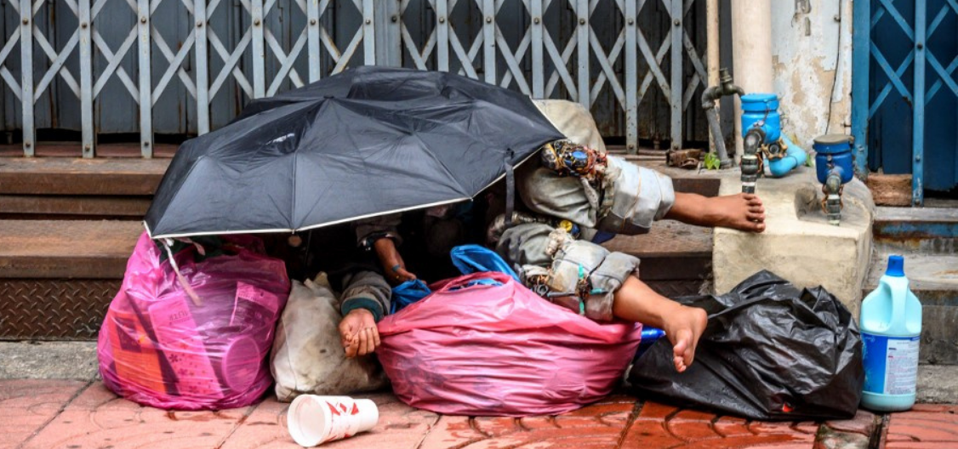
Find the correct name of the issue.
1
Gender inequality
Climate Change
Childhood obesity
Homelessness

Slide 6
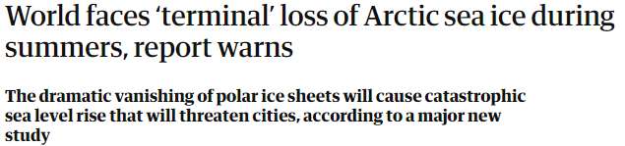
Find the correct name of the issue.
2
Civil rights
Bullying
Climate change
Gender inequality

Slide 7
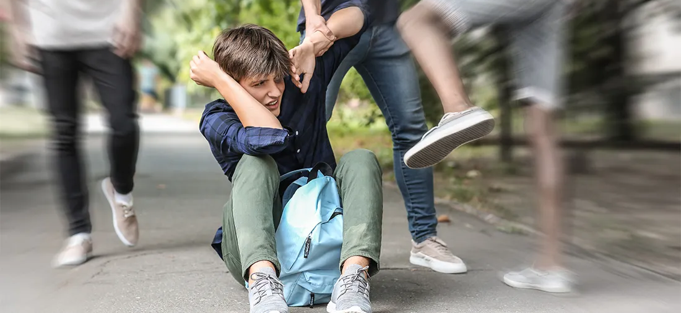
Find the correct name of the the issue.
3
School violence/ bullying
Health care availability
Gender inequality
Overpopulation

Slide 8

Find the correct name of the the issue.
4
Climate change
Childhood obesity
Homelessness
Gender inequality

Slide 9


PRESENTATION
awareness (n)
/əˈweənəs/
knowledge that something exists, or understanding of a situation or subject at the present time based on information or experience

Slide 10

PRESENTATION
campaign (n)
/kæmˈpeɪn/
a planned group of especially political, business, or military activities that are intended to achieve a particular aim

Slide 11
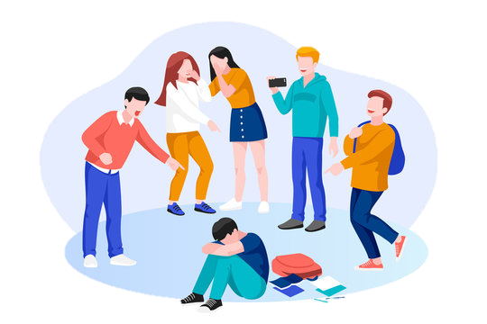
PRESENTATION
bully (v)
/ˈbʊl.i/
to hurt or frighten someone, often over a period of time, and often forcing that person to do something they do not want to do

Slide 12
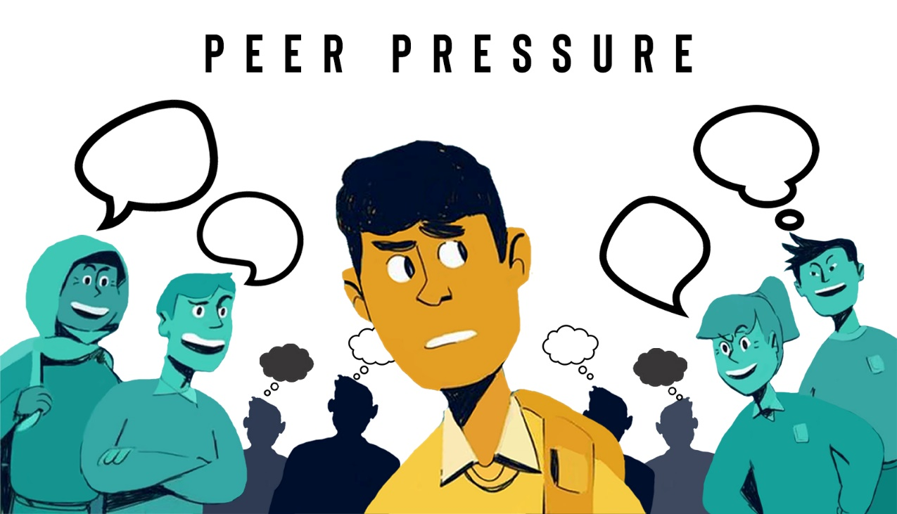
PRESENTATION
peer pressure (n)
/ˈpɪə ˌpreʃər/
the strong influence of a group, especially of children, on members of that group to behave as everyone else does

Slide 13

PRESENTATION
body shaming (n)
/ˈbɒdi ˌʃeɪmɪŋ/
criticism of someone based on the shape, size, or appearance of their body

Slide 14
Form | Pronunciation | Meaning
1. awareness (n) | /əˈweənəs/ | knowledge that something exists, or understanding of a situation or subject at the present time based on information or experience
2. campaign (n) | /kæmˈpeɪn/ | a planned group of especially political, business, or military activities that are intended to achieve a particular aim
3. bully (v) | /ˈbʊli/ | to hurt or frighten someone, often over a period of time, and often forcing that person to do something they do not want to do
4. peer pressure (n) | /ˈpɪə ˌpreʃər/ | the strong influence of a group, especially of children, on members of that group to behave as everyone else does
5. body shaming (n) | /ˈbɒd.i ˌʃeɪmɪŋ/ | criticism of someone based on the shape, size, or appearance of their body

Slide 15
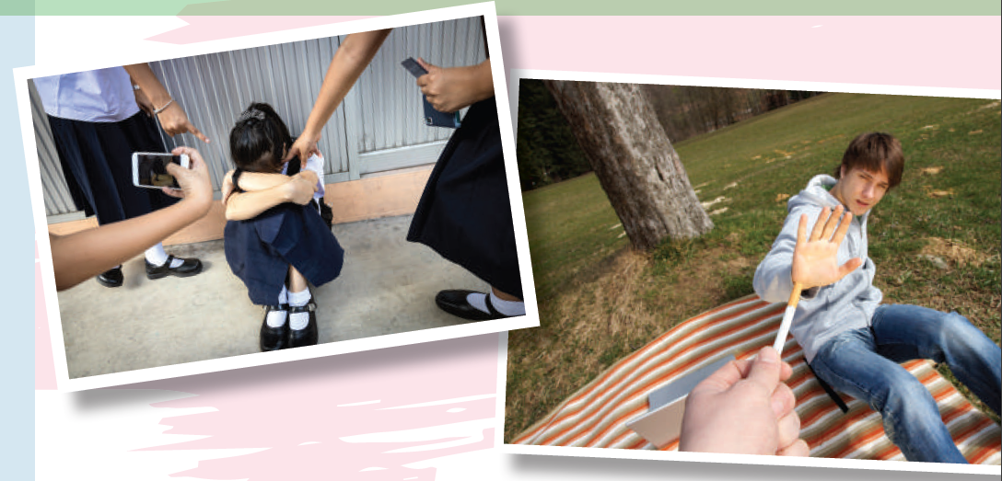
PRESENTATION
1
Listen and read.

Slide 16
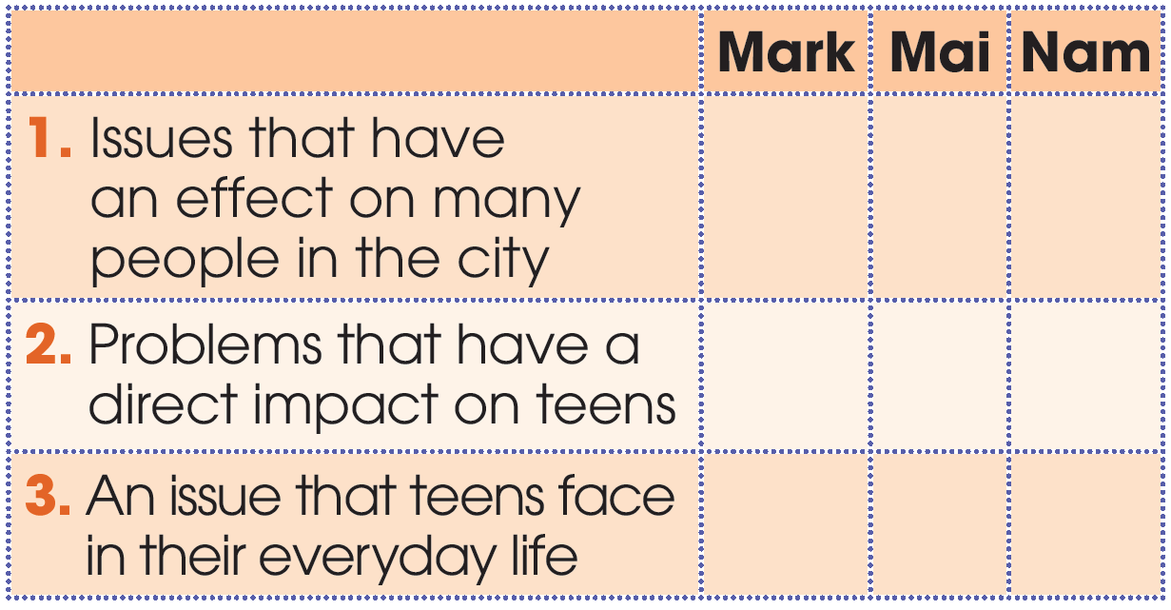
PRACTICE
2
Who suggests the following ideas? Tick (✓) the correct box.
✓
✓
✓
✓

Slide 17
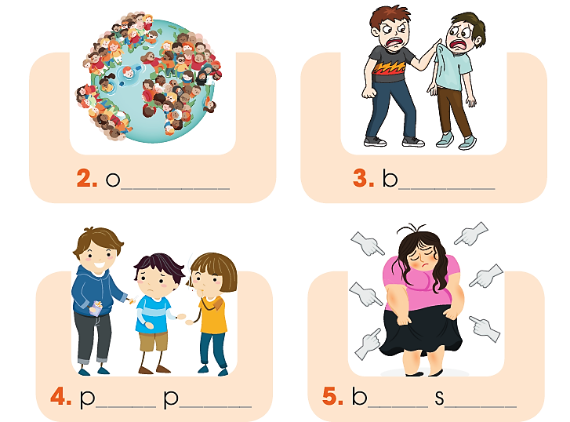
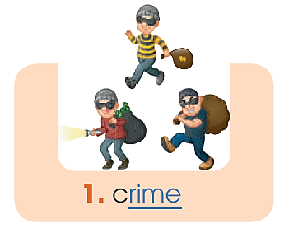
PRACTICE
3
Find five social issues in 1. Use the pictures and hints below to help you.
verpopulation
ullying
eer
ressure
ody
haming

Slide 18
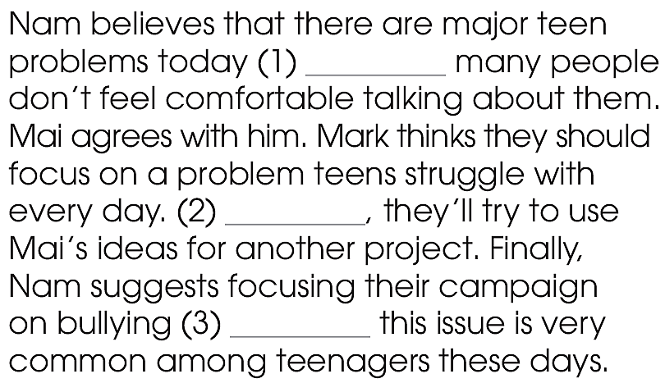
PRACTICE
4
Complete the summary with words from 1.
although
However
because

Slide 19

PRACTICE
5
Discussion
Can you think of other social issues that directly affect teenagers?
What can we do to stop them or help the victims?

Slide 20
1. WRAP-UP
CONSOLIDATION
What have you learnt today?
Use appropriate intonation in choice questions.
Understand and use words and phrases related to social issues.

Slide 21
2. HOMEWORK
CONSOLIDATION
Do exercises in the workbook.
Prepare for Lesson 2 - Unit 9.
Prepare materials for the project in lesson 8

Slide 22

Website: hoclieu.vn
Fanpage: facebook.com/www.tienganhglobalsuccess.vn/

