Slide 1

Unit 4: Holidays!
Progress Check (Cont.)
Page 85

Slide 2
Lesson Outline
Warm-up
Reading
Listening
Writing
Wrap-up

Slide 3
Objectives
By the end of this lesson, students will be able to…
- practise test-taking skills (Reading, Listening, and Writing).

Slide 4

WARM-UP

Slide 5
Work in groups. List down all holiday destinations in Vietnam you know.
Sapa
Vietnam
Ha Long Bay

Slide 6

It’s time to learn …

Slide 7
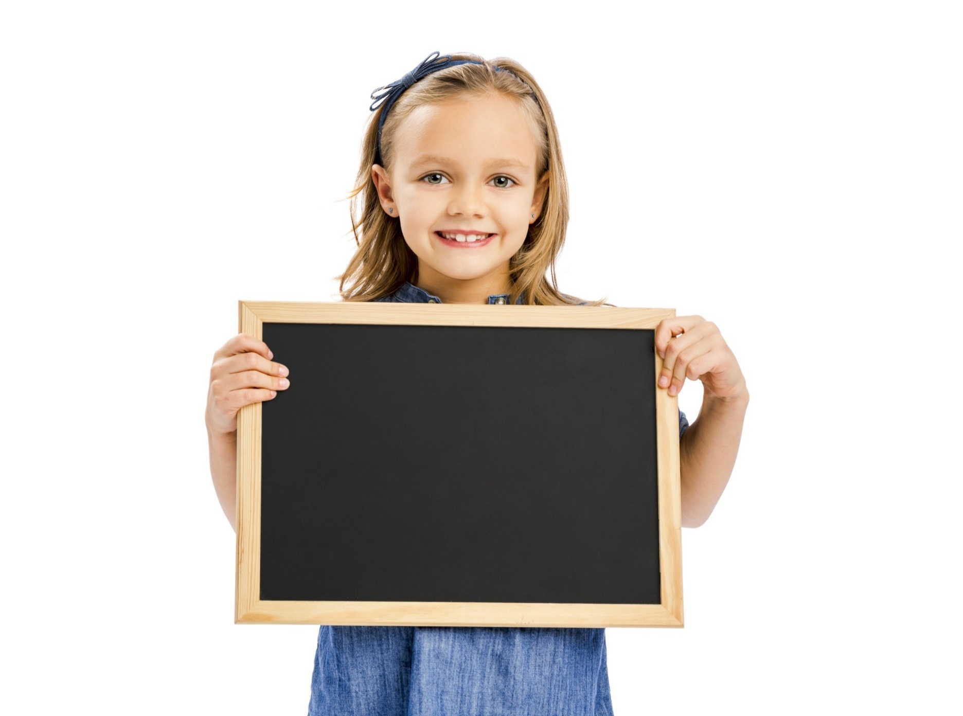
Reading

Slide 8
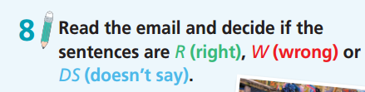
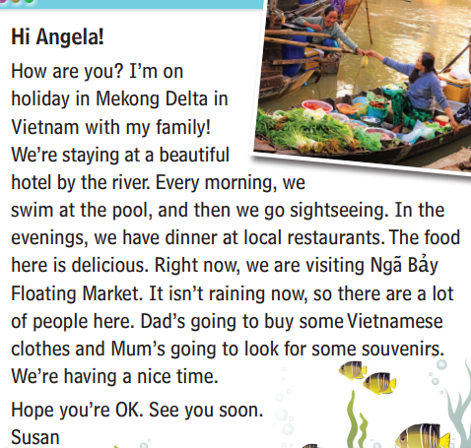
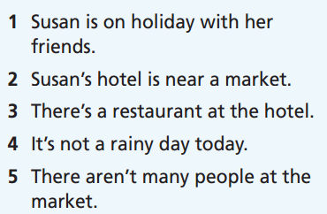
Read the instruction quickly. Underline the key words. What are we going to do?
Pre-Reading

Slide 9
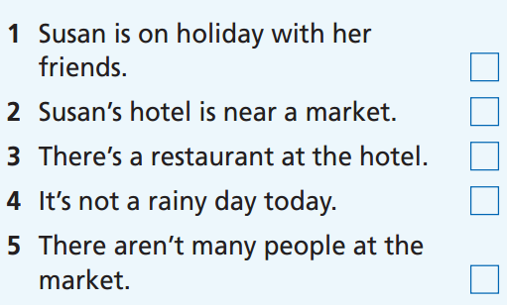
What is your answer?
While-reading
W
DS
DS
R
W

Slide 10
Extra Practice
Please read the email again and answer the following questions:
Where do they have dinner?
=> They have dinner at local restaurants.
2. What are they doing now?
=> They are visiting Ngã Bảy floating market.
3. What’s her mother going to do?
=> Her mother is going to look for some souvenirs.
4. How is she feeling about the holiday?
=> She’s having a nice time.

Slide 11
Post-reading
Work in pairs
Imagine you are Susan calling Angela about the holiday. Angela asks questions and Susan answers about the holiday. You should use the information in the email.
Hello Angela, I’m on holiday in Mekong Delta now.
Wow, that’s great. Who are you going with?
I’m going with my family.
…..

Slide 12
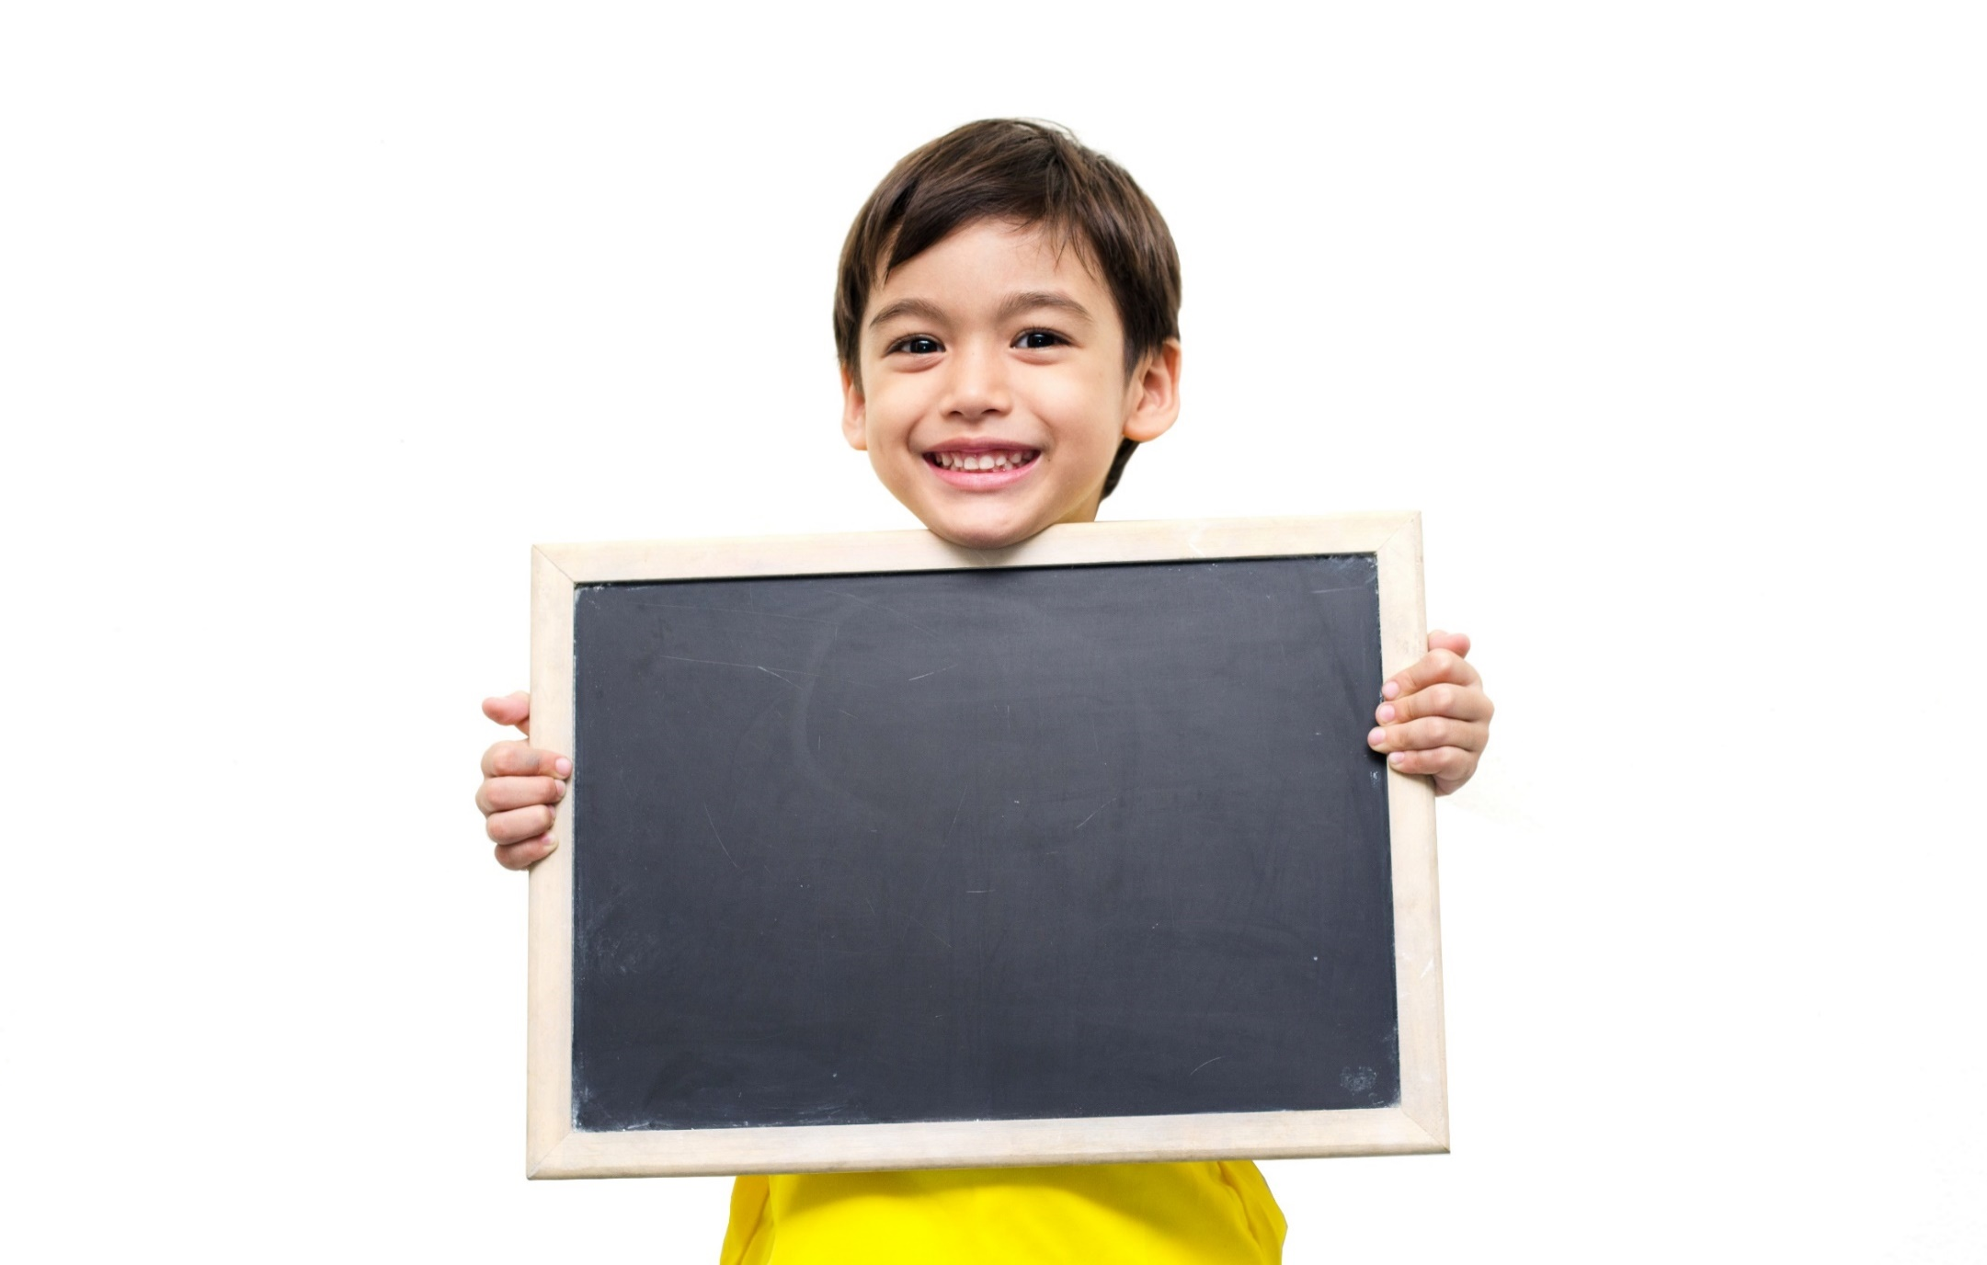
Listening

Slide 13
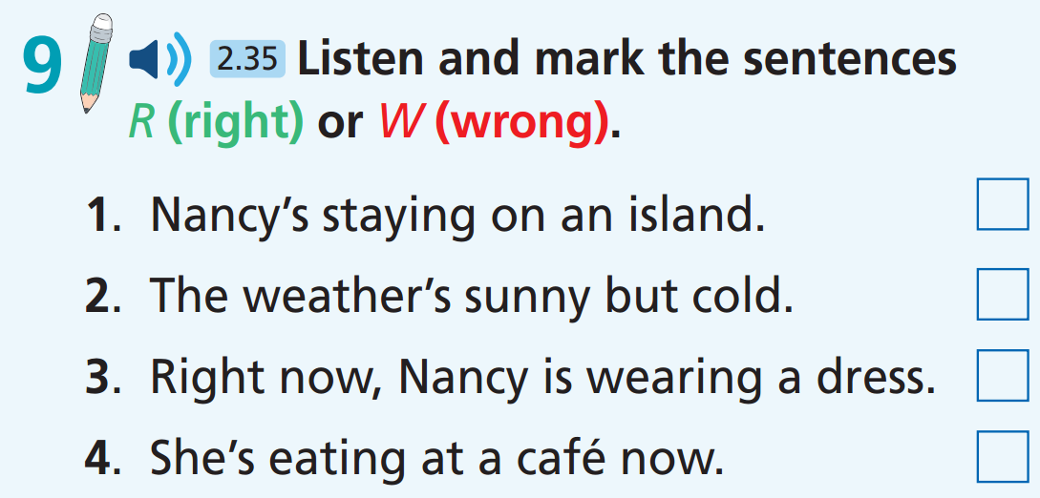
Pre-listening
Underline the key words

Slide 14

While-Listening
Now listen.  FIRST TIME
☞ WHAT ARE YOUR ANSWERS?

Slide 15
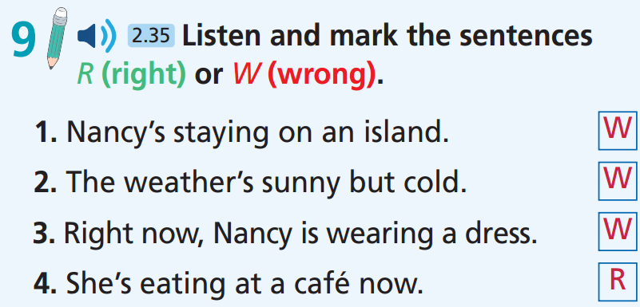
While - listening
Now listen again.  SECOND TIME
☞ WHY ARE THESE ANSWERS?

Slide 16
Now listen again and check.  THIRD TIME
I'm on holiday in the city of Porto. It’s on the coast of Portugal and our resort is right by the sea.

Slide 17
Now listen again and check.  THIRD TIME
The weather is lovely. It's sunny every day. I've got my jeans with me, but it's so hot.

Slide 18
Now listen again and check.  THIRD TIME
I wear shorts and a T-shirt every day!

Slide 19
Now listen again and check.  THIRD TIME
First, we're having lunch at a café. I'm waiting for my food now.

Slide 20
Extra listening
Listen again and write ONE word to fill in each gap.
resort
Nancy is on holiday. Her ________ is by the sea. The weather is sunny and hot. She wears ________ and a T-shirt every day. She wants to buy a ________ for tonight. Her mom is going shopping with her. Her dad goes on a ________ with his new friends. She’s having ________ at a café.
shorts
dress
trek
lunch

Slide 21
Audio Scripts
Practice the talk again.
I'm on holiday in the city of Porto. It’s on the coast of Portugal and our resort is right by the sea. The weather is lovely. It's sunny every day. I've got my jeans with me, but it's so hot. I wear shorts and a T-shirt every day! I want to buy a dress to wear at dinner tonight, though. My mum is coming shopping with me later while my dad goes on a trek with his new friends. First, we're having lunch at a café. I'm waiting for my food now and the view is amazing. I love it here. It's so beautiful!

Slide 22

Work in pairs
Post-Listening
If you are on holiday, discuss the answer to these questions:
You are in a beautiful resort by the sea. Which activities will you do?
It’s sunny and hot. What clothes will you wear?
You need beautiful clothes for dinner. What will you buy?
You are having lunch at a café. What food will you eat?

Slide 23
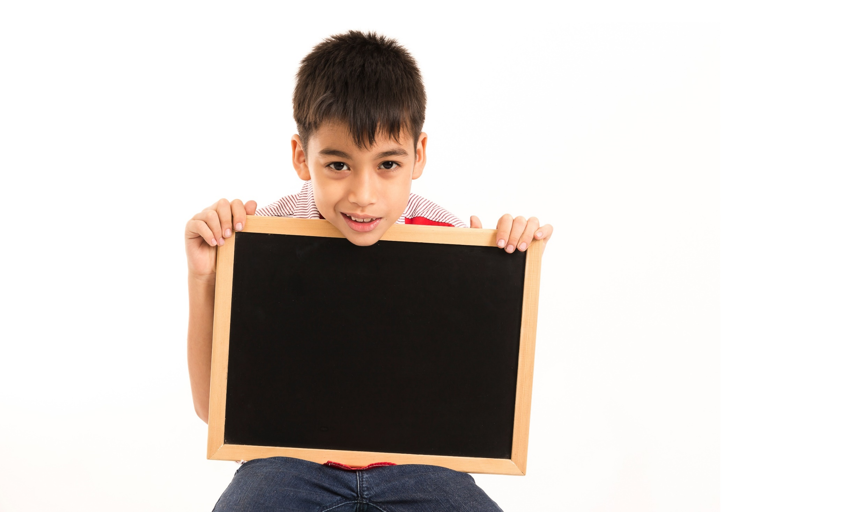
Writing

Slide 24
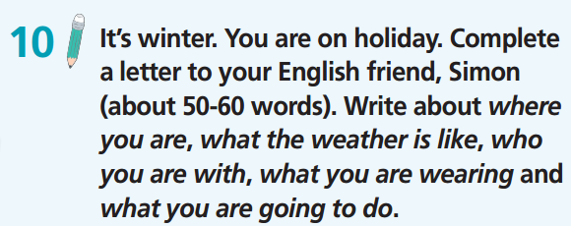

Slide 25
Hi Simon,
Greetings from …………………………. Today it’s …………………………………..
Right now, I ……………………………………………………………………………………
I’m wearing ……………………………………………………………………………………
I’m going to …………………………………….……… I’m having a great time!
Write back!
Ahmed

Slide 26
Sample letter
Hi Simon,
Greetings from Sicily, a beautiful island in Italy! Today it's hot and sunny! Right now, I'm sitting in a café. I’m having a meal and writing my postcards. I’m wearing shorts and a T-shirt. I’m going to go sightseeing tomorrow. I’m having a great time!
Write back!
Ahmed

Slide 27
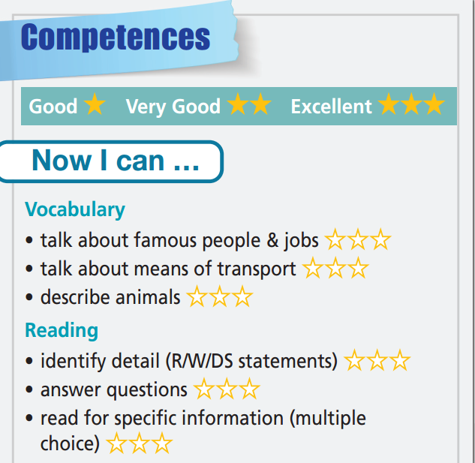
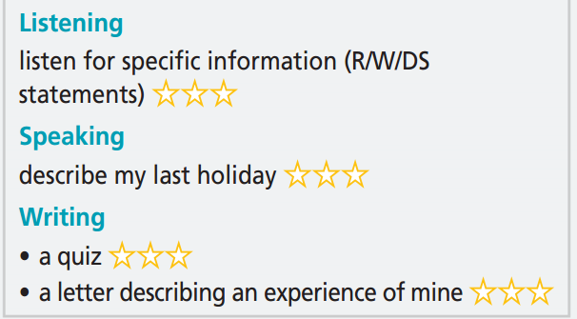

Slide 28

WRAP-UP

Slide 29
Today’s lesson
Practise test-taking skills (Reading, Listening, and Writing).

Slide 30
Homework
Practise the vocabulary and make sentences using them.
Do Unit 4 Test 2 in Bài Tập Bổ Trợ TA 6 Right on (pp. 40-41).
Prepare for the next lesson (p. 86 SB).

Slide 31
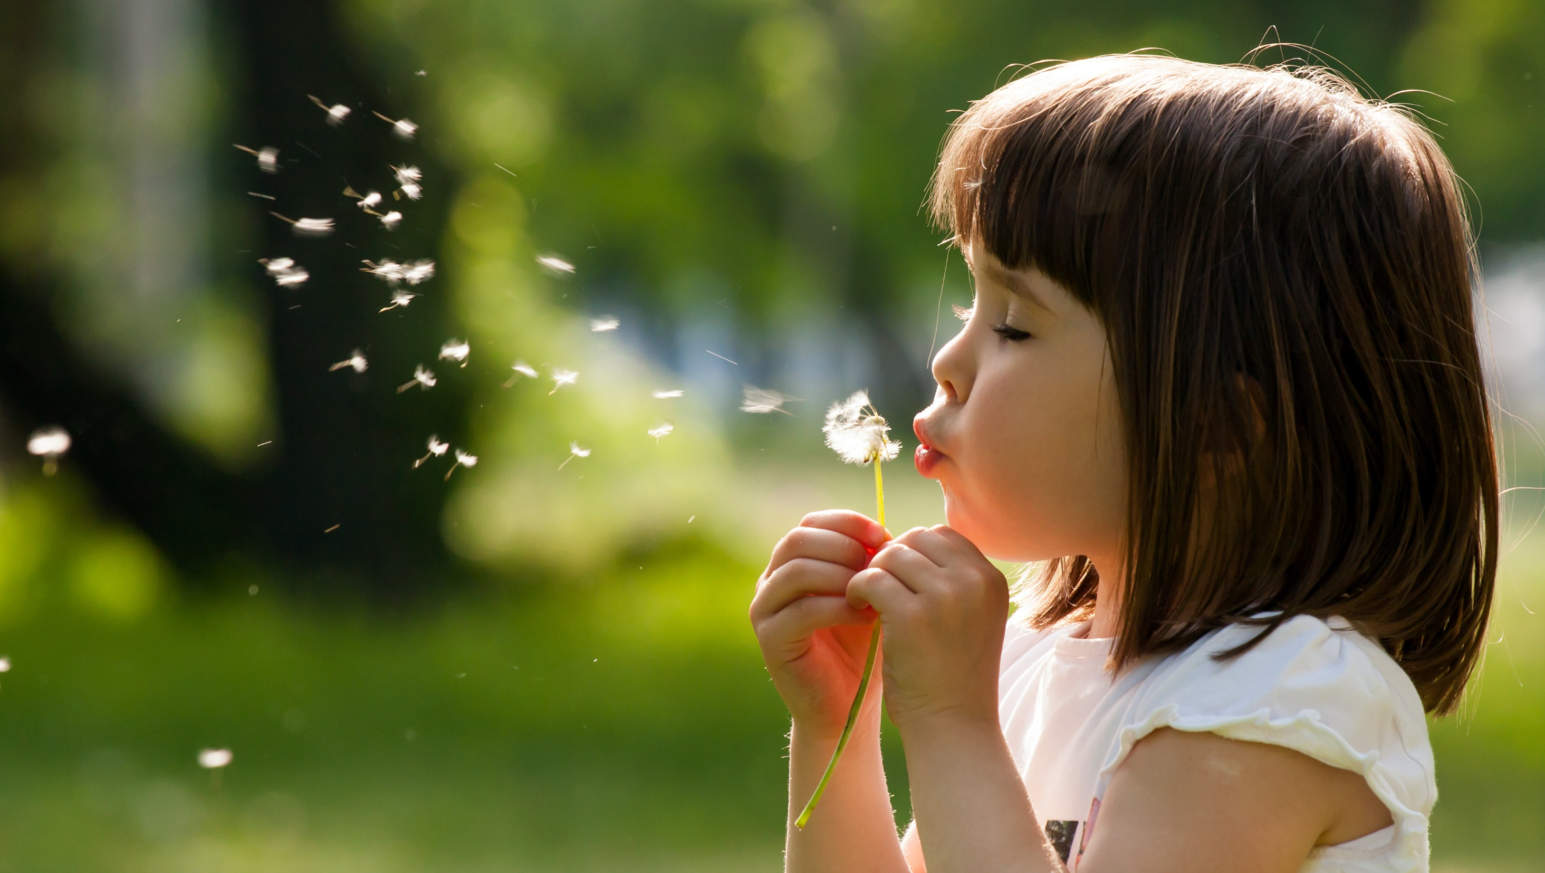
Enjoy your day!

