Slide 1



Unit 0: Introduction
Lesson B: Grammar

Slide 2
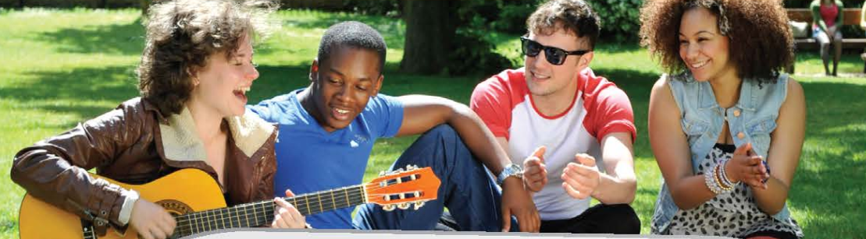

They are enjoying themselves.
The boys are wearing jeans and T-shirts
The girl on the left is playing the guitar and laughing.
What are the people doing?
Everyone is sitting on the grass and having fun.
The other people are listening to her.
www.phuongnam.edu.vn

Slide 3
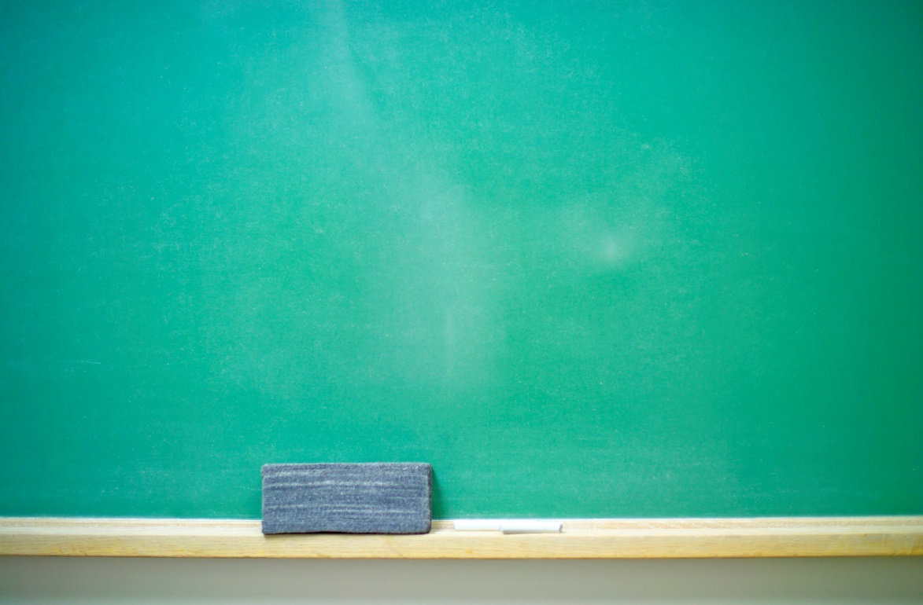


www.phuongnam.edu.vn

Slide 4

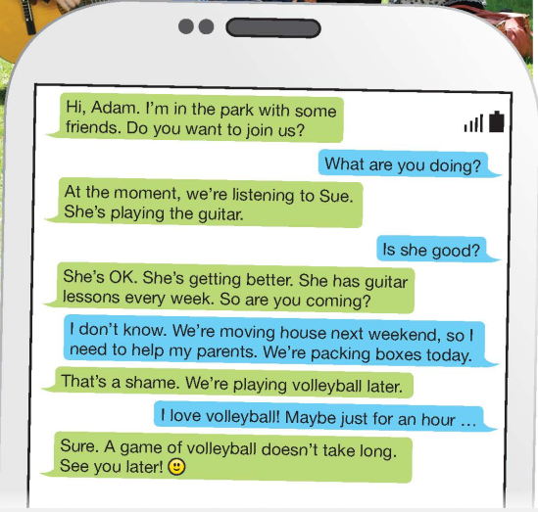
www.phuongnam.edu.vn

Slide 5


LOOK AT TWO SENTENCES. WHAT IS THE DIFFERENCE?
am
S + is + V_ing + O
are
S + V (s/es) + O
Example:
🡪 My friends and I play soccer on Sundays.
Example:
🡪 The students are learning English.
PRESENT CONTINUOUS!!!
PRESENT SIMPLE

Slide 6
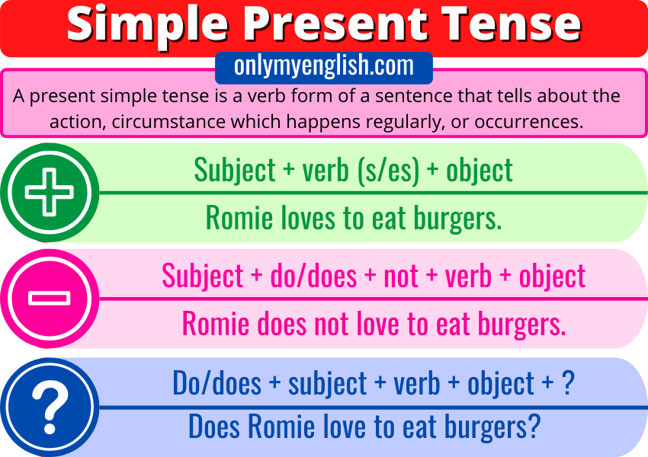
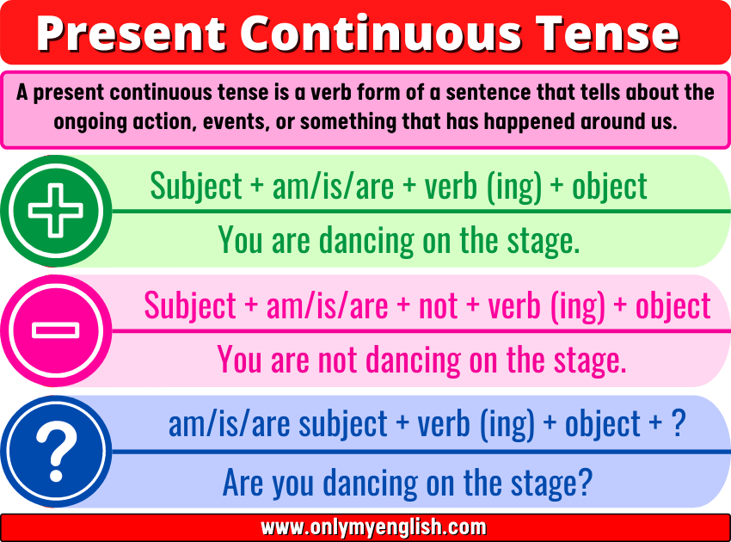
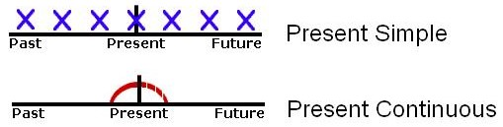

Slide 7
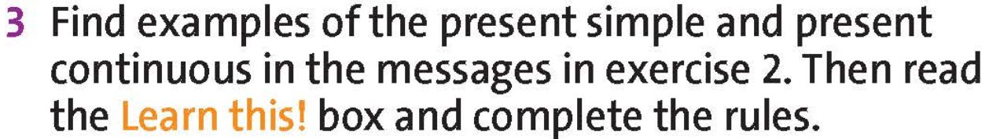
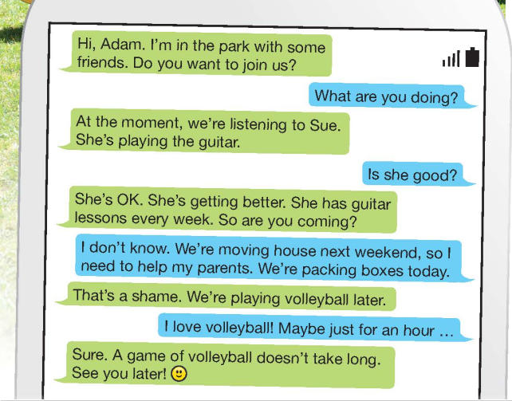
www.phuongnam.edu.vn

Slide 8
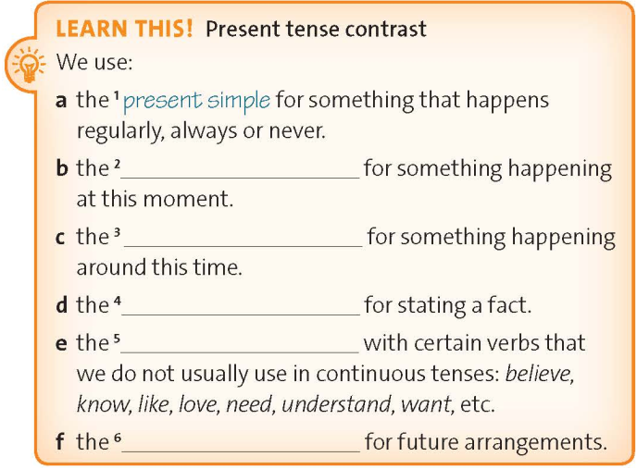
present continuous
present continuous
present simple
present simple
present continuous
www.phuongnam.edu.vn

Slide 9
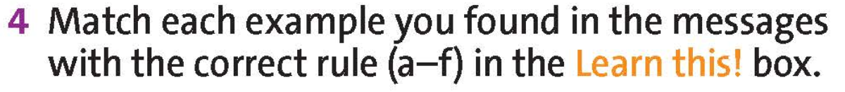
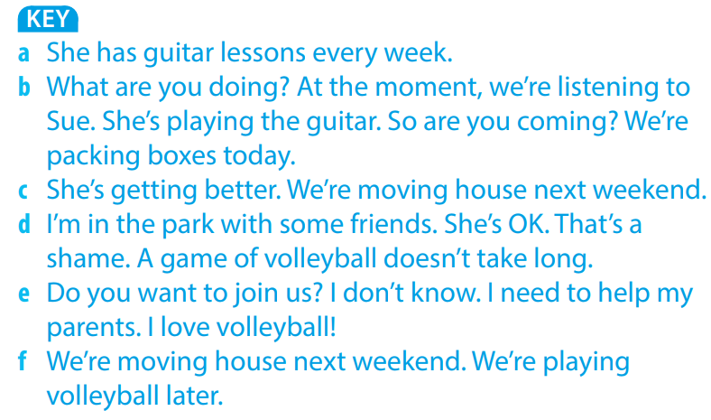

Slide 10
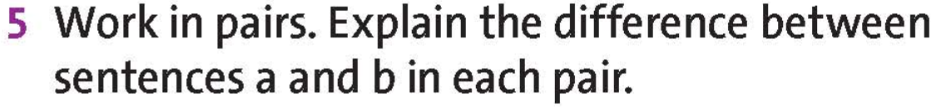
a I’m doing my homework after school.
b I do my homework after school.
a Joe is learning to drive.
b Many teenagers learn to drive when they are seventeen.
a Mark plays the guitar.
b Mark is playing the guitar.
🡪 I have arranged to do my homework after school today.
🡪 I always do my homework after school.
🡪 Joe is learning to drive at the moment,
🡪 This is a fact.
🡪 This is a fact.
🡪 He is playing the guitar at this moment.
www.phuongnam.edu.vn

Slide 11
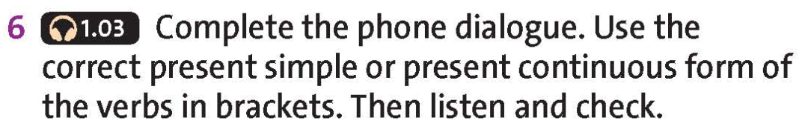

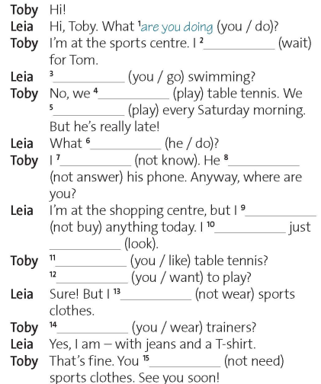
‘m waiting
Are you going
are playing
play
is he doing
don’t know
isn’t answering
‘m not buying
‘m
looking
Do you like
Do you want
‘m not wearing
Are you wearing
don’t need
www.phuongnam.edu.vn

Slide 12

Pair - Work
www.phuongnam.edu.vn

Slide 13
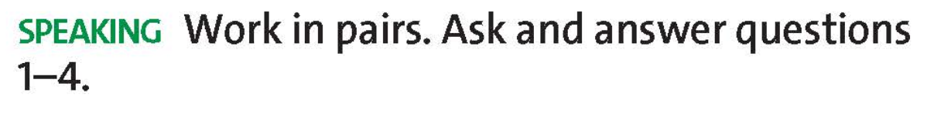
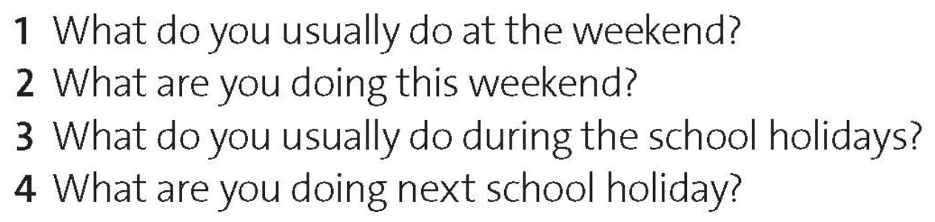
1 What do you usually do at the weekend?
2 What are you doing this weekend?
3 What do you usually do during the school holidays?
4 What are you doing next school holiday?
www.phuongnam.edu.vn

Slide 14
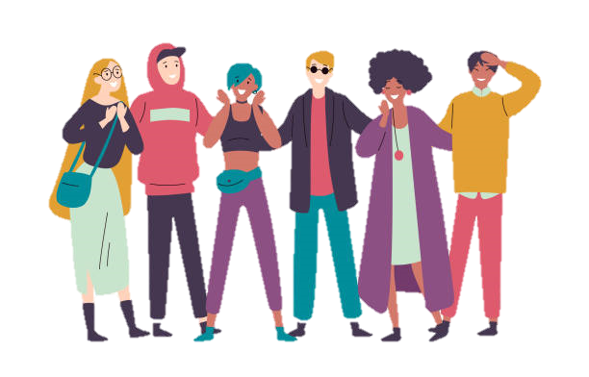
This question uses the present simple tense !!!
I usually hang out with my best friends at the weekend.

Slide 15
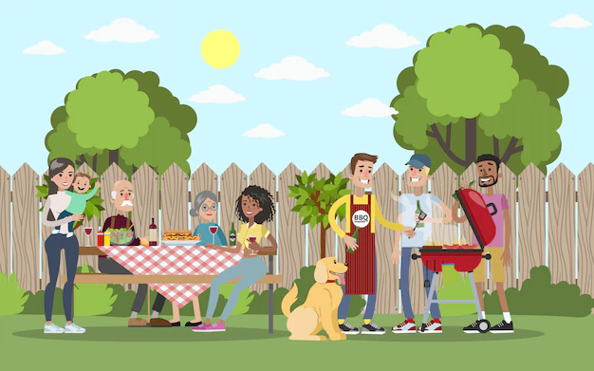
This question uses the present continuous tense !!!
I am having a BBQ party with my family.

Slide 16
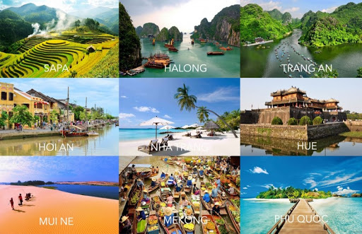
This question uses the present simple tense !!!
I usually travel to some tourist attractions in Vietnam during the school holidays.

Slide 17
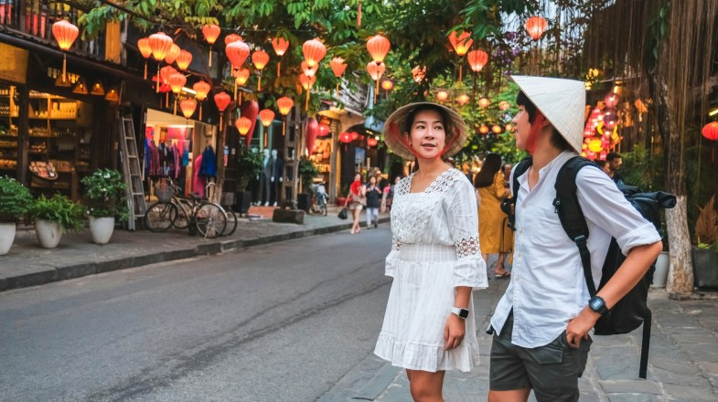
This question uses the present continuous tense !!!
I am visiting Hoi An for a few days with my cousins.

Slide 18
Homework
🏵 Learn by heart all the new words
🏵 Prepare for next lesson – vocabulary: Describing people
www.phuongnam.edu.vn

Slide 19

www.phuongnam.edu.vn

Slide 20



Thank you!
CTCP ĐẦU TƯ VÀ PHÁT TRIỂN GIÁO DỤC PHƯƠNG NAM

