Slide 1


Slide 2
GIVING WARNINGS AND RESPONDING
Unit
5
GLOBAL WARMING
Unit
FAMILY LIFE
LESSON 7
COMMUNICATION AND CULTURE / CLIL
Student Book – page 59

Slide 3
LESSON 7
COMMUNICATION AND CULTURE / CLIL
WARM-UP
Watch a video
EVERYDAY ENGLISH
Task 1: Complete the conversation.
Task 2: Make similar conversations.
CLIL
Task 1: Read and tick the pictures.
Task 2: Discussion.
CONSOLIDATION
Wrap-up
Homework

Slide 4
WARM-UP
WATCH THE VIDEO AND ANSWER THE QUESTIONS
According to the video,
Farm animals contribute less to the emission of CO2 than vehicles. True or False?
How many kilograms of plant protein are used in order to produce 1kg of animal protein?
What can we do to reduce greenhouse gas?

Slide 5

WARM-UP
WATCH A VIDEO
Notes:
https://www.youtube.com/watch?v=7I0v3LhKhQg

Slide 6
WARM-UP
According to the video,
Farm animals contribute less to the emission of CO2 than vehicles. True or False?
False

Slide 7
WARM-UP
According to the video,
2. How many kilograms of plant protein are used in order to produce 1 kilogram of animal protein?
6 kilograms

Slide 8
WARM-UP
According to the video,
3. What can we do to reduce greenhouse gas?
We can consume fewer animal products or even go meat free.

Slide 9

EVERYDAY ENGLISH
1
Listen and complete the conversation with the expressions in the box. Then practise it in pairs.
Jane: Hi, Nga. Is that a coal-burning stove?
Nga: Hi. Yes, my dad bought it last week. It heats up our home very quickly. Let me put in some more coal.
Jane: (1) __________! You’re too close and will burn yourself!
Nga: (2) __________. I’m very careful.
Jane: Yes, it feels very warm, but (3) _______________ burning coal produces soot.
Nga: Oh no, I didn’t know that. (4) ______________. I’ll tell my dad.
Watch out
Don’t worry
I must warn you
Thanks so much

Slide 10
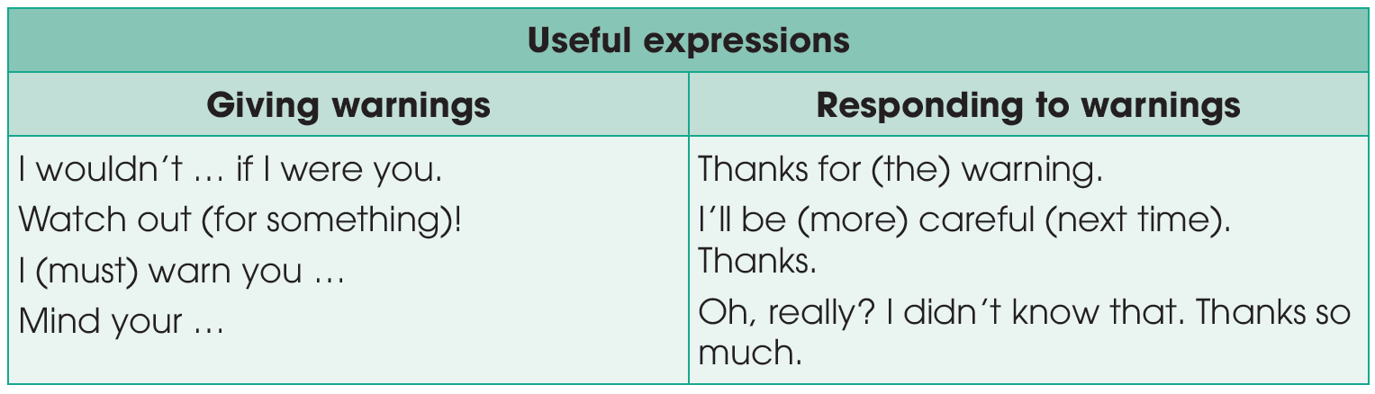
EVERYDAY ENGLISH

Slide 11
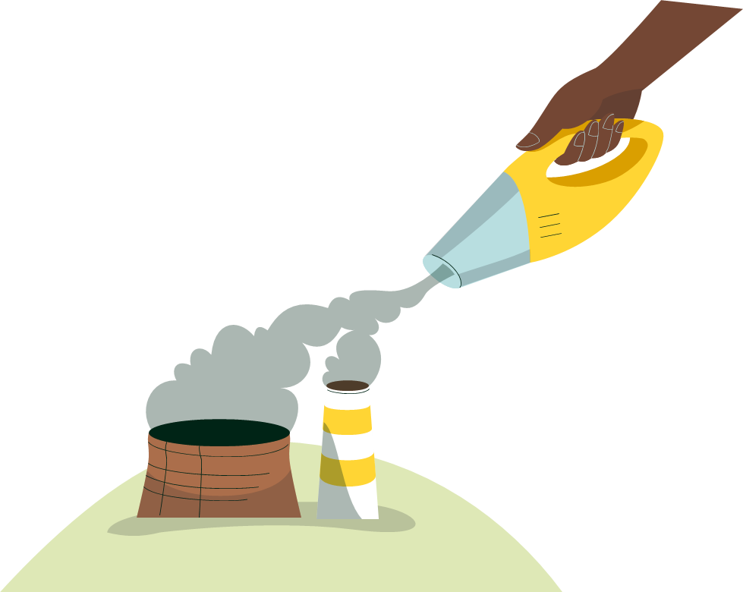
EVERYDAY ENGLISH
2
Work in pairs. Use the model in 1 to make similar conversations for these situations. One of you is Student A, the other is Student B. Use the expressions below to help you.
1. Student A is burning rubbish. Student B is warning him/her about the dangers of open waste burning to people's health and the environment.
2. Student B is building a campfire. Student A is warning him/her about the risk of starting a forest fire and the health risks.

Slide 12
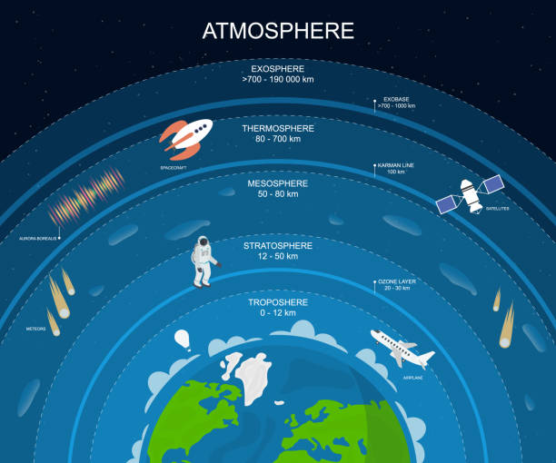
CLIL
atmosphere (n)
/ˈætməsfɪə(r)/
the mixture of gases that surrounds the earth

Slide 13
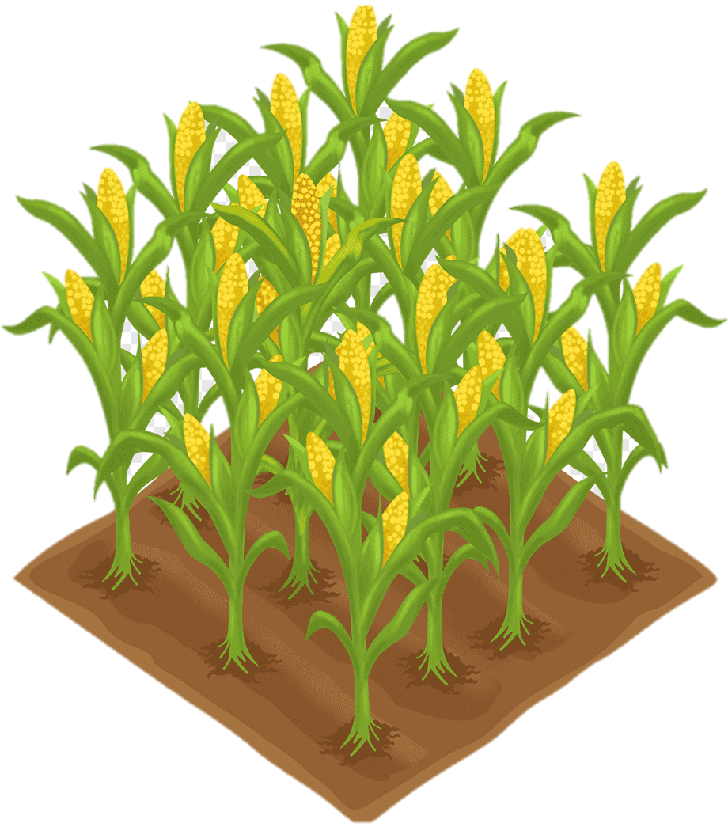
CLIL
crop (n)
/krɒp/
the amount of grain, fruit, etc. that is grown in one season

Slide 14
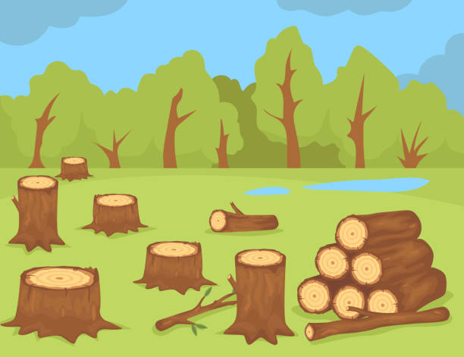
CLIL
deforestation (n)
/ˌdiːˌfɒrɪˈsteɪʃn/
the act of cutting down or burning the trees in an area

Slide 15
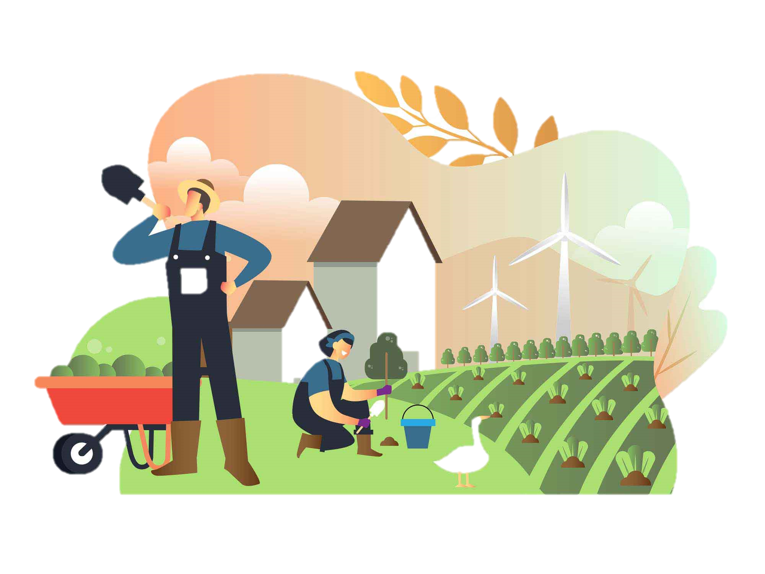
CLIL
farming (n)
/ˈfɑːmɪŋ/
the activity of working on a farm or organizing the work there

Slide 16
CLIL
Form | Pronunciation | Meaning
1. atmosphere (n) | /ˈætməsfɪə(r)/ | the mixture of gases that surrounds the earth
2. crop (n) | /krɒp/ | the amount of grain, fruit, etc. that is grown in one season
3. deforestation (n) | /ˌdiːˌfɒrɪˈsteɪʃn/ | the act of cutting down or burning the trees in an area
4. farming (n) | /ˈfɑːmɪŋ/ | the activity of working on a farm or organizing the work there

Slide 17
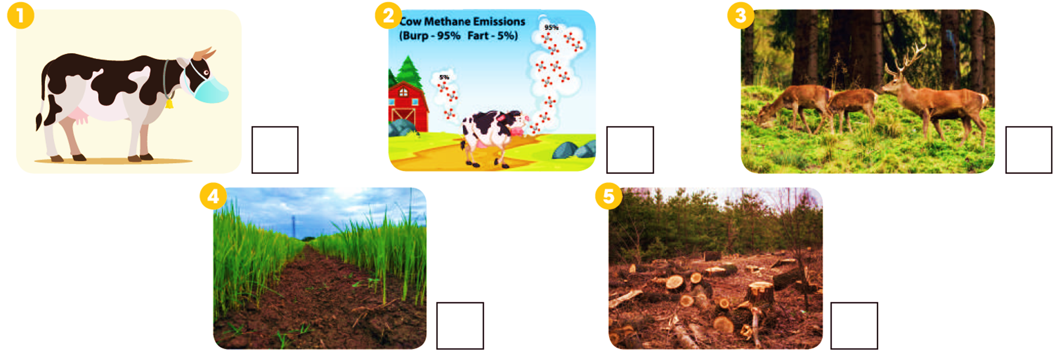
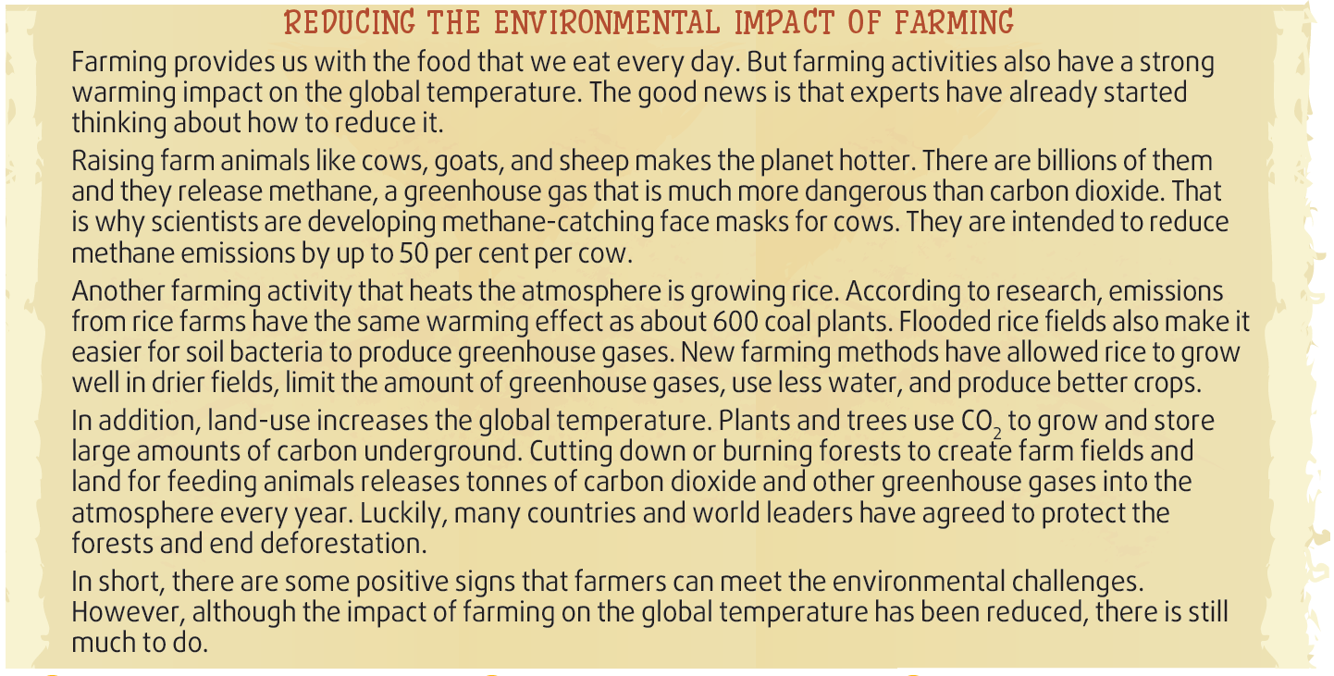
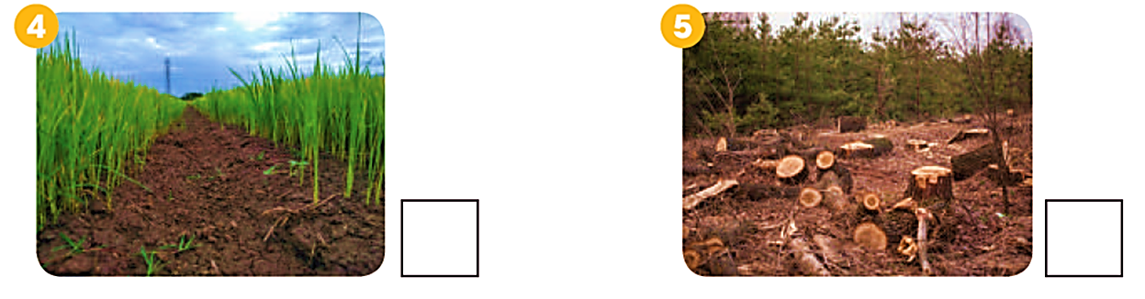
CLIL
1
Read the text and tick (✓) the pictures that show ways to reduce global warming.
✓
✓

Slide 18
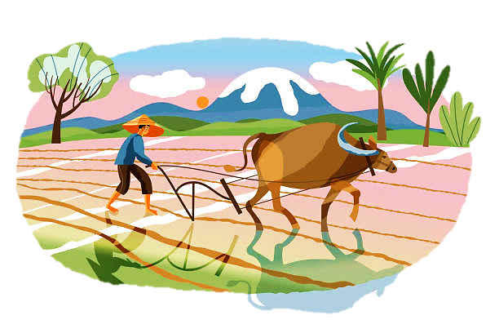
CLIL
2
Work in groups. Discuss the following questions.
What farming activities in Viet Nam do you think have negative impact on the global temperature?
What do you think are the alternatives to those activities?

Slide 19
What have you learnt today?
CONSOLIDATION
1
Wrap-up
Give warnings and respond
The environmental impact of farming and how to reduce it

Slide 20
Homework
CONSOLIDATION
2
1. Do exercises in the workbook.
2. Prepare for Lesson 8 - Unit 5

Slide 21

Website: hoclieu.vn
Fanpage: facebook.com/www.tienganhglobalsuccess.vn/

