Slide 1

Unit 9: English in the World
Lesson 3.1: Listening & Reading
Page 74

Slide 2



Lesson 3.1
Unit 9 Lesson 3.1
LESSSON OUTLINE
Consolidation

Slide 3

Unit 9 Lesson 3.1
By the end of this lesson, students will be able to…
- practice listening and reading for specific information.
- talk about benefits of speaking English.

Slide 4

Unit 9 Lesson 3.1
WARM UP

Slide 5



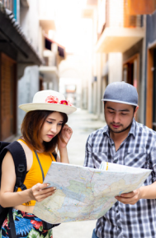


Unit 9 Lesson 3.1
Work in pairs.
Look at the pictures and discuss:
1 What are they doing?
2 What are some ways speaking English can help you?
Suggested answers:
1 They are making friends, reading books, working with foreigners, asking for direction, ordering foods and drinks.
2. Buying things, working abroad, …..

Slide 6


Unit 9 Lesson 3.1
It’s listening time….

Slide 7
Unit 9 Lesson 3.1
Pre – listening
Read the task, underline the keys words
a. Listen to Minh talking at a school career day. Choose the correct statement.
He is…
1. planning to study English.
2. happy he learned English.

Slide 8

Unit 9 Lesson 3.1
While - listening
The first time
Listen and choose the correct answer.
a. Listen to Minh talking at a school career day. Choose the correct statement.
He is…
1. planning to study English.
2. happy he learned English.
What is your answer?

Slide 9
Unit 9 Lesson 3.1
While - listening
The second time
Listen and check
I think my English score helped a lot. Finally, of course, I got a job in banking and had the chance to work in London. I'm so glad I decided to study English.
The answer is…
2. happy he learned English.

Slide 10
Unit 9 Lesson 3.1
someone who you exchange letters with as a hobby, but usually have not met.
Pre – listening
Read the task, underline the keys words.
b. Now, listen and tick (✓) the things Minh used English for
1. Buying things
2. Chatting to people in America
3. Writing to his American pen pal
4. Making friends during his homestay in Australia
5. Studying English at university
6. Working abroad
a type of holiday or
visit in which you stay in the home of a person you do not know

Slide 11
Unit 9 Lesson 3.1
While - listening
The first time
Listen and tick the correct answers.
b. Now, listen and tick (✓) the things Minh used English for
1. Buying things
2. Chatting to people in America
3. Writing to his American pen pal
4. Making friends during his homestay in Australia
5. Studying English at university
6. Working abroad
What is your answer?

Slide 12
Unit 9 Lesson 3.1
While - listening
The second time
Listen and check
...When my parents took me to America for the first time, I could buy things in English, …..
1. Buying things
✓
…but I couldn't talk to people at all…
2. Chatting to people in America
…I got a British pen pal, Tom – it was fun to write to someone and read about his daily life….
3. Writing to his American pen pal

Slide 13
Unit 9 Lesson 3.1
While - listening
Listen and check
The second time
…Later, I did a homestay in Australia and made some foreign friends…
4. Making friends during his homestay in Australia
✓
…Then, I got into a good university to study business – I think my English score helped a lot…
5. Studying English at university
…Finally, of course, I got a job in banking and had the chance to work in London…
6. Working abroad
✓

Slide 14

Unit 9 Lesson 3.1
Post - listening
Work in pairs
Do you think English is important to you? How can it help you in the future?

Slide 15
Unit 9 Lesson 3.1
Audio Scripts
M: Hi, I'm Minh. I work for an international bank. I'd like to talk about how English changed my life. When I was your age, I didn't think English was so important. When my parents took me to America for the first time, I could buy things in English, but I couldn't talk to people at all. It was a big shock! So, I decided to study harder. I got a British pen pal, Tom – it was fun to write to someone and read about his daily life. Later, I did a homestay in Australia and made some foreign friends. Then, I got into a good university to study business – I think my English score helped a lot. Finally, of course, I got a job in banking and had the chance to work in London. I'm so glad I decided to study English.

Slide 16

FURTHER PRACTICE

Slide 17


Unit 9 Lesson 3.1
Extra Practice
WB, page 54
a. Listen to a job interview. What job is Hà applying for?
1. English teacher
2. hotel worker
3. waitress
b. Now, listen and circle the correct word(s).
1. Ms. Hà wants to use English at work/work in another country.
2. The interviewer asked about her school life/work experience.
3. She is working in a restaurant/café now.
4. The customer complained about his food/drink.
5. The interviewer thinks she did/didn't do the right thing.

Slide 18


Unit 9 Lesson 3.1
It’s reading time….

Slide 19
Unit 9 Lesson 3.1
Pre - reading
Read the instruction, underline the key words.
a. Read the postcard. Which country is An visiting?

Slide 20
Unit 9 Lesson 3.1
While - reading
Skim the email to find out the answer.
Canada
Hi Kim,
I'm really enjoying myself in Vancouver. I'm practicing my English a lot and I think I'm getting better. Last week, I went to the aquarium. I took the bus there. At first, I was nervous speaking English, but now it's fun to use English to buy tickets and order food. On Saturday, I watched a hockey game. Canadians are crazy about hockey. I talked to a Canadian guy named Troy. He explained the rules of ice hockey to me. I enjoyed the game a lot more once I understood it better. He gave me his email address, so I'll write to him soon. I'm coming back to Vietnam next week – I wish I could stay longer so I could practice my English more. See you soon.
Love,
An

Slide 21
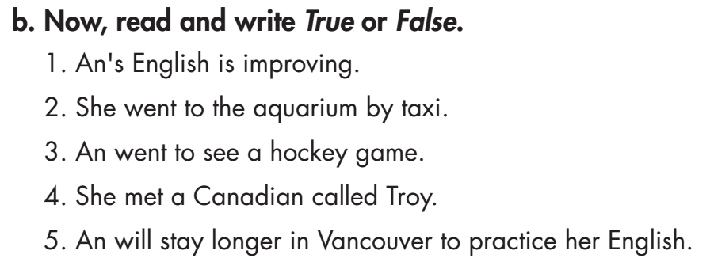
Unit 9 Lesson 3.1
Pre - reading
Read the task, underline the key words.

Slide 22
Unit 9 Lesson 3.1
While - reading
Scan the email to find out the answer.
1. An's English is improving.
True
Hi Kim,
I'm really enjoying myself in Vancouver. I'm practicing my English a lot and I think I'm getting better. Last week, I went to the aquarium. I took the bus there. At first, I was nervous speaking English, but now it's fun to use English to buy tickets and order food. On Saturday, I watched a hockey game. Canadians are crazy about hockey. I talked to a Canadian guy named Troy. He explained the rules of ice hockey to me. I enjoyed the game a lot more once I understood it better. He gave me his email address, so I'll write to him soon. I'm coming back to Vietnam next week – I wish I could stay longer so I could practice my English more. See you soon.
Love,
An

Slide 23
Unit 9 Lesson 3.1
While - reading
Scan the email to find out the answer
2. She went to the aquarium by taxi.
False
Hi Kim,
I'm really enjoying myself in Vancouver. I'm practicing my English a lot and I think I'm getting better. Last week, I went to the aquarium. I took the bus there. At first, I was nervous speaking English, but now it's fun to use English to buy tickets and order food. On Saturday, I watched a hockey game. Canadians are crazy about hockey. I talked to a Canadian guy named Troy. He explained the rules of ice hockey to me. I enjoyed the game a lot more once I understood it better. He gave me his email address, so I'll write to him soon. I'm coming back to Vietnam next week – I wish I could stay longer so I could practice my English more. See you soon.
Love,
An

Slide 24
Unit 9 Lesson 3.1
While - reading
Scan the email to find out the answer
3. An went to see a hockey game.
True
Hi Kim,
I'm really enjoying myself in Vancouver. I'm practicing my English a lot and I think I'm getting better. Last week, I went to the aquarium. I took the bus there. At first, I was nervous speaking English, but now it's fun to use English to buy tickets and order food. On Saturday, I watched a hockey game. Canadians are crazy about hockey. I talked to a Canadian guy named Troy. He explained the rules of ice hockey to me. I enjoyed the game a lot more once I understood it better. He gave me his email address, so I'll write to him soon. I'm coming back to Vietnam next week – I wish I could stay longer so I could practice my English more. See you soon.
Love,
An

Slide 25
Unit 9 Lesson 3.1
While - reading
Scan the email to find out the answer
4. She met a Canadian called Troy.
True
Hi Kim,
I'm really enjoying myself in Vancouver. I'm practicing my English a lot and I think I'm getting better. Last week, I went to the aquarium. I took the bus there. At first, I was nervous speaking English, but now it's fun to use English to buy tickets and order food. On Saturday, I watched a hockey game. Canadians are crazy about hockey. I talked to a Canadian guy named Troy. He explained the rules of ice hockey to me. I enjoyed the game a lot more once I understood it better. He gave me his email address, so I'll write to him soon. I'm coming back to Vietnam next week – I wish I could stay longer so I could practice my English more. See you soon.
Love,
An

Slide 26
Unit 9 Lesson 3.1
While - reading
Scan the email to find out the answer
5. An will stay longer in Vancouver to practice her English.
False
Hi Kim,
I'm really enjoying myself in Vancouver. I'm practicing my English a lot and I think I'm getting better. Last week, I went to the aquarium. I took the bus there. At first, I was nervous speaking English, but now it's fun to use English to buy tickets and order food. On Saturday, I watched a hockey game. Canadians are crazy about hockey. I talked to a Canadian guy named Troy. He explained the rules of ice hockey to me. I enjoyed the game a lot more once I understood it better. He gave me his email address, so I'll write to him soon. I'm coming back to Vietnam next week – I wish I could stay longer so I could practice my English more. See you soon.
Love,
An

Slide 27
Unit 9 Lesson 3.1
Unit 9 Lesson 3.1
Post - reading
Work in pairs
Would you like to visit an English-speaking country? Which one?
What problems do you think you would have?

Slide 28
FURTHER PRACTICE

Slide 29

Unit 9 Lesson 3.1
Extra Practice
WB, page 54
a. Read Hảo's postcard. Is he enjoying his vacation?
1. Yes 2. No
Hey Phương,
I'm having a really nice vacation in Cambridge. I'm staying at a hotel near King's College. I was worried about speaking English when I arrived here. But when I checked in to the hotel, I answered all their questions OK. Later, I went out for dinner. I asked the waiter to explain the menu. He spoke slowly so I understood everything! Cambridge is so beautiful. I did have one big problem, though. Yesterday, I left my bag on the bus! I went to the bus station to ask for help. It was difficult to explain, but… I got my bag back! I was so happy. It's fun to use English with native speakers. I'm taking a ride on a punt tomorrow. It's a special boat that people ride on the river here.
See you soon!

Slide 30
Unit 9 Lesson 3.1
b. Now, read and fill in the blanks.
Extra Practice
WB, page 54
1. Hảo is staying in ______________.
2. He answered some questions at the _______________.
3. He asked a ______________ to help him understand the menu.
Cambridge
hotel
waiter
Hey Phương,
I'm having a really nice vacation in Cambridge. I'm staying at a hotel near King's College. I was worried about speaking English when I arrived here. But when I checked in to the hotel, I answered all their questions OK. Later, I went out for dinner. I asked the waiter to explain the menu. He spoke slowly so I understood everything! Cambridge is so beautiful. I did have one big problem, though.

Slide 31
Unit 9 Lesson 3.1
b. Now, read and fill in the blanks.
on the bus
4. He left his bag ______________.
5. He's going on a boat trip ______________.
tomorrow
Cambridge is so beautiful. I did have one big problem, though. Yesterday, I left my bag on the bus! I went to the bus station to ask for help. It was difficult to explain, but… I got my bag back! I was so happy. It's fun to use English with native speakers. I'm taking a ride on a punt tomorrow. It's a special boat that people ride on the river here.
See you soon!
Extra Practice
WB, page 54

Slide 32

Unit 9 Lesson 3.1
CONSOLIDATION

Slide 33
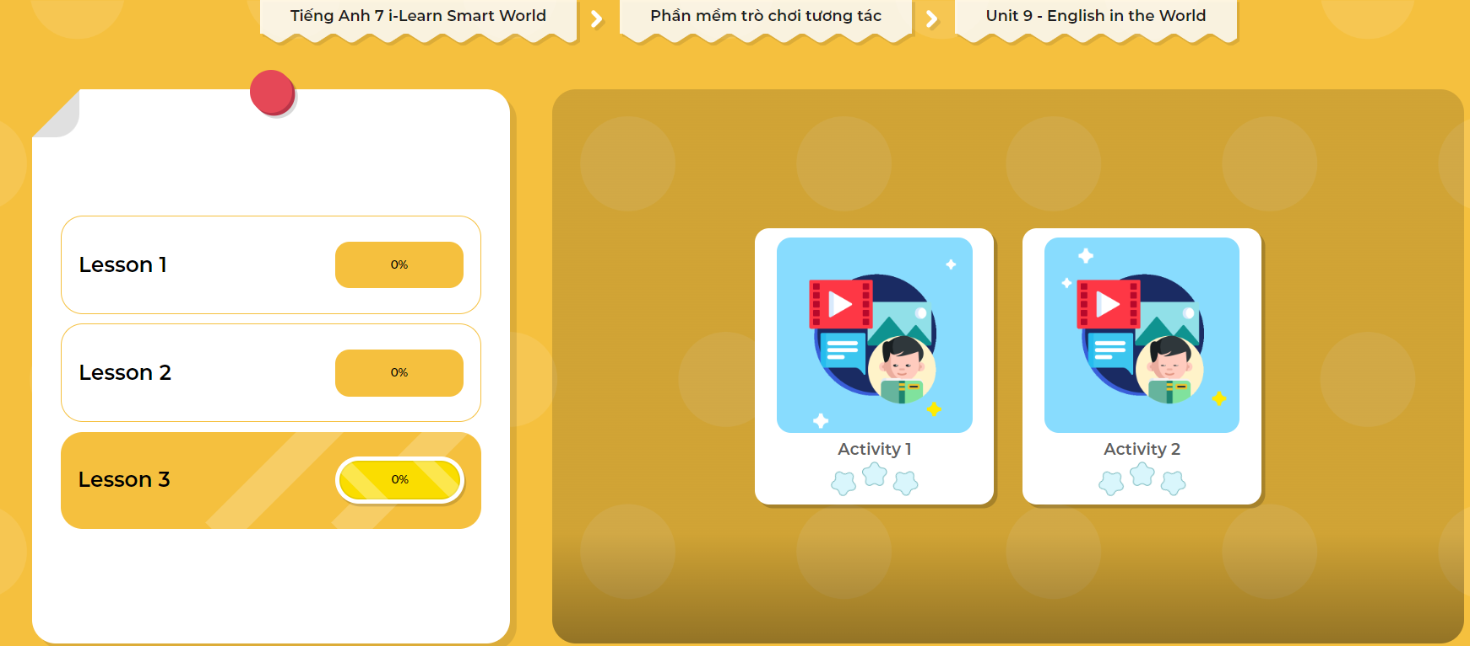
LET’S PLAY!
Click here to play the games!

Slide 34
Unit 9 Lesson 3.1
Write a paragraph about what you would like to do in an English-speaking country. (60-80 words)

Slide 35

WRAP-UP

Slide 36
Today’s lesson
Listening:
- Listen for gist and recognize the correct/ incorrect information
Reading:
- Skim and scan for general and specific information

Slide 37
Homework
Learn by hearts vocabularies and make sentences using them.
Do the Reading exercise on page 54 WB (Reading).
Do the exercise in Tiếng Anh 7 i-Learn Smart World Notebook (page 58)
Prepare the next lesson (page 75 SB).
Play the consolidation games in Tiếng Anh 7 i-Learn Smart World DHA App on www.eduhome.com.vn

Slide 38

Lesson 3
Stay positive and have a nice day!

