Slide 1

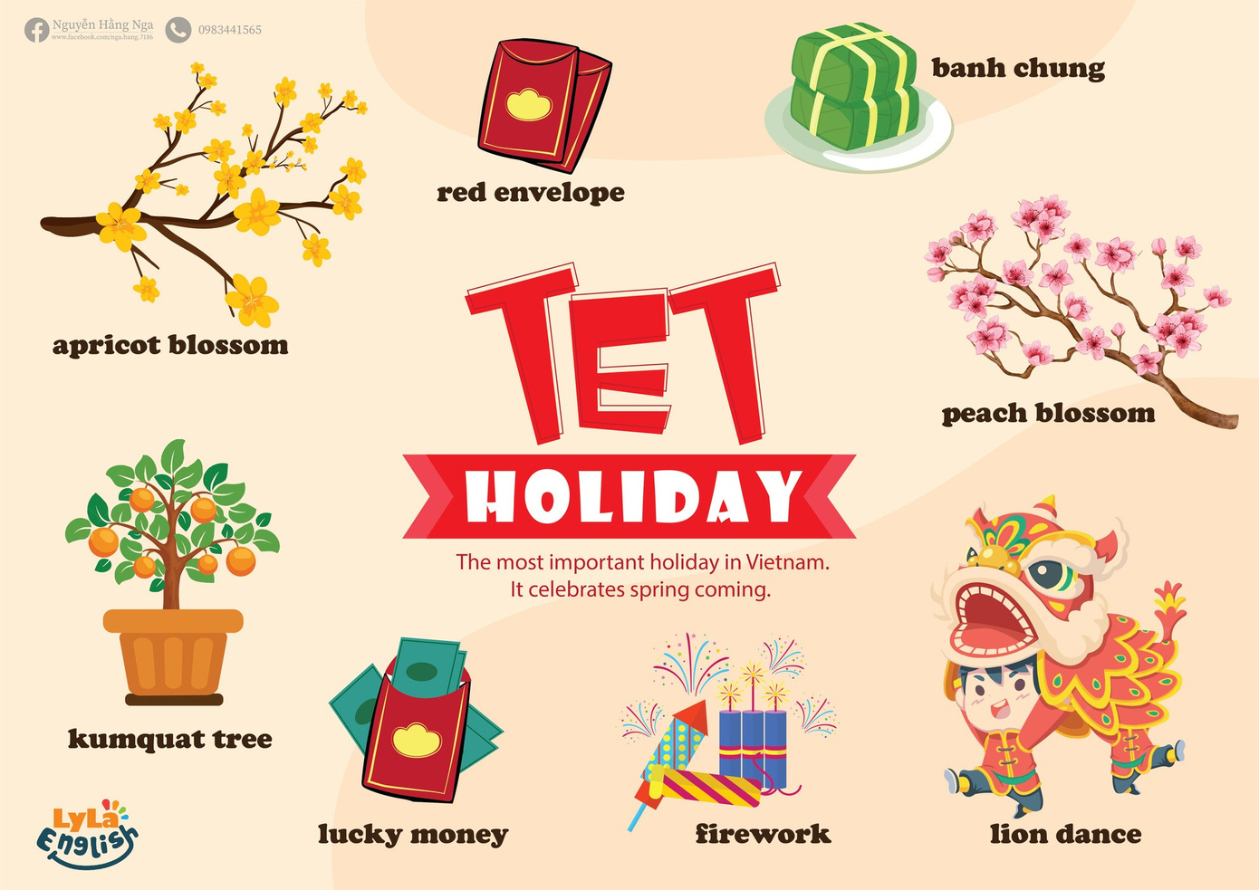


Slide 2

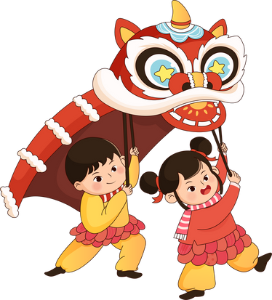
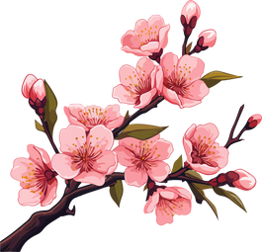

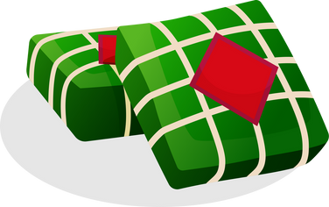

I. QUESTION
1.What do you see on Tet Holiday?
- I see….
2. What flower do you see?
- I see ... and ...
3. What cake do you eat?
-I eat ...
4. What shape is the Banh Chung?
- It’s ...

Slide 3
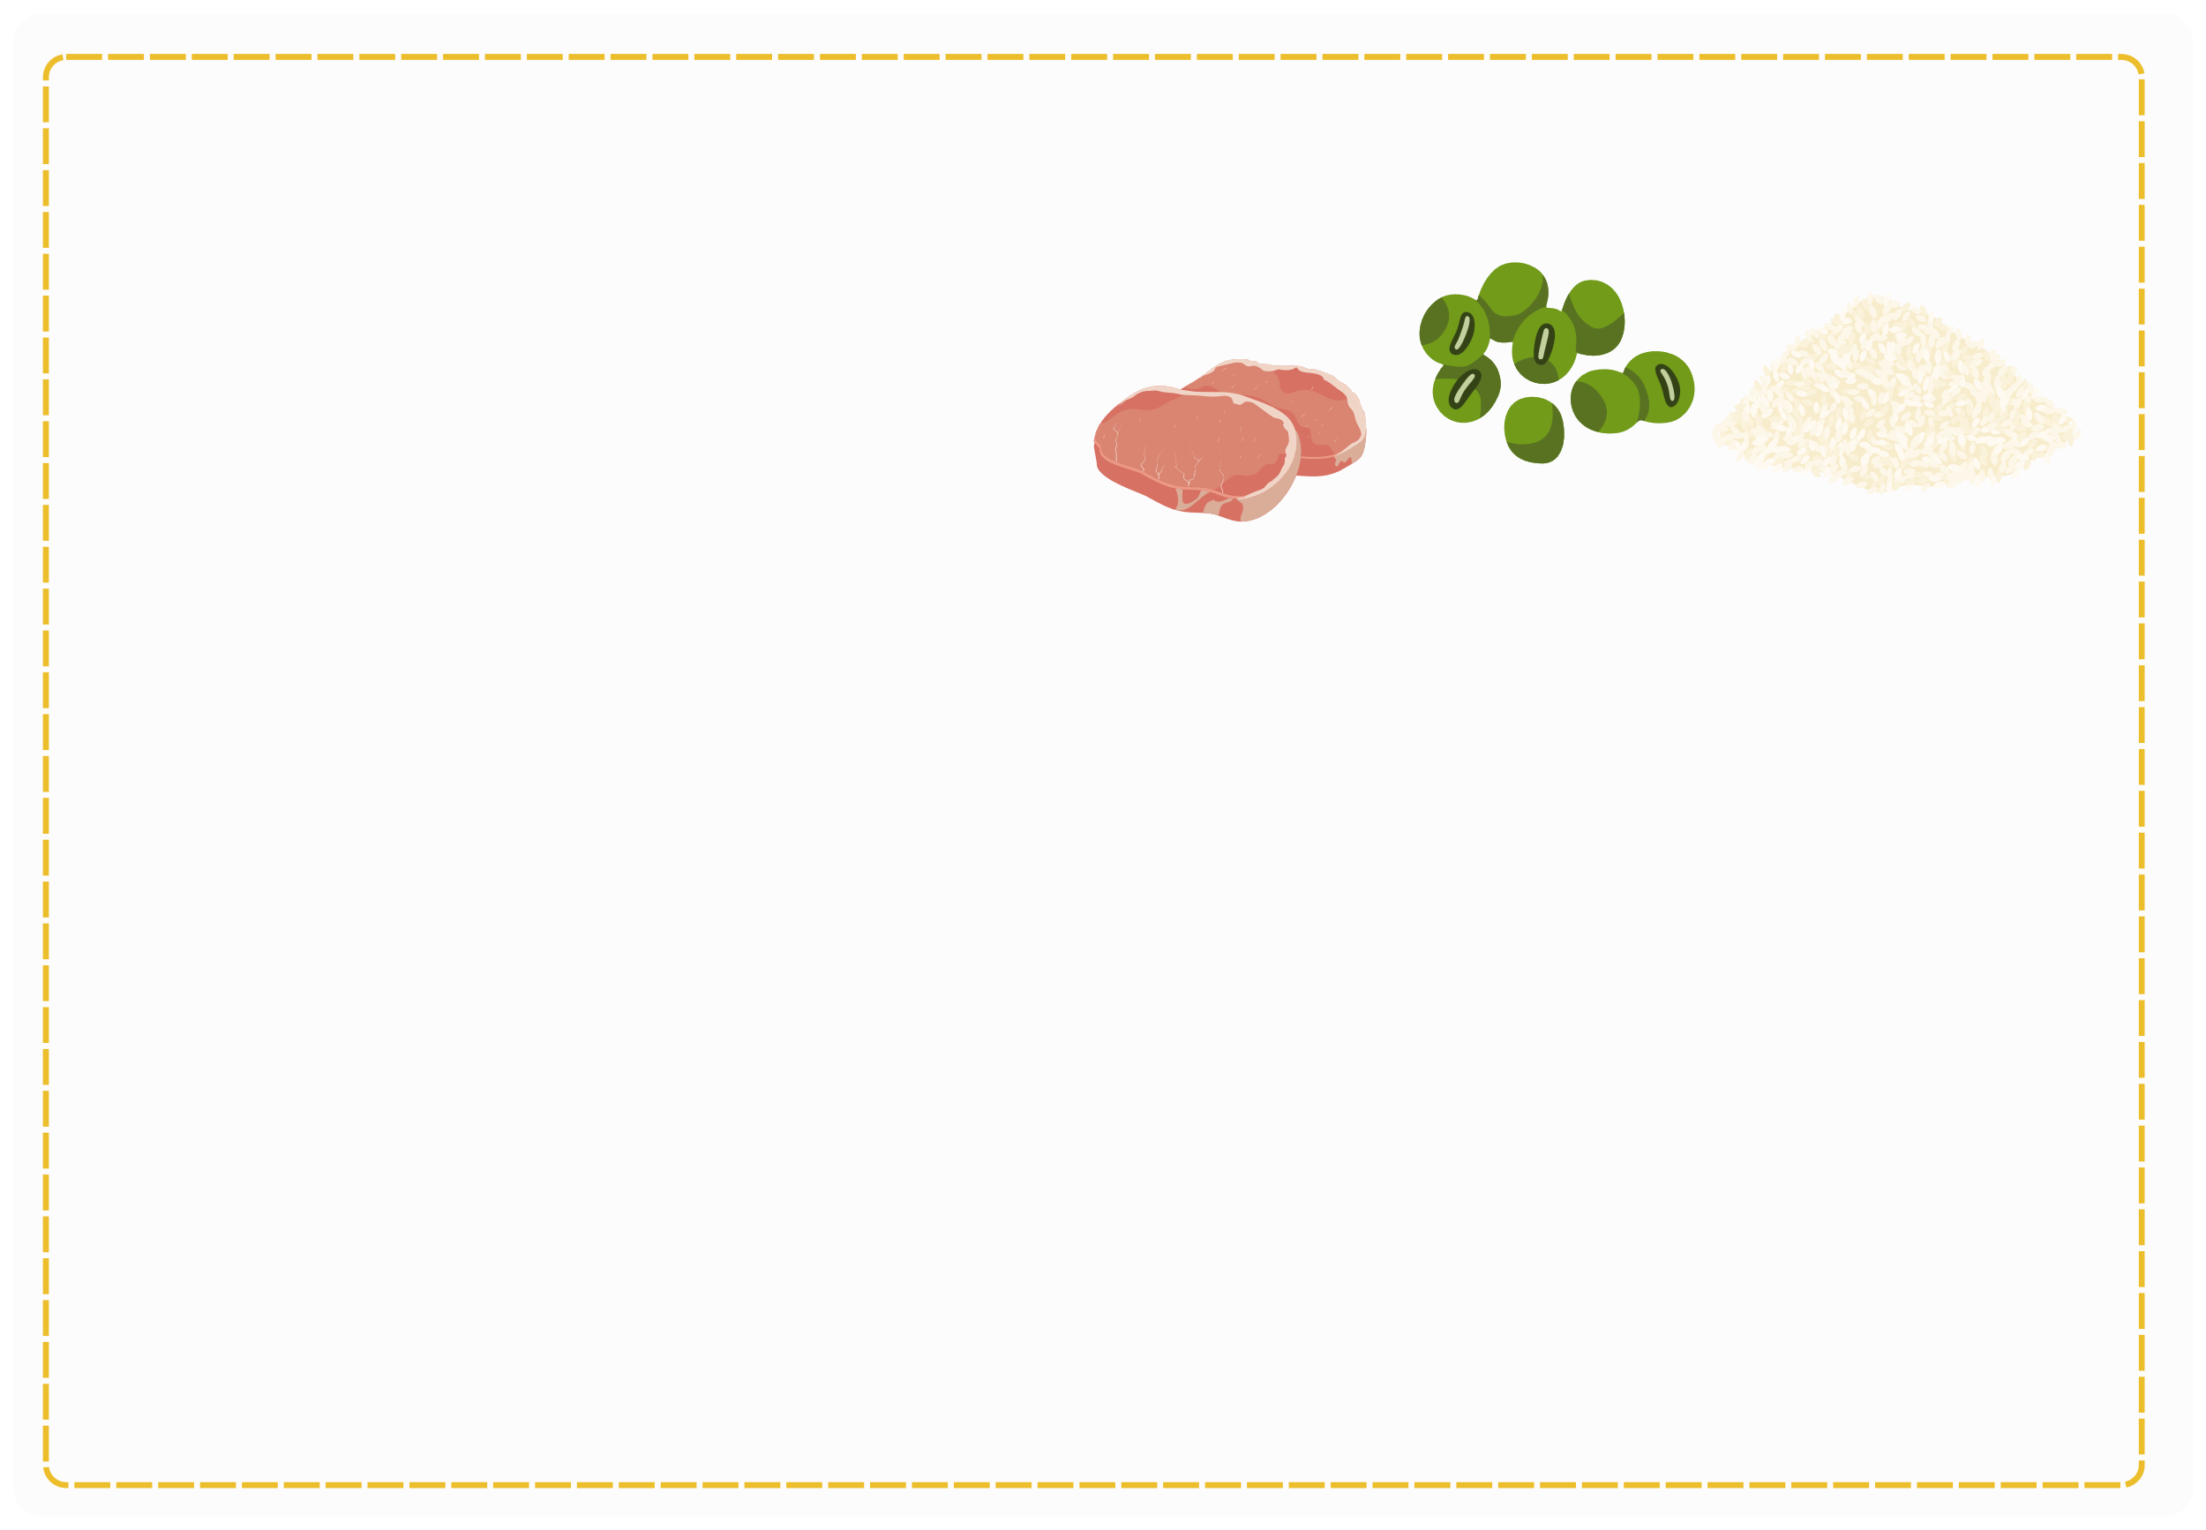
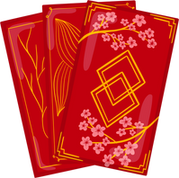

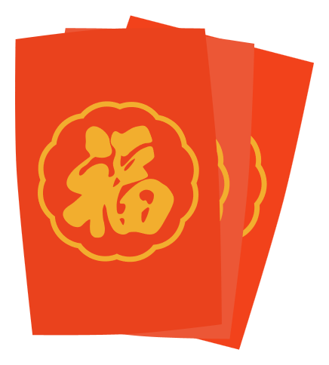
I. QUESTION
5. What do you see inside Banh Chung? - I see pork, bean, sticky rice.
6. What do you get on Tet Holiday? - I get red envelop.
7. What do you see inside red envelop? - It’s lucky money.

Slide 4

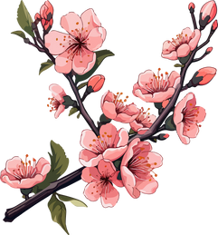
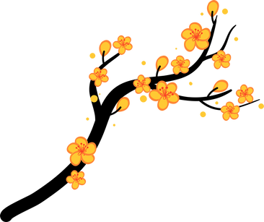
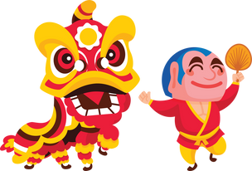

II. VOCABULARY
Peach blossom:..............................................
Apricot blossom:..............................................
Lion dance:......................................................
Firework:........................................................

Slide 5



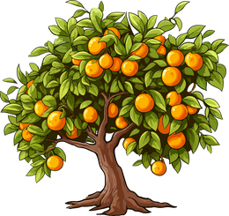
II. VOCABULARY
Red envelop:...................................................
Lucky money:..................................................
Kumquat tree:.................................................

Slide 6
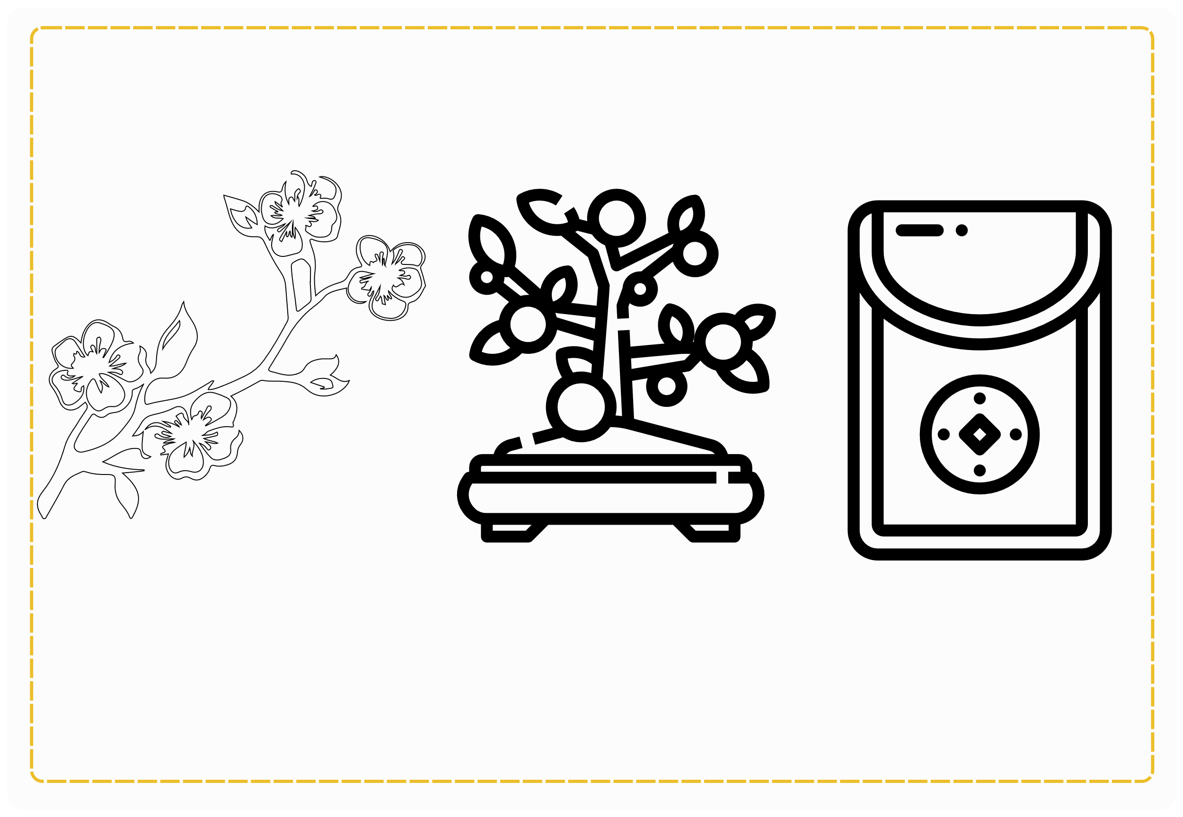
III. EXERCISES:
1. Read and color:
Peach blossom
kumquat tree
Red envelop

Slide 7
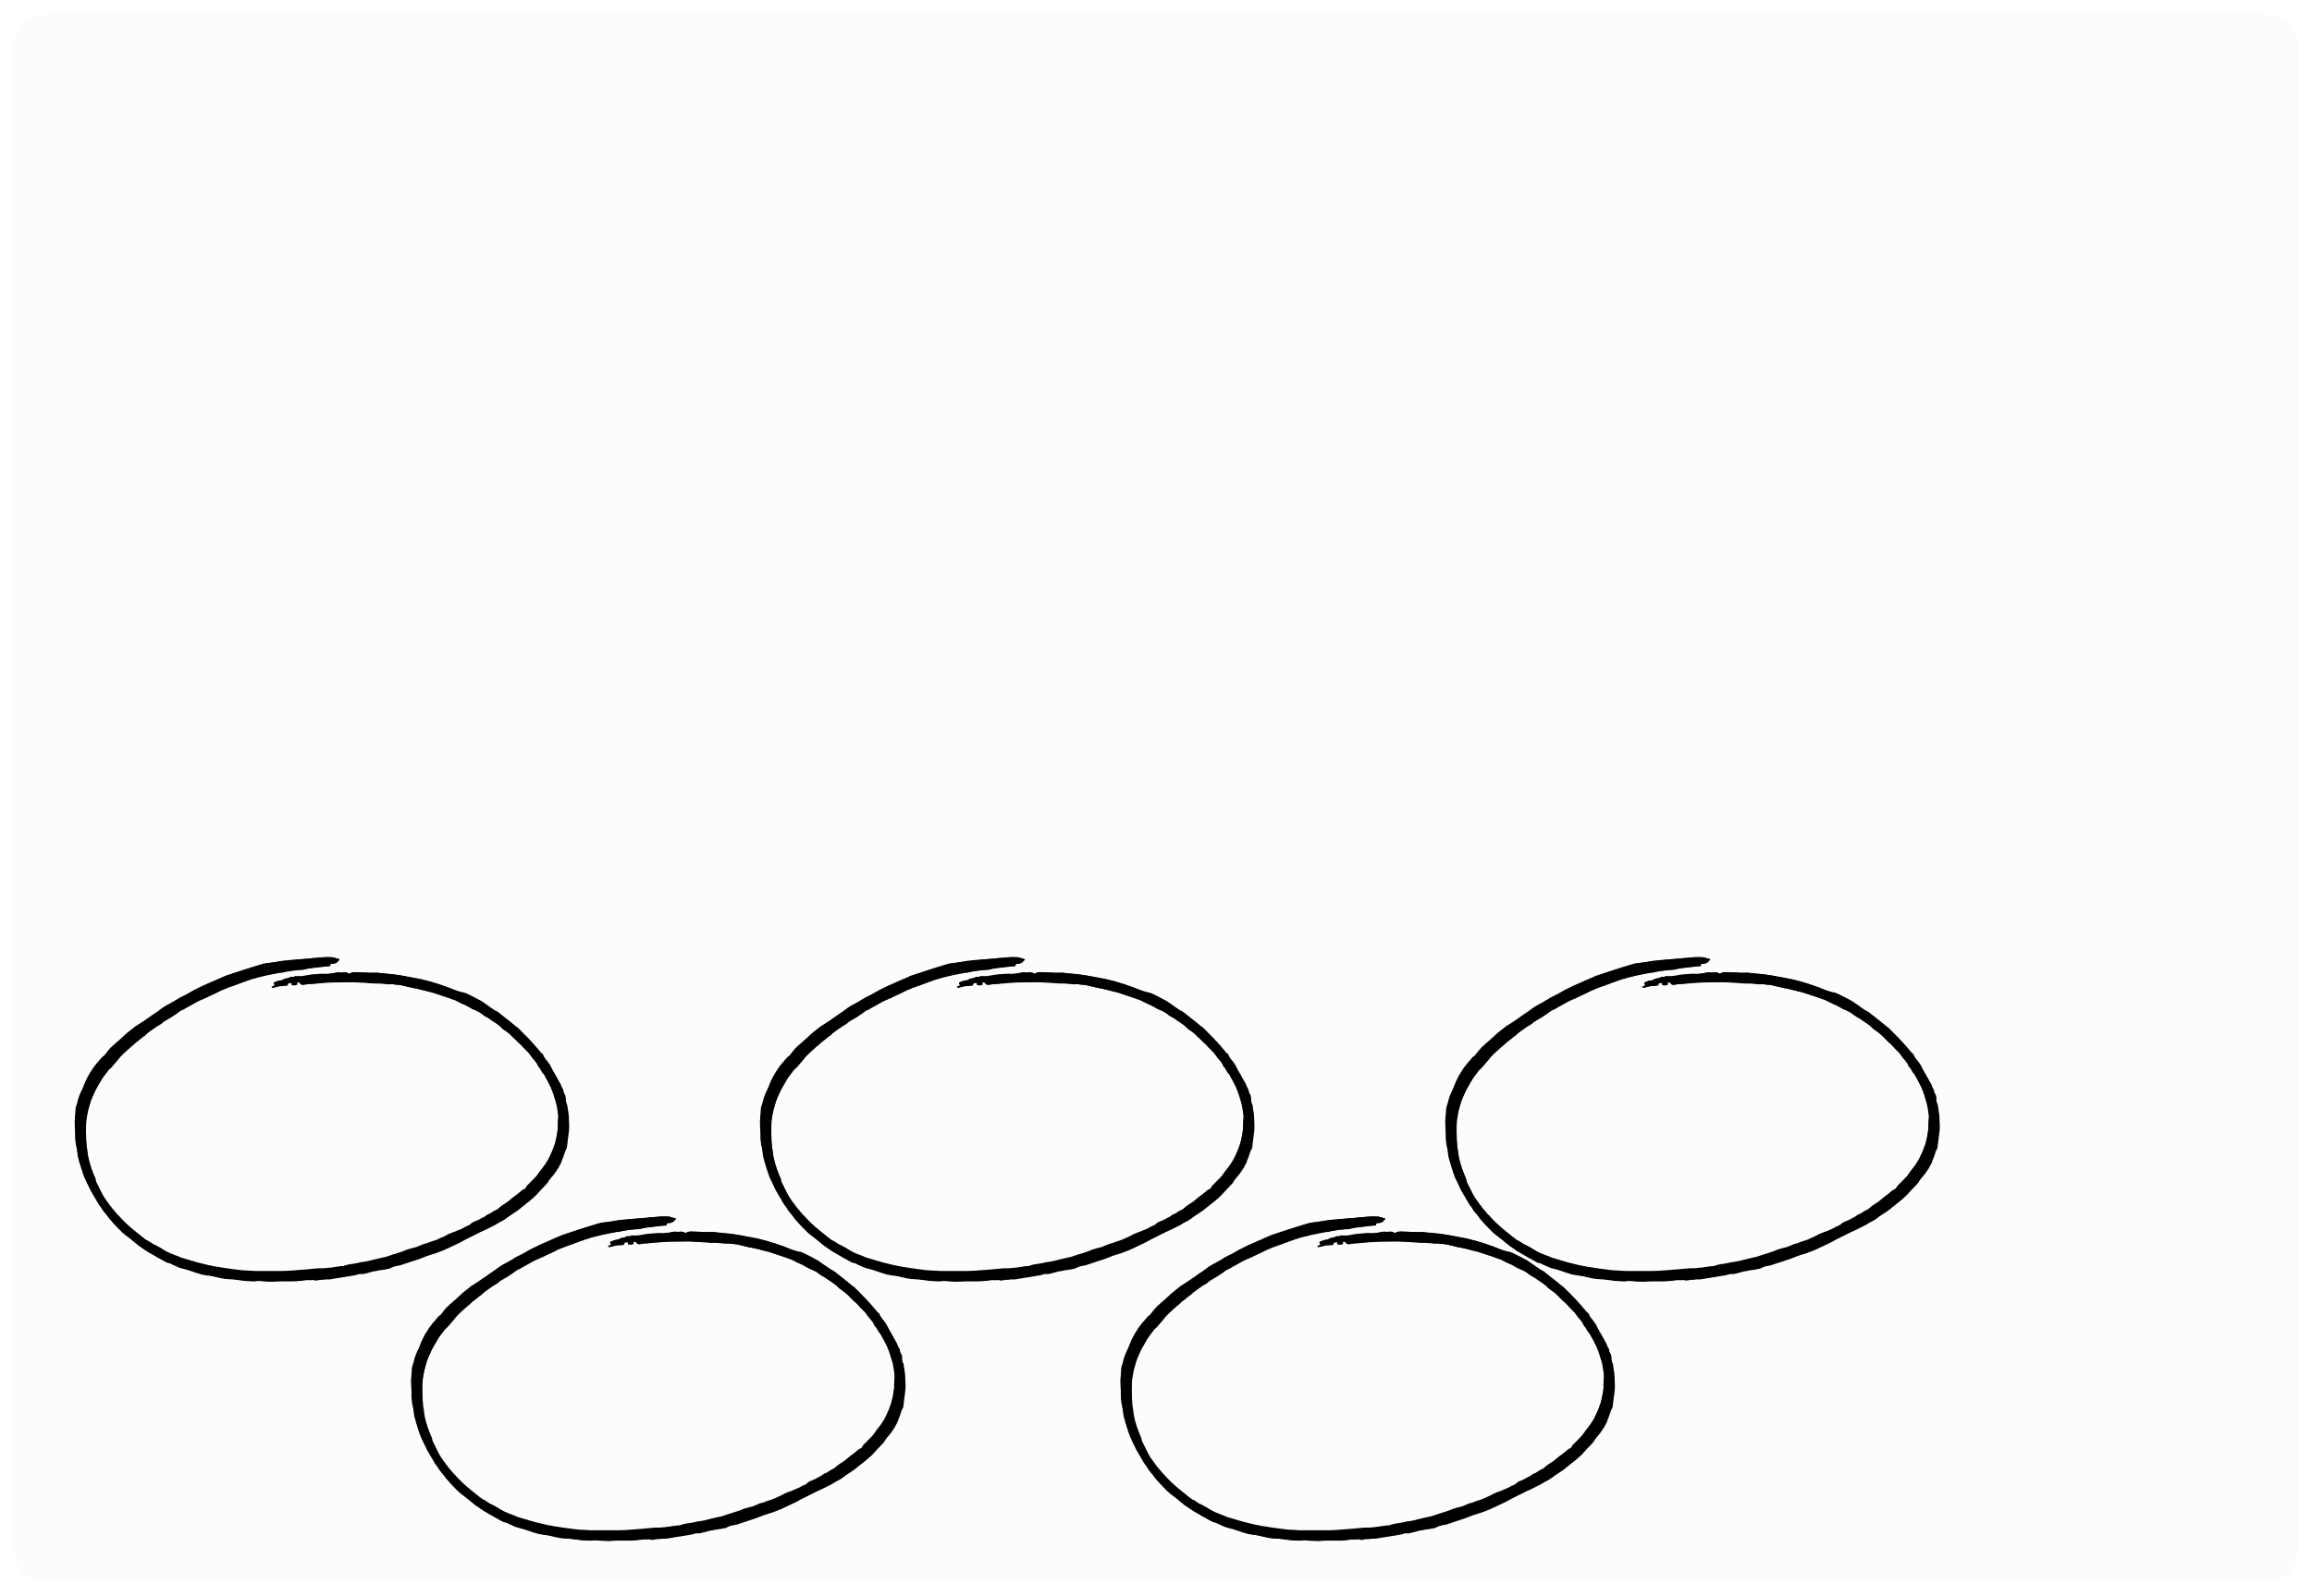
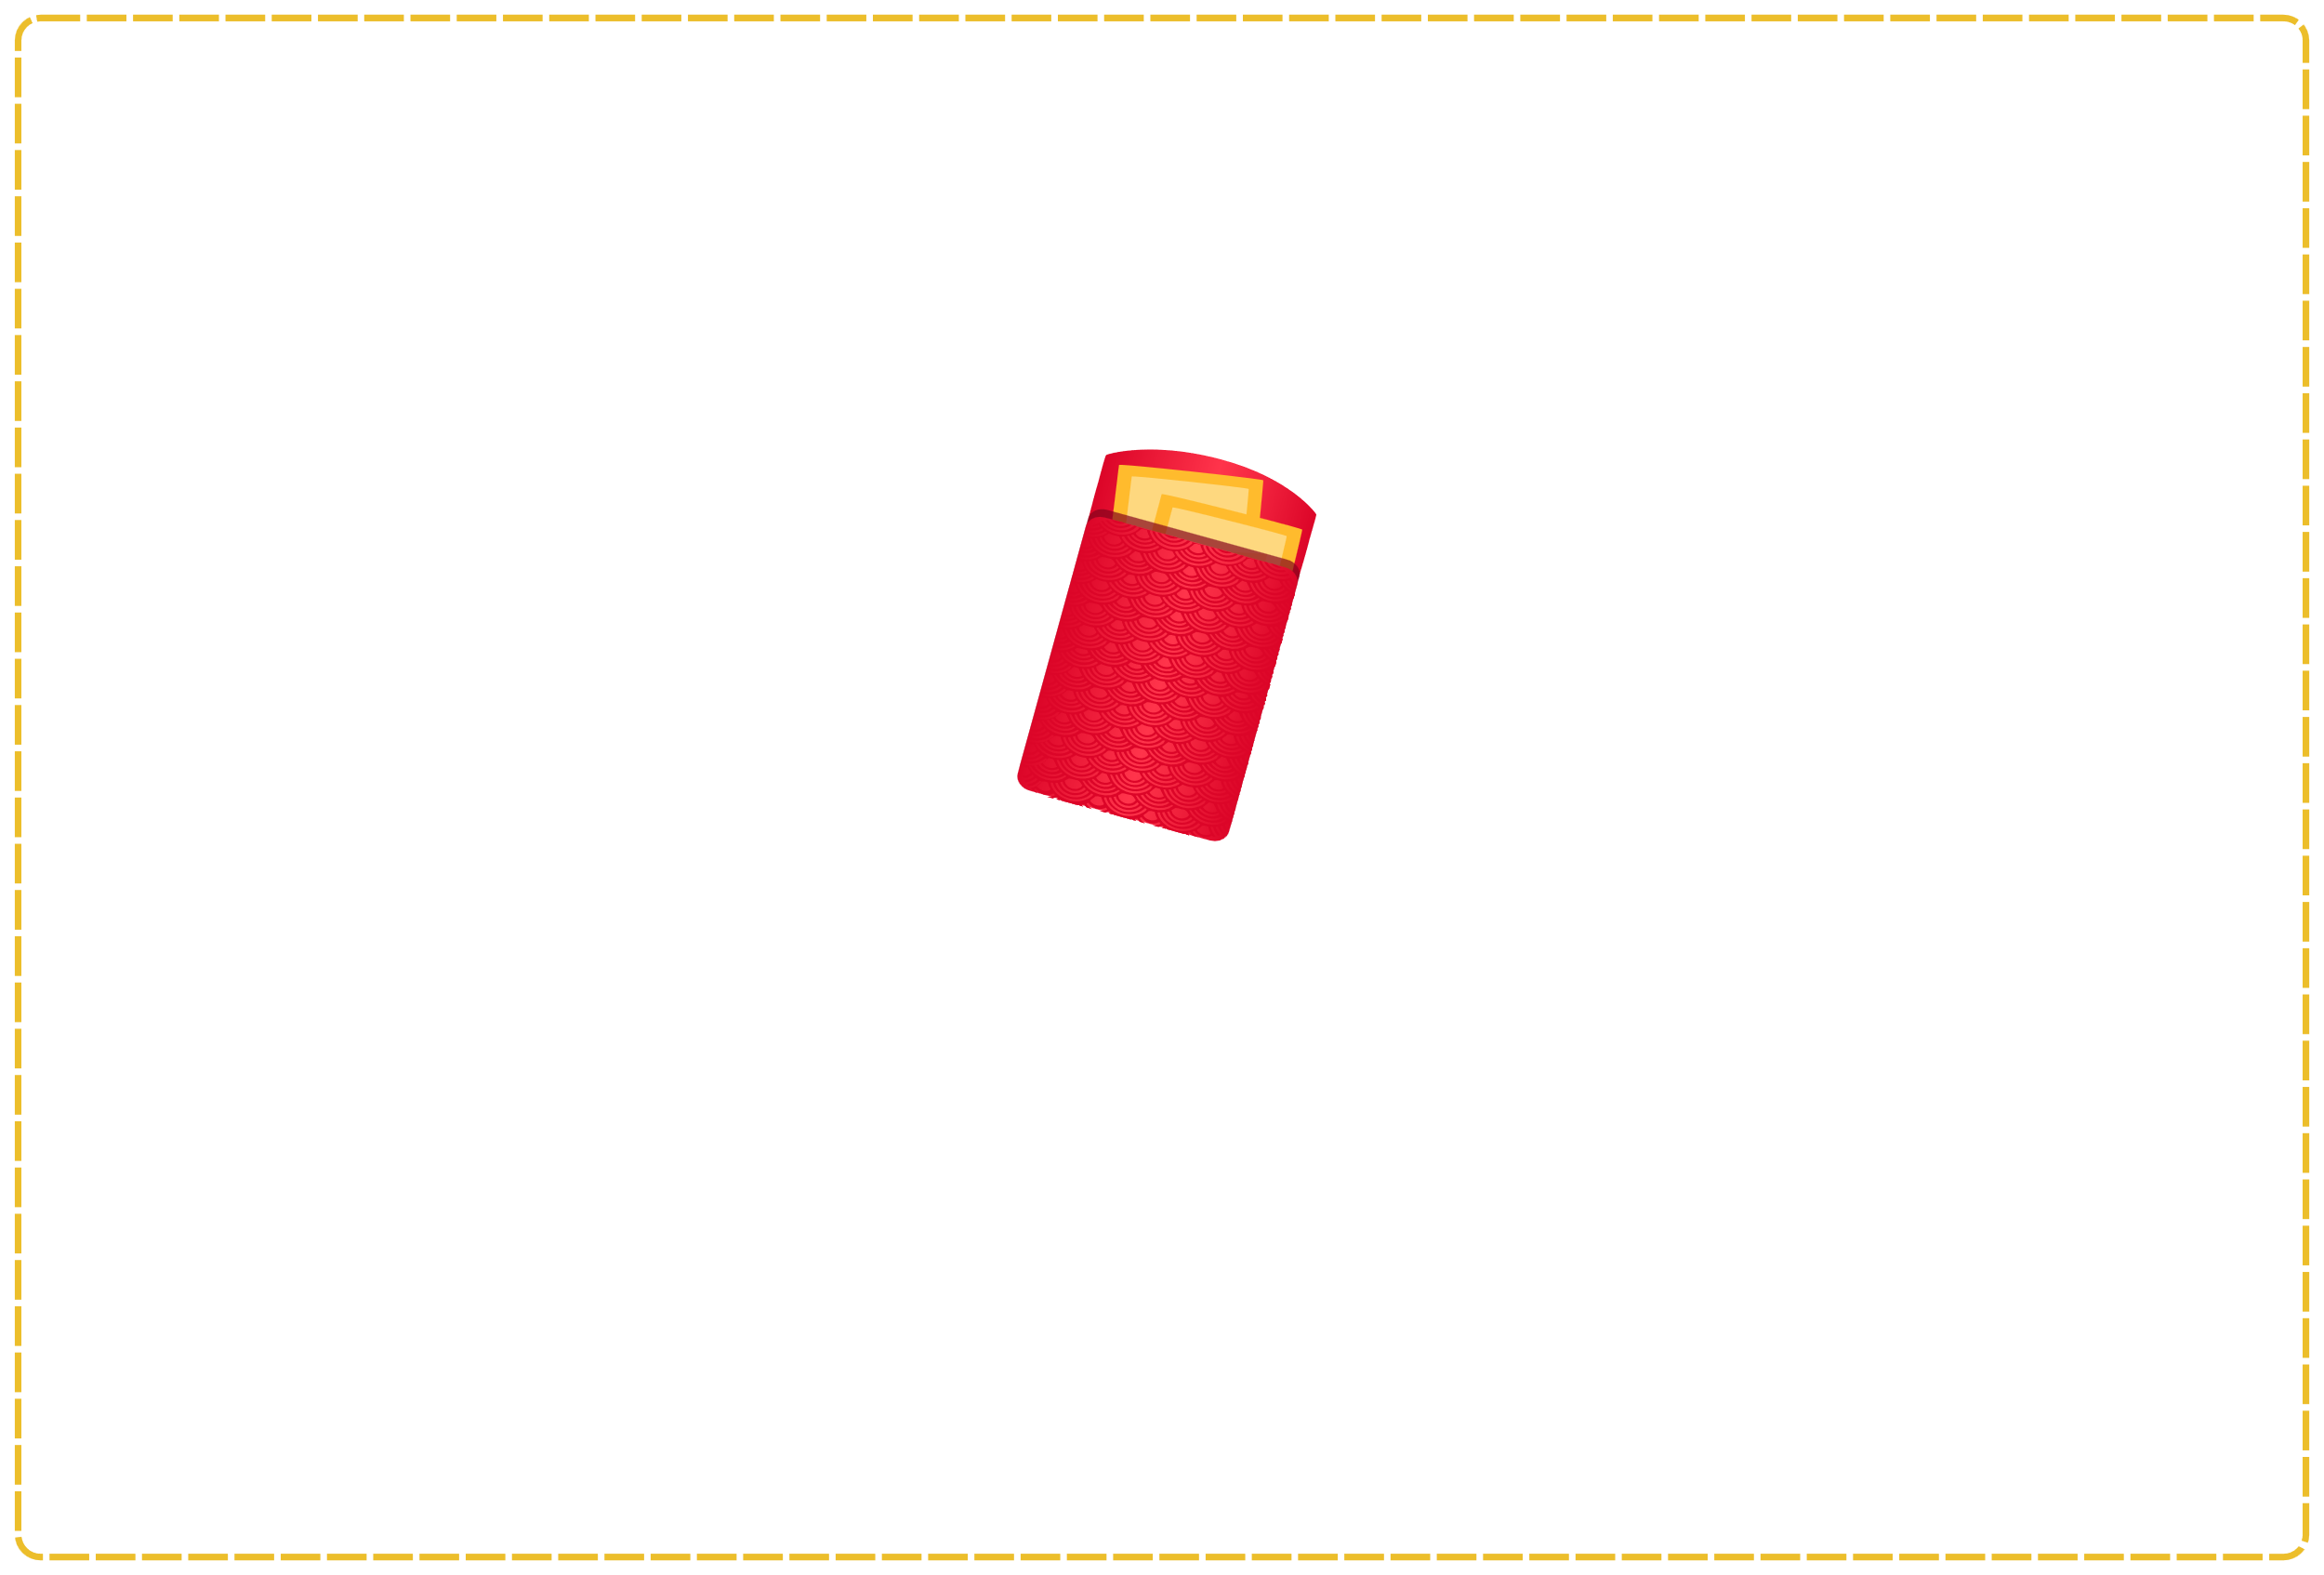
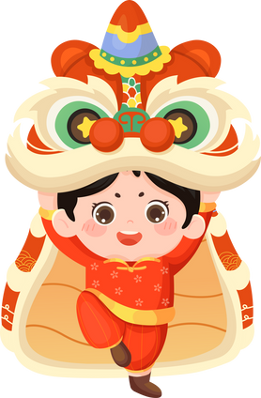
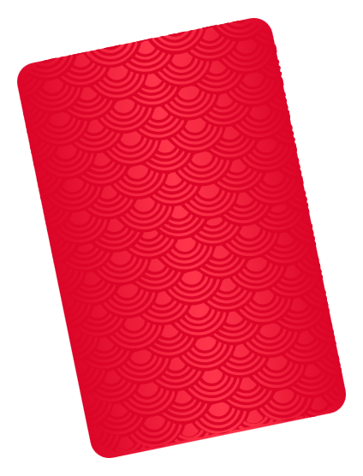
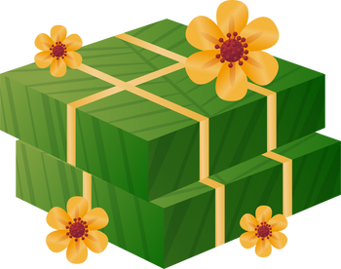
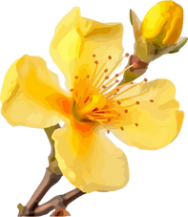




III. EXERCISES:
2. Match the picture and its name:
lucky money
lion dance
firework
Banh
Chung
apricot blossom

Slide 8


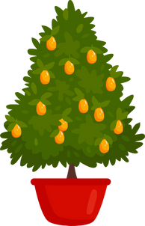
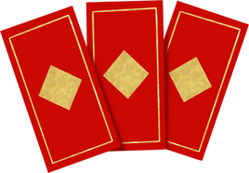
III. EXERCISES:
3. Look at the picture and write:
It’s
It’s
It’s

Slide 9
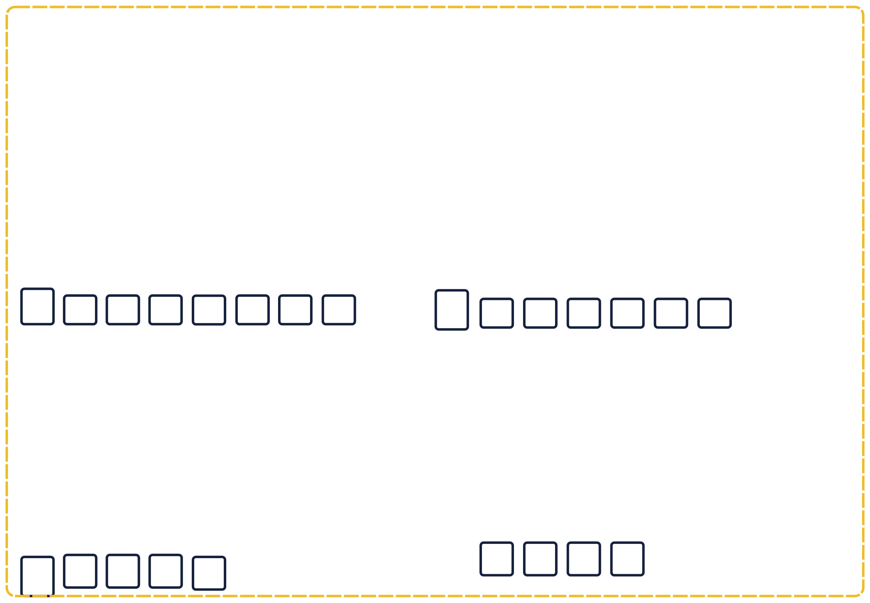

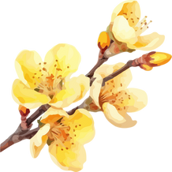
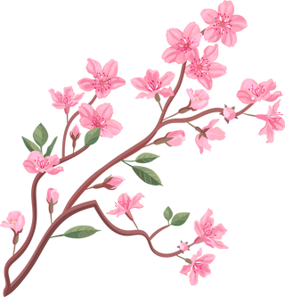
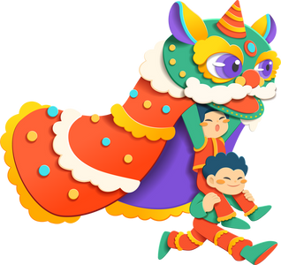
III. EXERCISES:
4. Fill in the blank:
f
a
blossom
dance
p
blossom

Slide 10
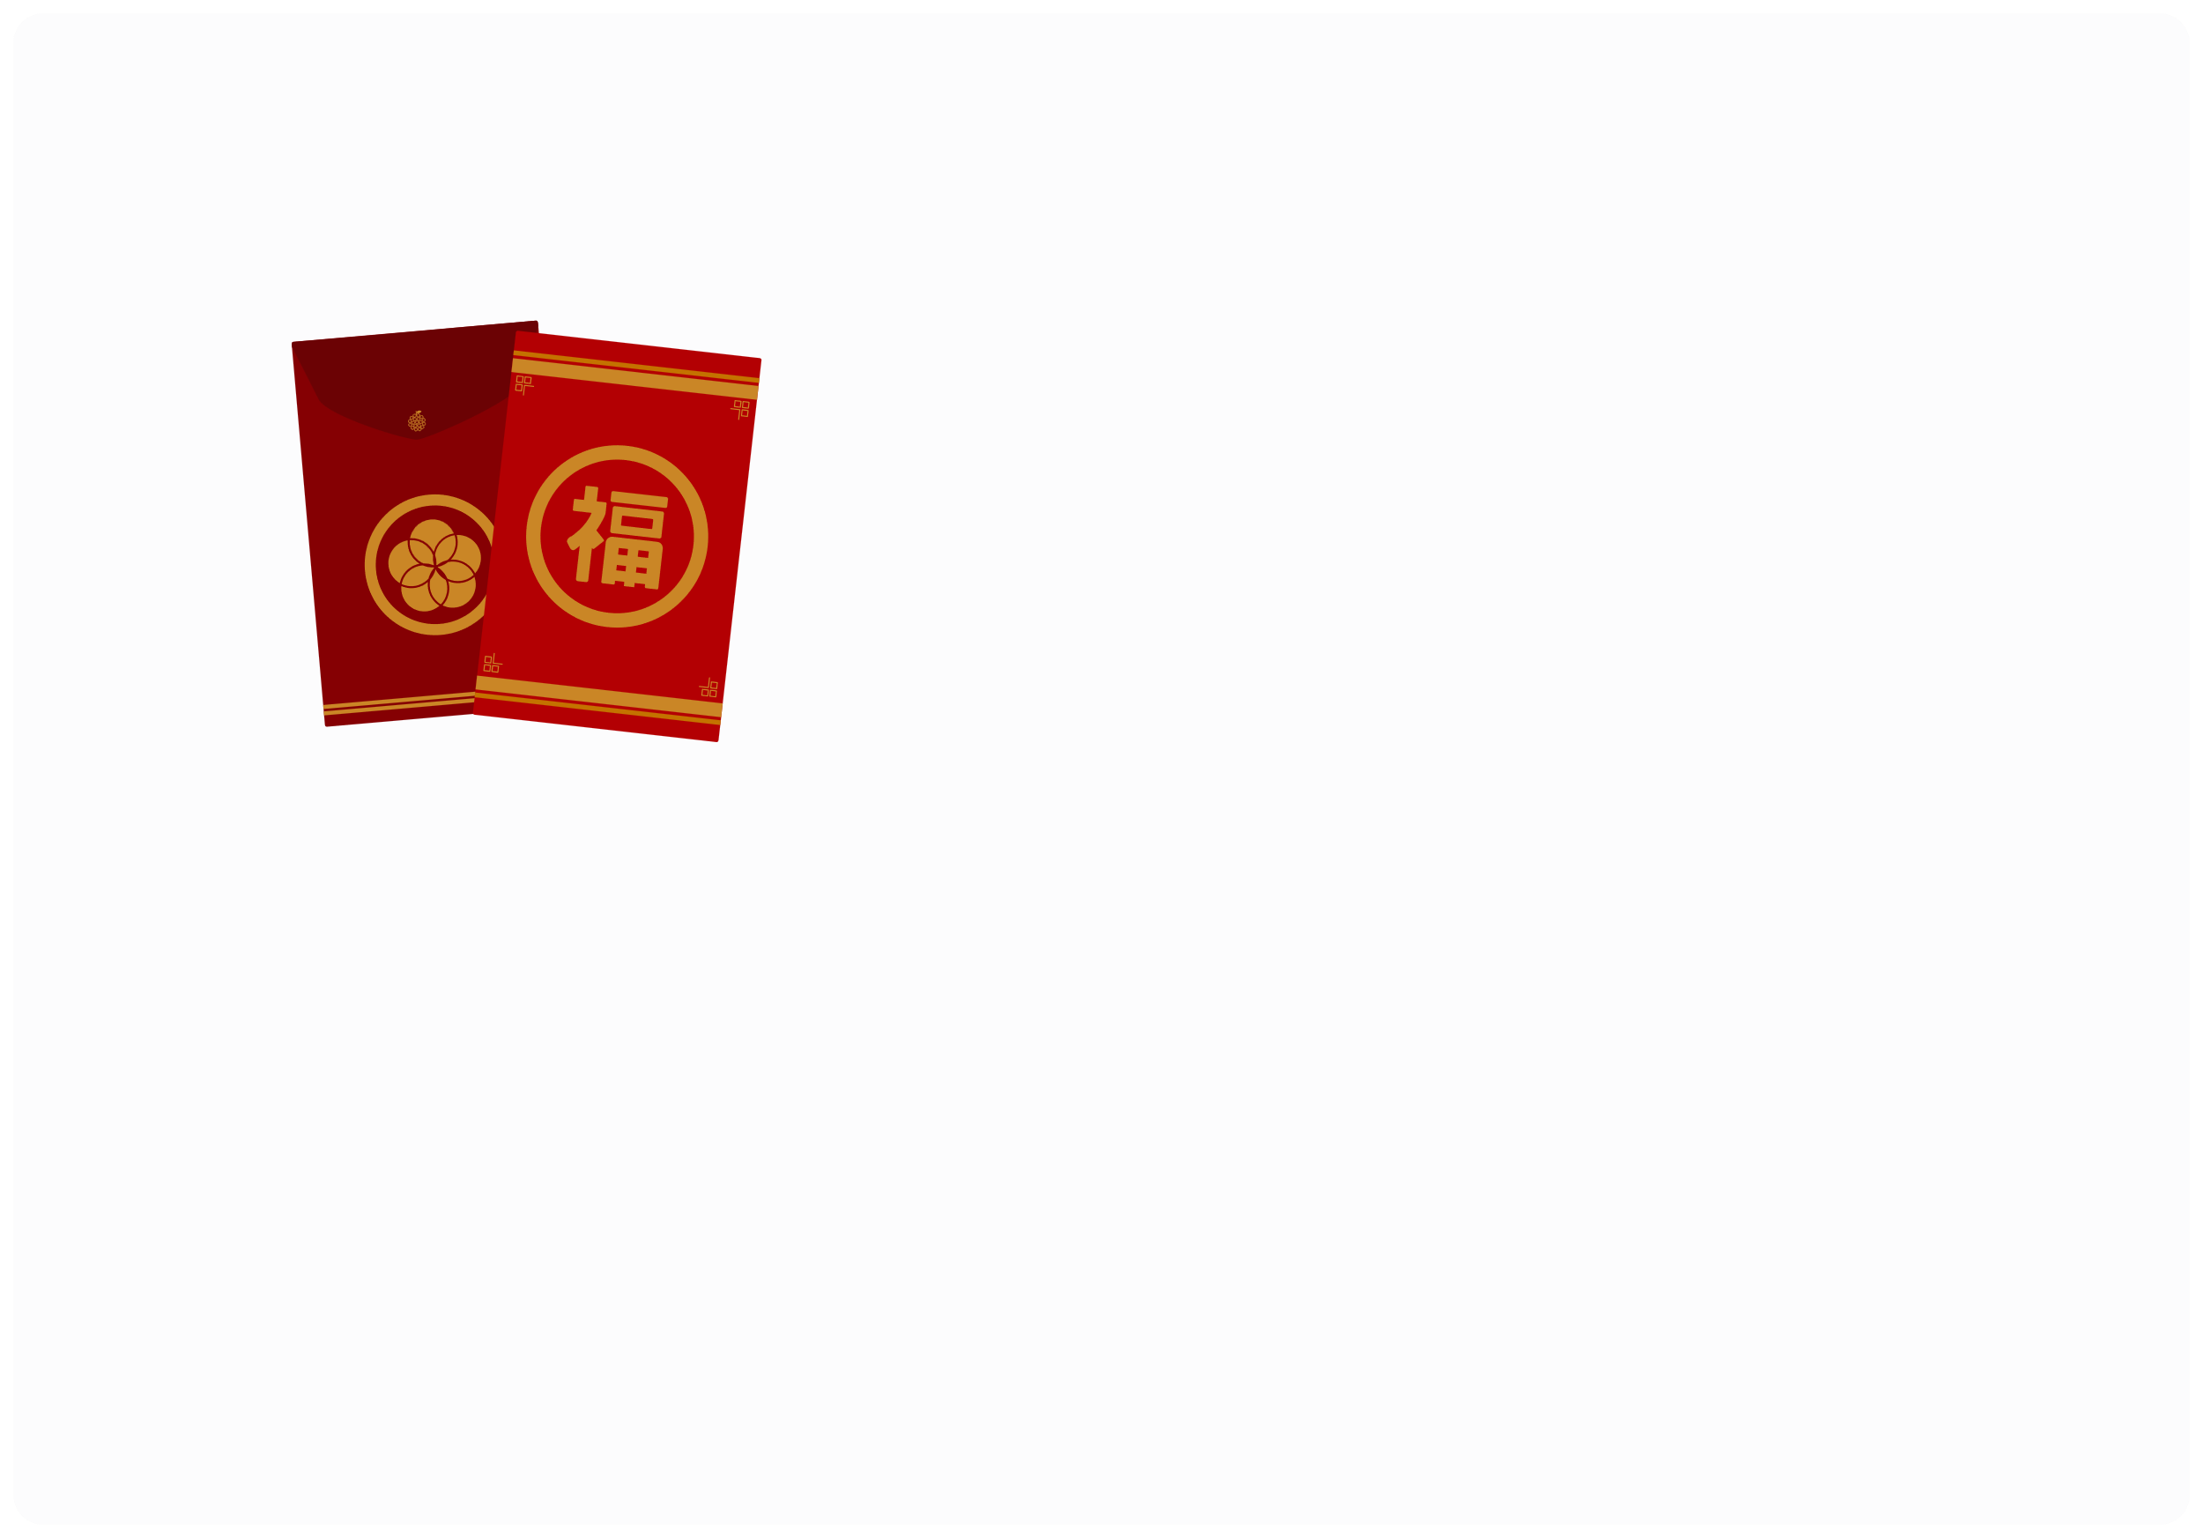


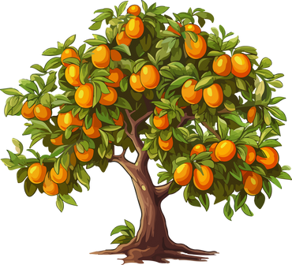
III. EXERCISES:
7. Reorder the words:
r/d/e
e/v/n/e/p/l/o
l/o/i/n d/n/a/e/c ...
...
K/m/u/u/t/q/a t/e/r/e ...
L/c/u/y/k m/y/e/o/n .....

Slide 11
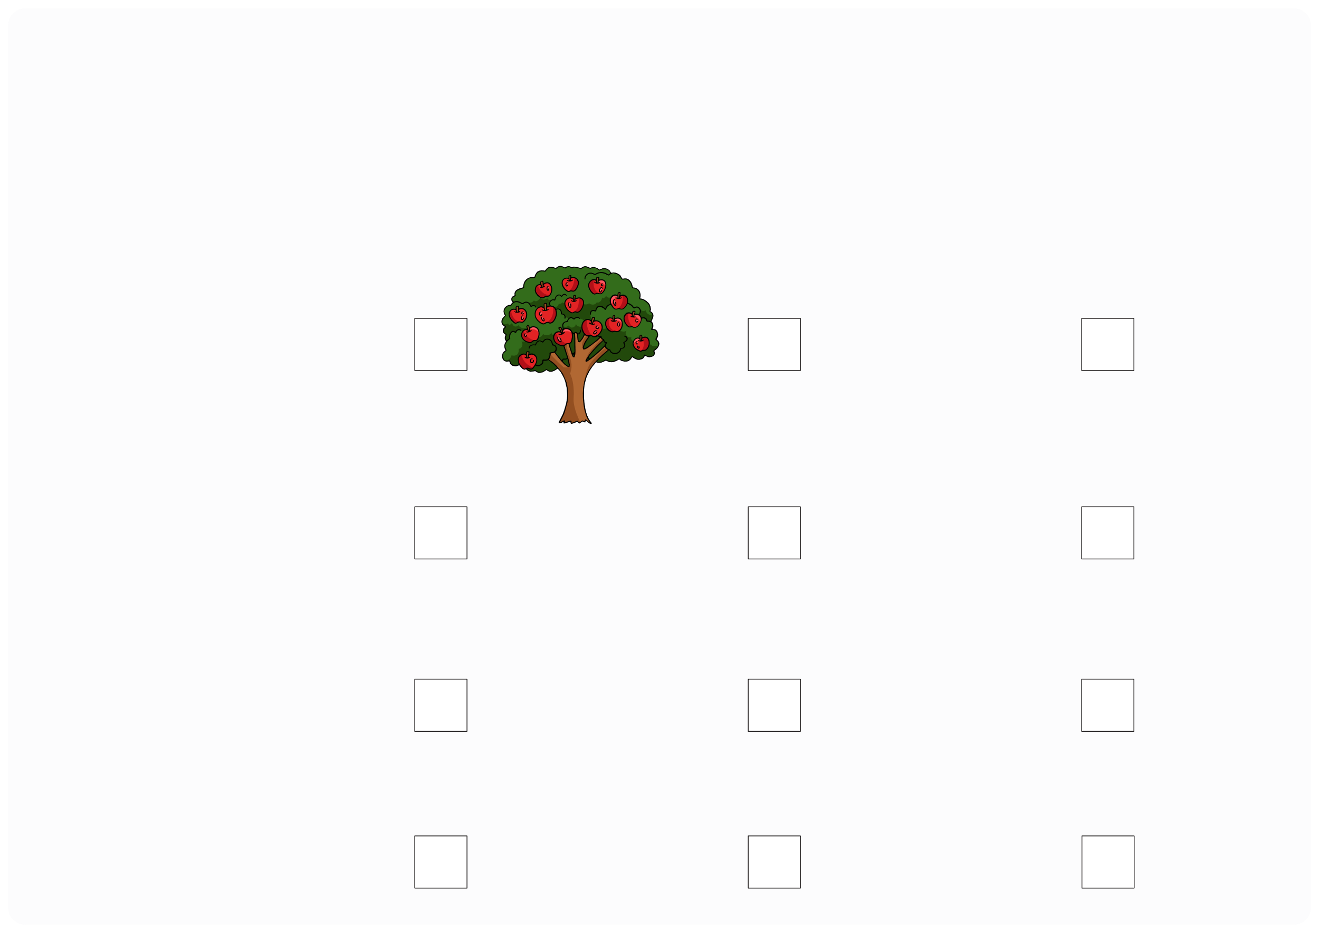

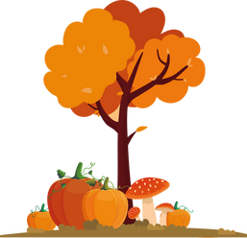
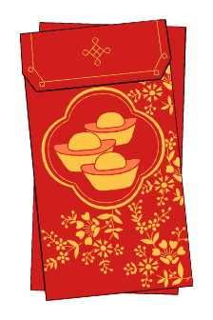



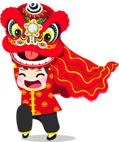
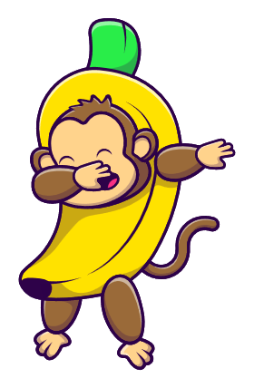

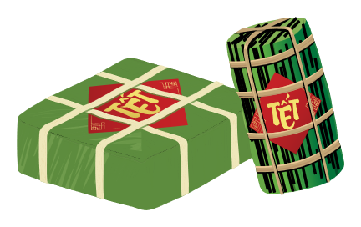
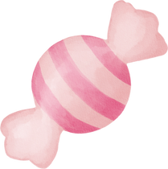
III. EXERCISES:
6. Choose the correct answer:
Kumquat tree
Red envelop
Lion dance
Firework

Slide 12
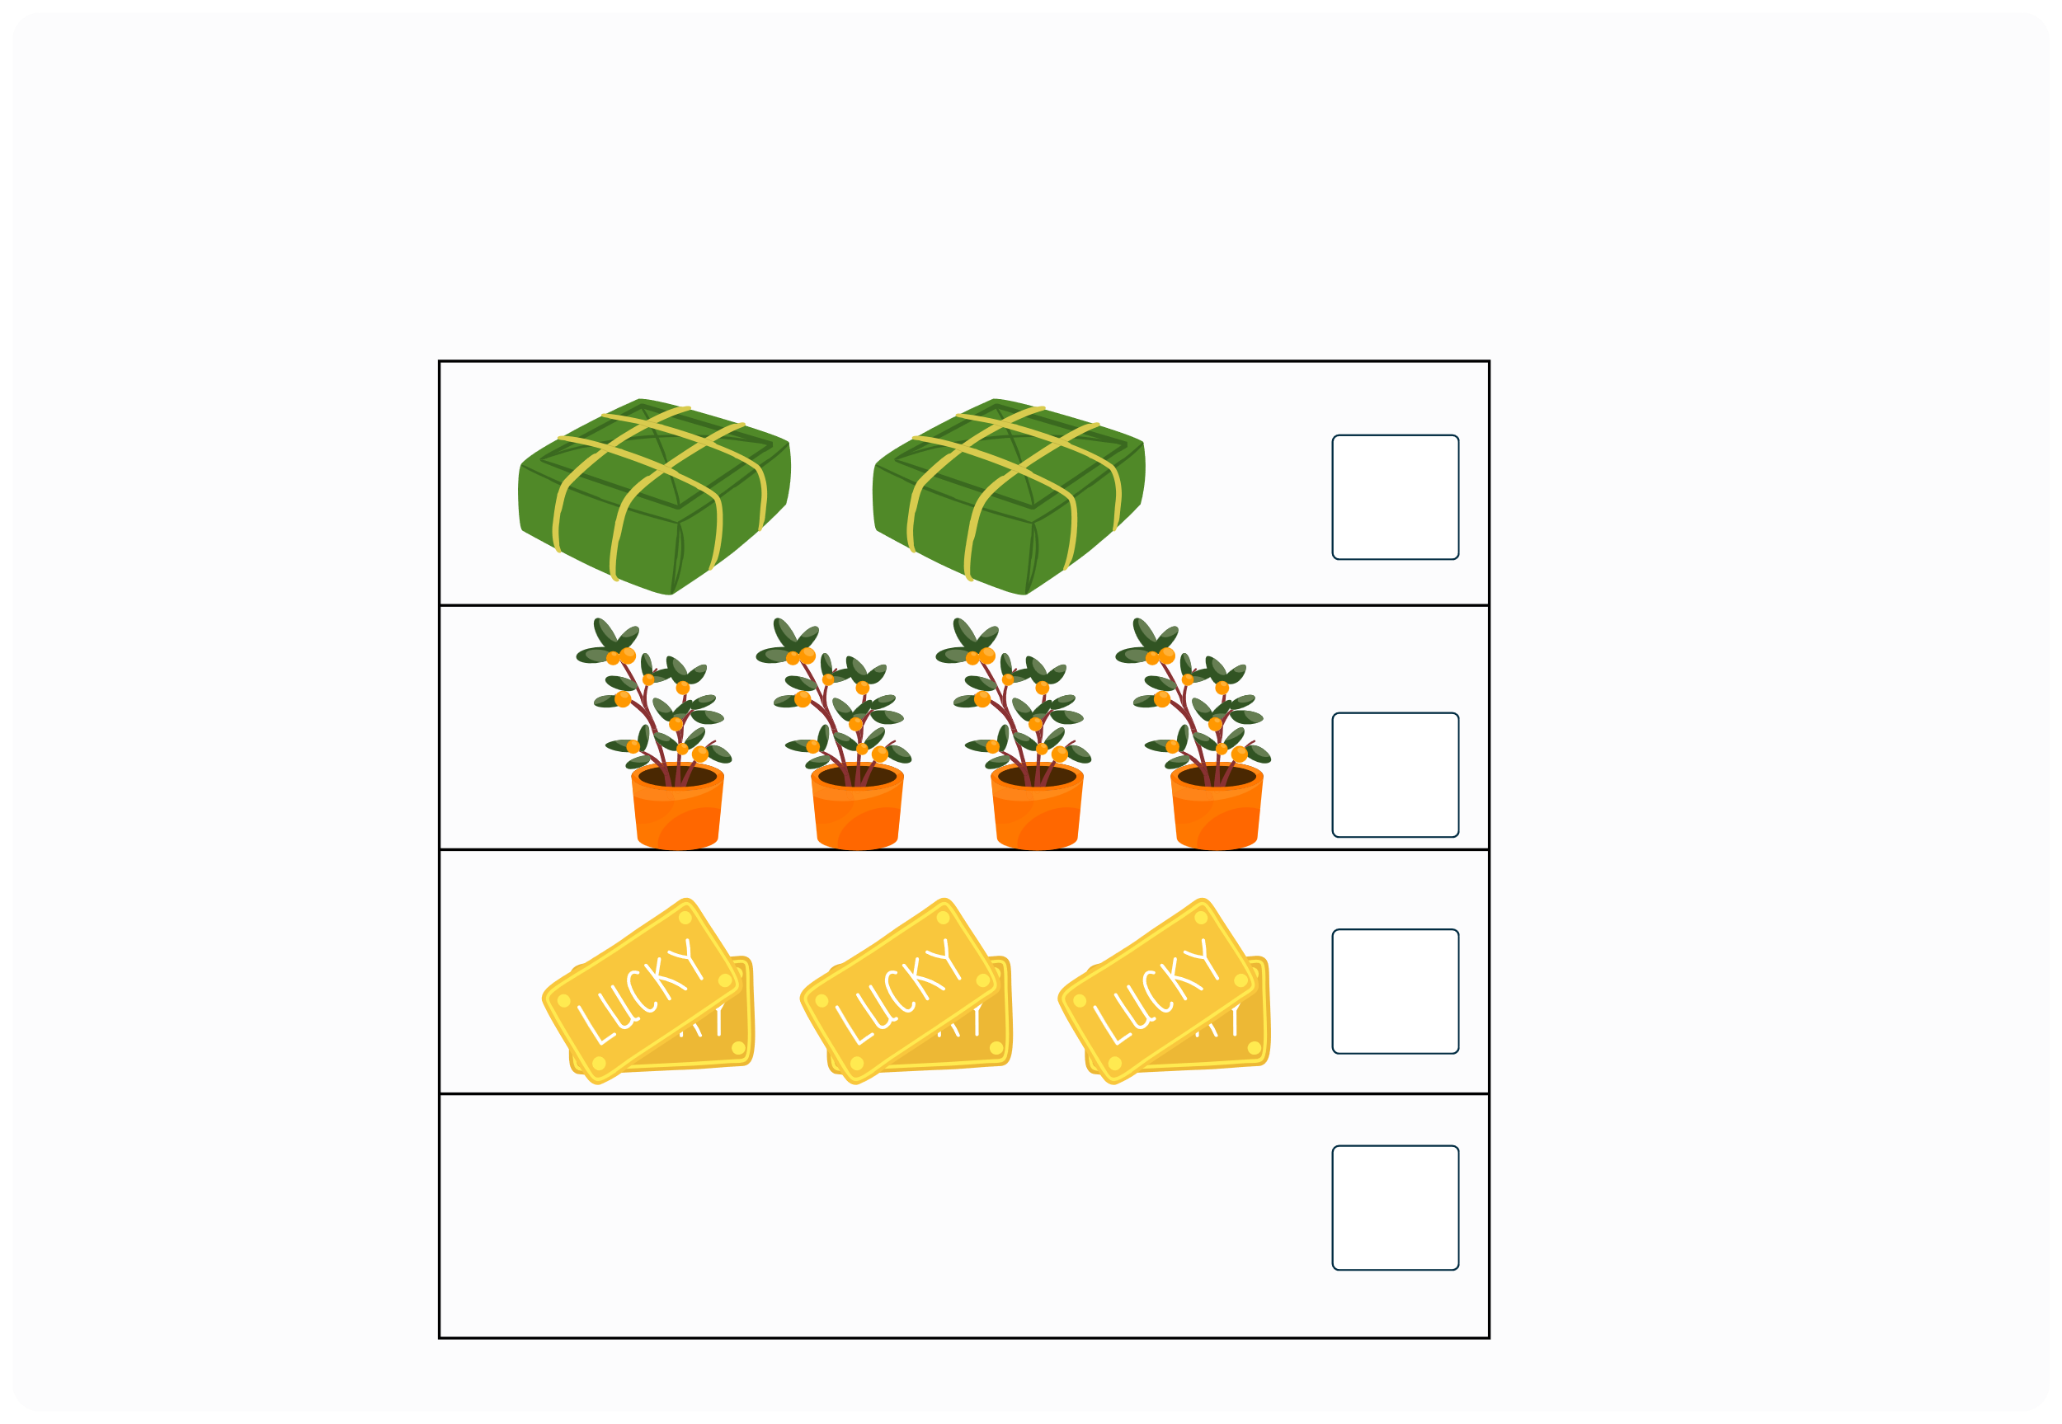
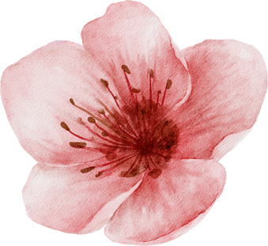
III. EXERCISES:
7. Look at the pictures and count:

Slide 13
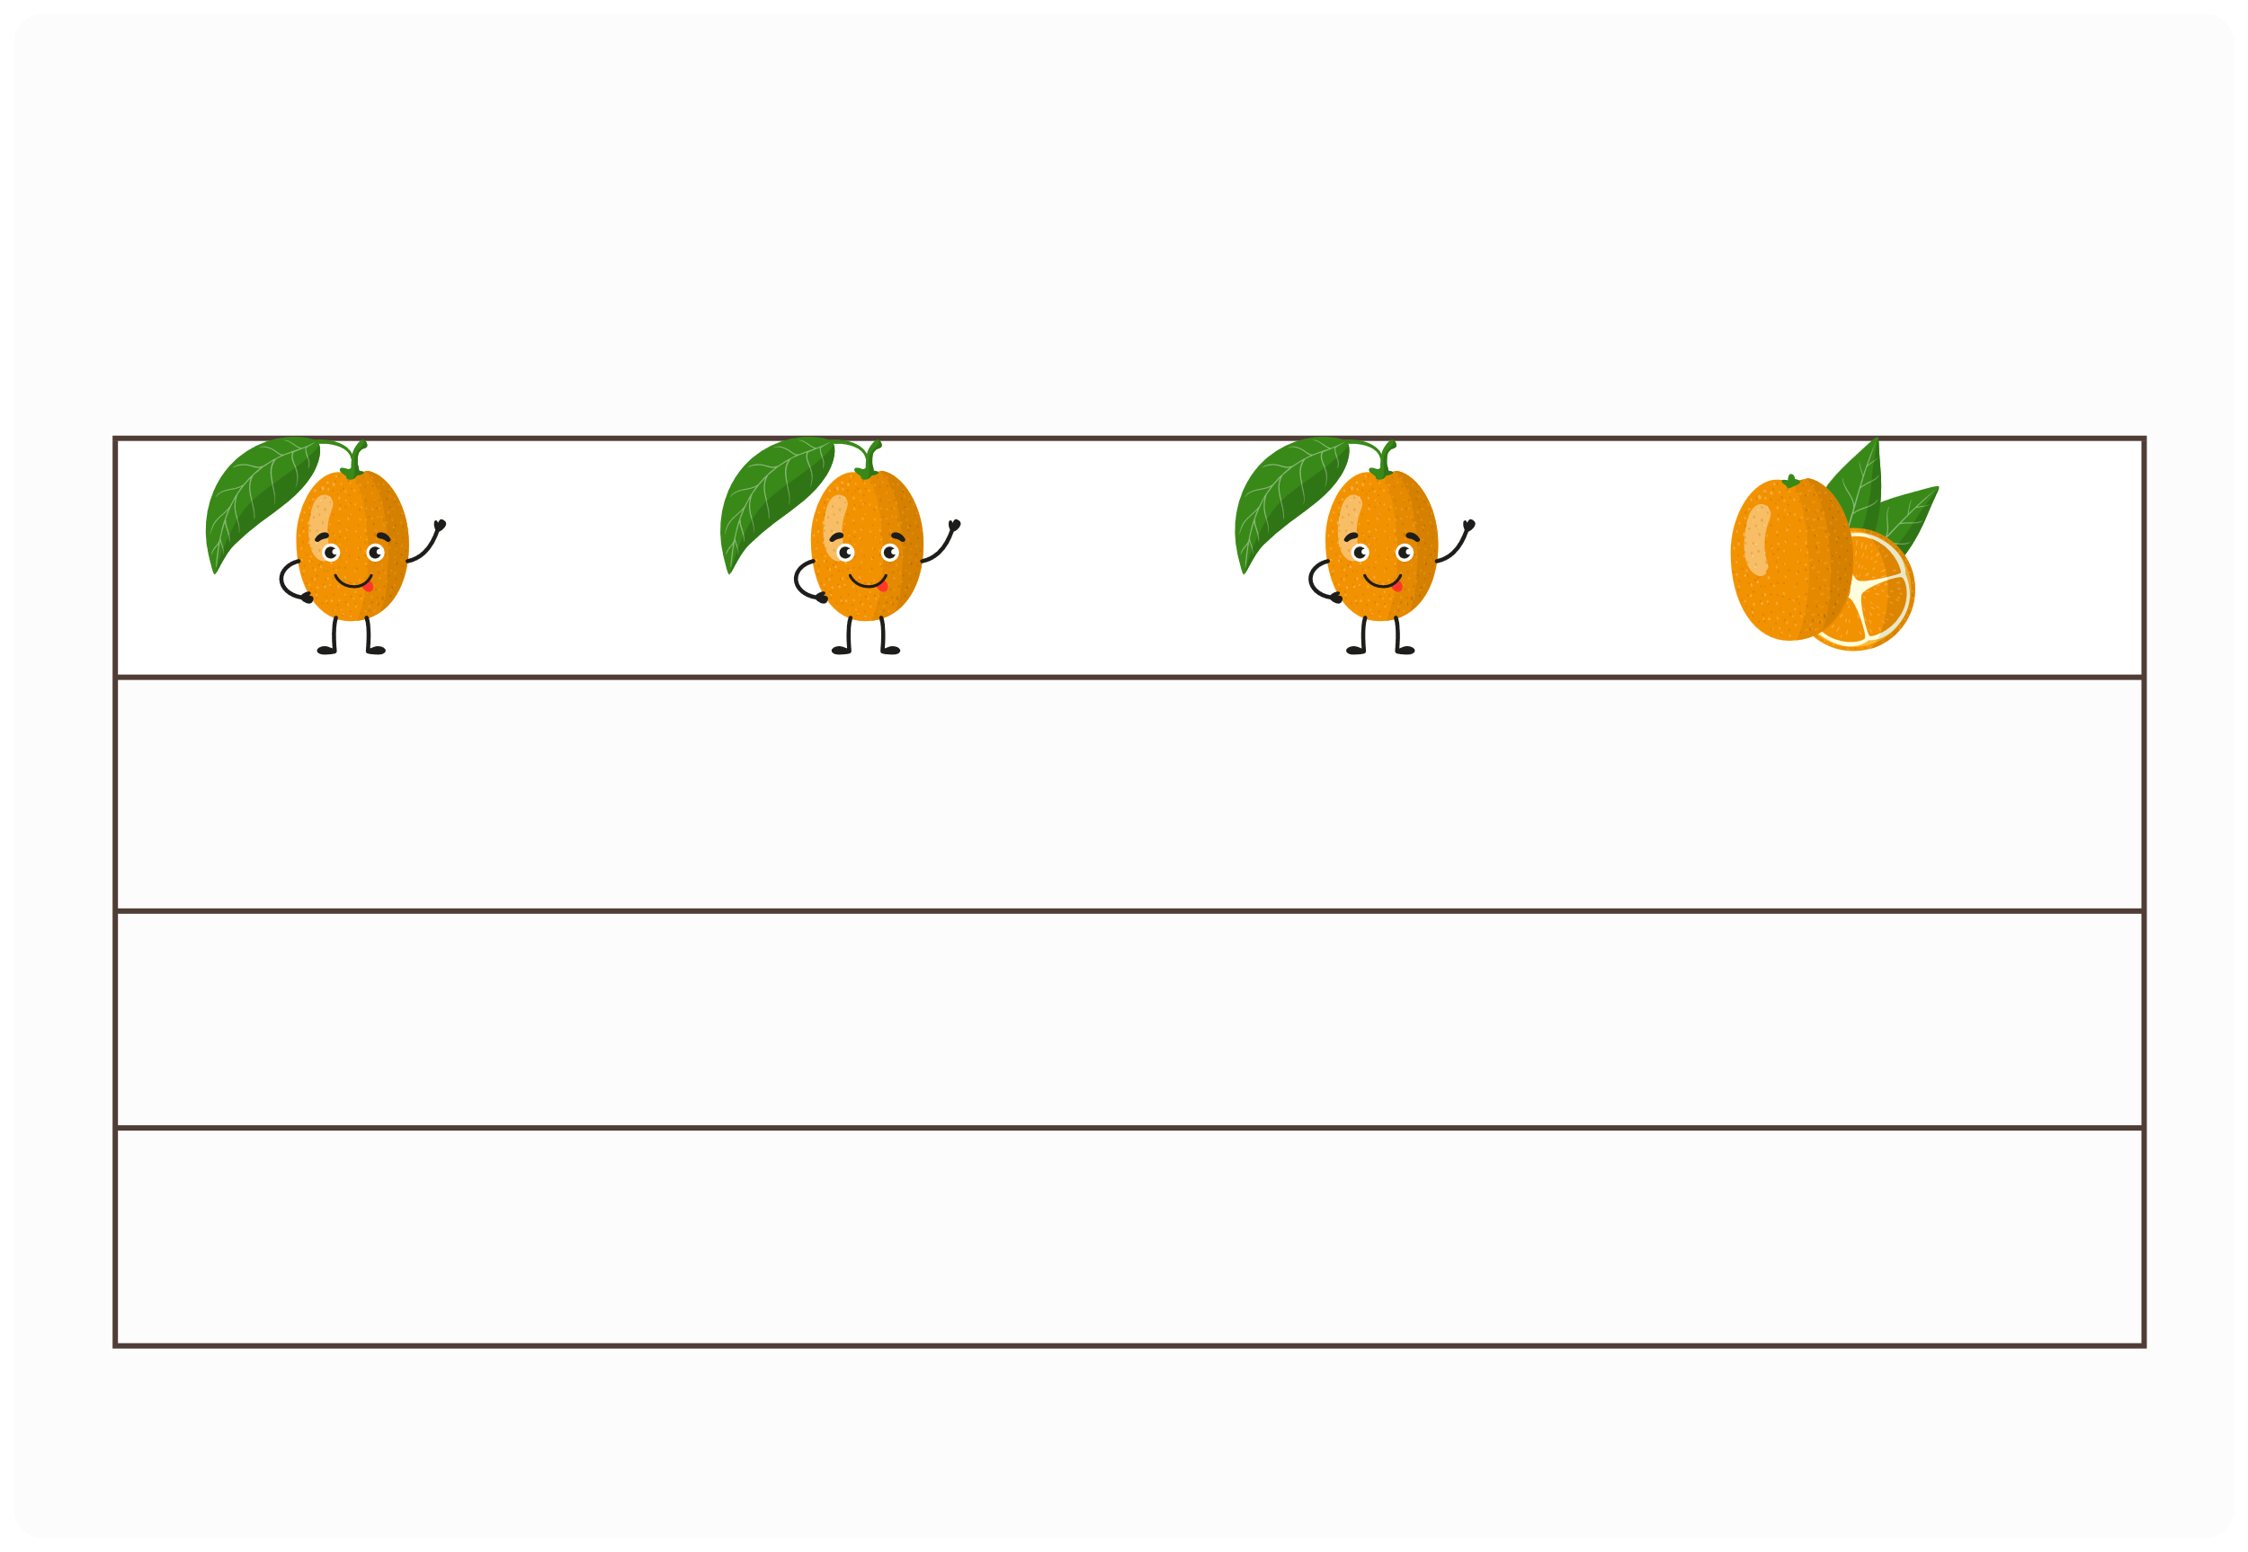
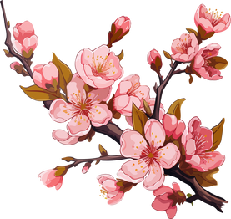

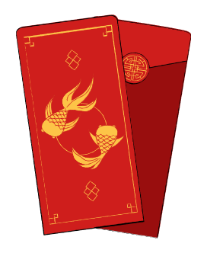
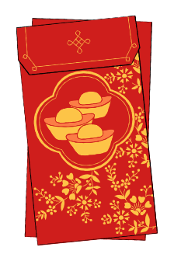
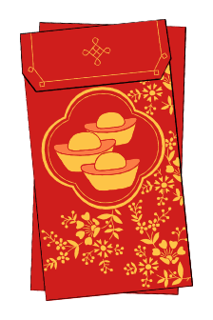





III. EXERCISES:
8. Which is different?

