Slide 1


Slide 2
PEER
PRESSURE
Unit
9
SOCIAL ISSUES
Unit
FAMILY LIFE
LESSON 3
READING

Slide 3

LESSON 3
READING
WARM-UP
Video watching
PRE-READING
Task 1: Discuss the question.
Task 2: Match the highlighted words and phrase with their meanings.
Task 3: Which paragraph contains the following information?
Task 4: Choose the correct answer.
WHILE-READING
POST-READING
Task 5: Discussion.
CONSOLIDATION
Wrap-up
Homework

Slide 4
WARM-UP
Watch the video and decide if the statements below are true or false.
Teenagers are considered easily affected by peer pressure.
Positively, peer pressure can motivate us to try and become better.
Social media always bring stress to us when we see other peers having success and comfortable lives.
To define a clear life goal, respect yourself and others are effective ways to avoid peer pressure.

Slide 5
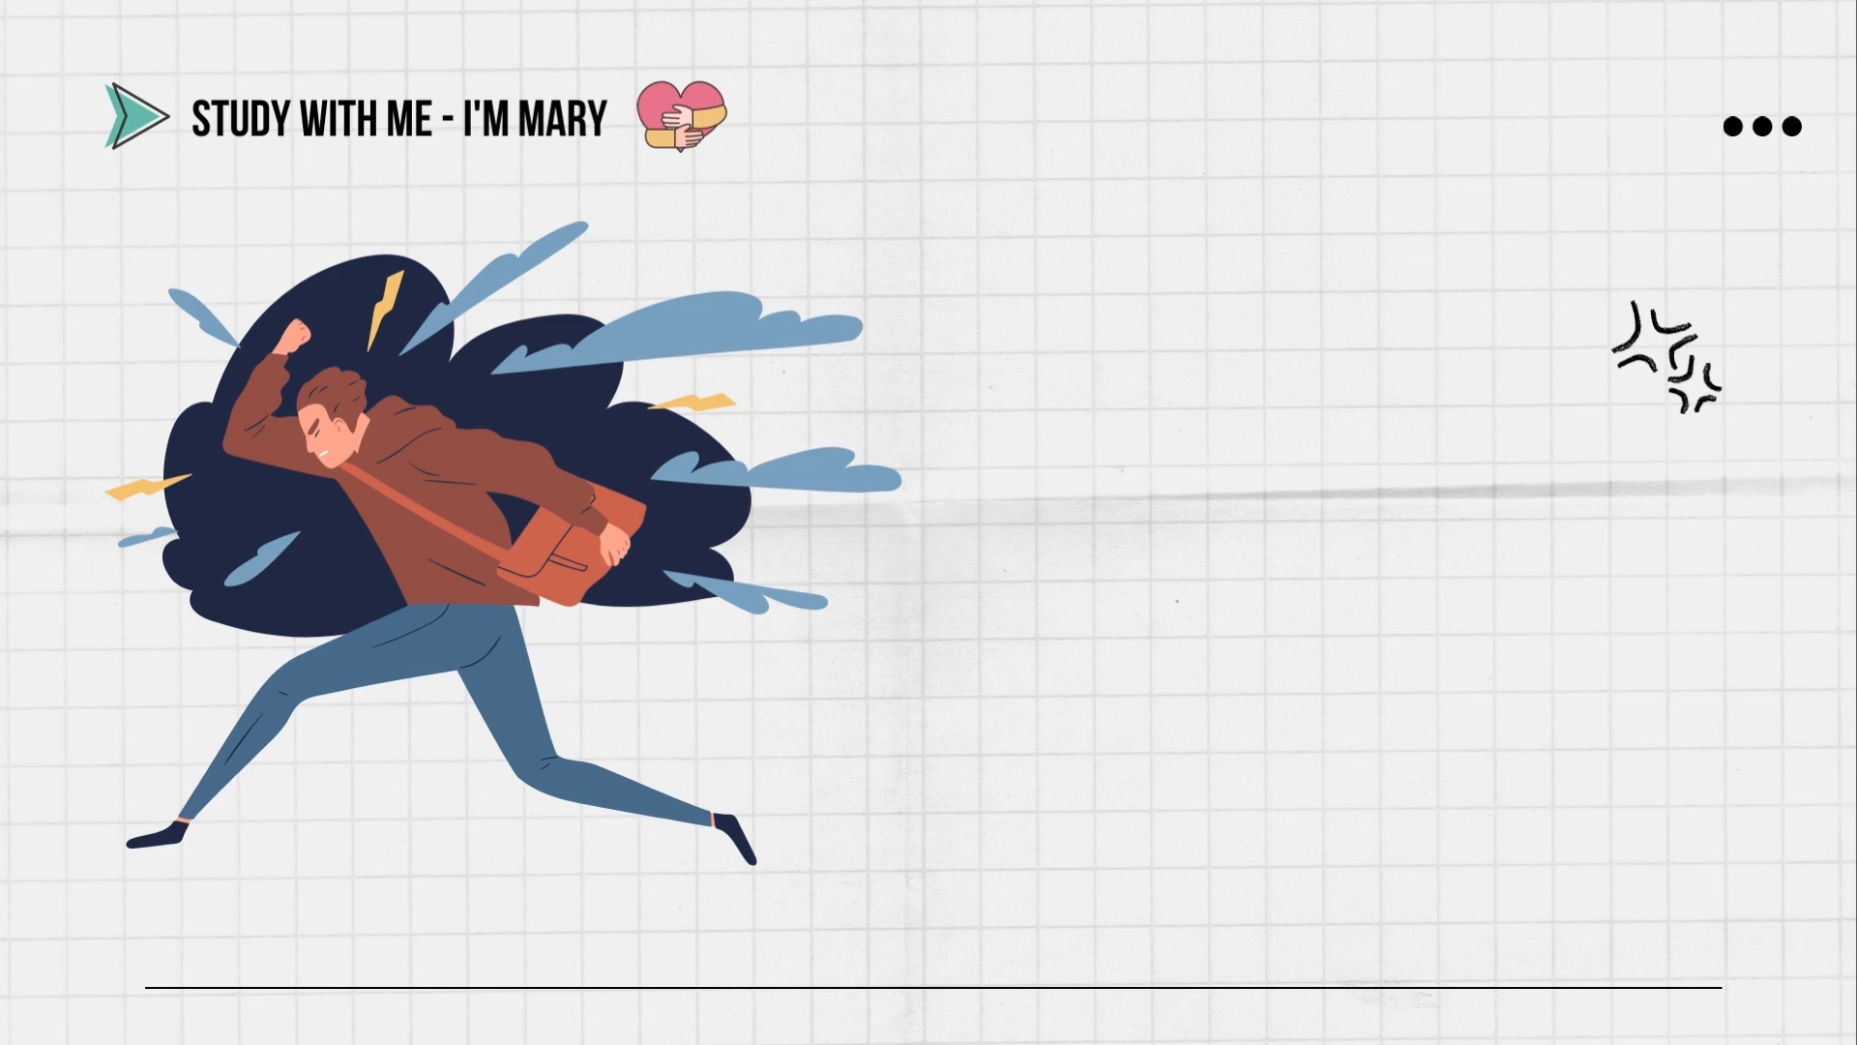
WARM-UP
Watch the video and decide if the statements below are true or false.
Notes:
https://youtu.be/6ZT0DAmOpWw

Slide 6

WARM-UP
1. Teenagers are considered uneasily affected by peer pressure.

Slide 7
WARM-UP
2. Positively, peer pressure can motivate us to try and become better.

Slide 8
WARM-UP
3. Social media always brings stress to us when we see other peers having success and comfortable lives.

Slide 9
WARM-UP
4. To define a clear life goal, respect yourself and others are effective ways to avoid peer pressure.

Slide 10
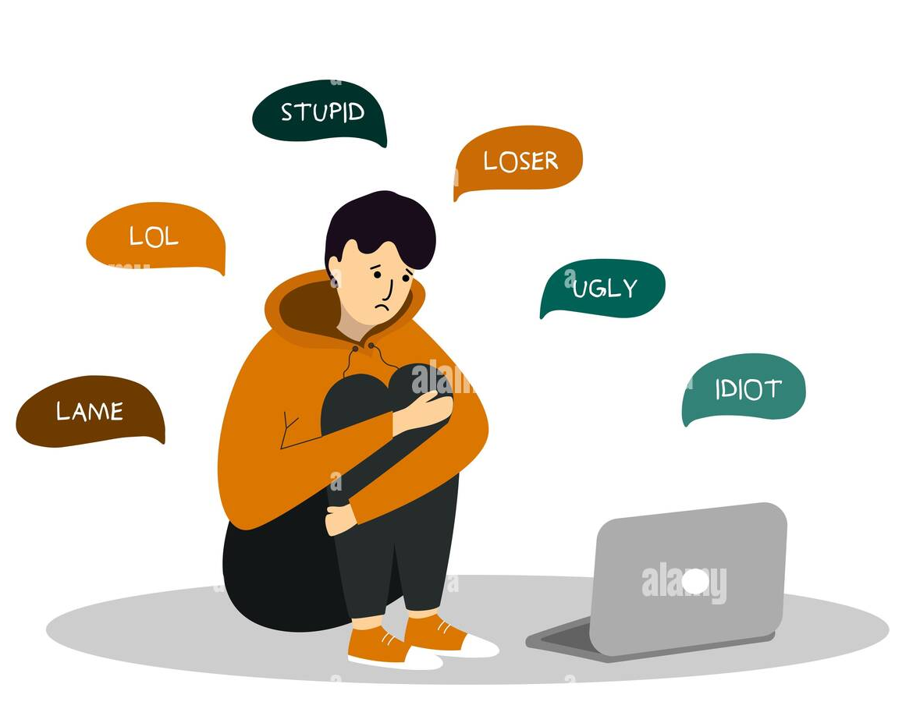

PRE-READING
1
Work in pairs. Discuss the following question.
Have your friends ever made you do something you do not like? If yes, give an example.

Slide 11

PRE-READING
depression (n)
/dɪˈpreʃən/
the state of feeling very unhappy and without hope for the future

Slide 12

PRE-READING
self-confidence (n)
/ˌselfˈkɒnfɪdəns/
the belief that you can do things well and that other people respect you

Slide 13

PRE-READING
smoker (n)
/ˈsməʊkər/
someone who smokes tobacco regularly

Slide 14
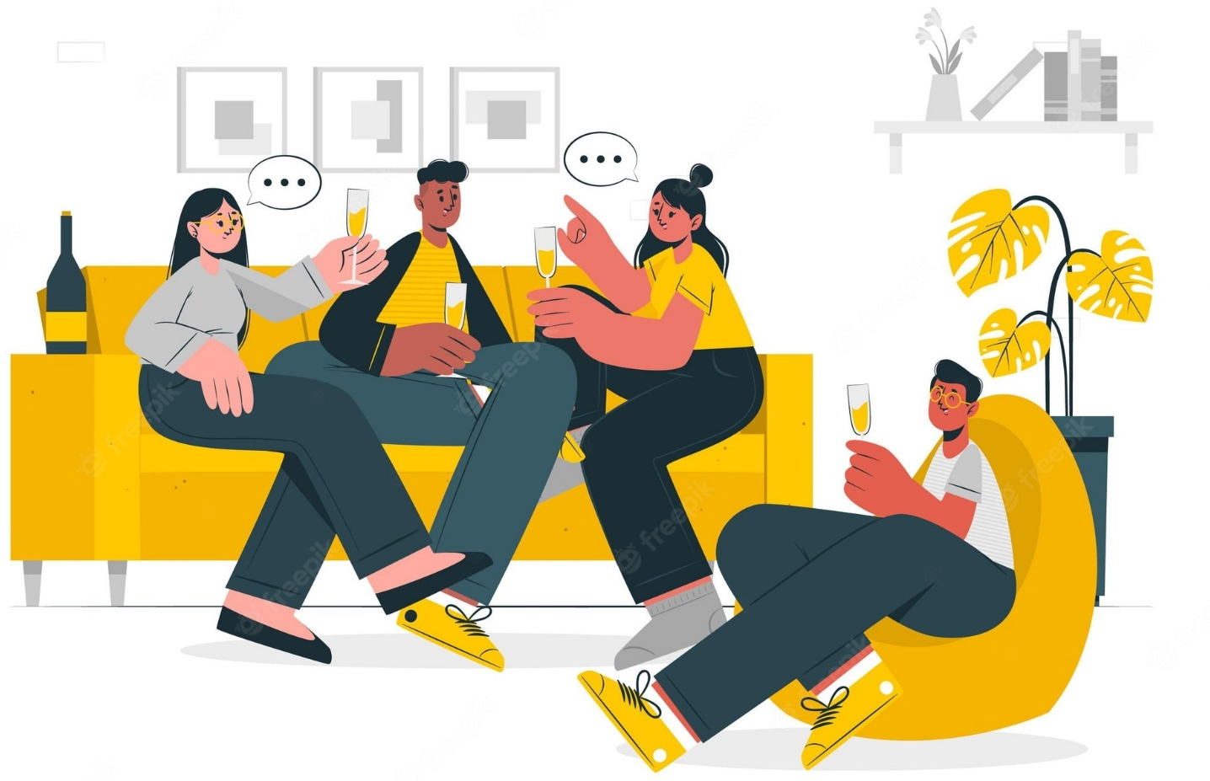
PRE-READING
hang out
/ˈhæŋ ˈaʊt/
to spend a lot of time in a place or with someone

Slide 15
Form | Pronunciation | Meaning
1. depression (n) | /dɪˈpreʃ.ən/ | the state of feeling very unhappy and without hope for the future
2. self-confidence (n) | /ˌselfˈkɒn.fɪ.dəns/ | the belief that you can do things well and that other people respect you
3. smoker (n) | /ˈsməʊ.kər/ | someone who smokes tobacco regularly
4. hang out | /ˈhæŋ ˈaʊt/ | to spend a lot of time in a place or with someone

Slide 16



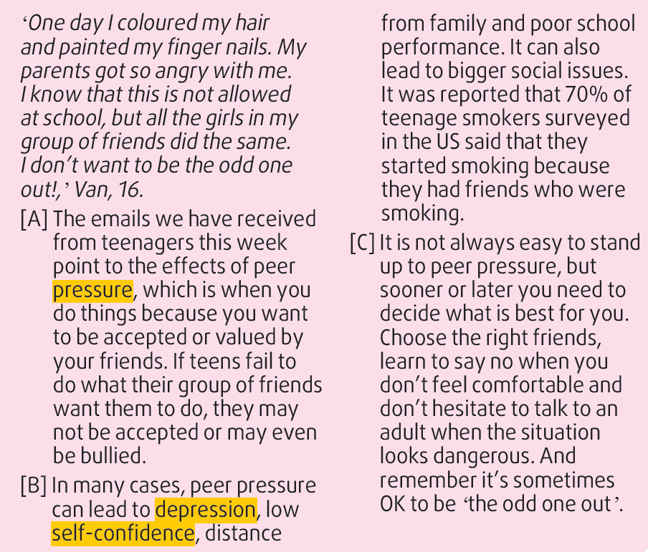

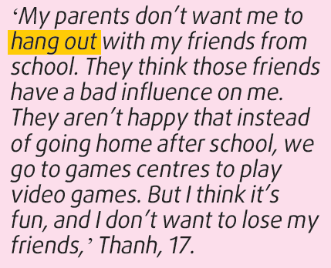
WHILE-READING
2

Slide 17
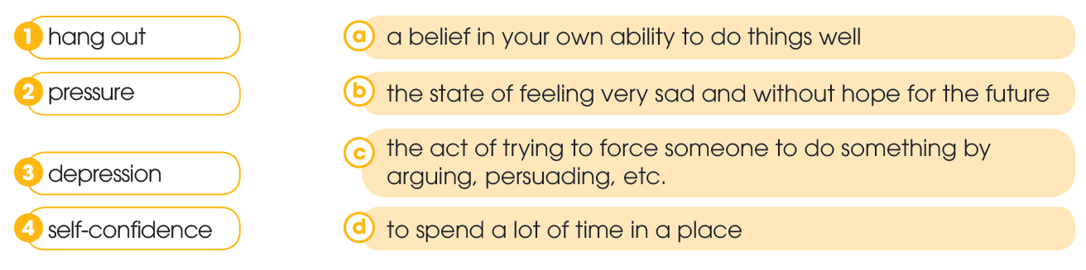
WHILE-READING
2
Read the article. Match the highlighted words and phrase with their meanings.

Slide 18
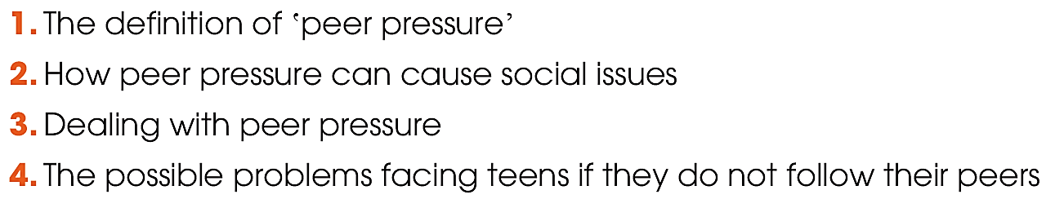

WHILE-READING
3
Read the article again. Which paragraph contains the following information? Write A, B, or C.
A
B
C
A

Slide 19
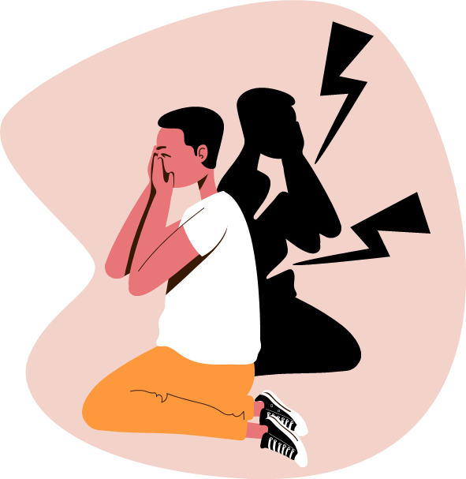
WHILE-READING
4
Read the article again and choose the correct answer A, B, or C.
1. What is the similarity between Thanh and Van?
A. They both changed their appearance.
B. They both want to be different from their friends.
C. Their parents do not approve of their behaviour.
2. Which is NOT mentioned in the article as a consequence of peer pressure?
A. Encouraging someone to fight.
B. Lack of a close relationship with family members.
C. Lack of confidence about what you can do.

Slide 20

WHILE-READING
4
Read the article again and choose the correct answer A, B, or C.
3. What was reported about the effects of peer pressure on teenagers in the US?
A. Fifty-five per cent of them started to smoke because of peer influence.
B. Seventy per cent of them were drinking alcohol with their friends.
C. More than two-thirds of teen smokers started the habit under the influence of their friends.
4. According to the article, what is one way of dealing with peer pressure?
A. Going to see the right doctor.
B. Not always saying yes to your friends.
C. Choosing friends who say no when they feel uncomfortable.

Slide 21
POST-READING
5
Work in pairs. Discuss the following question.
Have you, or has someone you know, experienced any of the problems mentioned in this article?

Slide 22

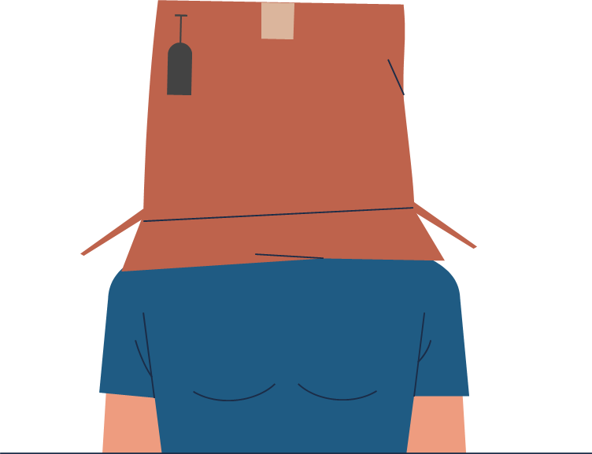
CONSOLIDATION
1
Wrap-up
What have you learnt today?
Read for main ideas and specific information in an article about peer pressure.
Talk about experiences of peer pressure and respond to peer pressure situations.

Slide 23
CONSOLIDATION
2
Homework
Do exercises in the workbook.
Prepare for Lesson 4 - Unit 9.

Slide 24

Website: hoclieu.vn
Fanpage: facebook.com/www.tienganhglobalsuccess.vn/

