Slide 1


Slide 2
6TH GRADE
A SOCIAL AWARENESS CLUB MEETING
LESSON I – GETTING STARTED
Unit
9
SOCIAL ISSUES
FAMILY LIFE
Unit

Slide 3
LESSON I
GETTING STARTED
WARM-UP
Quiz
PRESENTATION
Vocabulary
Task 1: Listen and read.
Task 2: Tick (✓) the correct box.
Task 3: Find five social issues.
Task 4: Complete the summary.
PRACTICE
PRODUCTION
Discussion
CONSOLIDATION
Wrap-up
Homework

Slide 4

Students work in 4 groups.
There are some news headlines, pictures and short clips about social issues.
Raise your hands and give the correct names of the issues.

Slide 5

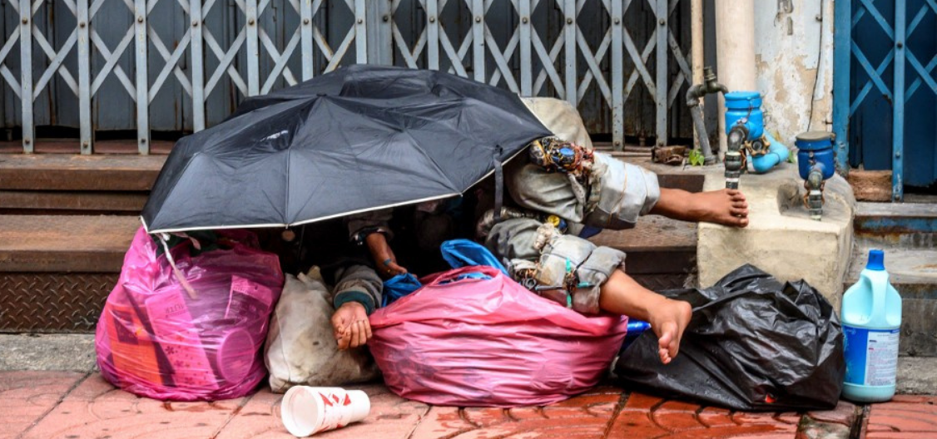
Find the correct name of the issue.
1
Gender inequality
Climate change
Childhood obesity
Homelessness

Slide 6
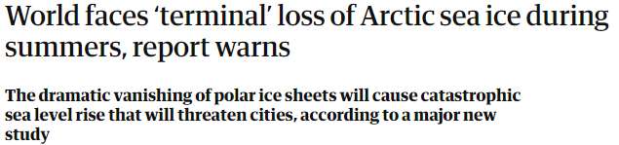
Find the correct name of the issue.
2
Civil rights
Bullying
Climate change
Gender inequality

Slide 7
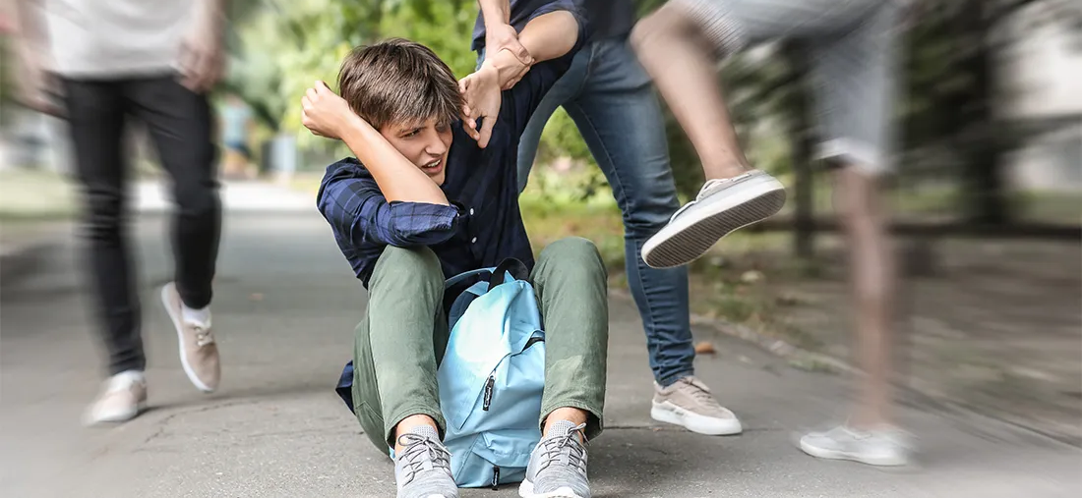
Find the correct name of the the issue.
3
School violence/ bullying
Health care availability
Gender inequality
Overpopulation

Slide 8

Find the correct name of the the issue.
4
Climate change
Childhood obesity
Homelessness
Gender inequality

Slide 9


VOCABULARY
awareness (n)
/əˈweənəs/
knowledge that something exists, or understanding of a situation or subject at the present time based on information or experience

Slide 10

VOCABULARY
campaign (n)
/kæmˈpeɪn/
a planned group of especially political, business, or military activities that are intended to achieve a particular aim

Slide 11
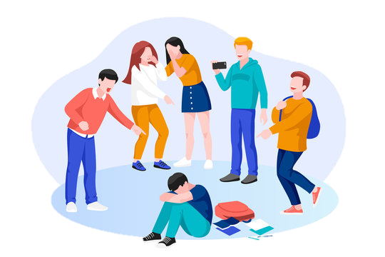
VOCABULARY
bully (v)
/ˈbʊl.i/
to hurt or frighten someone, often over a period of time, and often forcing that person to do something they do not want to do

Slide 12
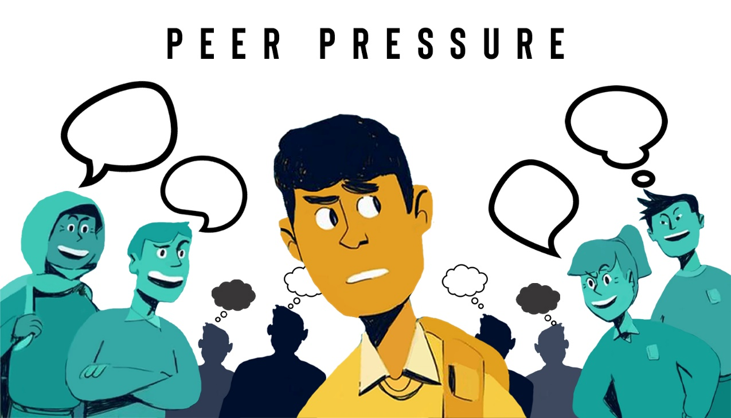
VOCABULARY
peer pressure (n)
/ˈpɪə ˌpreʃər/
the strong influence of a group, especially of children, on members of that group to behave as everyone else does

Slide 13

VOCABULARY
body shaming (n)
/ˈbɒdi ˌʃeɪmɪŋ/
criticism of someone based on the shape, size, or appearance of their body

Slide 14
Form | Pronunciation | Meaning
1. awareness (n) | /əˈweənəs/ | knowledge that something exists, or understanding of a situation or subject at the present time based on information or experience
2. campaign (n) | /kæmˈpeɪn/ | a planned group of especially political, business, or military activities that are intended to achieve a particular aim
3. bully (v) | /ˈbʊli/ | to hurt or frighten someone, often over a period of time, and often forcing that person to do something they do not want to do
4. peer pressure (n) | /ˈpɪə ˌpreʃər/ | the strong influence of a group, especially of children, on members of that group to behave as everyone else does
5. body shaming (n) | /ˈbɒd.i ˌʃeɪmɪŋ/ | criticism of someone based on the shape, size, or appearance of their body

Slide 15
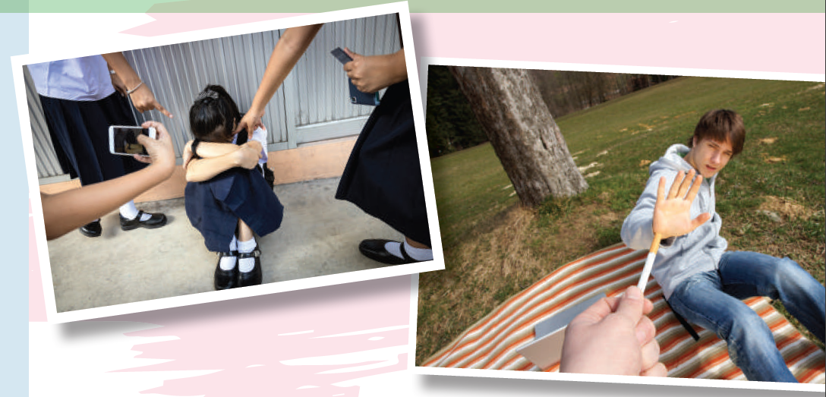
PRESENTATION
1
Listen and read.

Slide 16
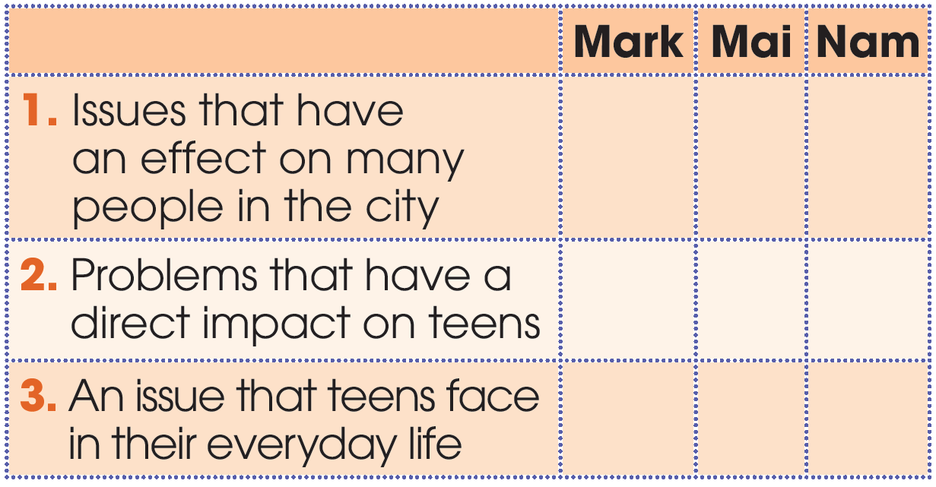
PRACTICE
2
Who suggests the following ideas? Tick (✓) the correct box.
✓
✓
✓
✓

Slide 17
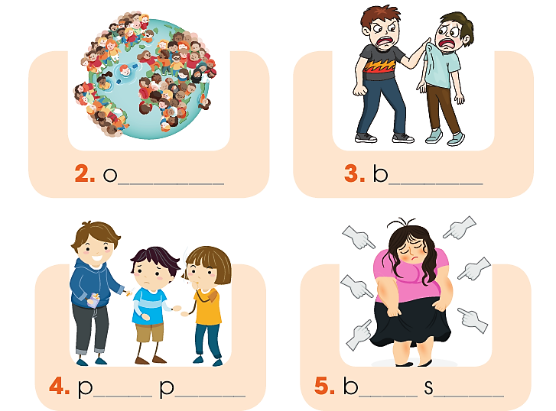
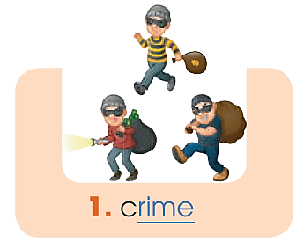
PRACTICE
3
Find five social issues in 1. Use the pictures and hints below to help you.
verpopulation
ullying
eer
ressure
ody
haming

Slide 18
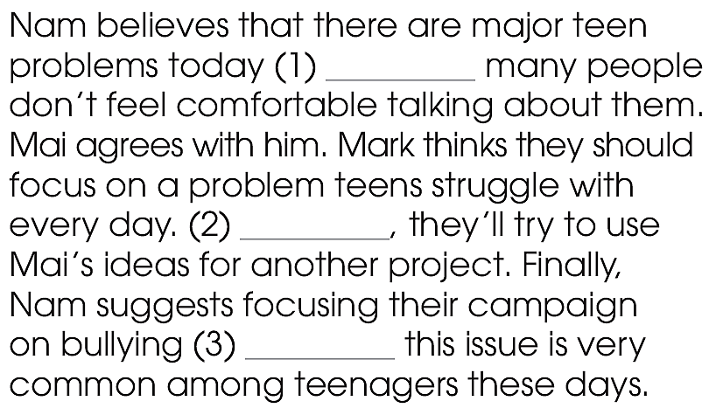
PRACTICE
4
Complete the summary with words from 1.
although
However
because

Slide 19

PRODUCTION
5
Discussion
Can you think of other social issues that directly affect teenagers?
What can we do to stop them or help the victims?

Slide 20
1. WRAP-UP
CONSOLIDATION
What have you learnt today?
A dialogue about a social awareness club meeting
Words and phrases rlated to social issues.

Slide 21
2. HOMEWORK
CONSOLIDATION
Do exercises in the workbook.
Prepare for Lesson 2 - Unit 9.
Prepare materials for the project in lesson 8

Slide 22

Website: hoclieu.vn
Fanpage: facebook.com/www.tienganhglobalsuccess.vn/

