Slide 2
Unit 7
The world of mass media
LESSON 2
LANGUAGE

Slide 3
LESSON 2
LANGUAGE
WARM-UP
Game: Say a name
PRONUNCIATION
- Task 1. Listen and repeat.
- Task 2. Mark the places.
- Task 1. Match the words with the meanings.
- Task 2. Complete the text.
VOCABULARY
- Task 1. Combine the sentences.
- Task 2. Talk about a type of mass media.
GRAMMAR
CONSOLIDATION
Wrap-up
Homework

Slide 4
WARM-UP
WATCH A VIDEO
Write the words with linking /r/ in the video

Slide 5
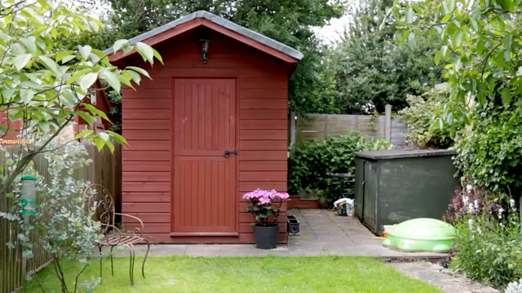
WARM-UP
WATCH A VIDEO
Notes:
Link: https://www.youtube.com/watch?v=wLprxwzWtc4

Slide 6

PRONUNCIATION
Linking /r/ between two vowels
Remember!
In natural and fast connected speech, a linking /r/ sound can appear between the vowel of one word ending in /ɑː/, /ɔː/, /ɜː/, /ə/, /ɪə/, /eə/, or /ʊə/ and the vowel of the next word.
1
Listen and repeat. Pay attention to the linking /r/. Then practise saying the sentences in pairs.
1. I’m sure an advert there can help draw attention to the event.
2. We can’t afford to promote the show as if it were a big profit-making event.
3. Perhaps you should consider all of our suggestions.
4. I’ll phone the local newspaper to see if they offer any discounts for charity advertising.

Slide 7
PRONUNCIATION
Mark ( ) the places where the linking /r/ can appear. Listen and check. Then practise saying the sentences.
2
1. I saw an interesting advert about the charity event.
2. Traditional mass media, for example, TV and newspapers, are still popular.
3. There are more adverts on TV nowadays.
4. There is a law against sharing private photos without permission.

Slide 8
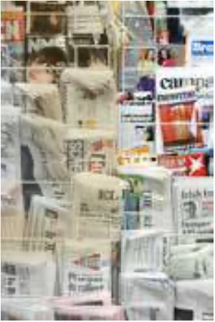




VOCABULARY
The mass media
1
Match each word (1–5) with its meaning (a–e).
1
4
the press(n)
reliable(adj)
a
to add the most recent information to something
b
newspapers and magazines
2
bias(n)
c
a strong feeling in favour of or against a group of people
d
that is likely to be true or correct
5
update(v)
fake news(n)
3
e
reports or stories that are not true

Slide 9
VOCABULARY
Complete the following text using the correct forms of the words in 1.
2
Nowadays, information on the Internet is (1) _________ very quickly. The Internet has also changed (2) ________, and forced newspapers and magazines to move online. However, not all information on the Internet is (3) _________. Some information sources on the Internet may spread (4) _________, which confuses people. Others may contain strong (5) _________ against certain groups of people in society such as women or old people. Therefore, users should be careful when accessing information on the Internet.
updated
the press
reliable
fake news
bias(es)

Slide 10
GRAMMAR
Adverbial clauses of manner and result
Remember!
An adverbial clause is a dependent clause that functions as an adverb. There are different types of adverbial clauses.
An adverbial clause of manner explains how something is done. It uses subordinating conjunctions such as as, as if, and like.
Example: He’s acting as if he were my father.
Note: We use the subjunctive were with all pronouns after as if.
An adverbial clause of result indicates the result of an action or a situation. It often uses subordinating conjunctions such as so ... that and such ... that.
Example: The weather was so hot that we couldn’t sleep.

Slide 11
GRAMMAR
1
Combine the sentences using suitable adverbial clauses.
1. My brother was looking at me nervously. I thought he was guilty of something.
->My brother was looking at me nervously like ____________________________________.
2. There is so much information available online. People sometimes get confused.
->There is so much information available online ____________________________________.
he was guilty of something
that people sometimes get confused

Slide 12
GRAMMAR
1
Combine the sentences using suitable adverbial clauses.
3. The injured reporter was talking in front of the camera. The pain didn’t affect him at all.
-> The injured reporter was talking in front of the camera _______________________________.
4. The Internet is a very powerful tool. As a result, it allows people to share information and ideas from around the world.
-> The Internet is such a powerful tool_______________________________________________
____________________.
as if the pain didn’t affect him at all
that it allows people to share information and ideas
from around the world

Slide 13

GRAMMAR
2
Work in pairs. Talk about a type of mass media you use in your everyday life, using adverbial clauses of manner and result.
Example:
I like watching TV so much that I always have the TV on at home. There are so many interesting programmes to watch that it is sometimes impossible to watch them all. When I’m not home, I watch my favourite TV channels
on my smartphone.

Slide 14
CONSOLIDATION
1
Wrap-up
What have you learnt today?
- Use the lexical items related to the topic The mass media;
- Recognise and practise the linking /r/;
- Review the use of adverbial clauses of manner and result.

Slide 15
CONSOLIDATION
2
Homework
Do exercises in the workbook.
Prepare for Lesson 3 - Reading.

Slide 16
Website: hoclieu.vn
Fanpage: facebook.com/www.tienganhglobalsuccess.vn

