Slide 1
KET SPEAKING
Time allowed - 8-10 minutes
Normally you will do the speaking test with another candidate. The two of you will meet two examiners. One of the examiners will talk to you, the other does not participate in the conversations.
There are two parts to the speaking test:
Speaking part 1: short questions and answers between you and the examiner.
Speaking part 2: the examiner gives you some information or a card with some ideas for questions. You have to talk with the other candidate and ask or answer questions.
Scoring The Speaking section is worth 25% of the total score for the exam.
How to prepare for KET Speaking:
Speak as much as you can, with your friends
Practise asking and answering questions about daily life
Practise giving information about yourself

Slide 2
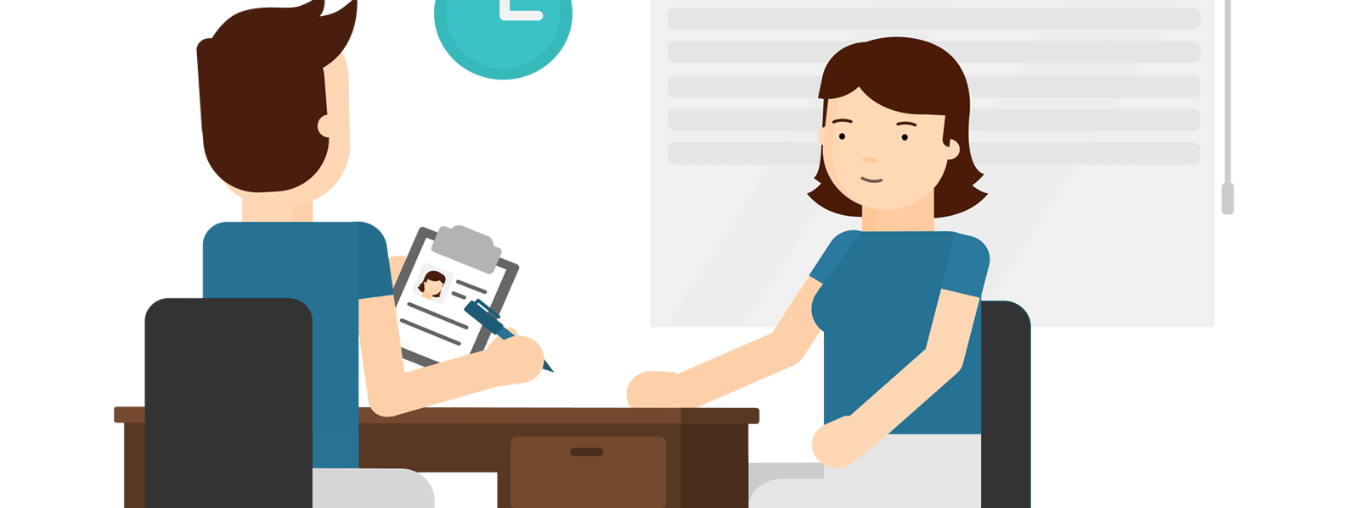
KEY ENGLISH TEST 5
Test 2 - Speaking

Slide 3
Part 1: Student – examiner interaction
Section 1:
The examiner will ask you:
Your name
Where you come from?
Provide full-sentence answers

Slide 4
Part 1: Student – examiner interaction
Section 2: You will be asked some questions that require longer answers. For example:
Why you like something
Details about a hobby…

Slide 5
family
best friend
hometown
your house
sport
computer
collecting
music
Popular topic

Slide 6
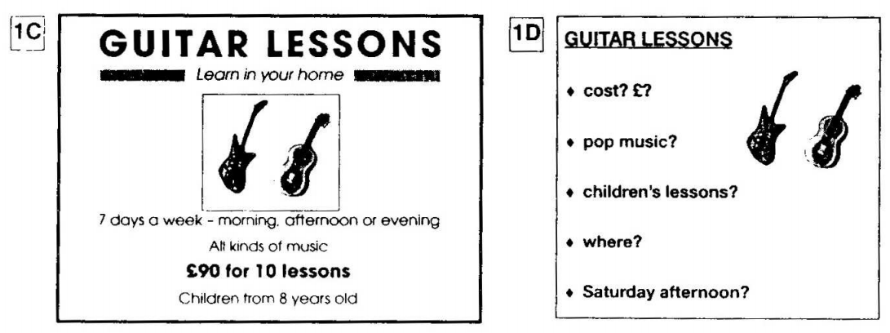
PART 2: Student – student interaction
Ask and answer questions based on the cue cards
For example:
Do not just read from the cards. Answer in full sentences.
Pay attention to the grammar.

Slide 7
SPEAKING PART 1

Slide 8
Part 1
What are you going to do when you leave school?
When are you going to leave school?
Are you going to study at university?
What are you going to study?
What do you want to be? Why?
Do you have any plans for the future?
What type of house are you going to live in?

Slide 10
USEFUL VOCABULARY
to be called for an interview: to be invited to attend an interview
to be your own boss: to have your own business
a high-powered job: an important or powerful job
manual work: work that requires physical activity
to run your own business: see ‘to be your own boss’
to work with your hands: to do manual work

Slide 11
Will you go to live in another country? Where? Why?

Slide 12
Talk about your dream job in the future
What this job would be
Where you would work
Which qualifications you would need and.
And explain why you would like to have this job most.

Slide 13
SPEAKING PART 2
Asking and answering questions using these prompt cards

Slide 14
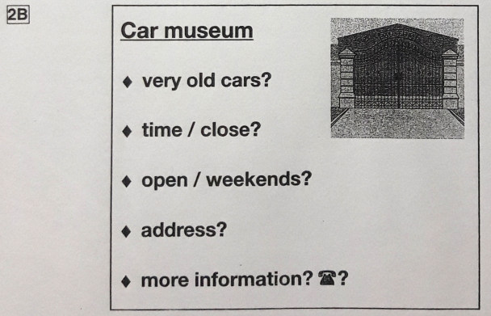
Ask and answer
Ask and answer questions using the words given.

Slide 15
Ask and answer
Ask and answer questions using the words given.
What are other questions and answers you can think of?

Slide 16
Based on the given information, talk about Visit Greystone Castle.

