Slide 1
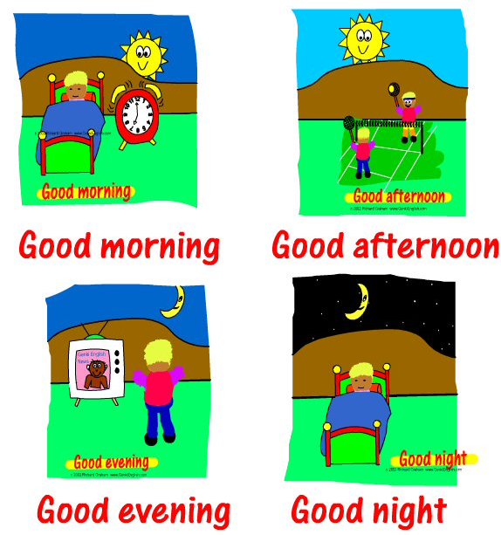
&
FAREWELL
GREETINGS

Slide 2
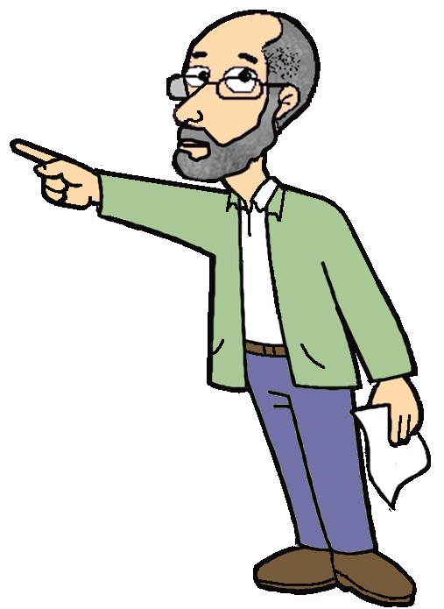
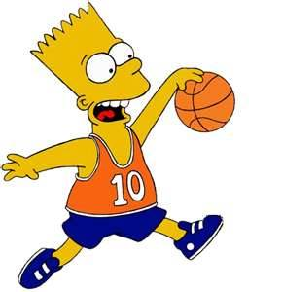
My name is Bart Simpson.
Hi. What’s your name?

Slide 3
Nice to meet you.
Nice to meet you too.

Slide 4
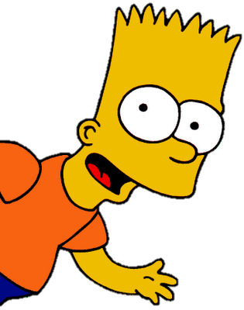
Hi.
How are you?
Fine.
Thanks.
Good.
How about you?

Slide 5
Hello !

Slide 6
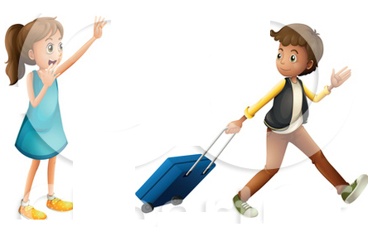
Goodbye !

Slide 7
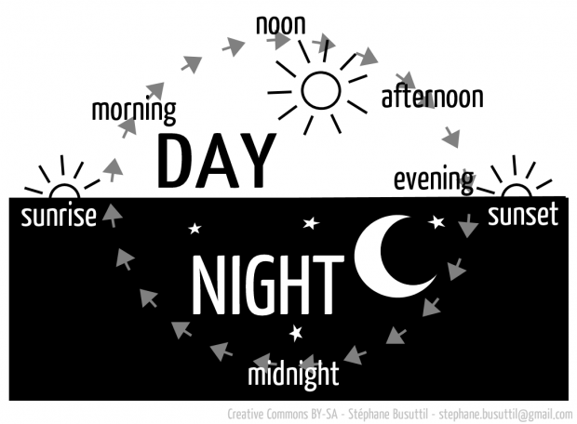
Let’s read the words.

Slide 8
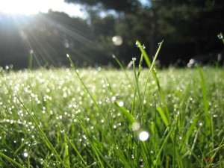
morning (am)
from 6:00 to 12:00

Slide 9
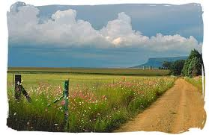
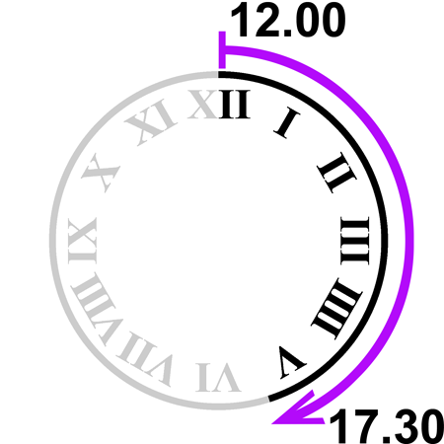
afternoon (pm)

Slide 10
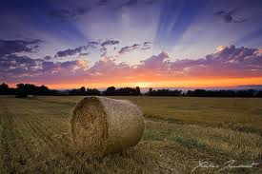
evening (pm)
from 5:30
to 10:00

Slide 11
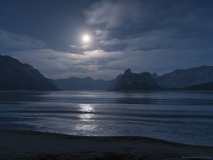
night (pm)
after 10:00

Slide 12
Read.
Match the pictures.

Slide 13
What’s your favourite
part of the day?
My favourite part of the day is ____________.
morning
afternoon
evening
night

Slide 14
Read the rhyme together.

Slide 15
on leaving:
©dorkas

Slide 16
SƯU TẦM: ĐOÀN VĂN DOANH, NAM TRỰC, NAM ĐỊNH
LINK NHÓM DÀNH CHO GV BỘ MÔN VẬT LÝ TRAO ĐỔI TÀI LIỆU VÀ CHUYÊN MÔN CT 2018
https://www.facebook.com/groups/299257004355186

