Slide 1


Slide 2

Unit
6
1
Unit
FAMILY LIFE
GENDER EQUALITY
LESSON 3
READING
For an equal world

Slide 3

Unit
1
1
FAMILY LIFE
Family Life
Unit
OBJECTIVES
Knowledge
Read for specific information about gender equality in employment
Core competence
Develop communication skills and creativity
Be collaborative and supportive in pair work and teamwork
Develop presentation skills
Personal qualities
Understand more about the gender equality and existing problems
Develop a self-reliant attitude

Slide 4
LESSON 3
READING
Small talk: Gender privileges
WARM-UP
Task 1: Match the sentences with the pictures
PRE-READING
Task 2: Read the text and circle the correct meaning of the highlighted words and phrases
Task 3: Read the text again and decide whether the following statements are True (T), False (F), Not given (NG)
WHILE-READING
POST-READING
Task 4: Work in groups. Discuss possible solutions to one of the following problems
CONSOLIDATION
Wrap-up
Homework

Slide 5
LESSON 3
READING
Small talk: Gender privileges
WARM-UP

Slide 6
WARM-UP
Gender privileges
List some activities boys are allowed to do but girls are not.
List some activities girls are allowed to do but boys are not.
Are such advantages fair/unfair?

Slide 7
LESSON 3
READING
Small talk: Gender privileges
WARM-UP
Vocabulary
PRE-READING

Slide 8
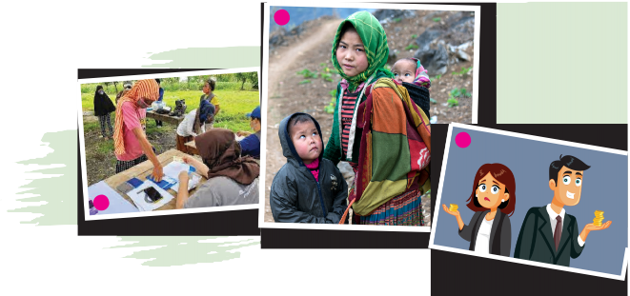
PRE-READING
1
Match the sentence with the pictures.
1
Men often earn more than women for doing the same job.
A child mother takes care of her small kids.
Some women are unable to read and write.

Slide 9
LESSON 3
READING
Small talk: Gender privileges
WARM-UP
Task 1: Match the sentences with the pictures
PRE-READING
Task 2: Read the text and circle the correct meaning of the highlighted words and phrases
Task 3: Read the text again and decide whether the following statements are True (T), False (F), Not given (NG)
WHILE-READING

Slide 10
WHILE-READING
2
Read the text and circle the correct meaning of the highlighted words and phrases.
1. Be forced Be made to do something unwanted Be made to do something necessary 2. Domestic violence Action taken to please someone Behaviour to hurt someone you live with | 3. Uneducated Having little or no education at school Not having many job opportunities 4. Low-paying Giving money to a person Providing very little money

Slide 11
WHILE-READING
3
Read the text again and decide whether the following statements are True (T), False (F), Not given (NG).
 | T | F | NG
1. Child marriage involves a girl under the age of 18.
2. Fewer men than women around the world are uneducated.
3. Men work much less than women but earn much more.
3. Men’s career choices lead to high-paying jobs.
4. Only individuals must work towards gender equality.
✓
✓
✓
✓
✓

Slide 12
LESSON 3
READING
Small talk: Gender privileges
WARM-UP
Task 1: Match the sentences with the pictures
PRE-READING
Task 2: Read the text and circle the correct meaning of the highlighted words and phrases
Task 3: Read the text again and decide whether the following statements are True (T), False (F), Not given (NG)
WHILE-READING
POST-READING
Task 4: Work in groups. Discuss possible solutions to one of the following problems

Slide 13
POST-READING
PRESIDENTIAL ELECTION:
Work in groups of four and roleplay as “president candidate”. Discuss ideas and make a speech about what you would do to solve ONE of these problems:
Child marriage
A lack of education for girls
Low pay for women

Slide 14

POST-READING
VOTING TIME!
Listen to other groups and vote for the most persuasive speech.
The group with most votes becomes “President”!
Child marriage
A lack of education for girls
Low pay for women

Slide 15
SUGGESTED SOLUTIONS
Child marriage
Educating girls: When girls can go to school and stay long there, they will get the knowledge and skills necessary to support themselves and their families.
Giving girls the right to decide their future: If girls are knowledgeable and independent, they won’t choose to get married early.
Educating parents and other adults: When parents and other adults know about the negative impact of child marriage, they will change their views and support girls’ rights.

Slide 16
SUGGESTED SOLUTIONS
A lack of education for girls
Keeping girls in school: Poverty can prevent or stop girls from going to school. Education should be free, and governments and charity organizations should help poor families pay for transport, textbooks and uniforms.
Making school safe for girls: It’s not safe for girls to travel long distances to school. Also, at school, girls may become victims of violence and bullying.
Reducing girls’ workload at home: In developing countries, girls may be kept home to do household chores like carrying water, preparing food and washing clothes. Sharing housework between all members of the family helps girls succeed in getting an education.

Slide 17
SUGGESTED SOLUTIONS
Low pay for women
Supporting equal pay: Companies have to commit to and provide equal pay for equal work.
Making salary information clear: Payment should be made clear to both genders so that women know if they make less money than men for doing the same job.
Sharing housework: When couples share household chores, women can focus on their paid jobs.

Slide 18
LESSON 3
READING
Small talk: Gender privileges
WARM-UP
Task 1: Match the sentences with the pictures
PRE-READING
Task 2: Read the text and circle the correct meaning of the highlighted words and phrases
Task 3: Read the text again and decide whether the following statements are True (T), False (F), Not given (NG)
WHILE-READING
POST-READING
Task 4: Work in groups. Discuss possible solutions to one of the following problems
CONSOLIDATION
Wrap-up
Homework

Slide 19
CONSOLIDATION
1
Wrap-up
Vocabulary related to gender equality
Skills: Reading for specific information about gender equality in employment

Slide 20
CONSOLIDATION
2
Homework
Do exercises in the workbook.
Prepare for Speaking lesson: Write down your opinion about gender equality in bullet points.

Slide 21


