Slide 1

Unit 5: London Was Great!
Lesson 5h: Right on!
Page 99

Slide 2
Lesson Outline
Warm-up
Project
Consolidation
Wrap-up

Slide 3
Objectives
By the end of this lesson, students will be able to…
create a poster of national wonders around the world.
develop presentation skills by giving a presentation on wonders around the world.
talk about the value of being a responsible traveller.

Slide 4

WARM-UP

Slide 5

This stone statue of Admiral Horatio Nelson, a hero in the British Navy, stands on a tall column, so its total height is 55.6 m! There are four bronze lions at the base.
51.6 m
Name:…………………………………….
Which information is incorrect?

Slide 6

This steel bridge across San Francisco Bay opened in 1937. It is 2.7 km long. Its bright colour, International Orange, helps people see the bridge in the snow.
fog
Name:…………………………………….
Which information is incorrect?

Slide 7

Emperor Shah Jahan built this amazing marble building in memory of his wife, Mumtaz Mahal. It’s the most popular tourist attraction in Italy.
India
Name:…………………………………….
Which information is incorrect?

Slide 8

It’s time to learn …

Slide 9

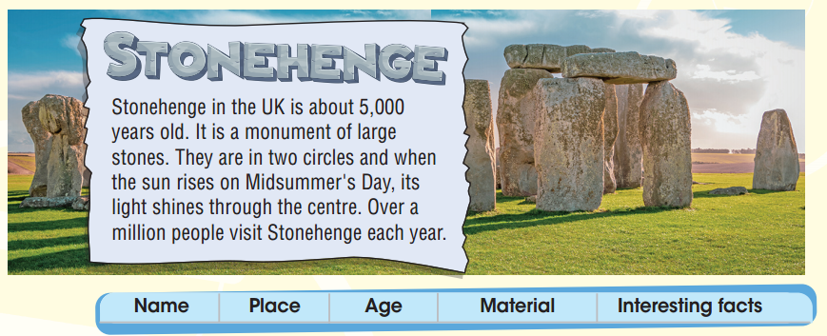
Work in groups.

Slide 10
Stonehenge
Name | Place | Age | Material | Interesting facts

Slide 11
Stonehenge
Name | Place | Age | Material | Interesting facts
Stonehenge | UK | 5,000 | stone | The sun on Midsummer’s Day shines through the centre. Over a million visitors per year.

Slide 12
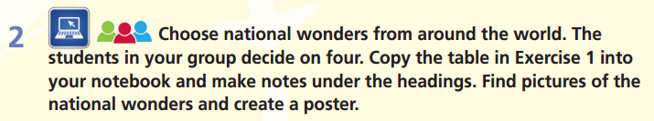

Slide 13
Research online and find information about four national wonders. Make notes, add pictures, and use notes to make a poster.
Name | Place | Age | Material | Interesting facts
1.
2.
3.
4.

Slide 14
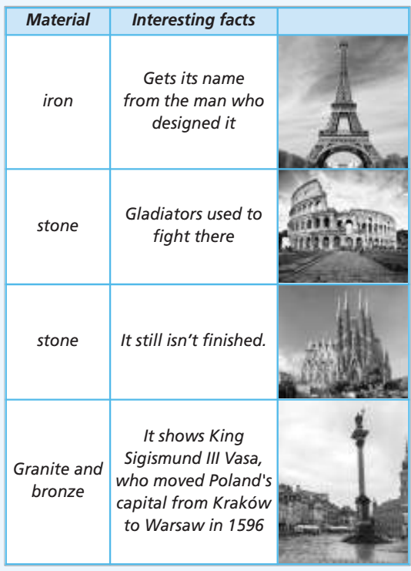
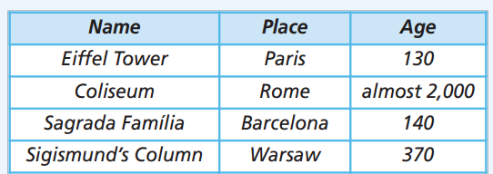
SAMPLE
POSTER

Slide 15
Groups of students present their national wonders to the class.
Hello everyone.
Welcome to our presentation. Today we want to tell you about some famous national wonders. Perhaps you will know some of them.
First of all, ………..
Another place you should see is ………….
One more place you might want to visit is ……………
The last wonder you should know is ………………..
If you get a chance to visit them, you should.
Thanks for listening.

Slide 16
Presentations tips
Keep eye contact with the class.
Look around the class.
Point at the poster (pictures, text…) when needed.
Use suitable movements.
Don’t turn your back to the class.
Be confident!
Speak loudly and clearly.

Slide 17
Evaluation form
While your friends are making a presentation, please leave your comments on the following form.
Criteria | Yes | No | Comments (if any)
Poster Nice pictures/drawings Clear and brief information Interesting content | ✓ | ✓
Presentation skills Confident Loud and clear voice Good eye-contact Suitable movement

Slide 18
Sample presentation
Good morning. Today I want to tell you about some famous landmarks. Perhaps you will know some of them.
The Eiffel Tower is an iron landmark in Paris. It is around 130 years old. It gets its name from the man who designed it.
The Colosseum is a stone landmark in Rome. It is almost 2,000 years old. Gladiators used to fight there.
The Sagrada Família is a stone landmark in Barcelona. It is around 140 years old, and it still isn’t finished.
Sigismund’s Column is a granite and bronze landmark in Warsaw. It is around 370 years old, and it shows King Sigismund III Vasa, who moved Poland's capital from Kraków to Warsaw in 1596.
If you get a chance to visit them, you should.
Thanks for listening.

Slide 19
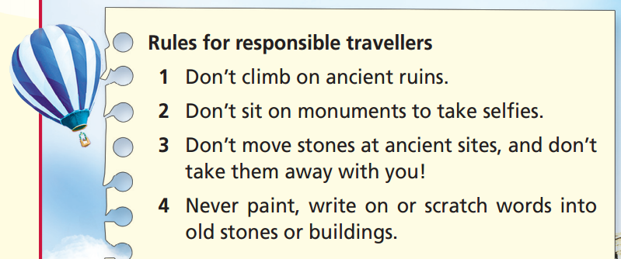
Read the rules. Why do we have these rules?
Which one could you do when you went on holiday?
We have these rules to protect our monuments
and ancient ruins.

Slide 20
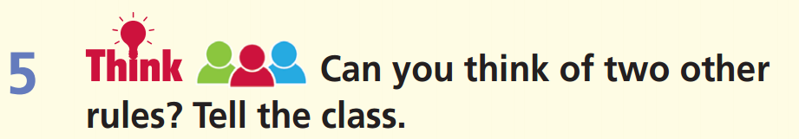
Work in groups.
You can draw some illustrations for your rules.

Slide 21
Present the rules to the class.
Hello everyone.
My name is …. I am here today to share with you some rules we should follow so that we can become responsible travellers.
First, we should/ shouldn’t ……. Second, ……….
There are so many rules for us to follow. Let’s do it together to protect the national wonders around us. Thanks for listening.

Slide 22
Hello everyone.
My name is …. I am here today to share with you some rules we should follow so that we can become responsible travellers.
First, we shouldn’t drop litter. Second, we shouldn’t write on the walls. Third, we should respect local culture and traditions.
There are so many rules for us to follow. Let’s do it together to protect the national wonders around us. Thanks for listening.

Slide 23

CONSOLIDATION

Slide 24
Write a letter of 50-60 words to a friend about a famous wonder in your country. Write about where it is, its history, its interesting facts, and rules that you must follow when visiting this place.

Slide 25

WRAP-UP

Slide 26
Today’s lesson
Create a poster of national wonders around the world.
Develop presentation skills by giving a presentation on wonders around the world.
Talk about the value of being a responsible traveller.

Slide 27
Homework
Practise the vocabularies and make sentences using them.
Prepare the next lesson (p. 100 SB).

Slide 28
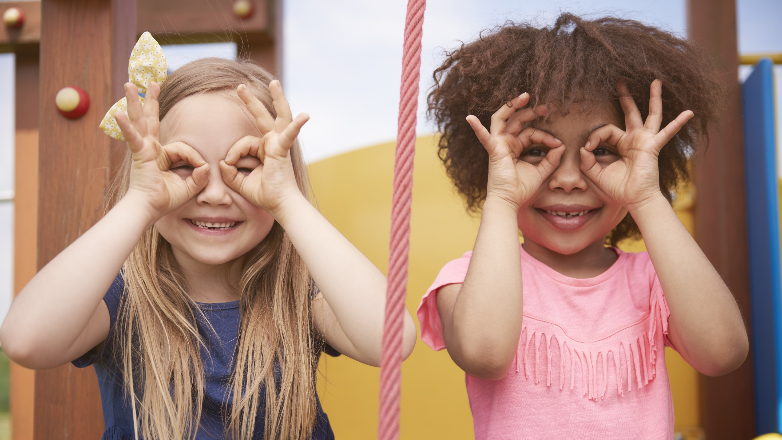
Enjoy your day!

