Slide 1

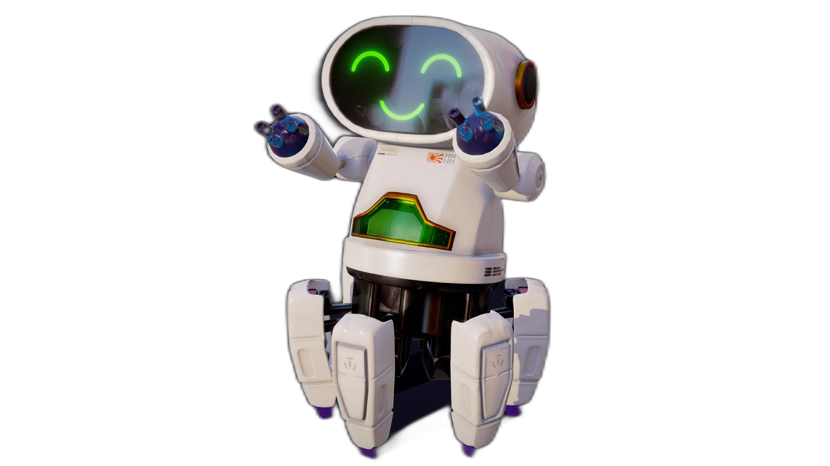

Slide 2


Unit
12
ROBOTS
LESSON 7: LOOKING BACK & PROJECT

Slide 3


LESSON 7: LOOKING BACK & PROJECT
LESSON 1: GETTING STARTED
Quiz
WARM-UP
Task 2: Fill in the blanks with the verbs from the box. (p. 66)
Task 3: Use the correct form of the adjectives in brackets to complete the paragraph. (p. 66)
Task 4: Complete the sentences with the superlative form of the adjectives in the brackets. (p. 66)
LOOKING BACK
PROJECT
Robot Design Competition
CONSOLIDATION
Wrap-up
Homework

Slide 4

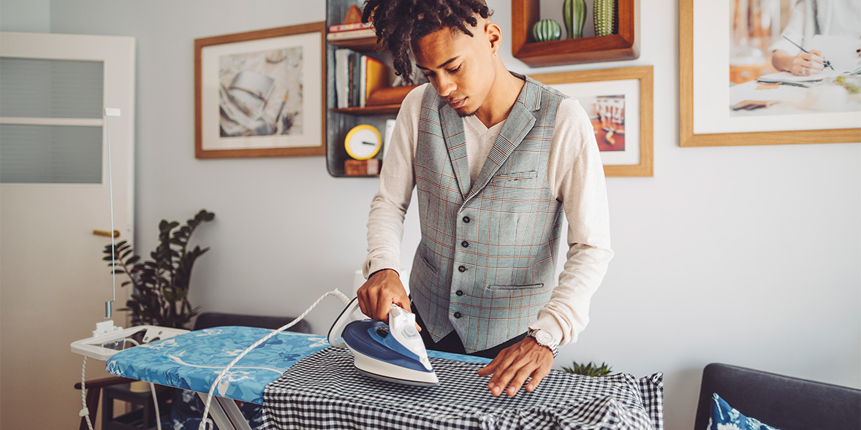
WARM-UP
QUIZ
TIME

Slide 5
WARM-UP
Work in groups
Write your answers in your miniboard.
The group having the most right answers is the winner.

Slide 6

WARM-UP
iron the clothes
1........................................................

Slide 7
WARM-UP
move heavy things
2................................................

Slide 8
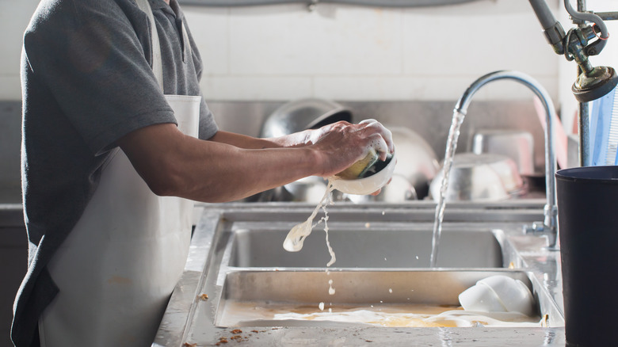
WARM-UP
pick fruit
3..............................................

Slide 9
WARM-UP
do the dishes/wash dishes
3....................................

Slide 10
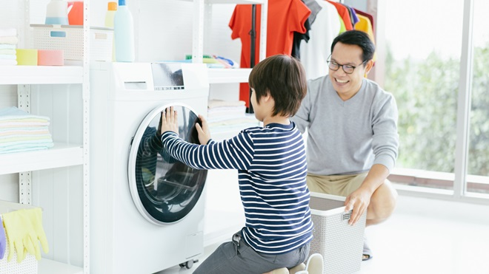
WARM-UP
do the washing/wash clothes
3....................................

Slide 11
LESSON 7: LOOKING BACK & PROJECT
LESSON 1: GETTING STARTED
Quiz
WARM-UP
Task 2: Fill in the blanks with the verbs from the box. (p. 66)
Task 3: Use the correct form of the adjectives in brackets to complete the paragraph. (p. 66)
Task 4: Complete the sentences with the superlative form of the adjectives in the brackets. (p. 66)
LOOKING BACK

Slide 12


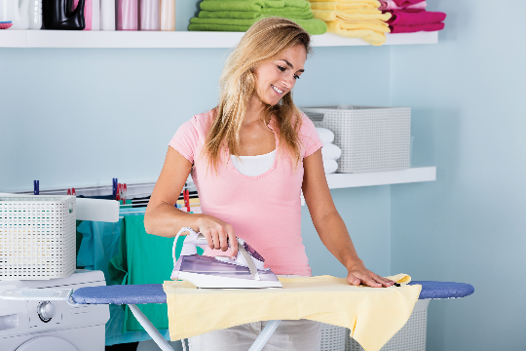
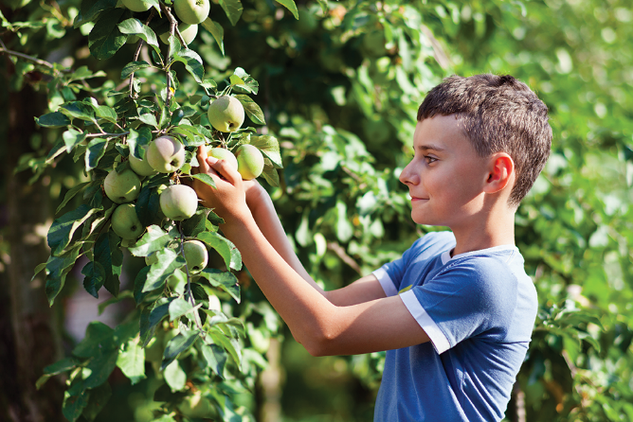
LOOKING BACK
Write the correct words to complete the phrases.
2.
_______ heavy things
1.
_______ the clothes
2.
move heavy things
1.
iron the clothes
3.
_______ fruit
3.
pick fruit

Slide 13
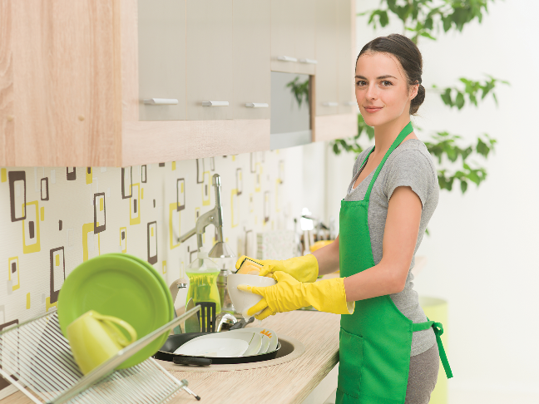
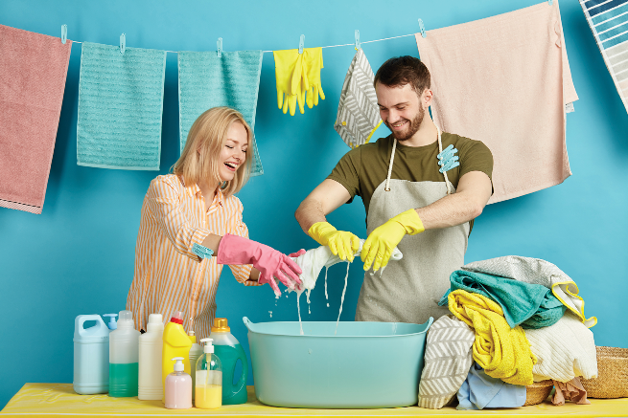
LOOKING BACK
Write the correct words to complete the phrases.
4.
4.
_______ the dishes
do the washing
5.
do the _______
5.
do the dishes

Slide 14

LOOKING BACK
Fill in the blanks with the verbs from the box.
water | make | repair | work | understand
work
1. Robots can_______ as guards when we’re away.
2. We rarely go to restaurants because my father can_______ delicious meals at home.
make
repair
3. Can you_______ my broken clock?

Slide 15
LOOKING BACK
Fill in the blanks with the verbs from the box.
water | make | repair | work | understand
understand
4. Can robots_______ our feelings
water
5. My father and I _______ the plants in our garden every morning.

Slide 16

LOOKING BACK
smartest
Welcome to our company. We’ve made the (1. smart) robot in the world. It’s the (2. small) and the (3. light)
we’ve made but it can do many things in your house. It can even ﬂy to clean the ceilings. It can teach children all school subjects. It’s also the (4. strong) in our lab because it can move more than 200 kg. It’s not difficult to own a robot like this because it’s one of the (5. cheap) robots in the world
Use the correct form of the adjectives in brackets to complete the paragraph.
smallest
lightest
strongest
cheapest

Slide 17

LOOKING BACK
Complete the sentences with the superlative form of the adjectives in the brackets.
highest
1. What is the (high) mountain in the world?
largest
2. What is the (large) lake in Viet Nam?
longest
3. What is the (long) beach in Viet Nam?
widest
4. What is the (wide) river in the world?
hottest
5. What is the (hot) desert in the world?
Do you know the answers?

Slide 18
LESSON 7: LOOKING BACK & PROJECT
LESSON 1: GETTING STARTED
Quiz
WARM-UP
Task 2: Fill in the blanks with the verbs from the box. (p. 66)
Task 3: Use the correct form of the adjectives in brackets to complete the paragraph. (p. 66)
Task 4: Complete the sentences with the superlative form of the adjectives in the brackets. (p. 66)
LOOKING BACK
PROJECT
Robot Design Competition

Slide 19

Robot Design Competition

Slide 20
Robot
Design
Competition
PROJECT
Work in groups
Think about the robot you will design and fill in the table
Design your amazing robot in the A0 paper.
Robot Design Competition

Slide 21
PROJECT
Robot name
Appearance (weight, height, etc.)
Where it can work
What it can do
Robot
Design
Competition

Slide 22
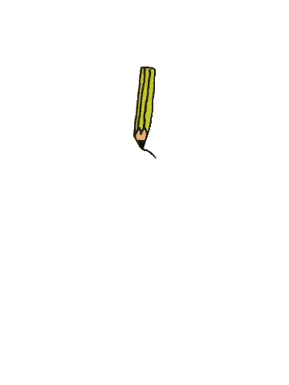
PROJECT
Draw your robot here
Robot
Design
Competition

Slide 23
PROJECT
Present your designs to other groups. Vote on the best robot.
Robot
Design
Competition

Slide 24
Now I can … |  |  | 
use the words for daily activities.
say statements with correct tones.
compare people and things using superlative adjectives.
express agreement and disagreement about something.
read about a robot show.
talk about what robots can do.
listen about what robots can do.
write a paragraph about a robot.
✓
✓
✓
✓
✓
✓
✓
✓
✓
✓
✓
✓
✓
✓
✓
✓
✓
✓
✓
✓
✓
✓
✓
✓

Slide 25
LESSON 7: LOOKING BACK & PROJECT
LESSON 1: GETTING STARTED
Quiz
WARM-UP
Task 2: Fill in the blanks with the verbs from the box. (p. 66)
Task 3: Use the correct form of the adjectives in brackets to complete the paragraph. (p. 66)
Task 4: Complete the sentences with the superlative form of the adjectives in the brackets. (p. 66)
LOOKING BACK
PROJECT
Robot Design Competition
CONSOLIDATION
Wrap-up
Homework

Slide 26

CONSOLIDATION
1
Wrap-up
What have we learnt in this lesson?
Review the vocabulary and grammar of Unit 12
Apply what they have learnt (vocabulary and grammar) into practice through a project

Slide 27

CONSOLIDATION
2
Homework
Prepare for the next lesson: Review 4 (Units 10-11-12).

Slide 28






Website: hoclieu.vn
Fanpage: facebook.com/www.tienganhglobalsuccess.vn/

