Slide 1

Unit 7: Movies
Lesson 3.1: Reading and Writing
Page 61

Slide 2
Lesson Outline
Warm-up
Reading
Writing
Consolidation
Wrap-up

Slide 3
Objectives
By the end of this lesson, students will be able to…
Reading: read a movie review about a famous person from history in a movie.
Writing: write a paragraph about a historical movie.

Slide 4

WARM-UP

Slide 5
Put these words in the correct column
soldiers history general battle army invaders
Words stressed on the first syllable | Words stressed on the second syllable
soldiers
invaders
history
general
battle
army

Slide 6
What do you remember from the last lesson? Which word is this?
S
A
Army
Soldier
I
K
Invaders
King
B
G
Battle
General

Slide 7
Who do you think of?
a famous Vietnamese King
Quang Trung
born in 1753
Người Anh Hùng Áo Vải
Ngọc Hồi – Đống Đa – 1789
What else do you know about him?
- When did he become King?
- Did he use horses?

Slide 8
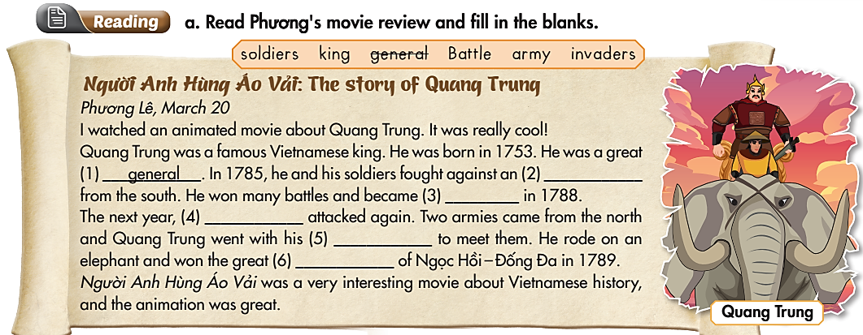
While-Reading
army
King
invaders
soldiers
Battle
Notes:
T can suggest S to watch the movie on youtube.

Slide 9
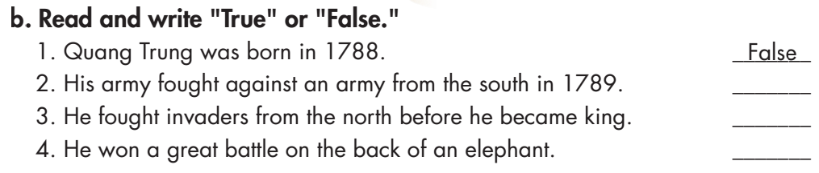
While-Reading
Underline the key words

Slide 10
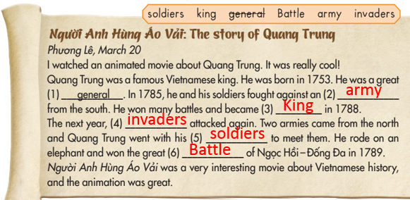
False

Slide 11
False
True

Slide 12

Work in pairs. Practice the conversation
A: What is the name of the movie?
B: It’s Anh Hùng Áo Vải.
A: What is the movie about?
B: It’s about Quang Trung.
A: When was he born?
B: He was born in 1753.
A: When did he become King?
B: He became King in 1788.
A: What is he famous for?
B: He is famous for the great battle of Ngọc Hồi - Đống Đa in 1789.

Slide 13
Use this conversation to ask and answer about movie
A: What is the name of the movie?
B: It’s _________.
A: What is the movie about?
B: It’s about ________.
A: When was he/she born?
B: He/ She was born ________.
A: When did he/she become King/ Queen?
B: He/ She became King/ Queen in _________.
A: What is he/ she famous for?
B: He/ She is famous for ____________.

Slide 14
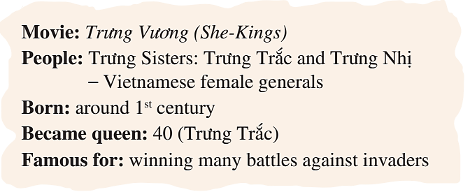
You answer your friend B’s questions about Movie Trưng Vương. And ask for information about the movie your friend watched. Fill in the table.
Student A:
Movie:
Person:
Born:
Became King:
Famous for:

Slide 15
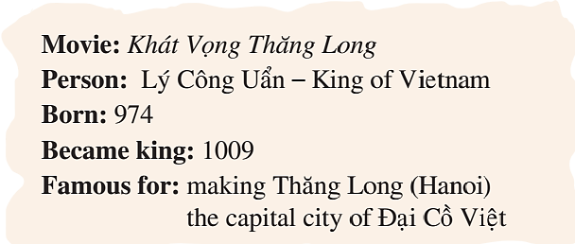
Student B:
You answer your friend A’s questions about Movie Khát Vọng Thăng Long. And ask for information about the movie your friend watched. Fill in the table.
Movie:
People:
Born:
Became King/Queen:
Famous for:

Slide 16
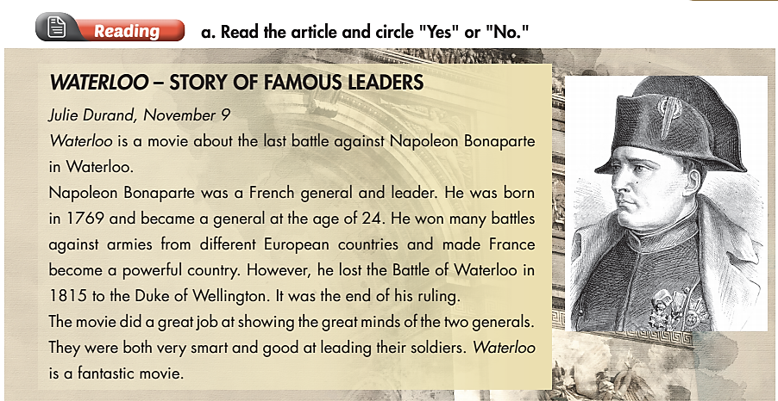
Extra Practice
WB page 43

Slide 17
Extra Practice
WB page 43

Slide 18

Extra Practice
WB page 43

Slide 19
Extra Practice
WB page 43

Slide 20
I know the movie……….
It is about………………….
He/ She was born in……
He/ She is famous for……

Slide 21

Writing

Slide 22
Work in pairs. List down some movies about famous people from history.
Pre-Writing
movies about famous people

Slide 23
Pre-Writing
Rearrange the words to make a complete sentence
movie I historical the Trưng Vương watched
I watched the historical movie Trưng Vương.
born in and he was 1769 became in 1793 a general
He was born in 1769 and became a general in 1793.
his soldiers against from an army He the south and fought
He and his soldiers fought against an army from the south.
like watch this movie you if should you history
If you like history, you should watch this movie.

Slide 24
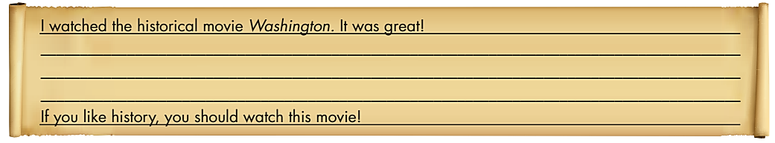
Pre-Writing
Movie Review
Introductory sentences
Conclusion

Slide 25
Work in pairs. List down some useful vocabulary to write a movie review about a person in history
Battle - first battle - last battle
Win-won
Useful
Vocabulary
King/ Queen/ general/ president
Fight-fought + against
Fantastic
army
war

Slide 26
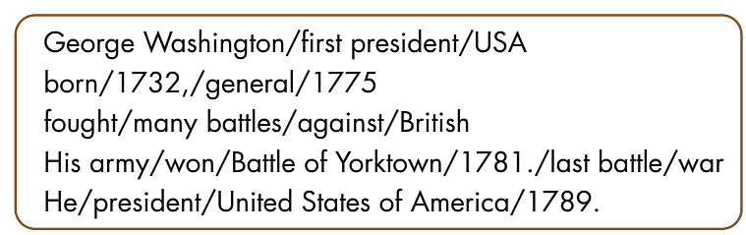
While-Writing
a. With a partner, use the notes to make sentences about the famous American, George Washington.

Slide 27
a. With a partner, use the notes to make sentences about the famous American, George Washington.
George Washington/ first president/ USA
George Washington was the first president of the USA.
born/ 1732,/ general/ 1775
He was born in 1732 and became a general in 1775.
fought/ many battles/ against/ British
He fought many battles against the British.
His army/ won/ Battle of Yorktown/ 1781./ last battle/ war
His army won the Battle of Yorktown in 1781. It was the last
battle of the war.
He/ president/ United States of America/ 1789.
He became president of the United States of America in 1789.

Slide 28
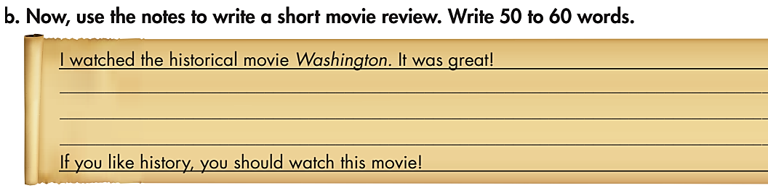
While-Writing

Slide 29
While-Writing
I watched the historical movie Washington. It was great! It was about George Washington. He was the first president of the USA. He was born in 1732 and he became a general in 1775. He fought many battles against the British. His army won the Battle of Yorktown in 1781. It was the last battle of the war. He became president of the United States of America in 1789. If you like history, you should watch this movie!

Slide 30
Post-Writing
Choose a movie about a famous person from history and write a movie review.
I watched the historical movie _______. It was great! It was about _______. He/ She was the _______ . He/ She was born _______ and he became a _______ in _______. He/ She fought many battles against _______ in______. If you like history, you should watch this movie!

Slide 31

CONSOLIDATION

Slide 32
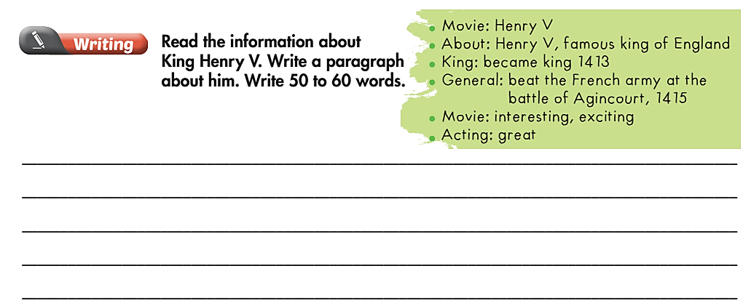
Extra Practice
WB page 43

Slide 33
I watched the movie Henry V. Henry V was a very famous king of England. He became king in 1413. His army won a battle against the French army at Agincourt in 1415. The movie was interesting and exciting. The acting was great!

Slide 34

WRAP-UP

Slide 35
Today’s lesson
Reading
read a movie review about a famous
person from history in a movie
Writing
write a paragraph about a historical movie.

Slide 36
Homework
Do the exercises on page 43 WB.
Complete the writing notes in Tiếng Anh 6 i-Learn Smart World Notebook on page 45.
Prepare the review lesson (pages 98 & 99 - SB)
Play the consolidation games in Tiếng Anh 6 i-Learn Smart World DHA App on www.eduhome.com.vn

Slide 37
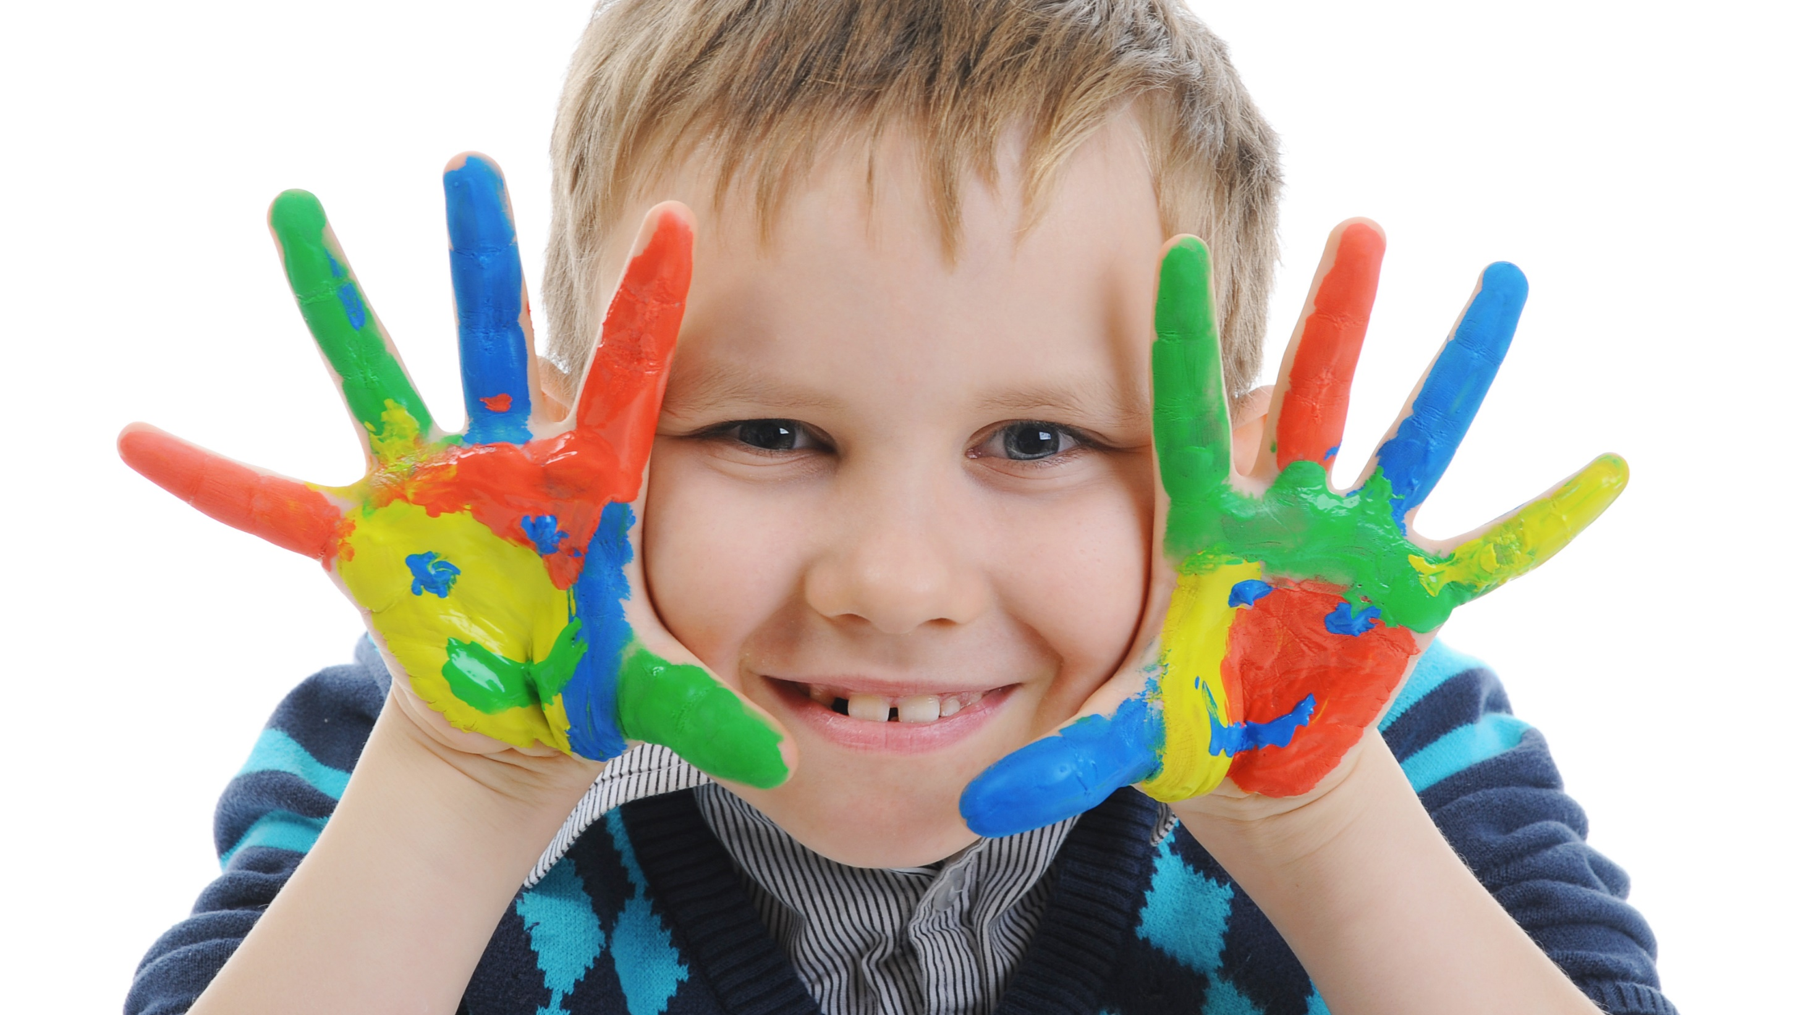
Enjoy your day!

