Slide 2
Unit 6
Artificial Intelligence
LESSON 6
WRITING
An essay about the advantages and disadvantages of home robots

Slide 3
LESSON 6
WRITING
WARM-UP
Watch a video
PRE-WRITING
- Task 1: Decide advantages or disadvantages. Then complete the notes.
WHILE-WRITING
- Task 2: Write an essay (180–200 words) about the advantages and disadvantages of home robots.
POST-WRITING
Peer review
CONSOLIDATION
- Wrap-up
- Homework

Slide 4
WARM-UP
Watch a video
- Teacher divides the class into 2 groups.
- Before playing the video, teacher asks Ss to watch carefully and try to remember as many details as possible. Ss can take notes if they want.
- Teacher shows the question, Ss write down all the answers, as many as possible.
- The team with more correct answers will be the winner.

Slide 5

WARM-UP
Questions: What can the robot in the video do?

Slide 6
WARM-UP
Suggested answers:
- listen and follow the user’s commands;
- make video calls;
- remind people what to do everyday;
- self-charge automatically;
- detect unusual situations,
- etc…

Slide 7
PRE-WRITING
Work in pairs. Decide whether the following ideas (a–d) are advantages (+) or disadvantages (–) of home robots. Then complete the notes using the sentences (a–d) in the box.
1
Advantages/ Disadvantages | Ideas
 | A. People will have more time for leisure activities and family bonding. Robots can do repetitive and boring jobs. (1) _______________________
 | B. Humans can become dependent on AI technologies. (2) _______________________ They may become lazy.
b. They can work without a break and provide 24/7 service.
a. They may lose their critical thinking skills.

Slide 8
PRE-WRITING
Work in pairs. Decide whether the following ideas (a–d) are advantages (+) or disadvantages (–) of home robots. Then complete the notes using the sentences (a–d) in the box.
1
Advantages/ Disadvantages | Ideas
 | C. The cost of development and maintenance of robots is high. Robots need expensive spare parts. (3) __________________________________
 | D. They can answer questions about many topics. l (4) _________________________________ l They can provide information and entertainment.
d. They need to be programmed to perform each task.
c. They can interact and play games with people.

Slide 9
WHILE-WRITING
Write an essay (180–200 words) about the advantages and disadvantages of home robots, using the ideas in task 1 and the suggested outline below.
3
Introduction
People are beginning to use home robots.
They have advantages and disadvantages.
_______________________________________________
Body
Advantages: Using home robots has several advantages. _____________
Disadvantages: _______________________________________________
Conclusion
Home robots may make lives easier and happier, but there are certain problems as well.

Slide 10
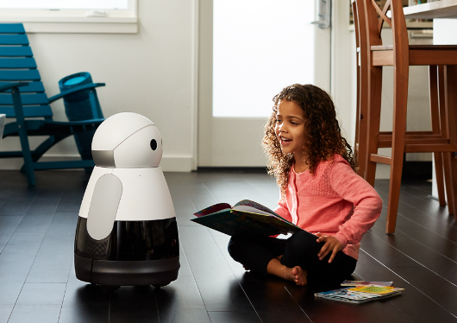
POST-WRITING
4
Cross-checking
Suggested writing rubric
1. Organization: …/10
2. Legibility: …/10
3. Ideas: …/10
4. Word choice: …/10
5. Grammar usage and mechanics: …/10
TOTAL: …/50

Slide 11
CONSOLIDATION
1
Wrap-up
What have you learnt today?
Write an essay to present about the advantages and disadvantages of home robots.

Slide 12
CONSOLIDATION
2
Homework
Do exercises in the workbook.
Prepare for Lesson 7 – Communication & Culture.

Slide 13
Website: hoclieu.vn
Fanpage: facebook.com/www.tienganhglobalsuccess.vn

