Slide 1


Slide 2

Unit
5
1
Unit
FAMILY LIFE
INVENTIONS
LESSON 1
GETTING STARTED
Inventions for Education

Slide 3

Unit
1
1
FAMILY LIFE
Family Life
Unit
OBJECTIVES
Gain an overview about the topic Inventions for education.
Memorize vocabulary to talk about inventions for education.

Slide 4
LESSON 1
GETTING STARTED
Unit
GETTING STARTED
Guessing game
WARM-UP
Vocabulary
PRESENTATION
Activity 1: Listen and read.
Activity 2: Read the conversation again and answer the following questions.
Activity 3: Find three nouns and three adjectives in the conversation in activity 1 to talk about inventions. Follow the example.
Activity 4: Fill in the gap in the summary of the conversation with ONE word from activity 1.
PRACTICE
CONSOLIDATION
Wrap-up
Home work

Slide 5
LESSON 1
GETTING STARTED
Unit
GETTING STARTED
WARM-UP
Guessing game

Slide 6

WARM-UP
Guessing game
Ảnh minh họa
What invention?

Slide 7
LESSON 1
GETTING STARTED
Unit
GETTING STARTED
WARM-UP
Guessing game
PRESENTATION
Vocabulary

Slide 8


PRESENTATION
Invent (v)
/ɪnˈvent/
to produce or design something that has not existed before

Slide 9

PRESENTATION
Improve (v)
/ɪmˈpruːv/
to become better than before;
to make something/somebody better than before

Slide 10

PRESENTATION
Suitable (a)
/ˈsuːtəbl/
right or appropriate for a particular purpose or occasion

Slide 11

PRESENTATION
App (n)
/æp/
a piece of software that you can download to a device such as a smartphone or tablet

Slide 12

PRESENTATION
Convenient (a)
/kənˈviːniənt/
useful, easy or quick to do; not causing problems

Slide 13
PRESENTATION
New words | Pronunciation | Meaning
1. invent (v) | /ɪnˈvent/ | to produce or design something that has not existed before
2. improve (v) | /ɪmˈpruːv/ | ​to become better than before; to make something/somebody better than before
3. suitable (a) | /ˈsuːtəbl/ or /ˈsjuːtəbl/ | right or appropriate for a particular purpose or occasion
4. app (n) | /æp/ | a piece of software that you can download to a device such as a smartphone or tablet
5. convenient (a) | /kənˈviːniənt/ | useful, easy or quick to do; not causing problems

Slide 14
LESSON 1
GETTING STARTED
Unit
GETTING STARTED
WARM-UP
Guessing game
PRESENTATION
Vocabulary
Activity 1: Listen and read.
Activity 2: Read the conversation again and answer the following questions.
Activity 3: Find three nouns and three adjectives in the conversation in activity 1 to talk about inventions. Follow the example.
Activity 4: Fill in the gap in the summary of the conversation with ONE word from activity 1.
PRACTICE

Slide 15
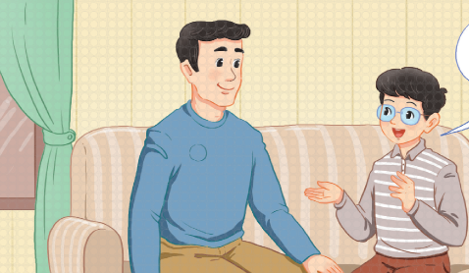
PRACTICE
1
Listen and read.
Inventions for education

Slide 16
PRACTICE
1
Listen and read.
Inventions for education
Phong: Dad, I’ve saved some money since Tet holiday. I think I’ll buy something new for my studies.
Dad: Good idea, Phong. What do you want to buy?
Phong: I’m not sure. It’s hard to choose between a smartphone and a laptop. They’re both useful and I’ve wanted either of them for a long time. What do you think, Dad?
Dad: Perhaps a laptop is a better choice. Since laptops were invented, they’ve allowed us to study better and work faster. They’ve completely changed our lives in the last 20 years.
Phong: That’s true, Dad. But smartphones have also improved the way we work and study.

Slide 17
PRACTICE
PRACTICE
1
Listen and read.
Inventions for education
Dad: Really? I didn’t know smartphones were suitable for learning.
Phong: Well, it’s actually a lot of fun to learn with educational apps. It’s also very convenient for learners to use them. Some of my classmates love using them on their smartphones. The apps allow them to communicate and learn at the same time.
Dad: I didn’t know that! There have been so many valuable inventions. Hmm … Perhaps you should ask your teacher. She may be able to help you decide.

Slide 18
PRACTICE
PRACTICE
2
Read the conversation again and answer the following questions.
1. What inventions are Phong and his dad talking about?
-> They are (talking about) laptops/ computers and smartphones.
2. How useful are laptops?
-> (Since they were invented,) Laptops have allowed us to study better and work faster.
3. Why is it fun and convenient to learn with educational apps on smartphones?
-> Because you can use educational apps that allow you to communicate and learn at the same time.

Slide 19
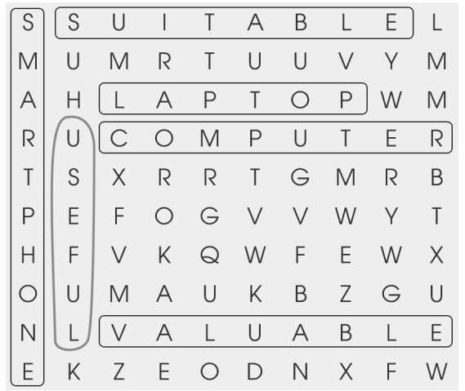
PRACTICE
3
Find three nouns and three adjectives in the conversation in activity 1 to talk about inventions. Follow the example.

Slide 20
PRACTICE
4
Fill in the gap in the summary of the conversation with ONE word from activity 1.
Phong and his father are discussing what to buy for his studies. Phong has wanted a laptop or a smartphone (1) _______ a long time because they are both very useful. Laptops (2) _________ completely changed our lives since their invention, but smartphones have also (3) _________ they way we work and study. For example, it’s fun (4) _________ study with educational apps on smartphones. They allow students (5) _________ (6) _________ and communicate at the same time. It’s really difficult for Phong to choose between the two.
for
have
changed
to
to
learn

Slide 21
LESSON 1
GETTING STARTED
Unit
GETTING STARTED
Guessing game
WARM-UP
Vocabulary
PRESENTATION
Activity 1: Listen and read.
Activity 2: Read the conversation again and answer the following questions.
Activity 3: Find three nouns and three adjectives in the conversation in activity 1 to talk about inventions. Follow the example.
Activity 4: Fill in the gap in the summary of the conversation with ONE word from activity 1.
PRACTICE
CONSOLIDATION
Wrap-up
Home work

Slide 22
CONSOLIDATION
1
Wrap-up
Gain an overview about the topic Inventions.
Memorize vocabulary to talk about Inventions.

Slide 23
CONSOLIDATION
2
Homework
Do exercises in the workbook

Slide 24


