Slide 1

Unit 1: Home & Places
Overview
Pages 20-21

Slide 2
Lesson Outline
Warm-up
Vocabulary
Speaking
Consolidation
Wrap-up

Slide 3
Objectives
By the end of this lesson, students will be able to…
- Revise vocabulary about rooms/places of a house.
Revise vocabulary about furniture and appliances.
Practise asking and answering questions about the house.

Slide 4

WARM-UP

Slide 5
Answer the questions
How many rooms are there in your house?
What are they?

Slide 6

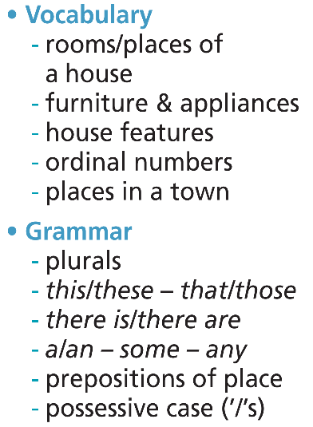
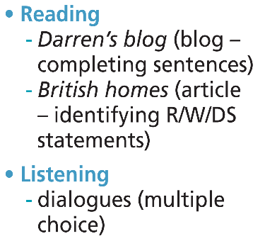
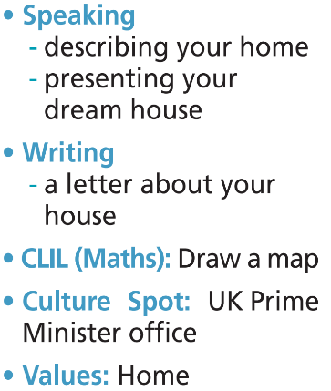

Slide 7

It’s time to learn …

Slide 8

Presentation

Slide 9

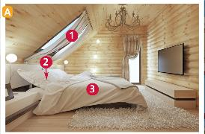
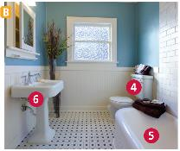
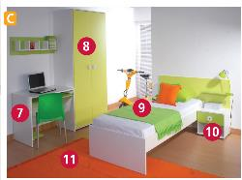
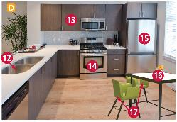
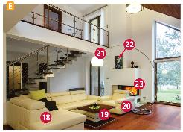
1 Match the rooms (1-5) to the pictures (A-E). Listen and check, then repeat.
child’s bedroom
kitchen
bathroom
parents’ bedroom
living room
1
A
B
C
1 | C
2
2
3
D
E
3
4
5

Slide 10
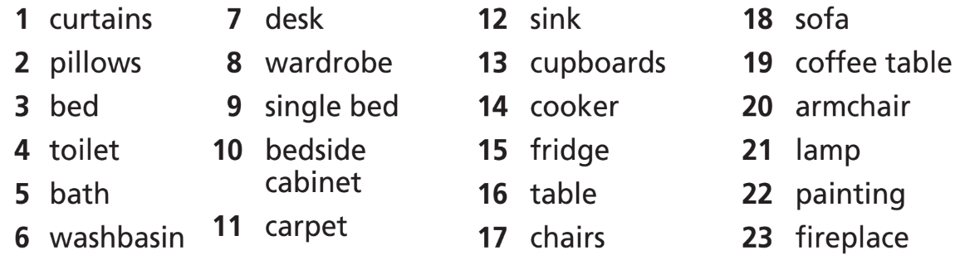
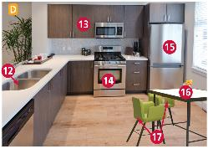

2 Listen, point and say. What are these words in your language?

Slide 11
Vocabulary
Listen and repeat.
curtain /ˈkɜːtən/ (n): tấm màn/ tấm rèm
pillow /ˈpɪləʊ/ (n): cái gối
bed /bed/ (n): cái giường
toilet /ˈtɔɪlət/ (n): nhà vệ sinh
bath /bɑːθ/ (n): bồn tắm
washbasin /ˈwɒʃˌbeɪsən/ (n): bồn rửa tay
desk /desk/ (n): bàn học/ bàn làm việc
wardrobe /ˈwɔːdrəʊb/ (n): tủ quần áo
single bed /ˌsɪŋɡəl ˈbed/ (n): giường đơn
bedside cabinet /ˌbedsaɪd ˈkæbɪnət/ (n): tủ đầu giường
carpet /ˈkɑːpɪt/ (n): tấm thảm
Notes:
Focus on words that may be new to your students. Review / go through very quickly those your students are familiar with.

Slide 12
sink /sɪŋk/ (n): bồn rửa bát
cupboard /ˈkʌbəd/ (n): tủ bếp, tủ ly, tủ chạn
cooker /ˈkʊkə(r)/ (n): cái bếp
fridge /frɪdʒ/ (n): tủ lạnh
table /ˈteɪbl/ (n): bàn
chair /tʃeə(r)/ (n): ghế
sofa /ˈsəʊfə/ (n): ghế sô pha
coffee table /ˈkɒfi ˌteɪbəl/ (n): bàn cà phê
armchair /ˈɑːmtʃeə(r)/ (n): ghế bành
lamp /læmp/ (n): cái đèn
painting /ˈpeɪntɪŋ/ (n): bức tranh
fireplace /ˈfaɪəpleɪs/ (n): lò sưởi
Notes:
Focus on words that may be new to your students. Review / go through very quickly those your students are familiar with.

Slide 13
vocabulary
Stress
curtain /ˈkɜːtən/ (n): tấm màn/ tấm rèm
pillow /ˈpɪləʊ/ (n): cái gối
bed /bed/ (n): cái giường
toilet /ˈtɔɪlət/ (n): nhà vệ sinh
bath /bɑːθ/ (n): bồn tắm
washbasin /ˈwɒʃˌbeɪsn/ (n): bồn rửa tay
desk /desk/ (n): bàn học/ bàn làm việc
wardrobe /ˈwɔːdrəʊb/ (n): tủ quần áo
single bed /ˌsɪŋɡəl ˈbed/ (n): giường đơn
bedside cabinet /ˌbedsaɪd ˈkæbɪnət/ (n phr): tủ đầu giường
carpet /ˈkɑːpɪt/ (n): tấm thảm
Notes:
Focus on words that may be new to your students. Review / go through very quickly those your students are familiar with.

Slide 14
sink /sɪŋk/ (n): bồn rửa bát
cupboard /ˈkʌbəd/ (n): tủ bếp, tủ ly, tủ chạn
cooker /ˈkʊkə(r)/ (n): cái bếp
fridge /frɪdʒ/ (n): tủ lạnh
table /ˈteɪbl/ (n): bàn
chair /tʃeə(r)/ (n): ghế
sofa /ˈsəʊfə/ (n): ghế sô pha
coffee table /ˈkɒfi ˌteɪbəl/ (n): bàn cà phê
armchair /ˈɑːmtʃeə(r)/ (n): ghế bành
lamp /læmp/ (n): cái đèn
painting /ˈpeɪntɪŋ/ (n): bức tranh
fireplace /ˈfaɪəpleɪs/ (n): lò sưởi
Notes:
Focus on words that may be new to your students. Review / go through very quickly those your students are familiar with.

Slide 15
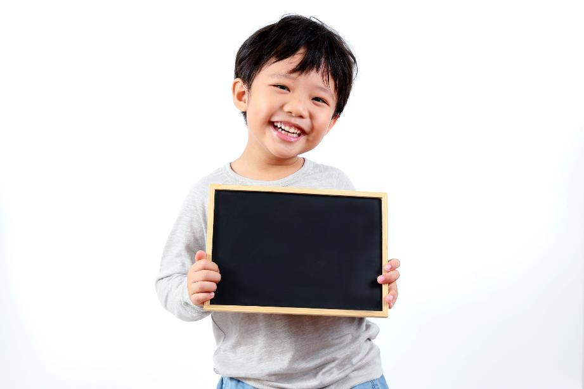
Practice

Slide 16

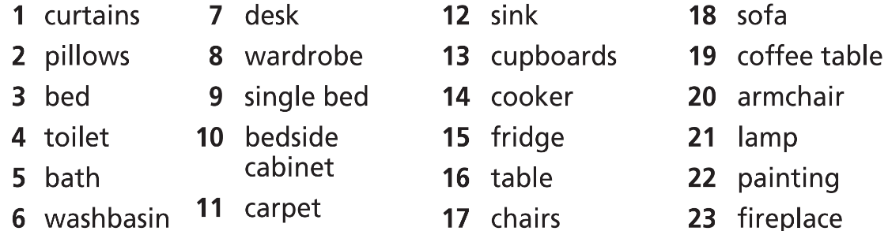
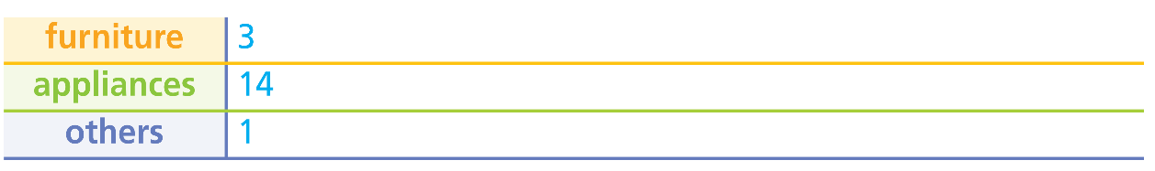
3 Complete the table with the number of the words in Exercise 2.
7
8
9
10
13
16
17
18
19
20
15
21
2
4
5
6
11
12
22
23

Slide 17
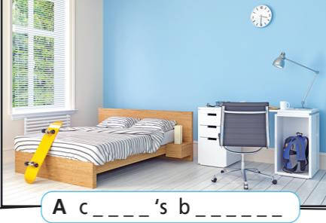
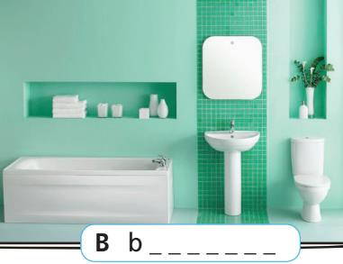
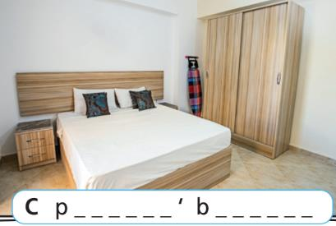
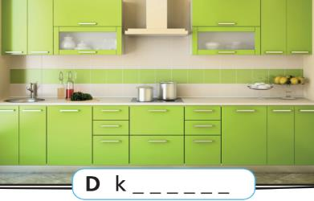
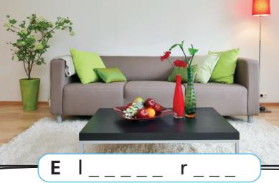
Further practice
Label the rooms in the pictures (A-E).
h i l d e d r o o m
a t h r o o m
a r e n t s e d r o o m
i t c h e n
i v i n g o o m

Slide 18
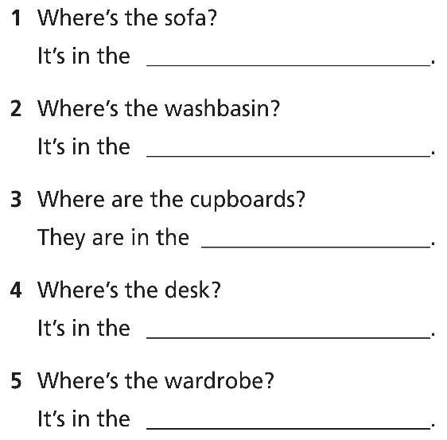
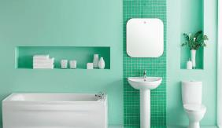
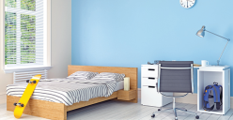
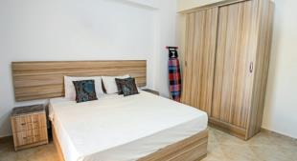
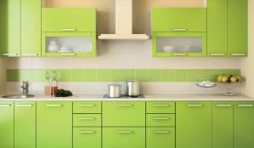
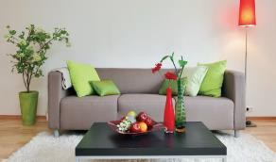
Further practice
Look at the pictures. Answer the questions.
living room
bathroom
kitchen
child’s bedroom
parents’ bedroom

Slide 19

Production

Slide 20
4 Ask and answer as in the example.
A: Where’s the single bed?
B: It’s in the child’s bedroom.

Slide 21

CONSOLIDATION

Slide 22
Write a paragraph (about 60 words) to describe your house.
How many rooms are there?
Which furniture/appliances are there in each room?

Slide 23

WRAP-UP

Slide 24
Today’s lesson
Vocabularies
Rooms of a house
Furniture/appliances

Slide 25
Homework
Practise the vocabularies and grammar and make sentences using them.
Do the exercises in TA 6 Right on WB (p. 12).
Do the exercises in TA 6 Right on Grammar bank (p. 65).
Do the exercises in TA 6 Right on Notebook (pp. 10-11).
Prepare the next lesson (p. 22 SB)

Slide 26

Enjoy your day!

