Slide 1
1
1
C
O
L
D
2
2
S
L
E
I
G
H
3
3
P
R
E
S
E
N
T
4
4
T
I
N
S
E
L
5
S
C
A
R
T
5
6
W
I
N
T
E
R
6
7
S
N
O
W
M
A
N
7
8
S
A
N
T
A
C
L
A
U
S
8
9
S
T
A
R
9
8. A man who always wear in red and creep into chimney.
6.It is the last season of the year
7. It is created by 2 snowballs and some vegetable.
9. They are twinkling in the sky.
4. A kind of string which is colorful.
5. You wear it to keep your neck to be warm.
3. It means “gift”
1. The felling which you need to wear more clothes.
2. A kind of transportation which is used in many centuries ago.

Slide 2
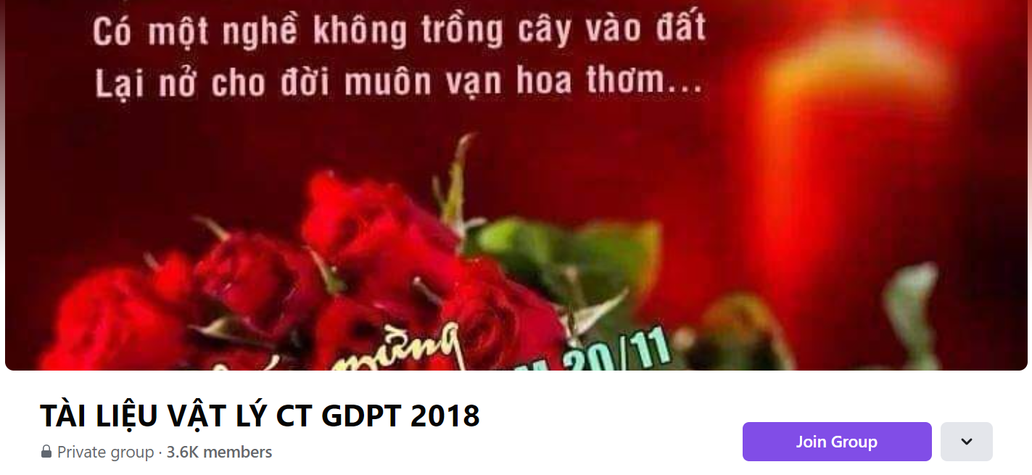
SƯU TẦM: ĐOÀN VĂN DOANH, NAM TRỰC, NAM ĐỊNH
LINK NHÓM DÀNH CHO GV BỘ MÔN VẬT LÝ TRAO ĐỔI TÀI LIỆU VÀ CHUYÊN MÔN CT 2018
https://www.facebook.com/groups/299257004355186

