Slide 1

UNIT 4: DISASTERS
Review
page 92

Slide 2
Lesson Outline
Warm-up
Listening
Reading
Consolidation
Wrap-up

Slide 3

By the end of this lesson, students will be able to…
Review the target language learnt in the unit
Practice test taking skills

Slide 4
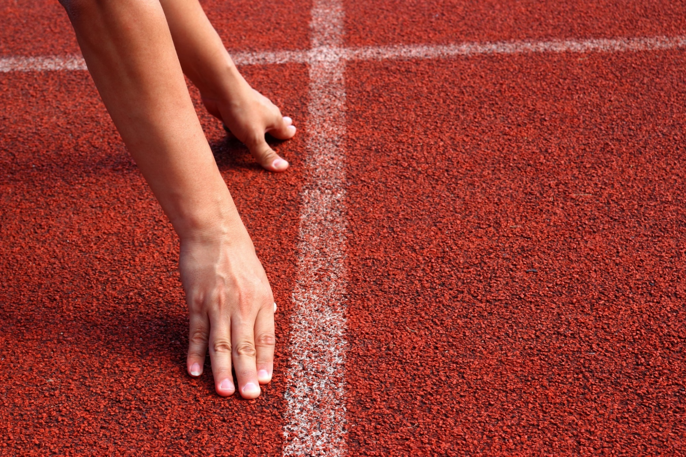
WARM UP

Slide 5
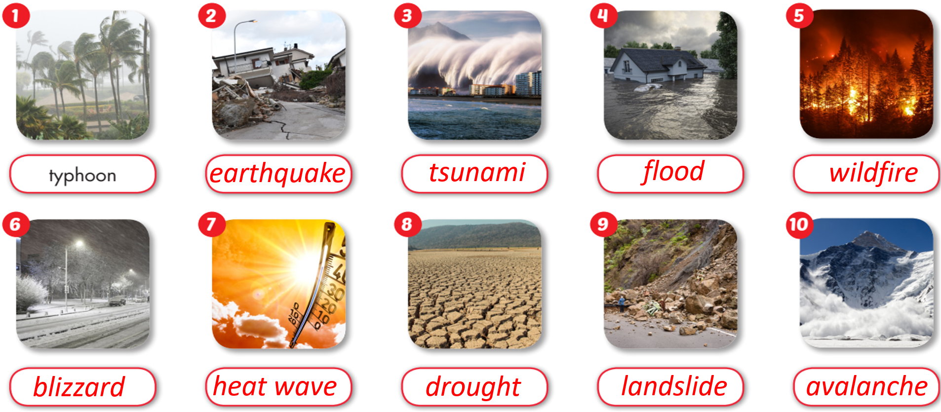
In pairs. Take turns testing your partner’s memory on the vocabulary about disasters.
bão nhiệt đới
trận bão tuyết
hạn hán
cháy rừng
lũ lụt
tuyết lở
sạt lở đất
sóng thần
động đất
đợt nắng nóng

Slide 6
Listen and repeat.
______________
typhoon (n) /taɪˈfuːn/ bão nhiệt đới
blizzard (n) /ˈblɪzərd/ trận bão tuyết
drought (n) /draʊt/ hạn hán
wildfire (n) /ˈwaɪldfaɪər/ cháy rừng
flood (n) /flʌd/ lũ lụt
avalanche (n) /ˈævəlæntʃ/ tuyết lở
landslide (n) /ˈlændslaɪd/ sạt lở đất
tsunami (n) /tsuːˈnɑːmi/ sóng thần
earthquake (n) /ˈɜːrθkweɪk/ động đất
heat wave (n) /ˈhiːt weɪv/ đợt nắng nóng

Slide 7

Listening

Slide 8
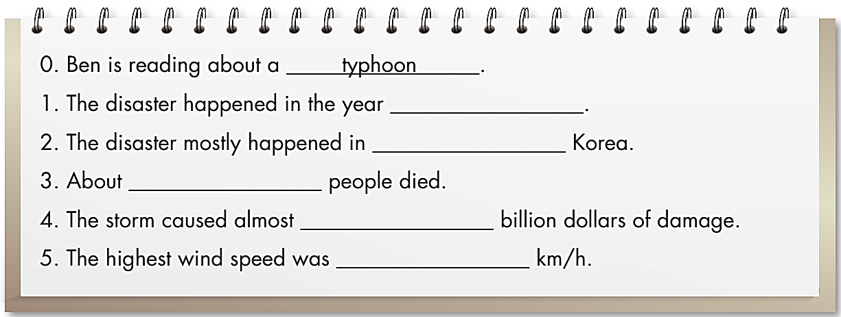
Pre - listening
Read the instruction quickly. Underline the key words.
What are we going to do?
Listen and complete questions 1-5.



Slide 9

While - listening

2003
North and South
120
5
280

Slide 10

Post - listening

Listen to the conversation.
Then practice with a partner.

Slide 11
Sue: Hi, Ben. That’s an interesting picture.
What are you reading?
Ben: Hi, Sue. I’m reading about a typhoon.
It’s called Typhoon Maemi. This is what it
looks like from space.
Sue: Wow. When was the typhoon?
Ben: It was in 2003.
Sue: Oh, OK. Where was it?
Ben: It mostly happened in North and South
Korea, but it affected other countries, too.
Sue: Was it a very strong storm?

Ben: Yes, it was very strong. It caused
a lot of damage, and many people died.
Sue: Oh, no. How many people died?
Ben: One hundred and twenty people.
Sue: How much damage did the typhoon cause?
Ben: It caused almost five billion dollars of
damage.
Sue: Wow! That’s a lot of money! How strong
was the wind?
Ben: The highest wind speed was two hundred
and eighty kilometers per hour.

Slide 12
Reading

Slide 13
Pre - reading
Read the instruction quickly. Underline the key words.
What are we going to do?
Read and choose the correct answer.

Slide 14
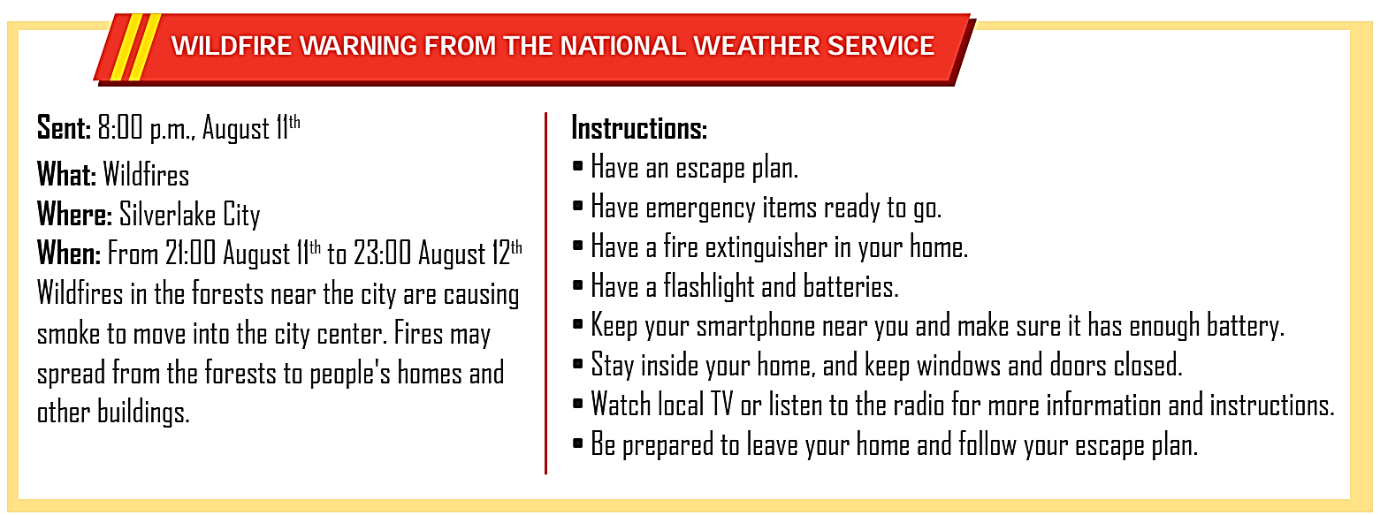
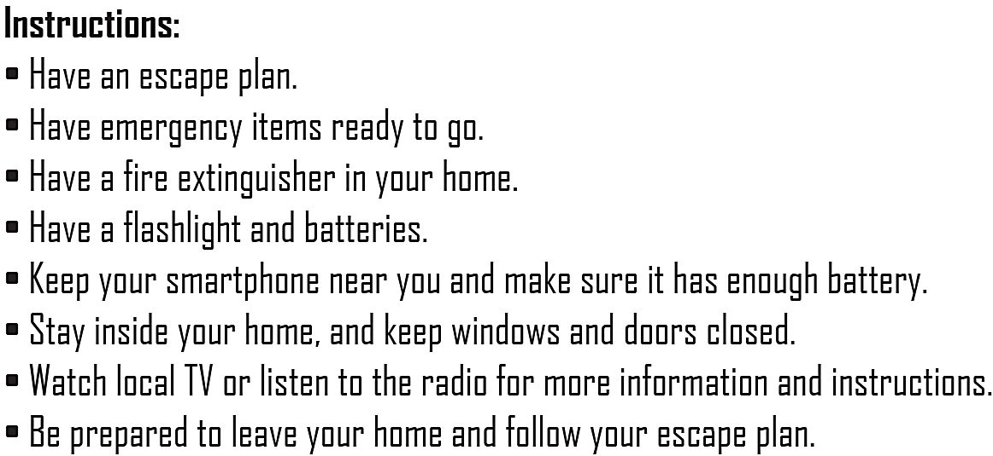
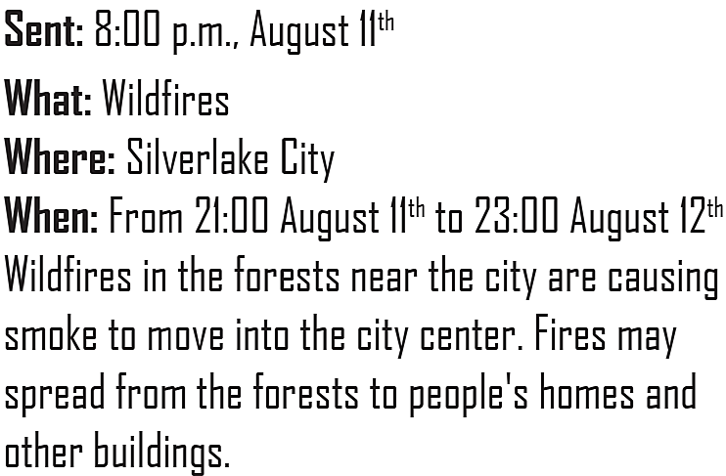
While - reading

Slide 15
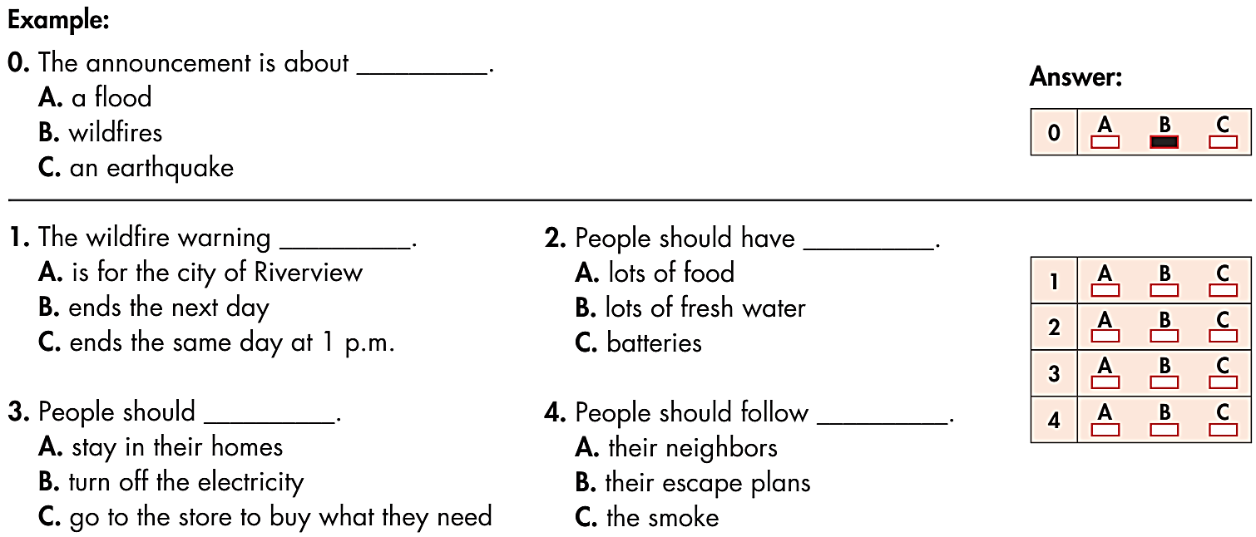

Slide 16

Post - reading

Listen, look and read.

Slide 17
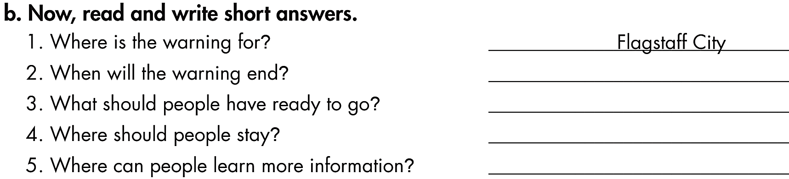
Write short answers for the questions about the warning. Then compare your answers with a partner.
Where is the warning for?
When will the warning start?
What should people have ready to go?
Where should people stay?
Where can people learn more information?
Silverlake city
At 21:00 on August 11th
Emergency items
Stay inside with doors and windows closed.
From the local TV or radio

Slide 18

CONSOLIDATION

Slide 19
Work in pairs.
What are 4 steps for writing an emergency announcement?


Slide 20
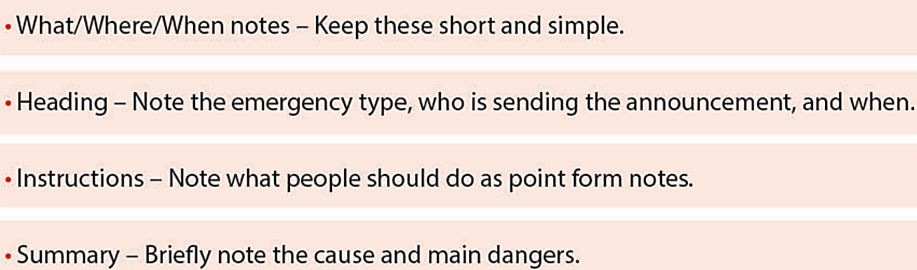
What are 4 steps for writing an emergency announcement?
1.
2.
3.
4.





Slide 21

WRAP-UP

Slide 22
Today’s lesson
Review the target language learnt in the unit
Practice test taking skills

Slide 23
Homework
Review Unit 4 about disasters.
Do the exercises on page 53, WB.
Prepare the next lesson (page 93, SB).
Play the consolidation games on www.eduhome.com.vn

Slide 24

Lesson 3
Stay positive and have a nice day!

