Slide 2
Unit 1
Life stories we admire
LESSON 6
WRITING
A biography of Walt Disney

Slide 3
LESSON 6
WRITING
WARM-UP
Listen to music and fill in the blanks
PRE-WRITING
Task 1: Answer the questions.
Task 2: Read some facts about Walt Disney. Answer the questions.
WHILE-WRITING
Task 3: Write a biography of Walt Disney.
POST-WRITING
Peer review
CONSOLIDATION
Wrap-up
Homework

Slide 4

WARM-UP
Song: I see the light (Mandy Moore, Zachary Levi – Tangled OST)
All those days watching from the (1) ____
All those years outside looking in
All that time never even knowing
Just how blind I've been
Now I'm here, blinking in the (2) _____
Now I'm here, suddenly I see
Standing here, it's all so clear
I'm where I'm meant to be
And at last I see the light
And it's like the fog has (3) _____
And at last I see the light
And it's like the sky is new
And it's warm and real and bright
And the world has somehow shifted
All at once everything looks (4) _____
Now that I see you
windows
lifted
starlight
different

Slide 5
WARM-UP
Song: I see the light (Mandy Moore, Zachary Levi – Tangled OST)
All those days (5) _____ down a daydream
All those years living in a blur
All that time, never truly seeing
Things the way they were
Now she's here, shining in the starlight
Now she's here, suddenly I know
If she's here, it's (6) ______ clear
I'm where I'm meant to go
And at last I see the light
And it's like the fog has (7) ____
And at last I see the light
And it's like the sky is new
And it's warm and real and bright
And the world has somehow shifted
All at once, everything is (8) _____
Now that I see you
Now that I see you
chasing
lifted
crystal
different

Slide 6
PRE-WRITING
1
Work in pairs. Answer these questions, using the information from Listening. Write NG (not given) if you cannot find the answer.
1. When and where was Walt Disney born?
2. What schools did he attend?
3. What talent did he have?
NG
NG
NG

Slide 7
PRE-WRITING
1
Work in pairs. Answer these questions, using the information from Listening. Write NG (not given) if you cannot find the answer.
4. What were his most impressive achievements in film-making?
5. What were his other achievements?
6. Was he married and how many children did he have?
7. When did he die?
He created Mickey Mouse, and produced successful animated films such as Snow White and the Seven Dwarfs. He also won 26 Oscars.
He created the Disneyland theme park.
NG
NG

Slide 8
PRE-WRITING
2
Read some facts about Walt Disney. Then work in pairs to answer all the questions in Task 1.
1. When and where was Walt Disney born?
2. What schools did he attend?
3. What talent did he have?
He was born in Chicago in 1901.
He attended Brenton Grammar School, but dropped out at the age of 16.
He had talent for drawing and painting.

Slide 9
PRE-WRITING
2
Read some facts about Walt Disney. Then work in pairs to answer all the questions in Task 1.
6. Was he married and how many children did he have?
7. When did he die?
Yes, he was married and had two children.
He died in 1966.

Slide 10
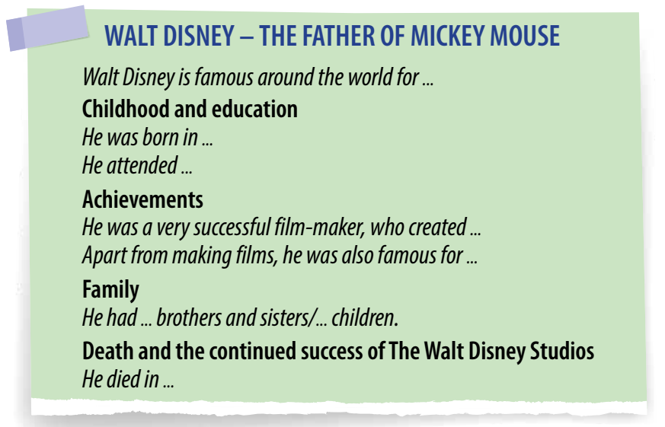
WHILE-WRITING
3
Write a biography (180 words) of Walt Disney.

Slide 11
WHILE-WRITING
Suggested answer
WALT DISNEY – THE FATHER OF MICKEY MOUSE
Walt Disney is famous around the world for making a lot of successful films, which are loved by children and adults of many generations.
Childhood and education
Walt Disney was born in Chicago in 1901. During his childhood, he loved drawing and painting. He attended Brenton Grammar School, but he left school when he was 16.
Achievements
Disney was a very successful film maker, who created Mickey Mouse and produced successful animated films such as Snow White and the Seven Dwarfs. Throughout his career, Disney won or received 26 Oscars, three Golden Globe Awards, one Emmy Award – a record in history.
He is also famous for building the first theme park in the world, called Disneyland. Now many more Disney parks have been built and have become popular worldwide.

Slide 12
WHILE-WRITING
Family
Walt Disney had three older brothers and a younger sister. He married Lillian Bounds, and they were together for 41 years. They had one biological daughter and one adopted daughter.
Death and the continued success of the Walt Disney Studios
Disney died from cancer in 1966, but the Walt Disney Studios continued to make live-action and animated films. These films inspire people of all ages to follow their dreams.

Slide 13
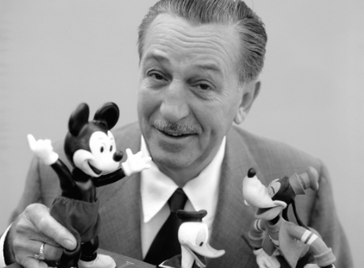
POST-WRITING
Cross-checking
Suggested writing rubric
1. Organization: …/10
2. Legibility: …/10
3. Ideas: …/10
4. Word choice: …/10
5. Grammar use: …/10
TOTAL: …/50

Slide 14
CONSOLIDATION
1
Wrap-up
What have you learnt today?
Synthesise and summarise information in order to write a biography about the life of Walt Disney

Slide 15
CONSOLIDATION
2
Homework
Do exercises in the workbook.
Prepare for Lesson 7 – Communication & Culture.

Slide 16
Website: hoclieu.vn
Fanpage: facebook.com/www.tienganhglobalsuccess.vn

