Slide 1
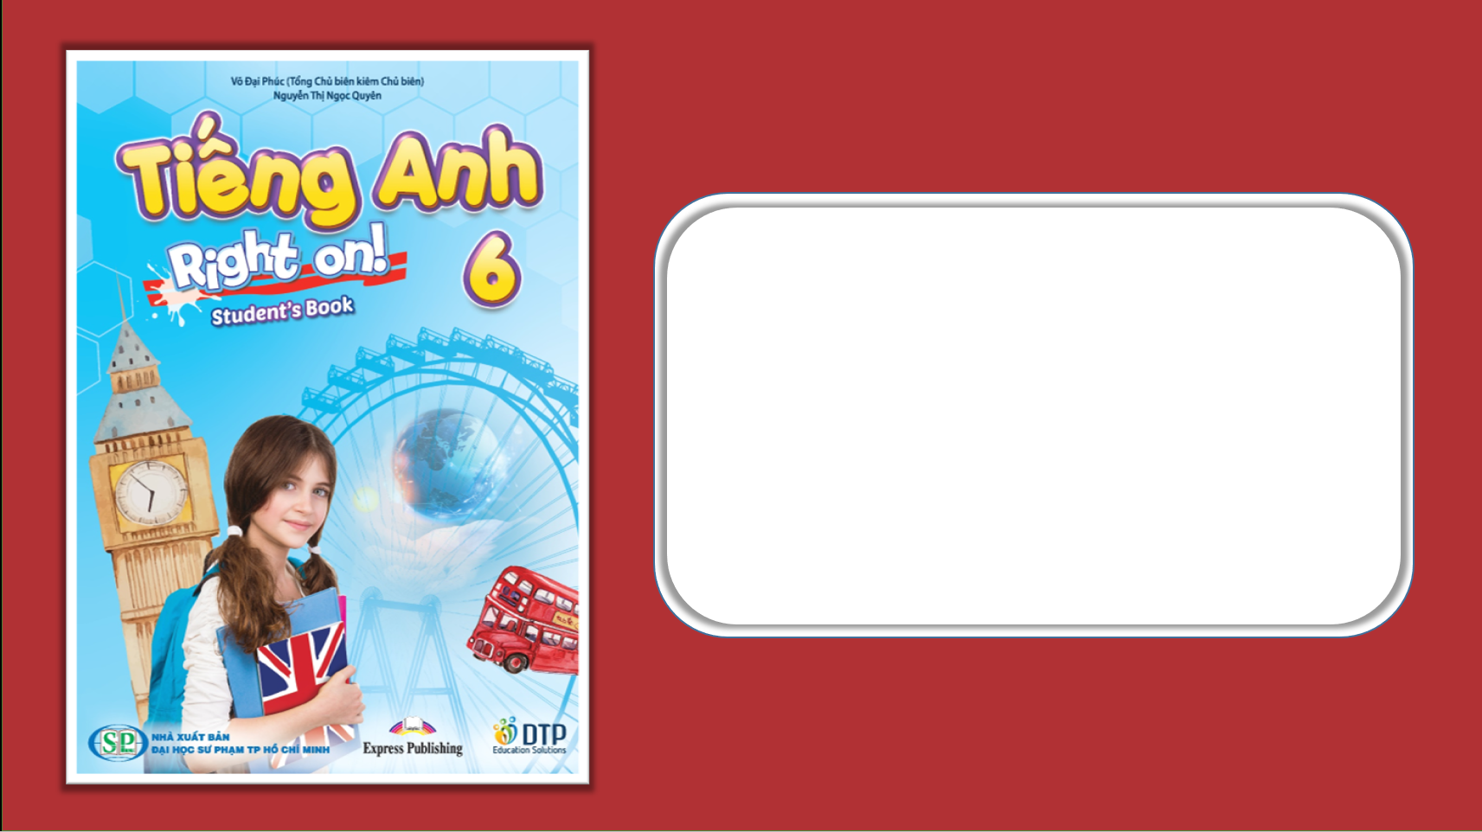
Unit 5: London Was Great!
Lesson 5a: Reading
Page 88

Slide 2
Lesson Outline
Warm-up
Vocabulary
Reading
Consolidation
Wrap-up

Slide 3
Objectives
By the end of this lesson, students will be able to…
- learn new words related to the topic: transport, move, arrive, later, interactive, tube station, railway station.
- read for the main idea and for specific information.

Slide 4

WARM-UP

Slide 5
Do you remember?
She was a member of the British Royal family.
She was a princess.
Princess Diana
She was born in 1961.
She died in 1997.

Slide 6
Do you remember?
He was an English actor.
Charlie Chaplin
He was born in 1889.
He died in 1977.

Slide 7
Do you remember?
She was a British actress.
Audrey Hepburn
She was born in 1929.
She died in 1993.

Slide 8
Do you remember?
He was a German physicist.
Albert Einstein
He was born in 1879.
He died in 1955.

Slide 9

Work in pairs.
What else do you know about London?
What do you often see at the museum?

Slide 10
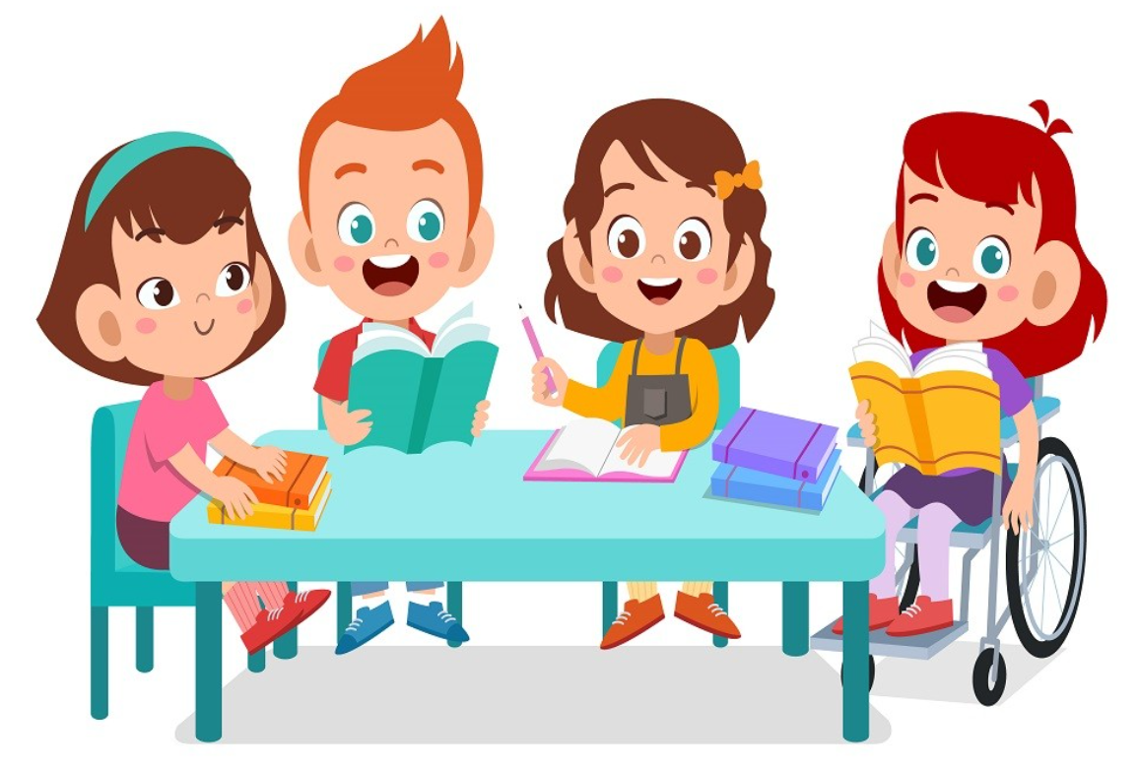
It’s time to learn …

Slide 11
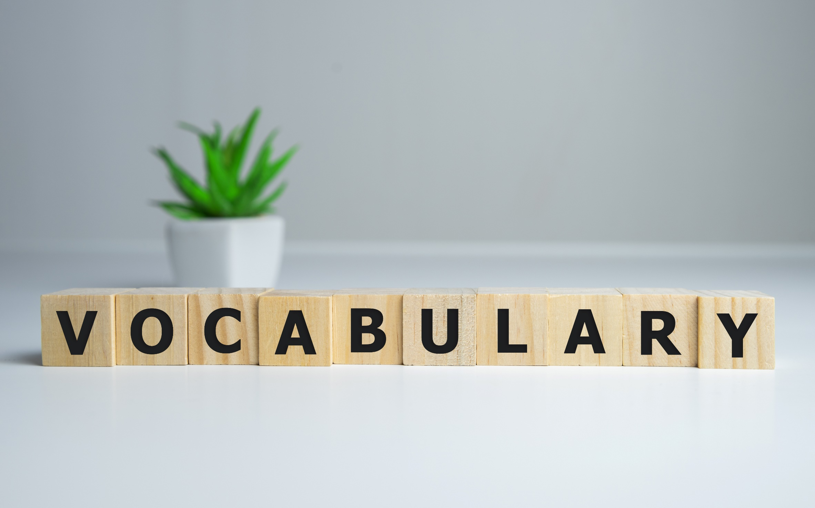


Slide 12

New words
transport
move
arrive
later
interactive
tube station
railway station

Slide 13

Listen and repeat. (Click each word to hear the sound)
transport (n) /ˈtrænspɔːt/ sự vận tải/vận chuyển, phương tiện đi lại
move (v) /muːv/ di chuyển
later (adv) /ˈleɪtə/ sau đó
arrive (v) /əˈraɪv/ đến
interactive (adj) /ˌɪntərˈæktɪv/ có tính tương tác
tube station (n) /ˈtjuːb ˌsteɪʃən/ ga tàu điện ngầm
railway station (n) /ˈreɪlweɪ ˌsteɪʃən/ nhà ga xe lửa
Notes:
GV click vào từng cụm nghe âm thanh

Slide 14
Match the correct word with the correct definition.
transport
To change the place
arrive
A vehicle such as train, bus, or plane for travelling
move
An underground station in London
tube station
After the time you are talking about
To get to a place
later

Slide 15
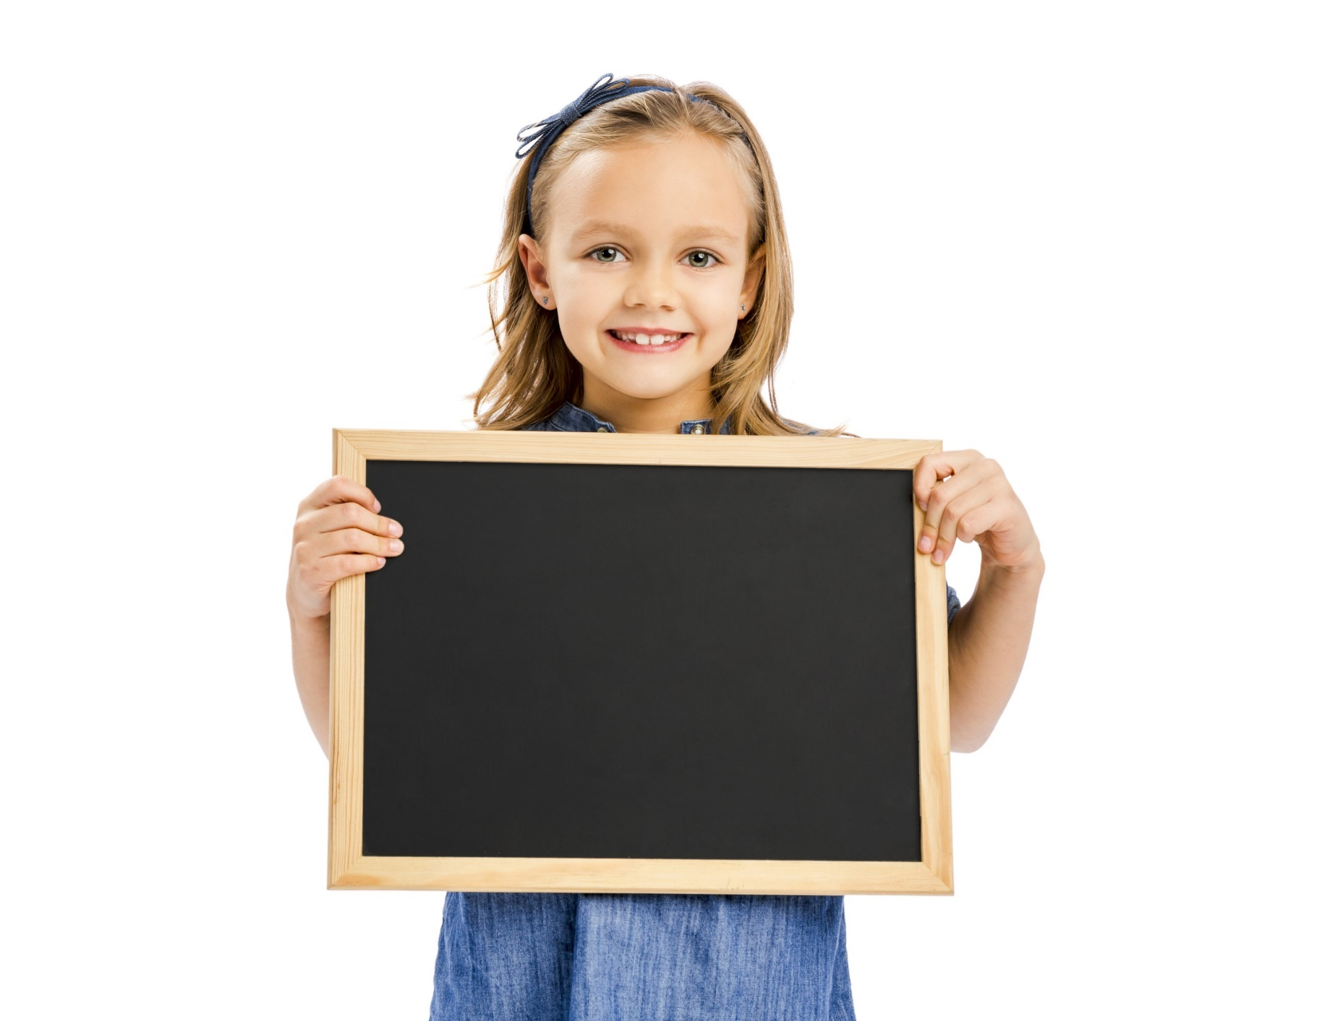
Reading

Slide 16
Brainstorm words you can think of when you hear “museum”.
Pre-Reading
TICKET
MUSEUM
ART
PHOTOGRAPHS
FILMS/ MOVIES

Slide 17
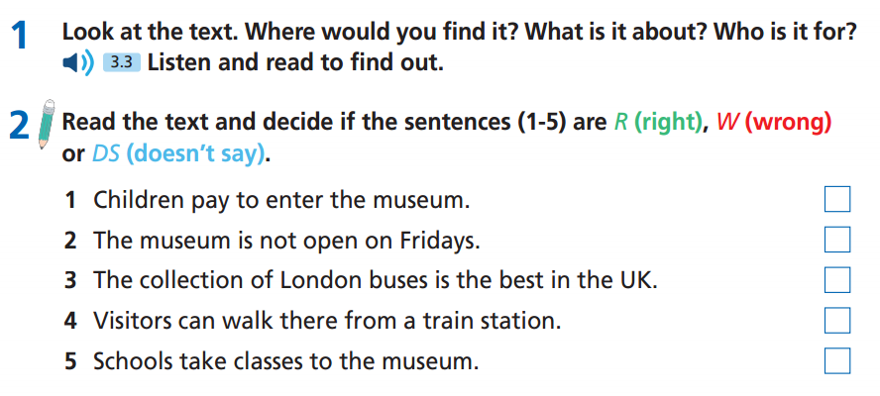
Read the instruction quickly. Underline the key words.
Pre-Reading

Slide 18
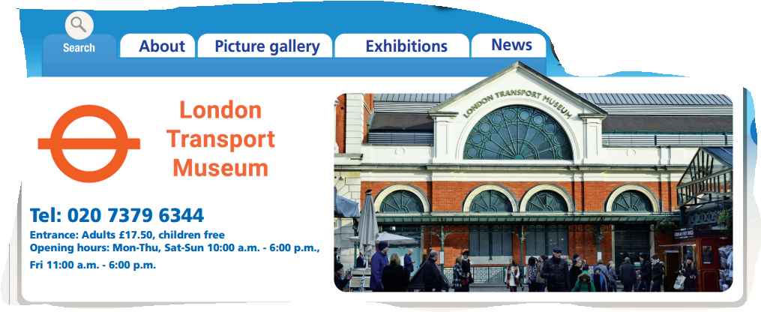
While-Reading
You would find this text on the Internet. It is about a museum in London. It is for visitors to London.

Slide 19
While-Reading

Slide 20
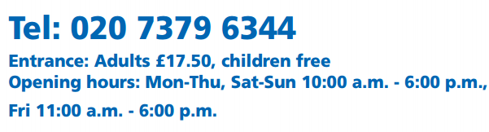
While-Reading
1. Children pay to enter the museum.
W

Slide 21
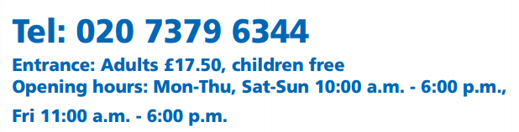
While-Reading
2. The museum is not open on Fridays.
W

Slide 22
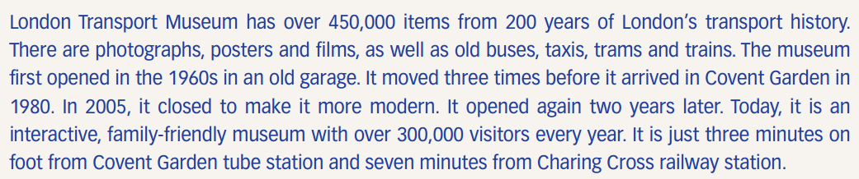
While-Reading
3. The collection of London buses is the best in the UK.
DS
No information about “the best”

Slide 23
While-Reading
4. Visitors can walk there from a train station.
R

Slide 24
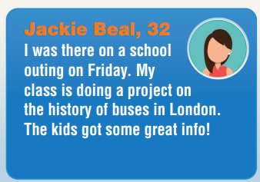
While-Reading
R
5. Schools take classes to the museum.

Slide 25
Extra-Reading
Read the text again and choose the best answer for the following questions.
1. How many items does London Transport Museum have?
Over 200
over 300,000
over 450,000
over 1,980
London Transport Museum has over 450,000 items from 200 years of London’s transport history.
There are photographs, posters and films, as well as old buses, taxis, trams and trains.

Slide 26
Extra-Reading
Read the text again and choose the best answer for the following questions.
2. Which one is NOT an item in the museum?
posters
photographs
trains
planes
London Transport Museum has over 450,000 items from 200 years of London’s transport history.
There are photographs, posters and films, as well as old buses, taxis, trams, and trains.

Slide 27
Extra-Reading
Read the text again and choose the best answer for the following questions.
3. When did the museum first open?
200 years ago
in the 1960s
in the 1980s
in 2005
The museum first opened in the 1960s in an old garage. It moved three times before it arrived in Covent Garden in 1980.

Slide 28
Extra-Reading
Read the text again and choose the best answer for the following questions.
4. Why did it close in 2005?
to buy more items
to make it better
to build a new garage
to move to Charing Cross
In 2005, it closed to make it more modern. It opened again two years later. Today, it is an interactive, family-friendly museum with over 300,000 visitors every year.

Slide 29
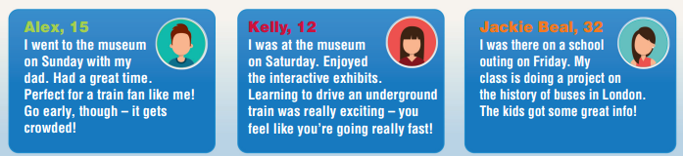
Extra-Reading
Read the text again and choose the best answer for the following questions.
5. Who went to the museum at the weekend?
Alex and Kelly
Kelly and Jackie Beal
Alex
Kelly

Slide 30
Extra-Reading
Read the text again and choose the best answer for the following questions
6. Who had to do a project?
Alex and Kelly
Kelly and Jackie Beal
Jackie Beal
Kelly

Slide 31
Post-Reading
Work in pairs.
If you can visit London Transport Museum, what do you enjoy doing there?
If I can visit London Transport Museum, I enjoy bus exhibition because I am a fan of buses and I want to know different kinds of buses in London.

Slide 32

CONSOLIDATION

Slide 33
Write some sentences about a museum you know. Try to answer these questions.
What is the name of the museum?
Where is the museum?
When does it open and close?
What can you see there?
What do you enjoy?
I want to write about ………… museum in ……… It opens at ….. and closes at …. from …… to ….. There are ……… there. I enjoy …….. because ……….

Slide 34

WRAP-UP

Slide 35
Today’s lesson
Vocabulary
transport
move
arrive
later
interactive
tube station
railway station
Reading
Reading for main idea.
Reading for specific information.

Slide 36
Homework
Practise the vocabulary and grammar and make sentences using them.
Do the exercises in TA 6 Right on WB (p. 44).
Prepare for the next lesson (p. 89 SB).

Slide 37
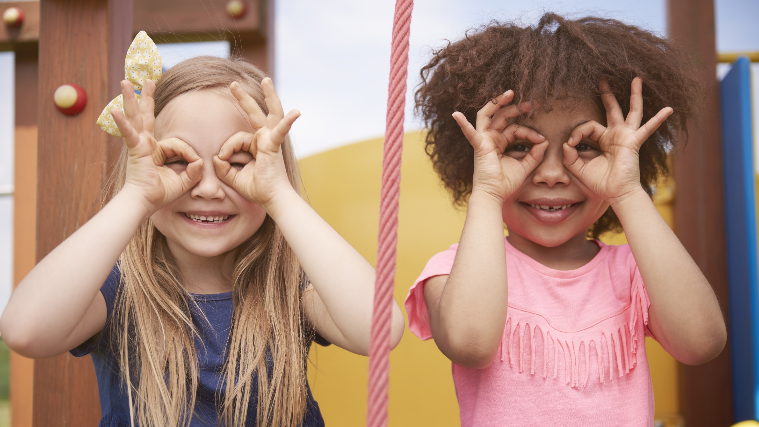
Enjoy your day!

